Slide 1
Teaching Computers to See
Cats vs dogs image classification with CNNs
Valentin Belougne, Simon Jennequin, Thomas Danjou
ST2AIM project, EFREI
Notes:
Hello. Our project: teach a computer to tell cats from dogs. We built a CNN from scratch, tried two improvements, then used transfer learning. We will show real results from our notebook, including where the network actually looks.

Slide 2
Goal and plan
Goal: given a photo, predict cat or dog.
• Understand how a CNN works
• Explore the dataset
• Build and train a 4-block CNN
• Evaluate on a held-out test set
• Improve it: data augmentation, dropout + batch normalization
• Bonus: transfer learning with MobileNetV2
• Look inside: feature maps and Grad-CAM
3,000
images
5
models compared
94.8%
best test accuracy
Notes:
Explain the goal in one sentence, then walk through the plan. Point out that every number in this talk comes from our notebook outputs.

Slide 3
What is a CNN?
Small learned filters slide over the image: local connections + shared weights
Convolution
learned 3×3 filters → feature maps (edges, textures, then ears, eyes…)
ReLU
max(0, x): nonlinearity, otherwise everything stays linear
Max pooling 2×2
keeps the strongest value, halves width and height
Dense layers
combine all features into a decision; sigmoid → P(dog)
Input
96×96×3
Block 1
48×48×16
Block 2
24×24×32
Block 3
12×12×64
Block 4
6×6×128
Flatten
4,608
Dense
64
Output
P(dog)
Each block = Conv 3×3 → ReLU → MaxPool 2×2
Notes:
A dense network on a 96x96x3 image would need 1.8 million weights for a single 64-neuron layer and would relearn every pattern at each position. A CNN uses small filters that slide over the image: local connections and weight sharing. Convolution finds patterns, ReLU adds nonlinearity, pooling shrinks the image, the dense layers decide. Training: forward pass, loss, backpropagation, optimizer step.

Slide 4
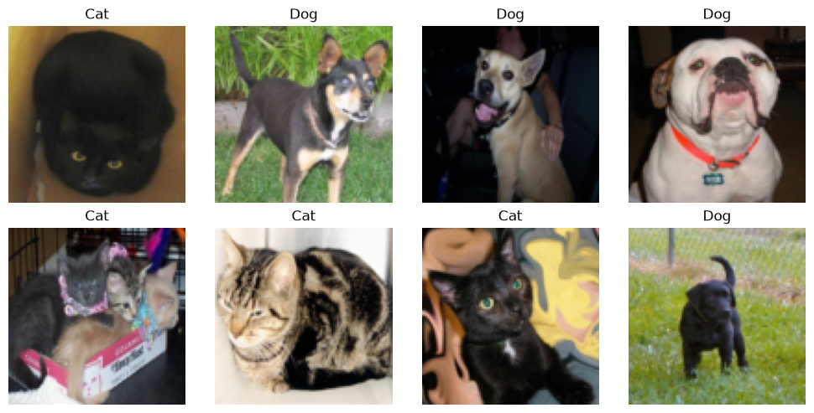
The dataset
cats_and_dogs_filtered (Kaggle Dogs vs. Cats subset), perfectly balanced
Split | Cats | Dogs | Role
Train | 800 | 800 | learn weights
Validation | 500 | 500 | pick best epoch / model
Test | 200 | 200 | final score, used once
• Train + test = original 2,000 training images, split 80/20 with stratification
• Labels: cat = 0, dog = 1
• No image is used for both training and evaluation
Notes:
Google's filtered Kaggle cats-and-dogs set. We split the 2,000 original training images 80/20, stratified, into 1,600 for training and 400 for the final test. The 1,000 validation images are only used to pick the best epoch and model. Classes are perfectly balanced, so accuracy is a fair metric.

Slide 5
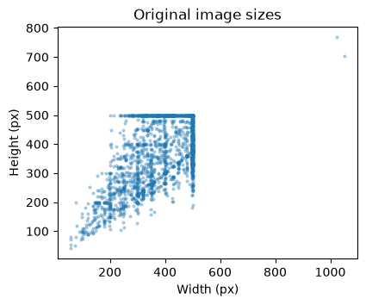
Input shape: before and after resizing
Raw images vary a lot; the network needs one fixed shape
Original size (px) | Width | Height
Mean | 406 | 360
Min | 59 | 41
Median | 447 | 374
Max | 1050 | 768
• 1,604 distinct sizes across 3,000 images
• Median aspect ratio 1.29 (landscape)
• Resized to 96 × 96 × 3 (RGB), pixels scaled to [0, 1]
• Trade-off: fast CPU training vs. lost detail
Notes:
The raw JPEGs come in 1,604 different sizes, from 59x41 to 1050x768 pixels, mostly landscape. A network needs a fixed input, so we resize to 96x96 with 3 RGB channels. 96 keeps CPU training fast; the cost is lost detail and some stretching.

Slide 6
Our CNN: 4 blocks, 392,481 parameters
Parameters computed by hand: (3·3·Cin + 1)·Cout for convolutions, (nin + 1)·nout for dense layers
Layer | Calculation | Parameters
Conv 16 | (3·3·3 + 1)·16 | 448
Conv 32 | (3·3·16 + 1)·32 | 4,640
Conv 64 | (3·3·32 + 1)·64 | 18,496
Conv 128 | (3·3·64 + 1)·128 | 73,856
Dense 64 | (4,608 + 1)·64 | 294,976
Output | (64 + 1)·1 | 65
Total |  | 392,481
Compilation
• Optimizer: Adam, learning rate 0.001, adapts the step size per weight
• Loss: binary cross-entropy, matches a single sigmoid output for 2 classes
• Metric: accuracy (balanced classes)
Training
• Batch size 100 → 16 updates per epoch
• 15 epochs, keep the epoch with lowest validation loss
Notes:
Four blocks with 16, 32, 64 and 128 filters. Conv parameters: (3x3xC_in + 1) x C_out, the +1 is the bias. The Dense(64) layer alone holds 75% of all parameters. We checked our hand calculation against Keras count_params. Adam because it adapts the step size per weight and works well by default; binary cross-entropy because we have one sigmoid output for two classes.

Slide 7
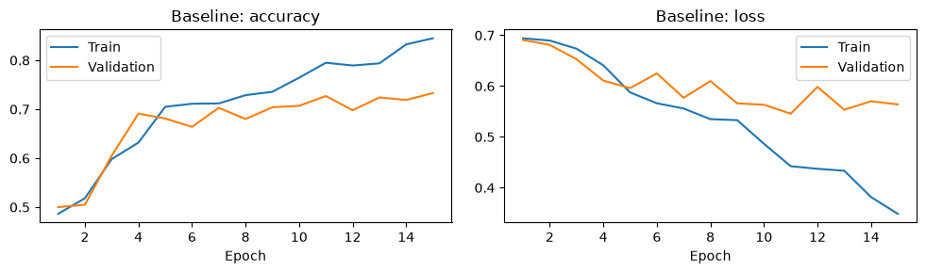
Baseline training: overfitting after epoch 11
• Best validation loss at epoch 11: 0.546 (72.7% accuracy)
• Training accuracy keeps climbing to 84.5%
• Gap train vs validation grows → overfitting
• We restore the epoch 11 weights
Test set: 77.8% accuracy, F1 0.757
Notes:
Training accuracy keeps rising to 84.5% while validation loss stops improving after epoch 11 and fluctuates. That is the classic sign of overfitting: the model starts memorizing the 1,600 training images. It is not underfitting: it learns well on training data. We keep the epoch 11 weights.

Slide 8
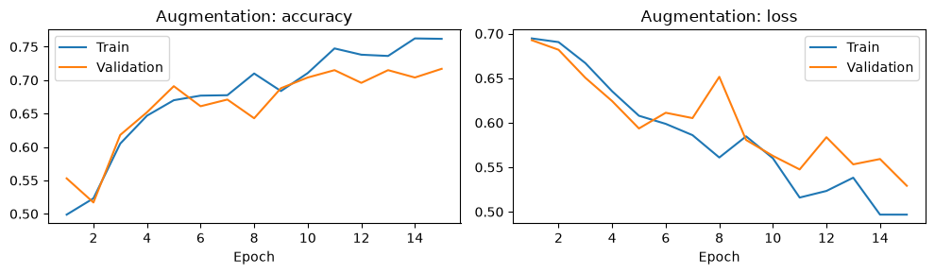
Improvement 1: data augmentation
• Random flip, rotation (±5%), zoom (±10%)
• Applied to train + validation, never to test
• Gap shrinks: 76.2% train vs 71.7% validation
• Learns slower: needs more than 15 epochs
Test set: 74.0% accuracy, F1 0.746
Notes:
Random horizontal flips, small rotations and zooms create new variants of each image every epoch. As the syllabus asks, we augment training and validation but never test. The train/validation gap shrinks a lot, so overfitting is reduced, but learning is slower: after 15 epochs it is not ahead yet. In a 30-epoch check it became our best CNN on validation.

Slide 9
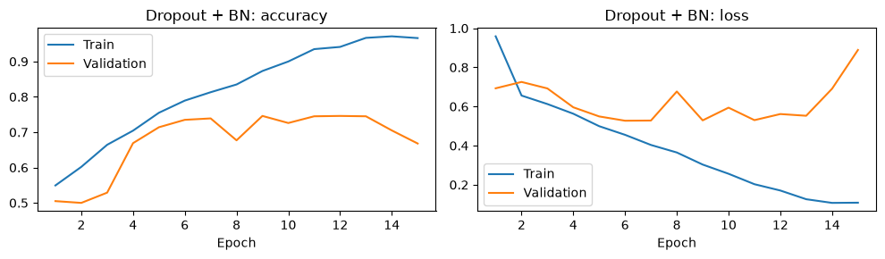
Improvement 2: dropout + batch normalization
• BatchNorm after each conv, Dropout 30% before Dense
• Learns faster: best epoch 6 (73.5% val.)
• Then overfits: 96.6% train vs 66.8% val.
• Bug fixed: BN momentum 0.99 → 0.9 (model predicted only one class)
Test set: 74.5% accuracy, F1 0.736
Notes:
Batch normalization makes learning much faster: best epoch 6 instead of 11. Dropout of 30% before the dense layer. Debugging story: our first version predicted only one class. Keras BN momentum 0.99 keeps about 9% of the initial statistics after our 240 updates, so validation used wrong statistics. Momentum 0.9 fixed it. It still overfits after epoch 6.

Slide 10
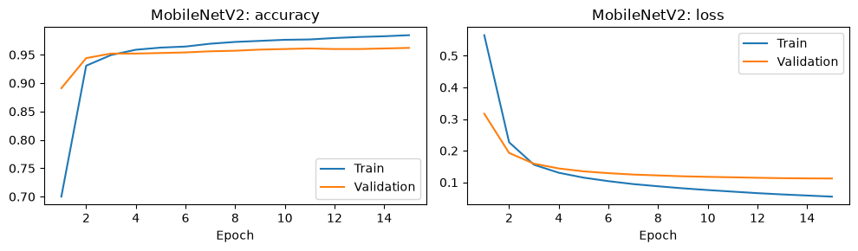
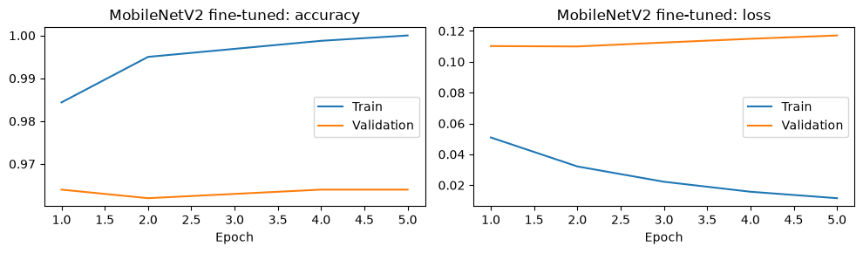
Bonus: transfer learning with MobileNetV2
A. Feature extraction
• Frozen ImageNet backbone + new sigmoid output
• 15 epochs, Adam 0.001
• Test: 94.5% accuracy
B. Fine-tuning
• Unfreeze last 30 layers (1.5 M trainable weights)
• 5 epochs, Adam 0.00001, BN kept frozen
• Test: 94.8% accuracy
Notes:
MobileNetV2 was pretrained on 1.2 million ImageNet images. Step A: freeze it and train only a new sigmoid output: 94.5% on test. Step B: unfreeze the last 30 layers and train with a learning rate 100 times smaller, so we adapt the filters without destroying them. Small gain, 94.8%, within noise, and it overfits quickly.

Slide 11
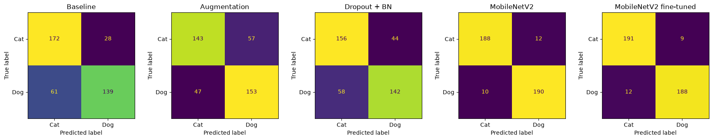
Test results (400 unseen images)
Model | Accuracy | Precision | Recall | F1
Baseline | 77.8% | 0.832 | 0.695 | 0.757
Augmentation | 74.0% | 0.729 | 0.765 | 0.746
Dropout + BN | 74.5% | 0.763 | 0.710 | 0.736
MobileNetV2 | 94.5% | 0.941 | 0.950 | 0.945
MobileNetV2 fine-tuned | 94.8% | 0.954 | 0.940 | 0.947
Notes:
Confusion matrices for all five models. Precision: of the images we call dog, how many are dogs. Recall: of the dogs, how many we find. The baseline has high precision but low recall: it misses many dogs. The three from-scratch CNNs are within about 2 standard errors of each other, so we cannot rank them reliably. Transfer learning is clearly better.

Slide 12
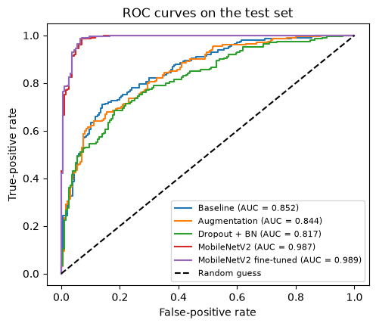
ROC curves: all thresholds at once
• x: cats wrongly called dogs (false-positive rate)
• y: dogs found (true-positive rate)
• AUC 0.5 = guessing, 1.0 = perfect
• From-scratch CNNs: AUC 0.82 to 0.85
• MobileNetV2: AUC 0.987 → 0.989 after fine-tuning
Notes:
The confusion matrix uses one threshold, 0.5. The ROC curve tries every threshold. AUC is the probability that a random dog gets a higher score than a random cat. Our CNNs are around 0.82 to 0.85; MobileNetV2 is near perfect at 0.99.

Slide 13
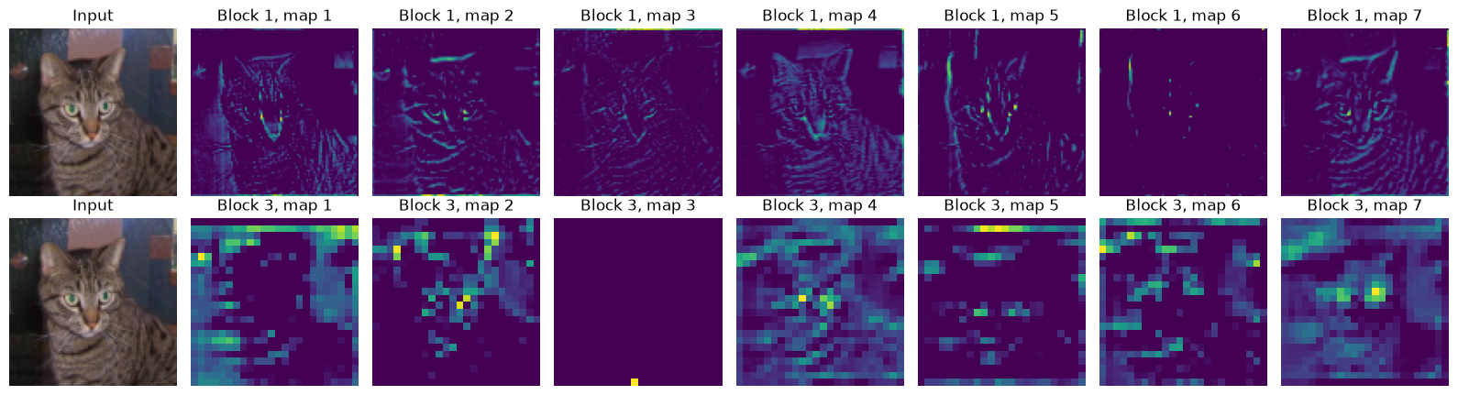
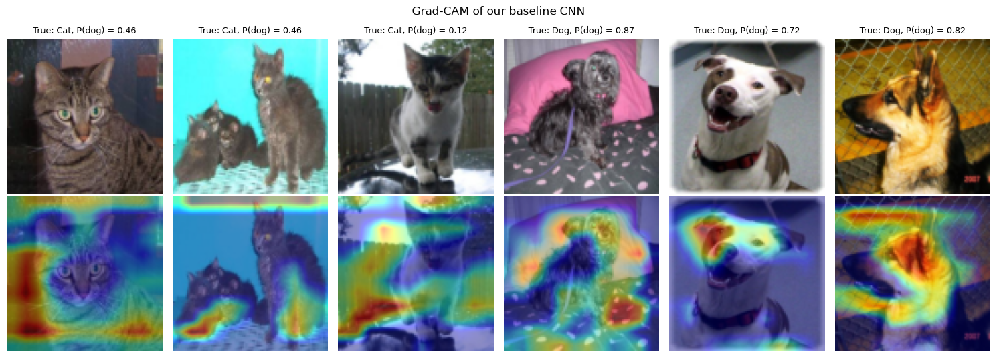
Inside our CNN: feature maps and Grad-CAM
Notes:
Top: feature maps of block 1 behave like edge detectors: whiskers, eyes, fur stripes. Block 3 is coarser and more abstract. Bottom: Grad-CAM shows where the baseline looks. Surprise: often the background, the floor, the fence, the image borders. With only 1,600 images a small CNN learns shortcuts. That explains why it plateaus near 75% and why pretraining helps so much.

Slide 14
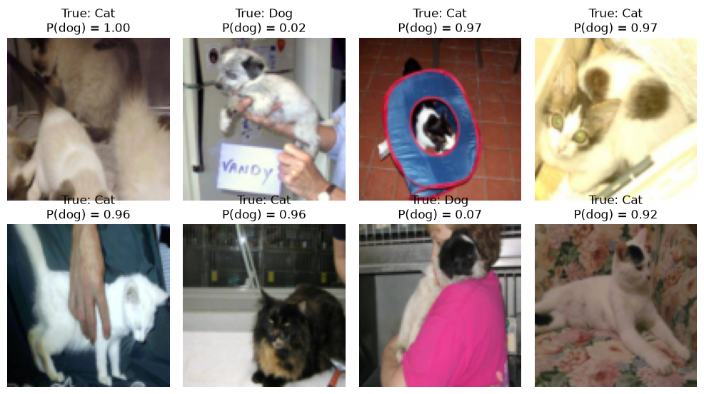
What the best model gets wrong
21 errors / 400 test images
• Animal small or partly hidden
• Held by a person
• Unusual pose or framing
• Fluffy, light-coloured cats → "dog"
• 96 × 96 resizing removes detail
Notes:
The fine-tuned MobileNetV2 makes 21 errors out of 400. These are its most confident mistakes. Typical causes: the animal is small or partly hidden, held by a person, unusual pose, or a fluffy light-coloured cat that looks like a small dog. At 96 by 96 pixels, fine details disappear.

Slide 15
Conclusion and next steps
What we learned
• From scratch: ~75–78% with 1,600 images
• Overfitting is the main problem
• Augmentation shrinks the gap but needs more epochs
• BatchNorm speeds up learning (after fixing its momentum)
• Pretrained features win: 94.8%
• Grad-CAM: small CNN relies on backgrounds
Limits and next steps
• One seed, 400 test images: ±2 points of noise
• Repeat with several seeds
• Train the augmented CNN longer (30+ epochs)
• Larger inputs, e.g. 160 × 160
• Combine augmentation + fine-tuning
Notes:
Summary: a 4-block CNN reaches about 78%. Our two improvements reduced overfitting or sped up learning, but with one run and 400 test images we cannot claim they beat the baseline. Transfer learning reaches almost 95%. Next steps: several seeds, longer augmented training, bigger images, augmentation combined with fine-tuning.

Slide 16
References and use of AI
• Dataset: storage.googleapis.com/tensorflow-1-public/course2/cats_and_dogs_filtered.zip (Kaggle Dogs vs. Cats; Elson et al., Asirra, CCS 2007)
• TensorFlow tutorials: Image classification; Transfer learning and fine-tuning
• Keras API docs; Keras Grad-CAM example; scikit-learn metrics docs
• Sandler et al., MobileNetV2, CVPR 2018
• Deng et al., ImageNet, CVPR 2009
• Kingma & Ba, Adam, ICLR 2015
• Ioffe & Szegedy, Batch Normalization, ICML 2015
• Srivastava et al., Dropout, JMLR 2014
• Selvaraju et al., Grad-CAM, ICCV 2017
Use of AI
We used an AI assistant (Claude) only for:
• hyperparameter recommendations
• questioning our choices and results
• text formatting
We ran every experiment ourselves.
Notes:
All sources are listed in the notebook too. We used an AI assistant only for hyperparameter recommendations, for questioning our choices and interpretations, and for text formatting. Thank you, we are happy to take questions.

