Slide 1
Finite Automata Project
Team: Int1-8
Names: Kiesgen de Richter, Mouillon, Taillieu, Vaio

Slide 2
Summary
Data structures, reading and displaying
Determinization and completion
Minimization
Complementary language, standardization and word recognition

Slide 3
Data structure
98 in the memory
(ASCII for b)
example #36:
transTable =
nbStates = 3
nbAlpha = 2
init = [2,1,3]
term = [2,2,3]
Structure fa:
transTable: 3D array
nbStates: int
nbAlpha: int
init: array
term: array
Number of
transitions 1b-
[0] | [a] | [b] | [*]
[1,0] | [1,1] | [2,1,2] | [0]
[1,1] | [0] | [2,0,2] | [0]
[1,2] | [2,0,1] | [0] | [0]
States
Line number in transTable
Number of
initial states

Slide 4

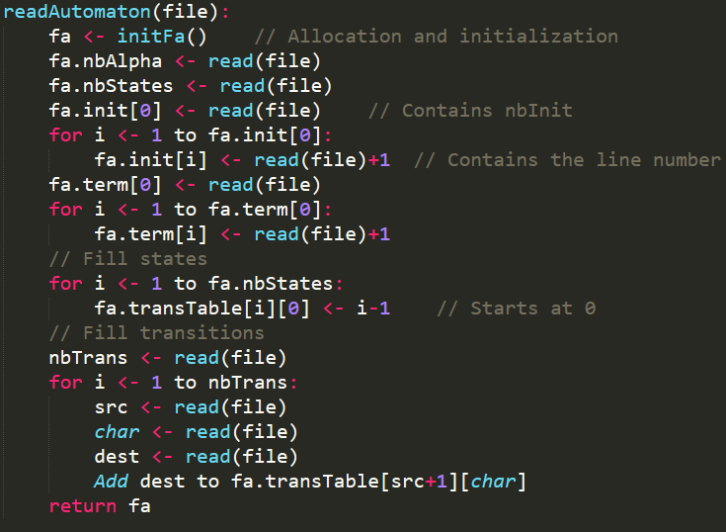
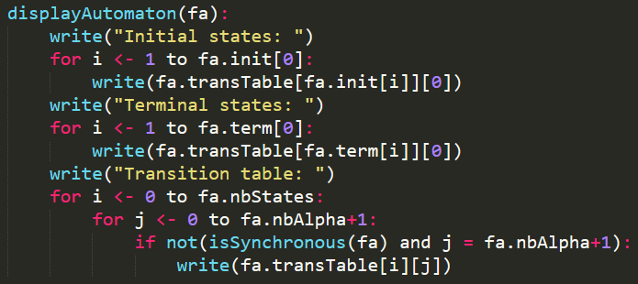
Reading and displaying
[0] | [a] | [b]
[1,0] | [1,1] | [2,1,2]
[1,1] | [0] | [2,0,2]
[1,2] | [2,0,1] | [0]
nbStates = 3 nbAlpha = 2
init = [2,1,3] term = [2,2,3]

Slide 5
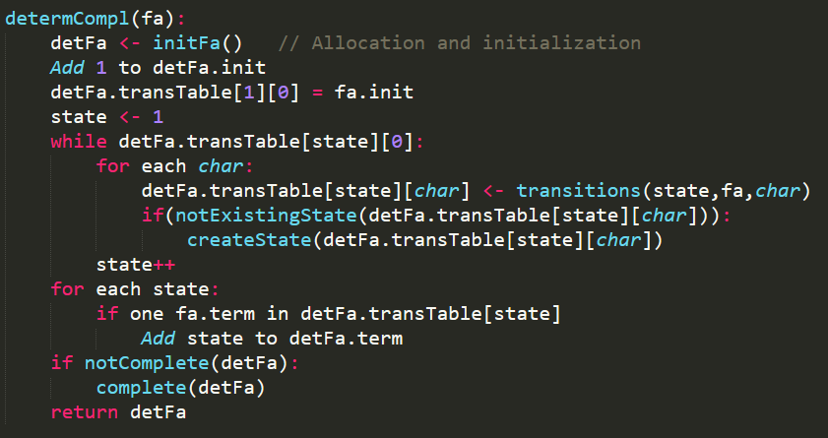
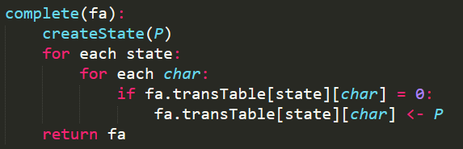
Determinization and completion
If the state doesn’t exist, add it
[0] | [a] | [b]
[2,0,2] | [2,0,1] | [2,1,2]
[2,0,1] | [1,1] | [3,0,1,2]
[2,1,2] | [2,0,1] | [2,0,2]
[1,1] | [1,-1] | [2,0,2]
[3,0,1,2] | [2,0,1] | [3,0,1,2]
[1,-1] | [1,-1] | [1,-1]
1st state = combination
of original initial states
-1 is the state P

Slide 6
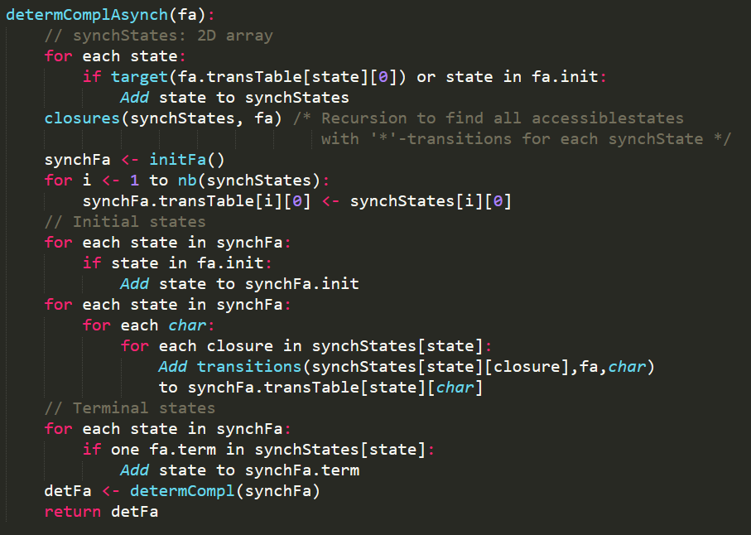
Asynchronous automaton
synchStates =
[0]
[1,2,4,5,6,9,13]
[3,2,4,5,6,9,13]
[7]
[8,5,6,9,12,13]
[10]
[11,5,6,9,12,13]
synchState
closures

Slide 7
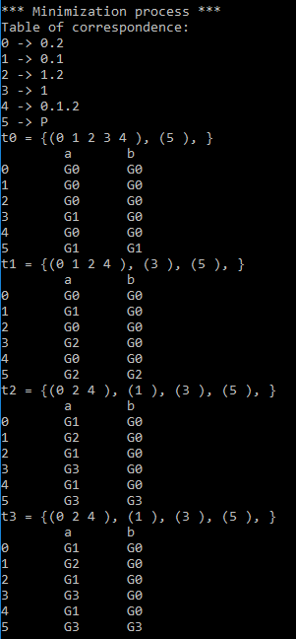
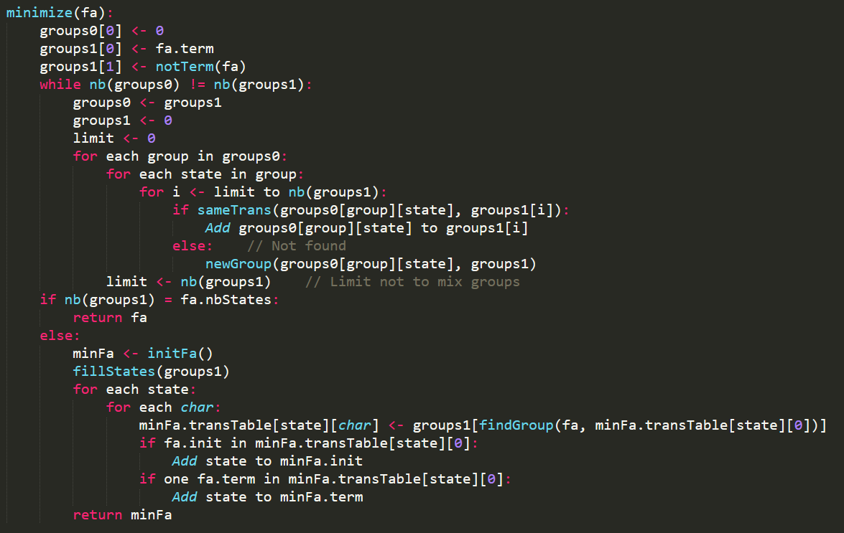
Minimization

Slide 8
Minimization
[0] | [a] | [b]
[2,0,2] | [2,0,1] | [2,1,2]
[2,0,1] | [1,1] | [3,0,1,2]
[2,1,2] | [2,0,1] | [2,0,2]
[1,1] | [1,-1] | [2,0,2]
[3,0,1,2] | [2,0,1] | [3,0,1,2]
[1,-1] | [1,-1] | [1,-1]
[0] | [a] | [b]
[3,0,2,4] | [1,1] | [3,0,2,4]
[1,1] | [1,3] | [3,0,2,4]
[1,3] | [1,5] | [3,0,2,4]
[1,5] | [1,5] | [1,5]

Slide 9
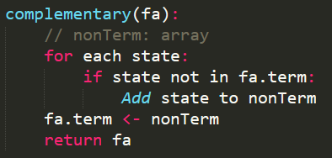
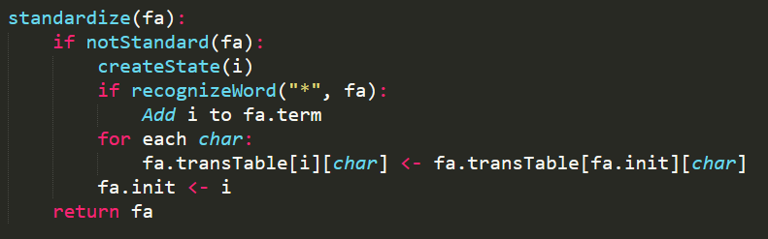
Complementary language and standardization

Slide 10
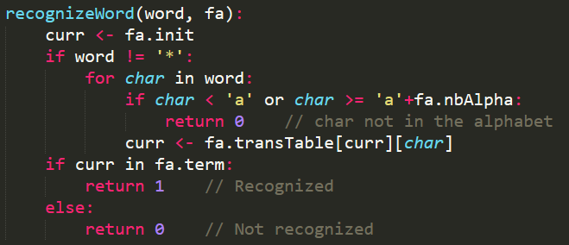
Word recognition

