Slide 1
Recurrent Neural Networks

Slide 2
Motivation

Slide 3
Word2Vec and Doc2Vec to CAZy2Vec & CGC2Vec
CAZy2Vec
CGC2Vec
For any observed gene in the supervised + unsupervised corpus:
Can provide a feature vector of d dimension.
Give a similarity score for any pair of genes.
Can even give a feature vector for an unobserved gene token. (FastText)
For each CGC sequence:
Can provide a feature vector of d dimension.
Give a similarity score for any pair of CGCs.

Slide 4
Combing CAZy2vec vectors – inattentive model
Xylan
GH30_8
GH43_16
CBM6
Gene | Dimension 1 | Dimension 2 | Dimension 3 | Dimension 4
GH30_8 | -0.04 | 0.06 | 1.73 | -2.34
GH43_16 | 4.11 | -2.22 | 1.61 | 3.41
CBM6 | -1.27 | 2.45 | 8.97 | -0.96
Central question – How do we combine these three vectors to produce a 1-dimensional vector?
Uniform weights solution
Assign uniform weights – weight(GH30_8) = weight(GH43_16) = weight(CBM6) = 1/3
Element wise weighted average – (1/3) vector(GH30_8) + (1/3) vector(GH43_16) + (1/3) vector(CBM6)
No learning is required to compute these weights.

Slide 5
Combing CAZy2vec vectors – attentive model
Xylan
GH30_8
GH43_16
CBM6
Gene | Dimension 1 | Dimension 2 | Dimension 3 | Dimension 4
GH30_8 | -0.04 | 0.06 | 1.73 | -2.34
GH43_16 | 4.11 | -2.22 | 1.61 | 3.41
CBM6 | -1.27 | 2.45 | 8.97 | -0.96
Learnable weights solution
Design a network that can learn customized weights for each CGC.
Great for interpretability – can now tell the users which genes contributed most to the classification into a specific category.
Weights sum up to 1
Model can learn for instance GH30_8 is very important and can communicate this to us via the weight parameter.
weight(GH30_8) =0.8
Element wise weighted average – (0.8) vector(GH30_8) + (0.1) vector(GH43_16) + (0.1) vector(CBM6)

Slide 6
Deep Learning Models – Recurrent Neural Networks

Slide 7
Recurrent Neural Networks (RNNs)
Assumption
Data has a sequential order to it.
We know that there is a sequential nature to the CGCs.
RNNs are feature extractors that process the genes in sequential order.
Gene | Dimension 1 | Dimension 2 | Dimension 3 | Dimension 4
GH30_8 | -0.04 | 0.06 | 1.73 | -2.34
GH43_16 | 4.11 | -2.22 | 1.61 | 3.41
CBM6 | -1.27 | 2.45 | 8.97 | -0.96
Steps
Read Weight(GH30_8) – keep a hidden memory till the first gene position, say Hidden(GH30_8)
Read Weight(GH43_16) – keep a hidden memory till the second gene position, say Hidden(GH30_8, GH43_16)
Read Weight(CBM6) – keep a hidden memory till the third gene position, say Hidden(GH30_8, GH43_16, CBM6)
Use Hidden(GH30_8, GH43_16, CBM6) as the feature to be used in a prediction model.

Slide 8
Results

Slide 9
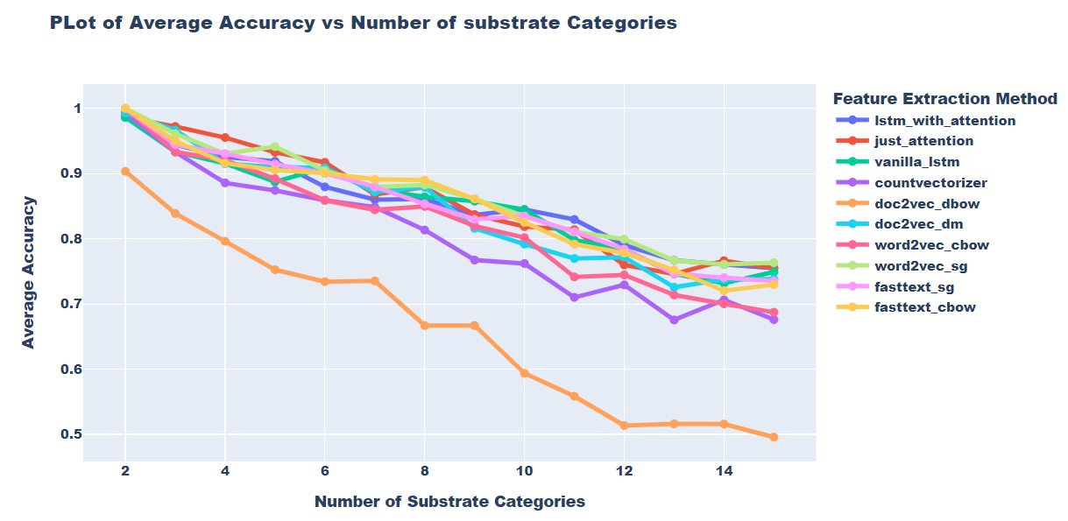
Results (without Others category)
Plot link

Slide 10
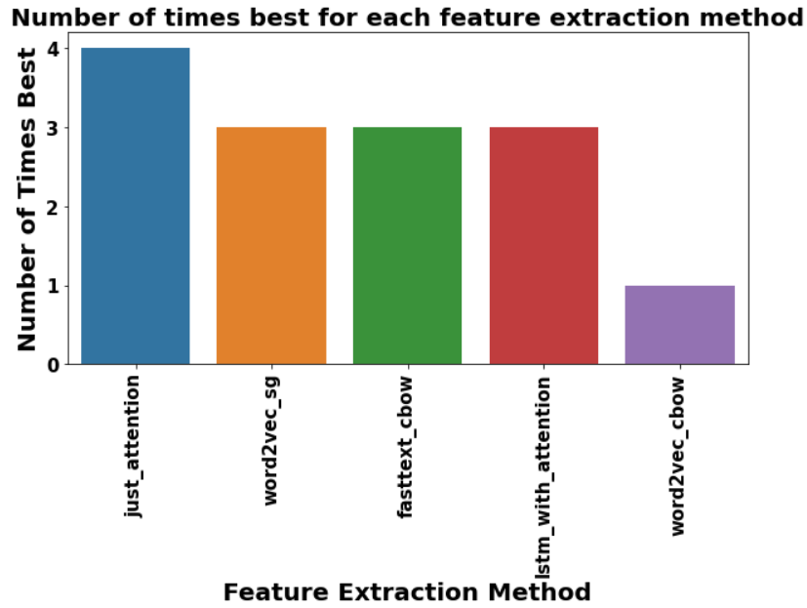
Assessing the Feature Extraction Methods (without Others category)

