Slide 1
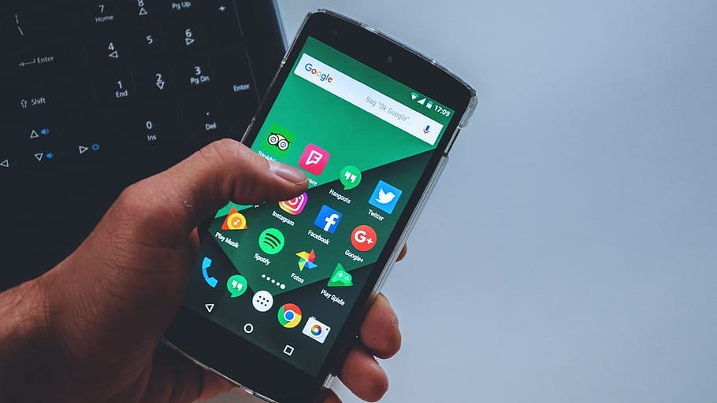
TEAM TECH TITANS
Sarthak Jain (22BCE7236)
Umanshu Anand (22BCE9173)
Vedant Kanoje (22BCE9039)

Slide 2

Introduction
In today’s fast-paced lifestyle, people often forget to take their medicines on time. This is especially common among elderly individuals, patients with chronic illnesses, or those managing multiple medications daily. Missing doses can lead to serious health issues, poor recovery, or treatment failure.
To address this issue, we have developed a simple yet effective Medicine Reminder App. The app is designed to help users manage their medication schedules with ease by sending timely reminders for each medicine. With a clean interface and essential features, the app allows users to add medicines, set dosage times, and receive alerts when it’s time to take them.
Our aim is to improve medication adherence, reduce health risks caused by forgetfulness, and provide a reliable digital health assistant that fits into users’ daily lives effortlessly.

Slide 3

IDEA:MEDICINE REMINDER APP
The idea behind the Medicine Reminder App is to create a digital solution that helps users take their medicines on time, every time. Forgetting medication is a common problem that can affect treatment outcomes and overall health. Our app aims to solve this by sending timely notifications and tracking medicine intake.
Users can add details such as the name of the medicine, dosage, and the exact times it needs to be taken. The app will then alert the user with a notification or alarm at those times. It also allows users to mark whether the medicine was taken or missed, which helps in monitoring consistency.
This idea is especially helpful for elderly people, patients with long-term treatments, or anyone with a busy lifestyle who may forget their daily medication. The goal is to make medicine management simple, reliable, and stress-free through a mobile application.

Slide 4

Contributions:
SARTHAK JAIN
Implement Room with @Entity, @Dao, and RoomDatabase for local storage.
Handle asynchronous data operations using Kotlin Coroutines and Flow.
Set up Reminders functionality (likely integrating with WorkManager).
Configure WorkManager for scheduled background tasks.
Add NotificationCompat for custom notifications.
UMANSHU ANAND
Design app architecture using MVVM (Model-View-ViewModel) pattern.
Create ViewModel, Repository, and manage state using StateFlow.
Implement Hilt for dependency injection (@Inject, @HiltAndroidApp).
Set up navigation using Navigation Component, NavHost, and NavController.
VEDANT KANOJE
Build UI using Jetpack Compose with @Composable, State, and remember.
Apply Material Design 3 using MaterialTheme, OutlinedButton, etc.
Ensure Dark Mode and responsive layout support for different devices.

Slide 5

CONCEPT USED
Data Layer
Room: @Entity, @Dao, RoomDatabase
Kotlin Coroutines & Flow for async data handling
Reminders
WorkManager for background tasks
NotificationCompat for custom notifications
Architecture
MVVM with ViewModel, Repository, StateFlow
Hilt for dependency injection (@Inject, @HiltAndroidApp)
Navigation Component with NavHost & NavController
UI/UX
Jetpack Compose with @Composable, State, remember
Material Design 3 with MaterialTheme, OutlinedButton
Dark Mode & responsive layout support

Slide 6

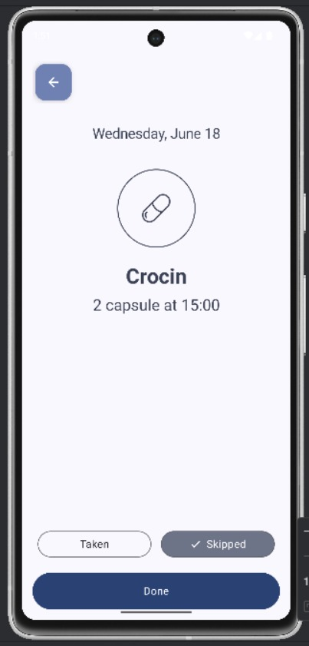
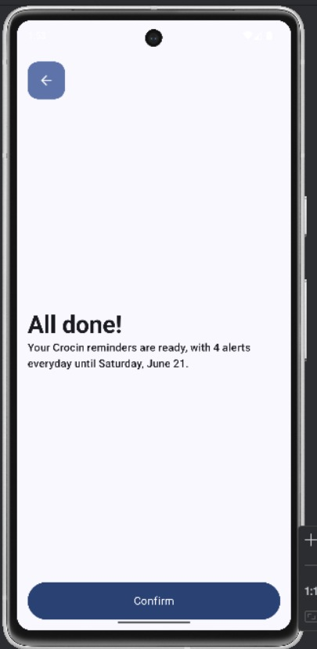
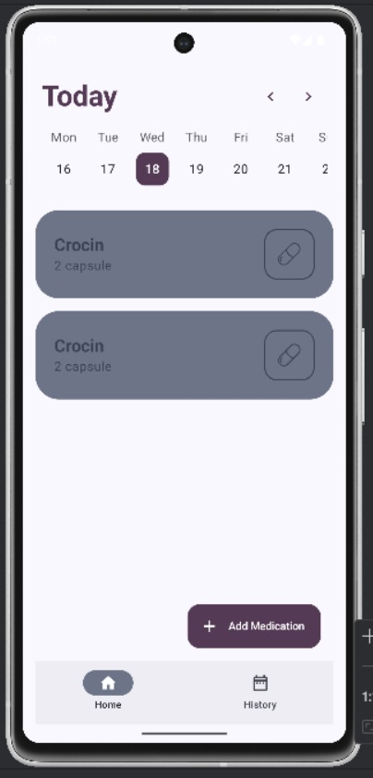
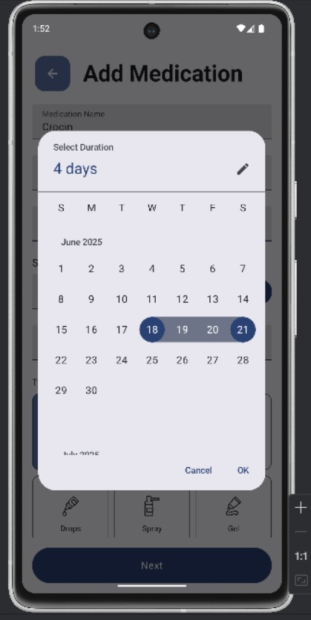
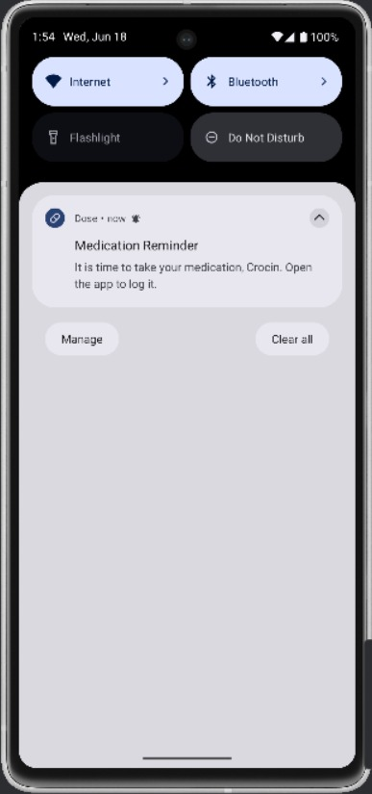
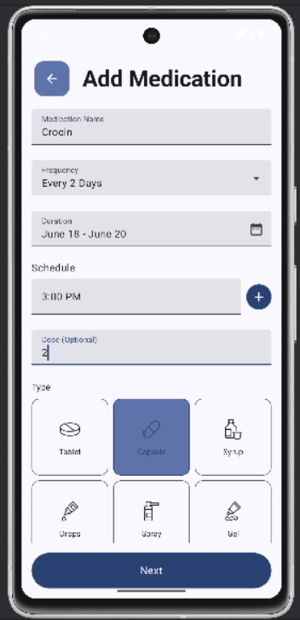
DEMO OF APP

