Slide 1
Charitable
to help you help others.

Slide 2

We are Charitable.
A way to centralize opportunities to give back to your community.

Slide 3






What Inspired Us?
We wanted our project to be for a good cause
We are humbled by the number of organizations and causes that rose to the occasion to help those in need
We wanted to learn more about them
We wanted to make learning about our communities easier and less overwhelming

Slide 4

Why Charitable?
2020 has been a year of some incredible causes coming to light.
Finding organizations to support these causes, specifically legitimate ones, can be difficult and overwhelming.
Charitable is here to help you help others.

Slide 5



Software Comparison
Best be described as a “LinkedIn” for charities.
Models the web application known as Charity Navigator, but adds an element of social media to promote and encourage involvement.
Users can create posts about their experiences to share with others
Users can create “events” (donations or plans to volunteer) that friends can join

Slide 6
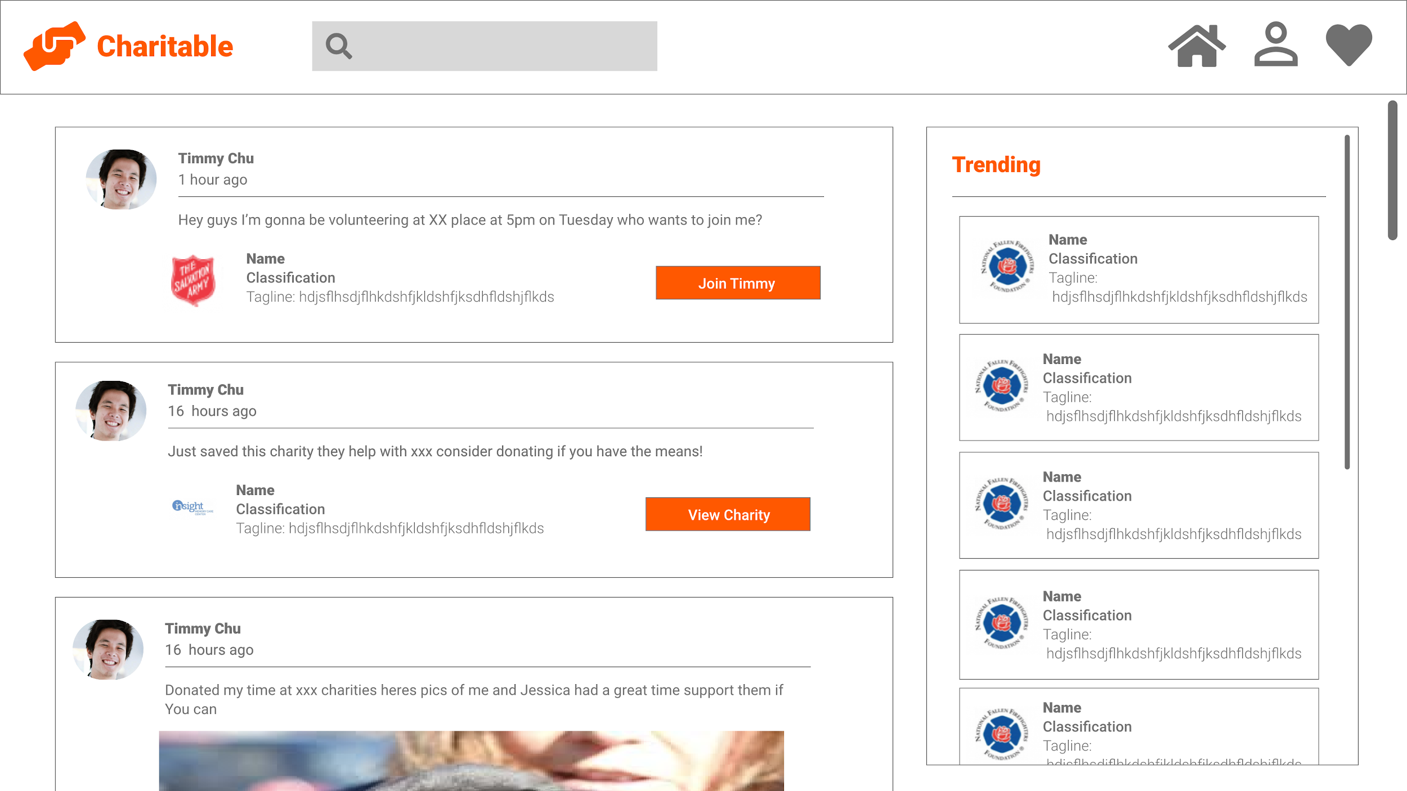
Home/Feed Activity Page
Search for charities
Links to home, profile, and favorites
Social Media Feed
View Trending Charities
Notes:
The Social Feed
Users can connect with others and share opportunities or charities with each other
Users can create “events” (donations or volunteer plans) that others can join from official organizations on the application

Slide 7
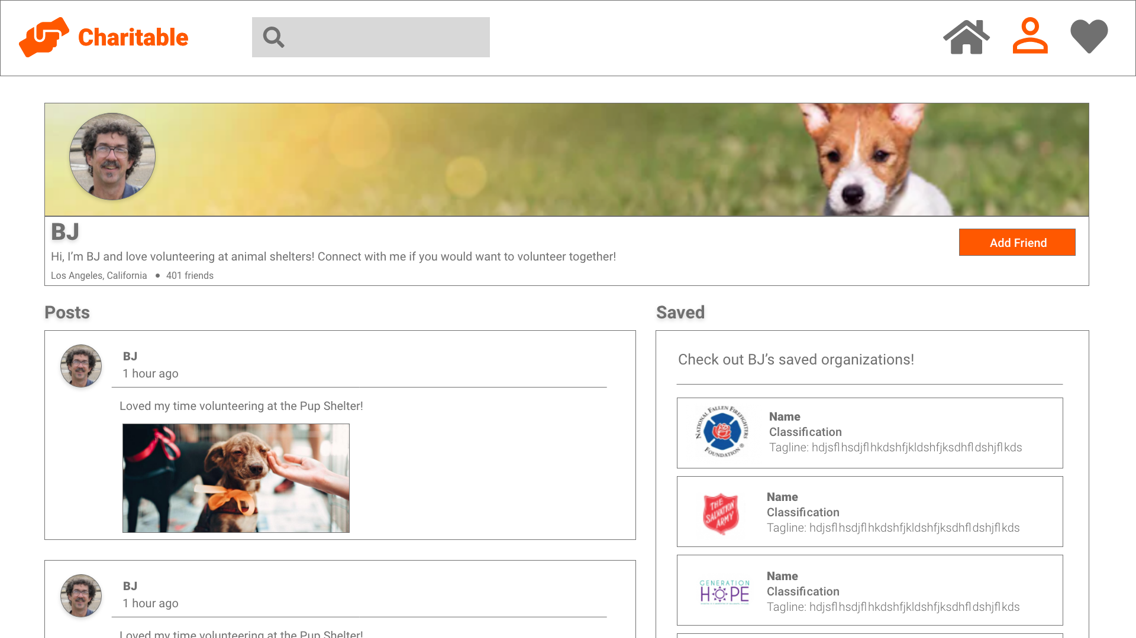
Profile Page
Links to user’s home page, profile, & liked
items
Search for charities
User’s name, bio, location, and friends
User’s saved charities
User’s feed
Notes:
The User Profile
Users can save their favorite charities and opportunities on a saved page
Users will receive notifications of updates from their saved organizations

Slide 8
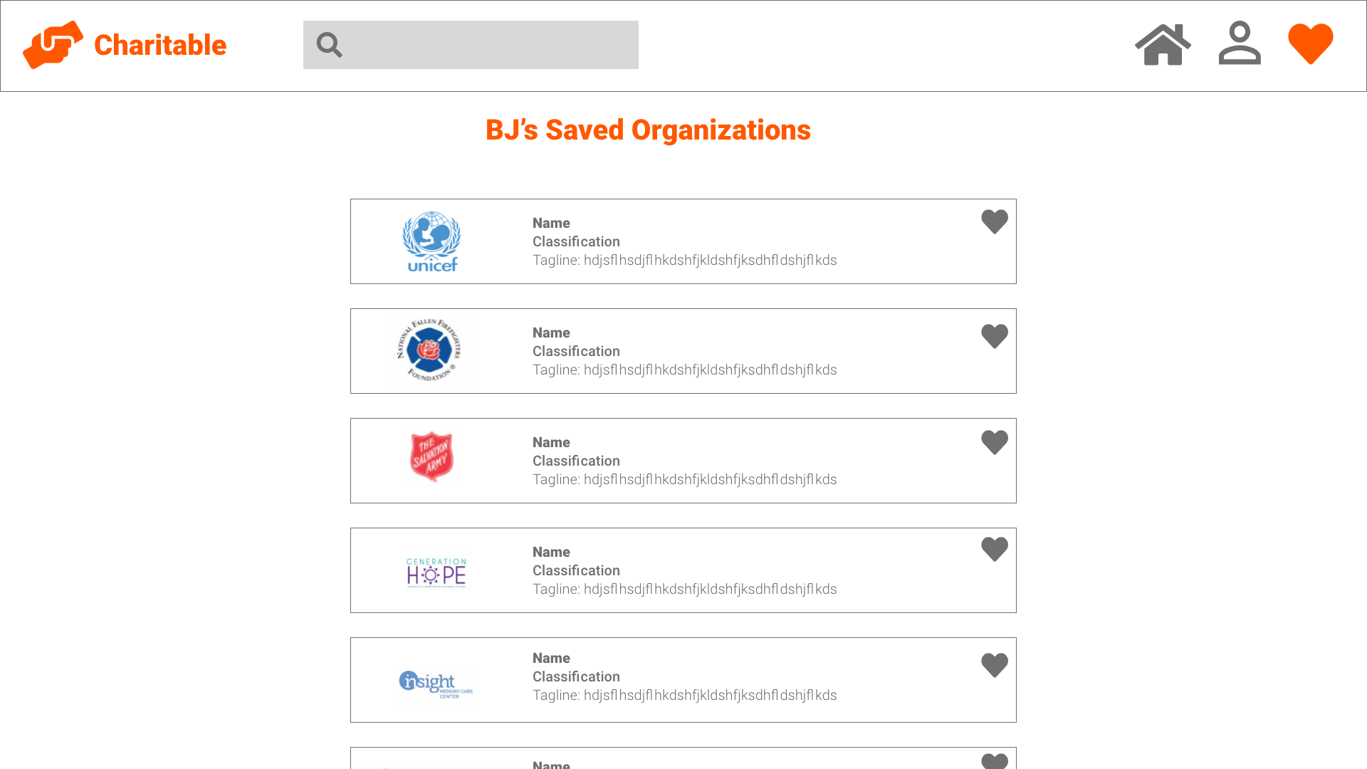
Saved Page
Search for charities
Links to home, profile, and favorites
View Saved Charities
Notes:
The User Profile
Users can save their favorite charities and opportunities on a saved page
Users will receive notifications of updates from their saved organizations

Slide 9
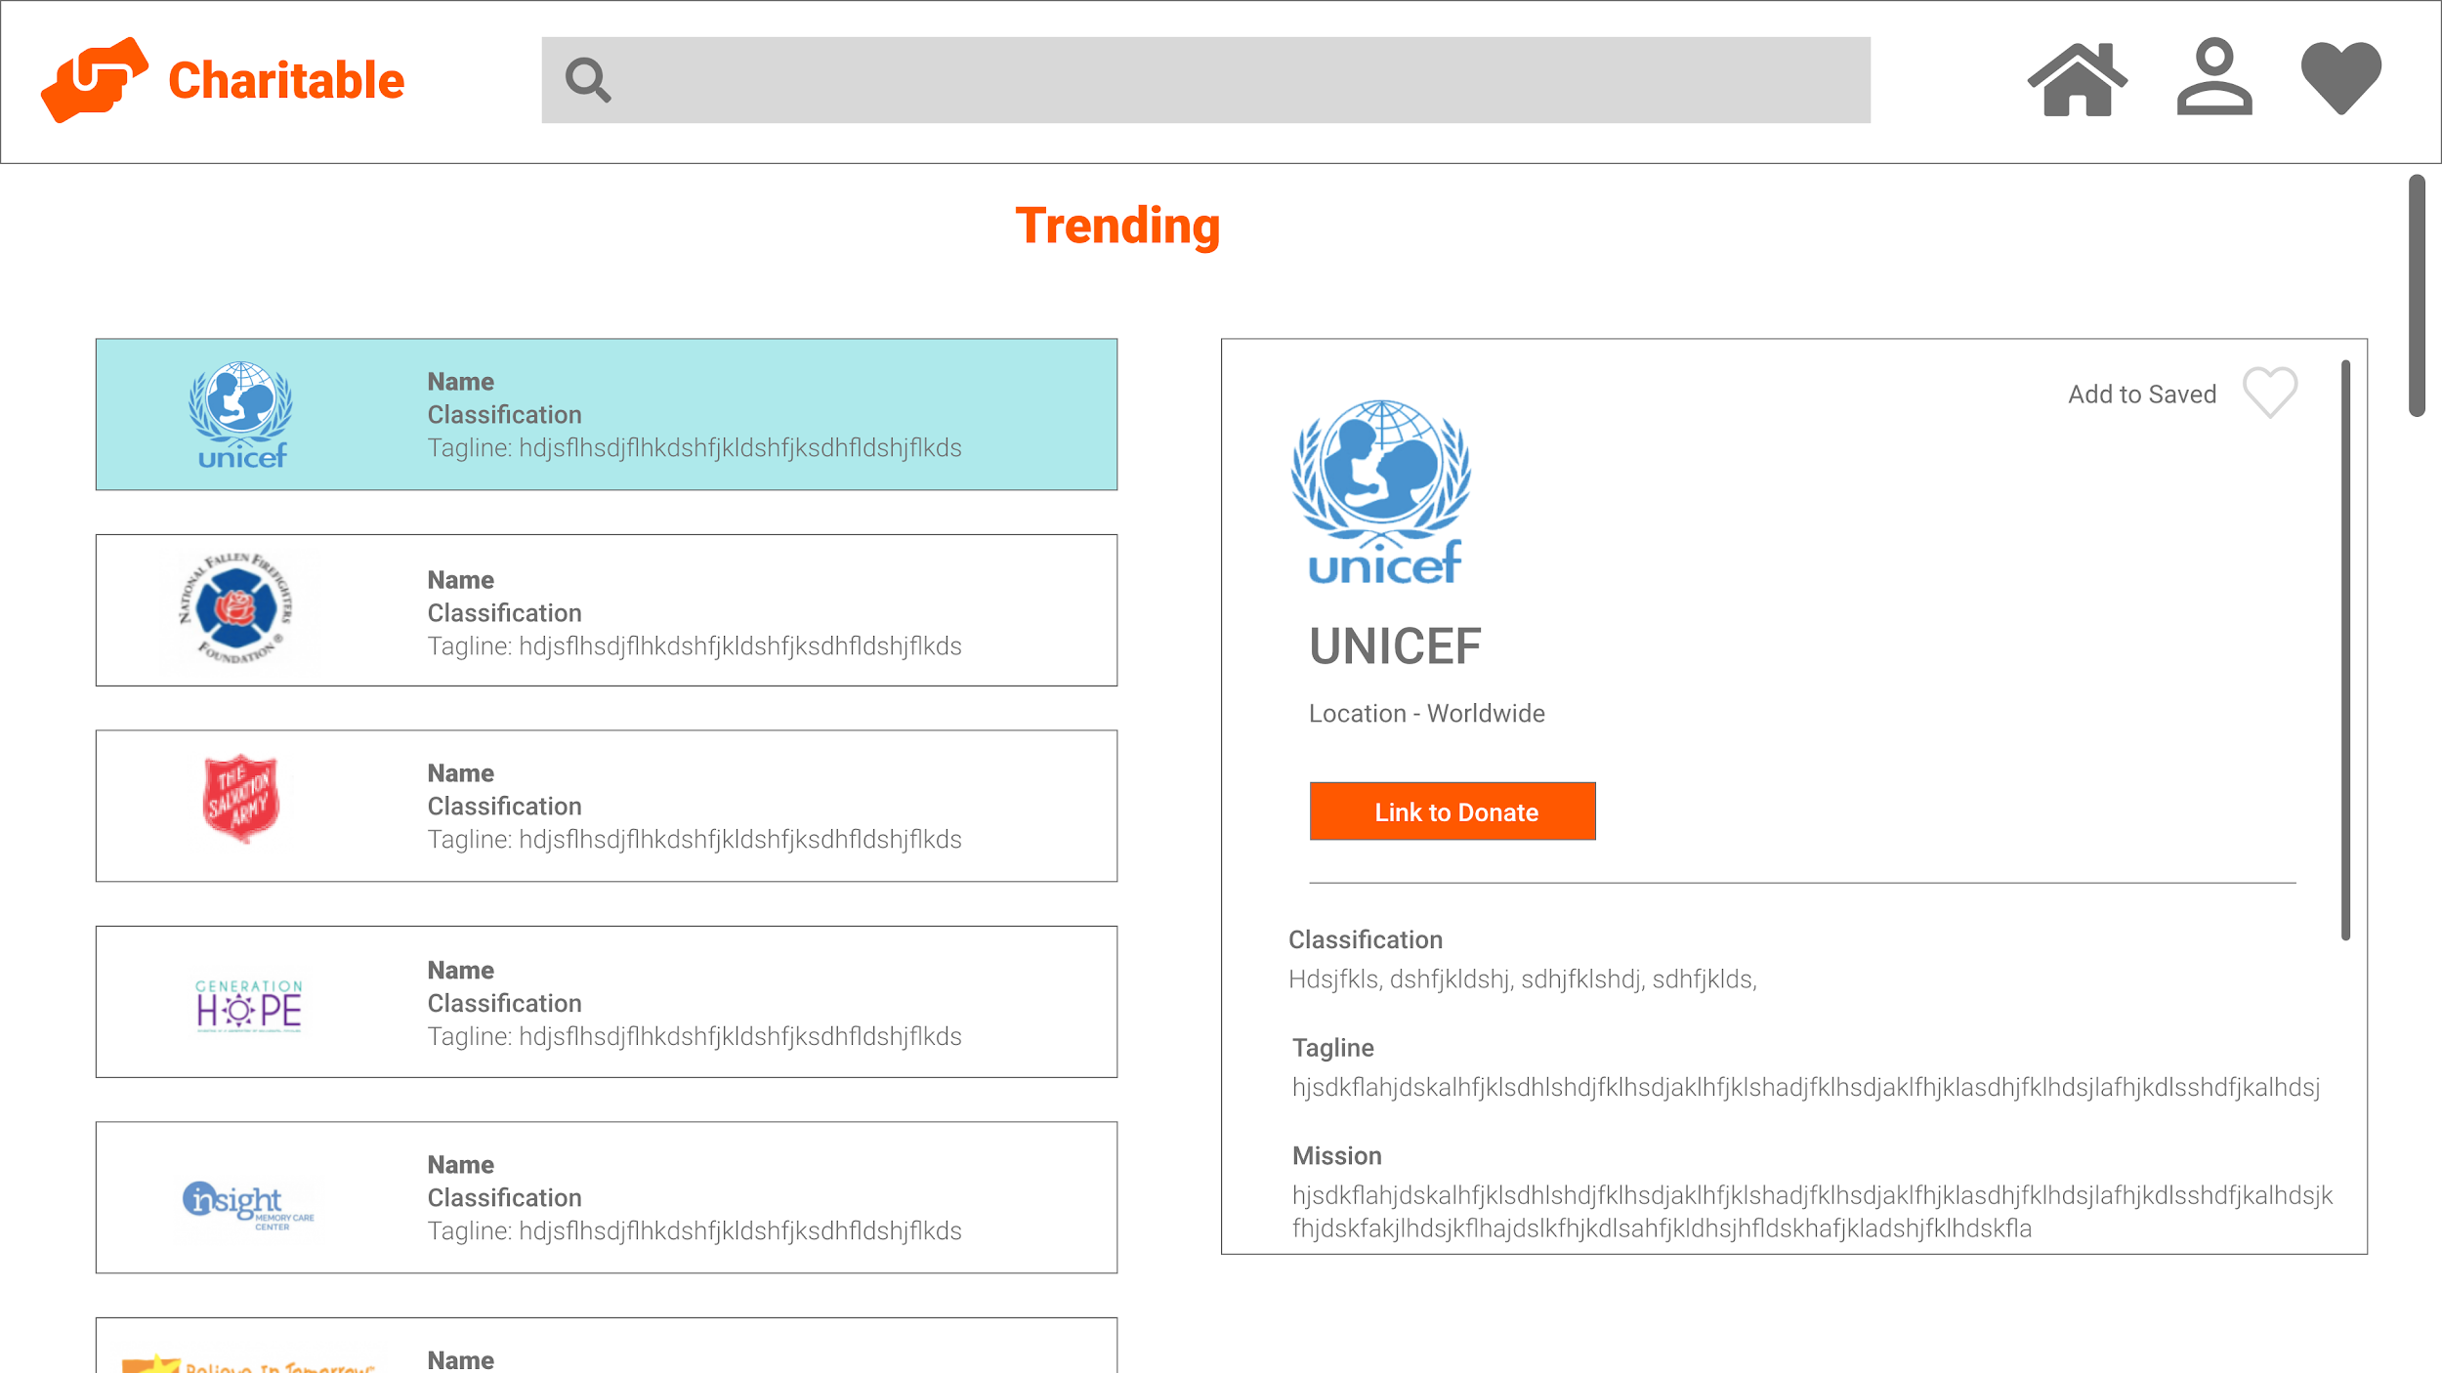
Trending/Search Page
Search Bar
Links to user’s home page, profile, & liked items
Description of charity or volunteer event page
Trending charities & volunteer opportunities
Notes:
The Search Engine
Users can search directly for organizations and causes
Users can also use filters to discover charities
The Trending Page
This page will show global causes and organizations that are popular in the U.S.

Slide 10

Required Hardware/Software
Hardware for Development :
Computers
Software for Development:
React
VS Code
Jira
Adobe XD
Potential use of the Charity Navigator API to aid in accessing data about charities.
Hardware for Use :
Any device that can run a web browser.
Software for Use:
Web Browser

Slide 11
Development
Apply our learnings from Databases, Networks, Interaction Design, and UI/UX Design.
Challenge ourselves in learning more about software development in industry
Timeframe:
We are aiming to complete this project within a semester

Slide 12



Who is Charitable?
You!
People in the U.S. who want to make a positive contribution to society by donating their time and money to a variety of benign causes.
Catered to a younger audience who are more comfortable navigating social media.

Slide 13
We are looking forward to making your day more Charitable.

