Slide 1


Charitable
to help you help others.
Veda Ashok, Bridget O’Connor, Sam Gibson, Rachel Nguyen, Krysten Tachiyama

Slide 2
What We Do
We are a Web Application…
that Centralizes Charitable Organizations and Activities,
provides a Social Media Platform to connect Charitable users,
and are non-profit (we are free!)

Slide 3
Project Goals
Make getting involved with your community easier.
Make learning about new causes and organizations easier.
Encourage long-term involvement for causes you are passionate about.
Encourage involvement and collaboration for good causes.

Slide 4
Project Justification
At Charitable, we…
…value service (Thank you, LMU)
01
…are passionate about bettering our communities
02
…want to create an easy-to-use platform that motivates people to give back.
03
…aim to foster a Charitable™ community
04
After a year of earthquakes, wildfires, social unrest, political unrest, and of course, a global pandemic, we wanted to create a community that is passionate about giving back. Charitable is here to help you help others.

Slide 5
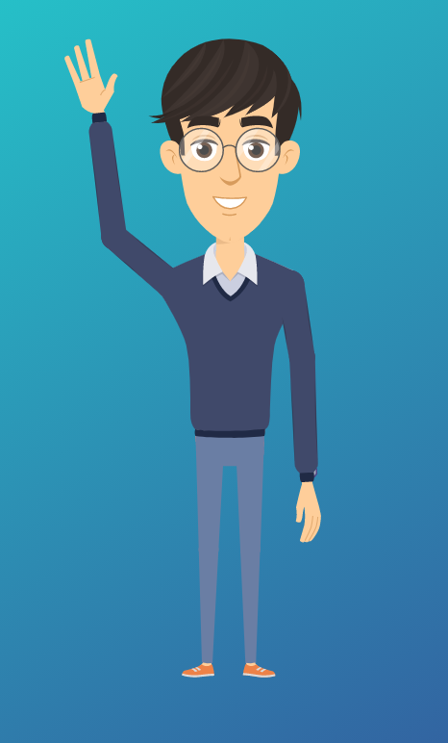
Timmy’s Story
Hi!
I am 26, I live in Seattle, WA, and I am passionate about saving our planet.
I’m Timmy Chu.
Charitable makes it easy to research organizations and projects that I can get involved in!

Slide 6
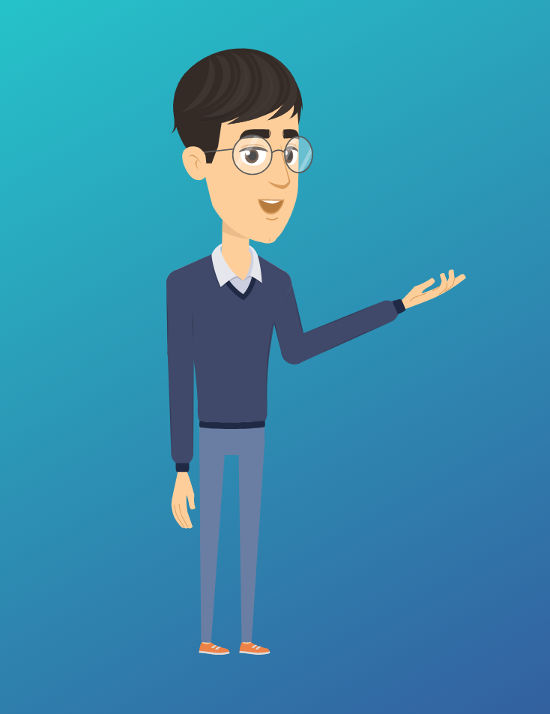
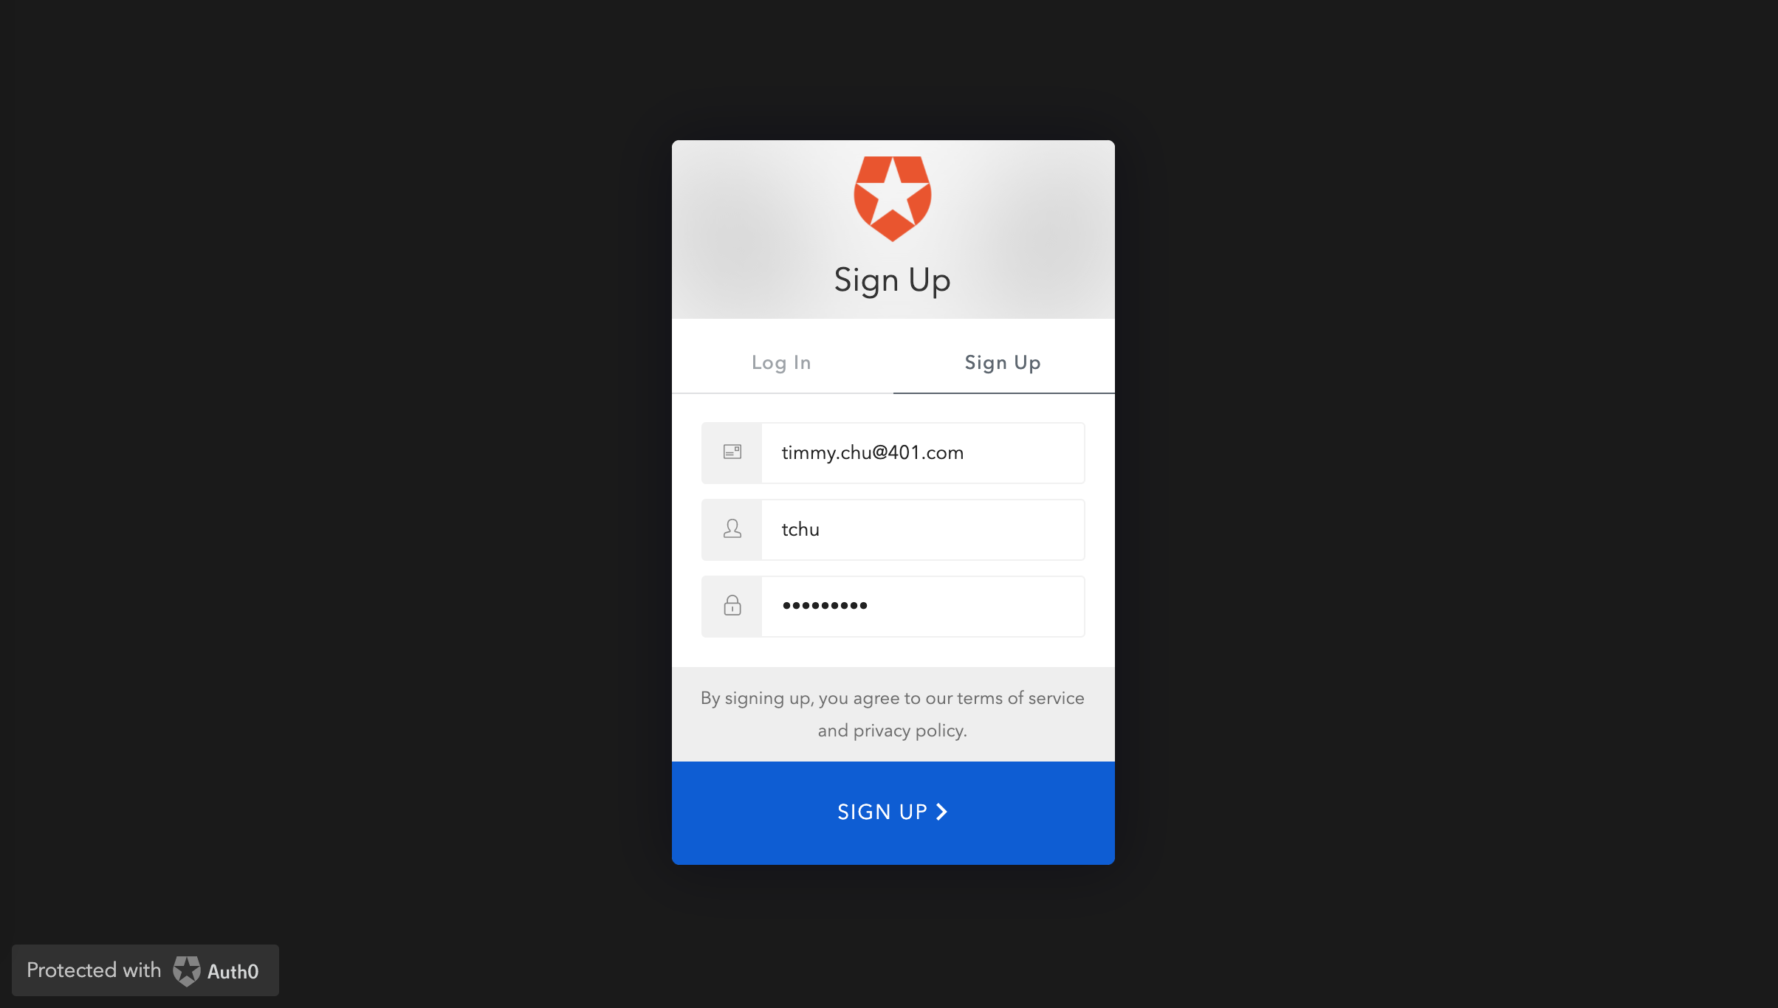
First, I sign up with Charitable on their sign-up page.

Slide 7
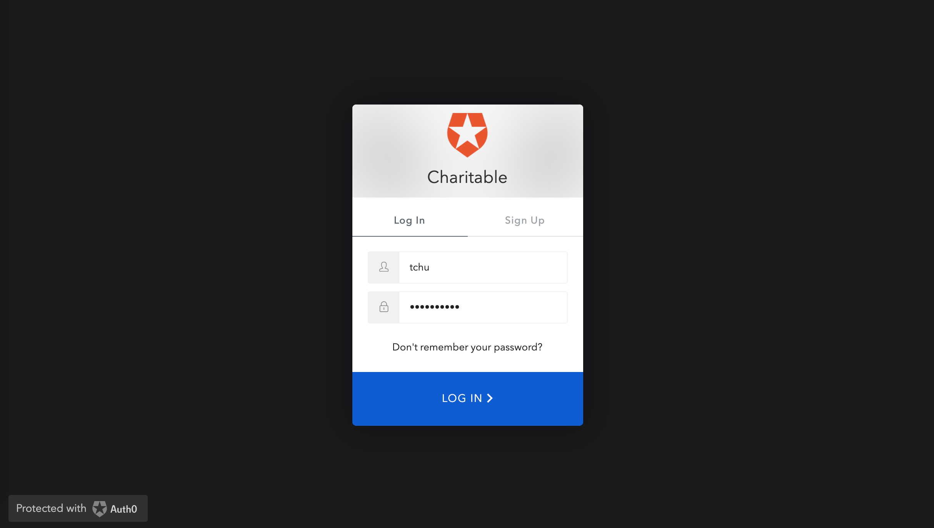
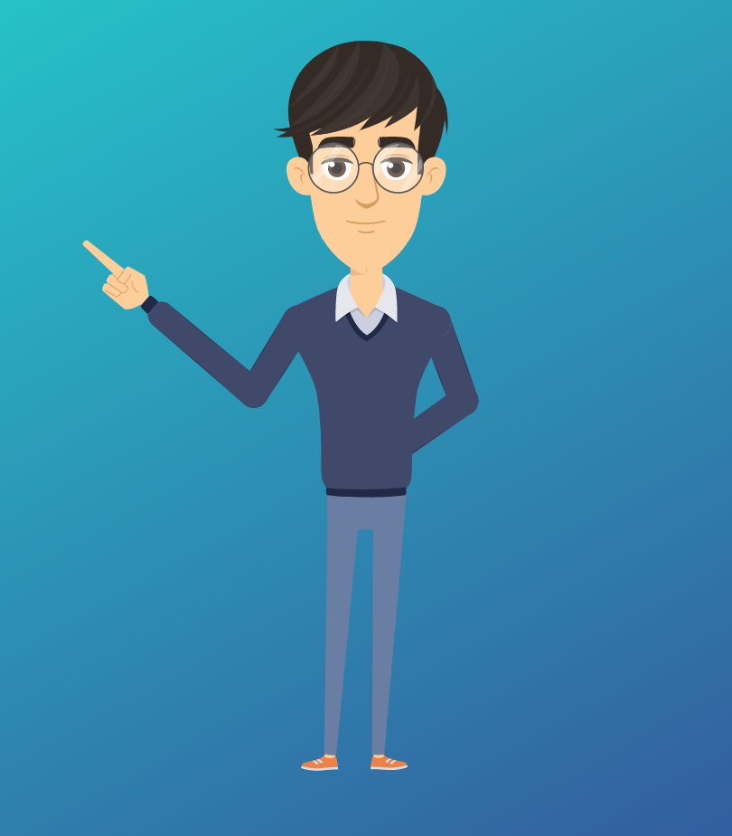
Once I verify my email, I login to my new account…

Slide 8
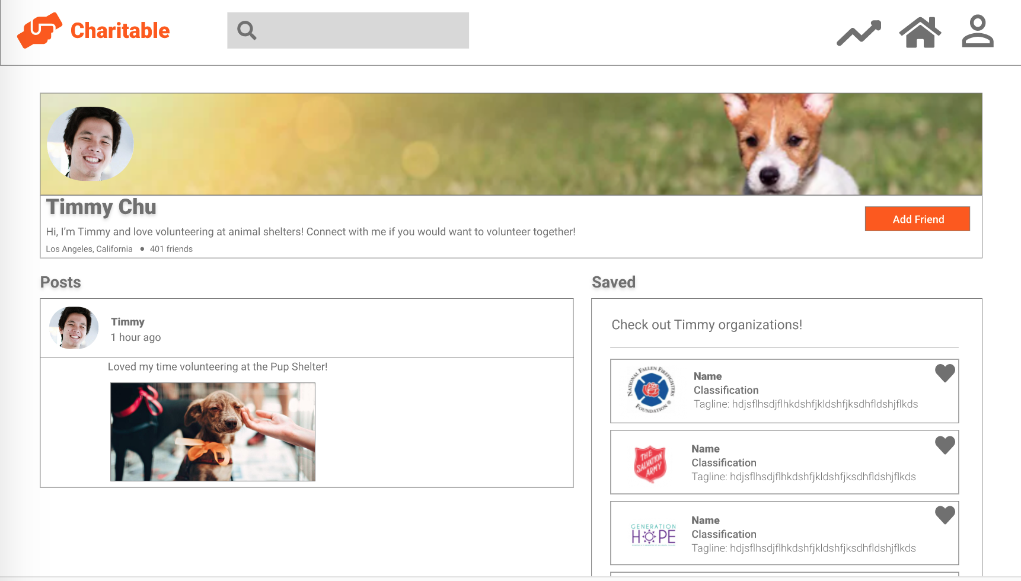

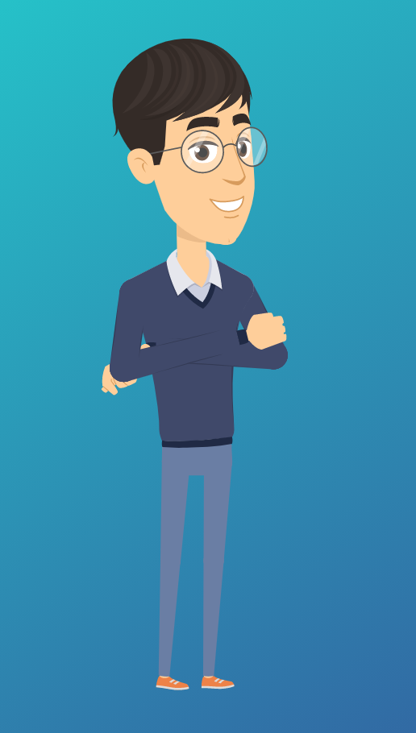
…then, I edit and setup my profile. I even made a post!
I can also search for organizations related to causes I am interested in and save the ones that I like.
I also connect with people who share my interests!

Slide 9
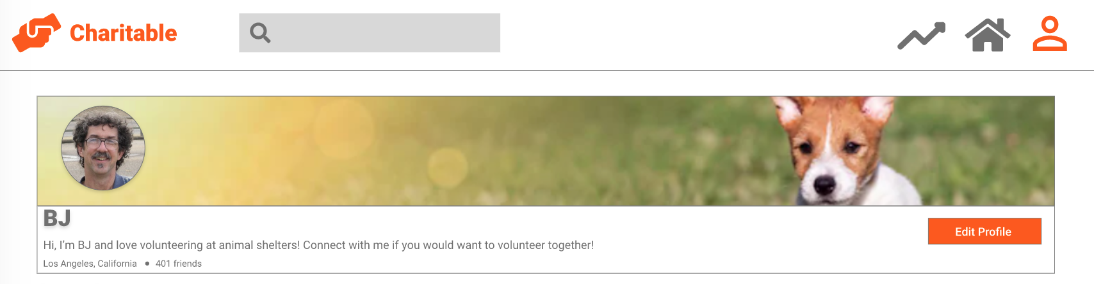
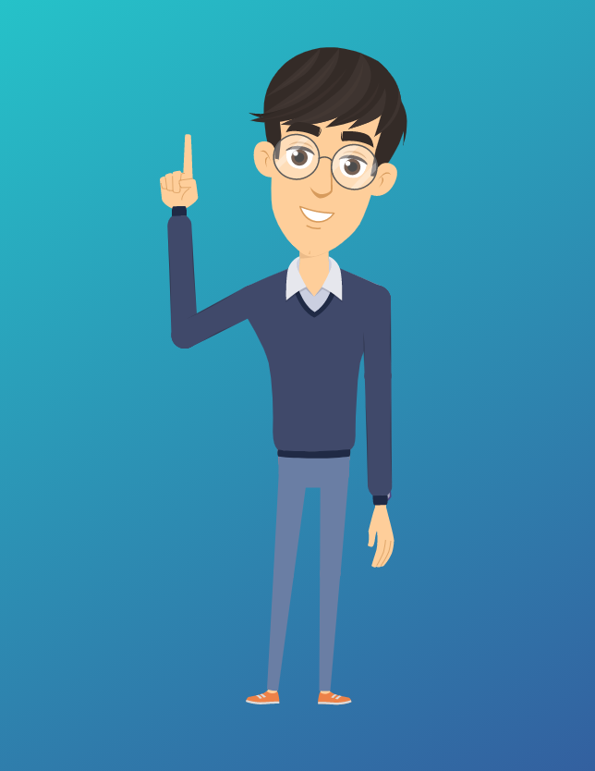

The ‘Add Friend’ button even lets me connect with other users!

Slide 10
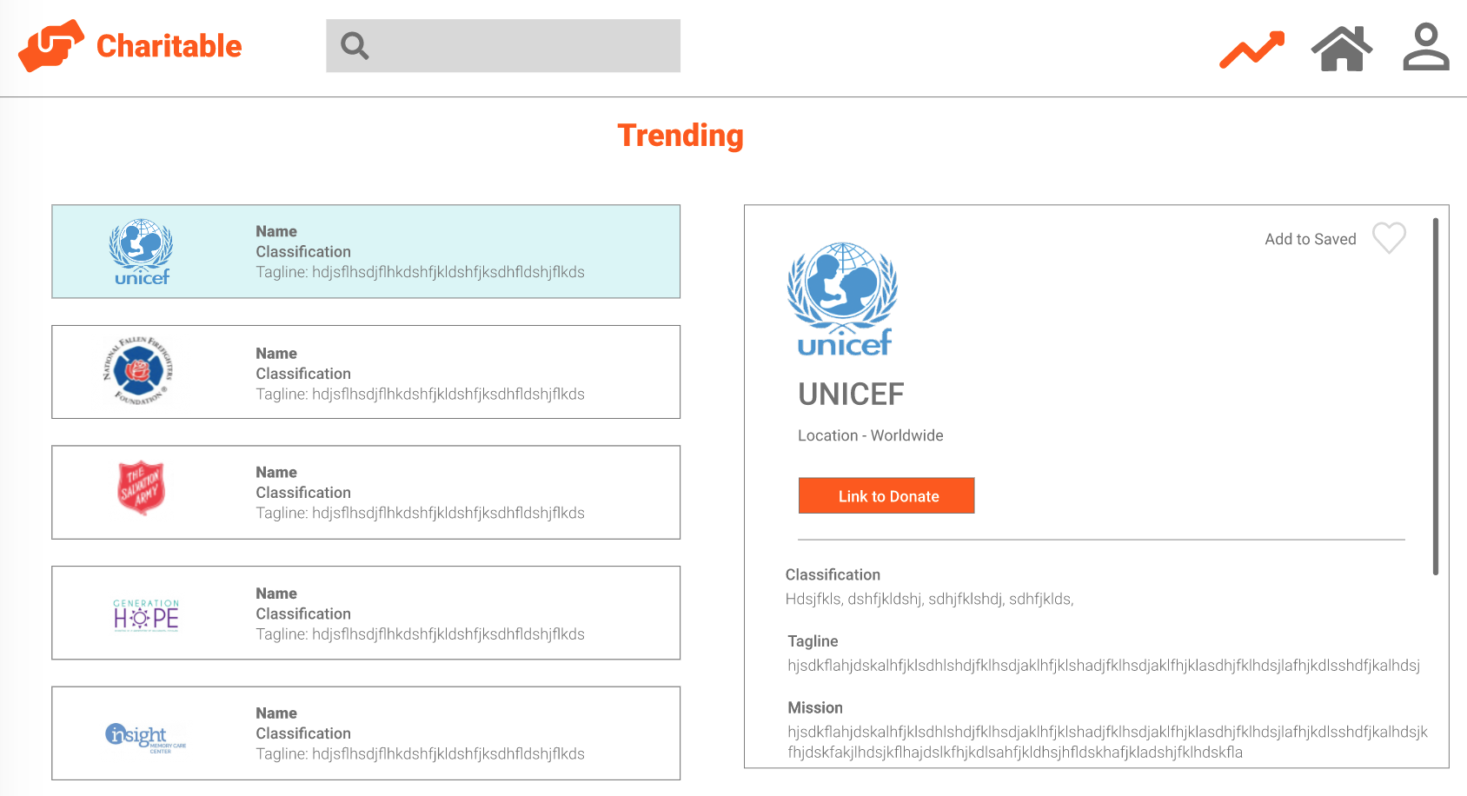
And, I can learn about trending organizations around the world!

Slide 11
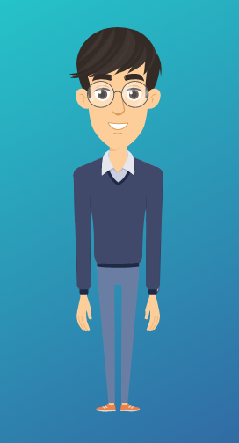
Charitable makes learning about our communities easy. I also get to meet other people
who share my passions and people who teach me more about the world!
I love Charitable because it helps me help others.

Slide 12
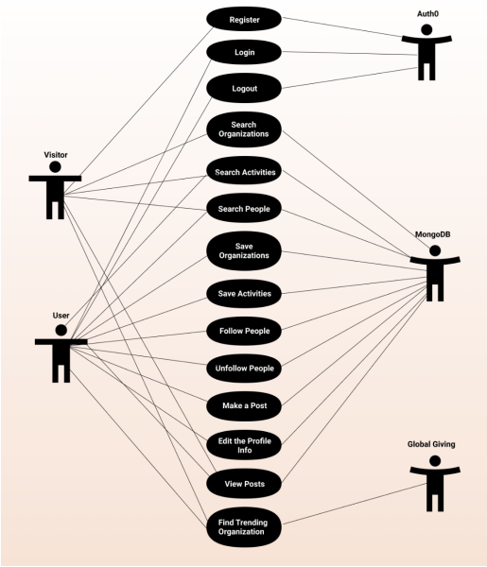
Use-Case Diagram

Slide 13
Demo

Slide 14
4-Panel Progress Report
Accomplishments | Risks
Schedule | Problems/Issues/Concerns
Built a functioning front-end
Set up our database
Set up our skeleton API using Next.js to hit MongoDB
Written search queries
Integrated Auth0 to our frontend and backend
Set up Trending Page using Global Giving’s API that updates hourly
If Auth0 has trouble, users may be locked out of their accounts.
If the GlobalGiving API goes down, our trending page will be empty.
If MongoDB API goes down, our app will lose all functionality except for logging in and viewing the Trending Page.
If our host, Vercel, goes down….we do not have a website.
The profile page may be confusing to navigate.
TASK | WEEK ESTIMATED | WEEK COMPLETED/ PROJECTED | PROGRESS
Create Mockups of Our Site | Week 01 | Week 01
Build Basic Frontend | Week 03 | Week 03
Obtain and Parse Data | Week 04 | Week 04
Enter Data into Database | Week 05 | Week 11
Set up Signup/Login/Logout | Week 06 | Week 06
Set up GET Calls | Week 07 | Week 12
Set up POST Calls | Week 13 | Week 14
Set up Friend Function | Week 14 | Week 14
Implement Post Ability | Week 14 | Week 14
Integrate | Week 14 | Week 14
Test | Week 15 | Week 15
Deploy | Week 15 | Week 15
Schedule shifted due to changing database
The async nature of the API calls/ re-rendering of the pages have been difficult to navigate.
There are issues in the data; GlobalGiving prevents users from visiting links more than once (GlobalGiving is not as giving as we thought)
We need to make new Auth0 accounts every 22 days – user accounts can only last for 22 days
Completed
On Track
Behind

Slide 15
Thank You
We are looking forward to making your day more Charitable.

