Slide 1

Financial Portfolio Optimization using Monte Carlo Simulation
Veda Sahaja Bandi
02105111
This Photo by Unknown Author is licensed under CC BY-NC

Slide 2

Introduction
Portfolio optimization balances risk and return by tailoring investments to individual risk tolerance, aiming to maximize returns while minimizing risk exposure.
In today's intricate asset landscapes, traditional optimization methods struggle to navigate extensive portfolios and complex market dynamics, prompting the need for innovative strategies.
The integration of parallel Monte Carlo simulations with Markowitz optimization offers a groundbreaking approach, accelerating portfolio exploration and precise identification of optimal asset allocations.

Slide 3



Data Source
Historical price data for selected assets (AAPL, GOOGL, MSFT, AMZN, TSLA, META) spanning from January 1, 2002, to December 31, 2022, was gathered using the yfinance library in Python.
Daily returns were calculated, factoring in adjustments for the risk-free rate, followed by estimating the mean and covariance matrix of these returns.
These steps laid the groundwork for subsequent Monte Carlo simulations (30,000) and optimization algorithms, emphasizing the critical role of meticulous data preparation in effective portfolio optimization strategies.

Slide 4
Monte Carlo Simulation: Embracing Uncertainty
The future is inherently uncertain, and so are financial markets. That's where the Monte Carlo Simulation steps in. This powerful technique utilizes probability and statistics to simulate various potential market scenarios. By running thousands of simulations, we can assess the likely range of outcomes for different portfolio compositions, providing a robust understanding of potential risks and rewards.
To execute this:
Create a function for random portfolio weights (e.g., uniform or normal distributions).
Simulate future returns for each portfolio using models like historical simulations or Geometric Brownian Motion.
Compute key metrics (expected return, standard deviation, Sharpe ratio) for assessing portfolio performance.

Slide 5

Markowitz Optimization: Finding the Optimal Path
Once we have a grasp of the possible futures, it's time to identify the optimal portfolio. This is where Markowitz’s optimization shines.
This mathematical framework uses the simulated data to identify the portfolio that delivers the highest expected return for a given level of risk, or vice versa.
It essentially helps you find the sweet spot on the risk-reward spectrum.

Slide 6
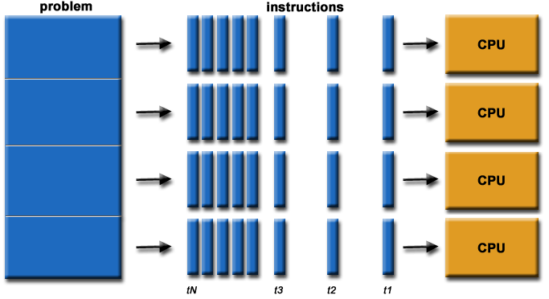
Parallel Monte Carlo Simulation
Traditional Monte Carlo simulations are computationally expensive, especially for large portfolios with many assets.
To address this challenge, Parallel processing can be leveraged using the Joblib library from Python, significantly reducing the computational cost.
This involves dividing the simulations into smaller tasks and running them simultaneously on multiple processors, enabling efficient exploration of the efficient frontier for large portfolios.

Slide 7
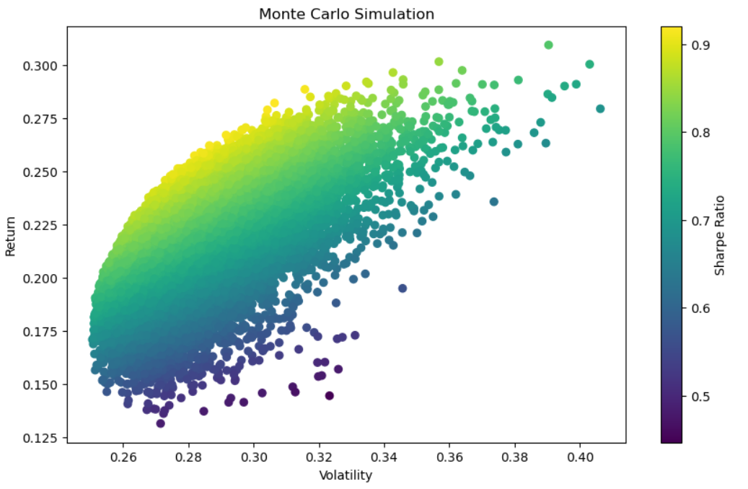
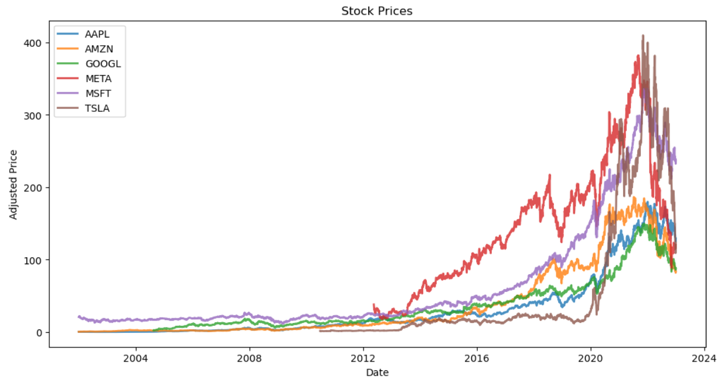
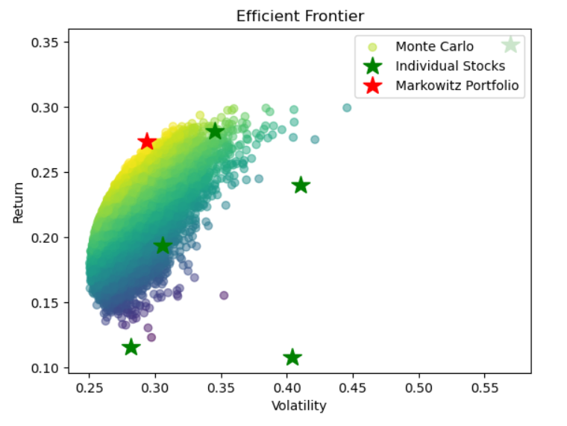
Visualizations

Slide 8
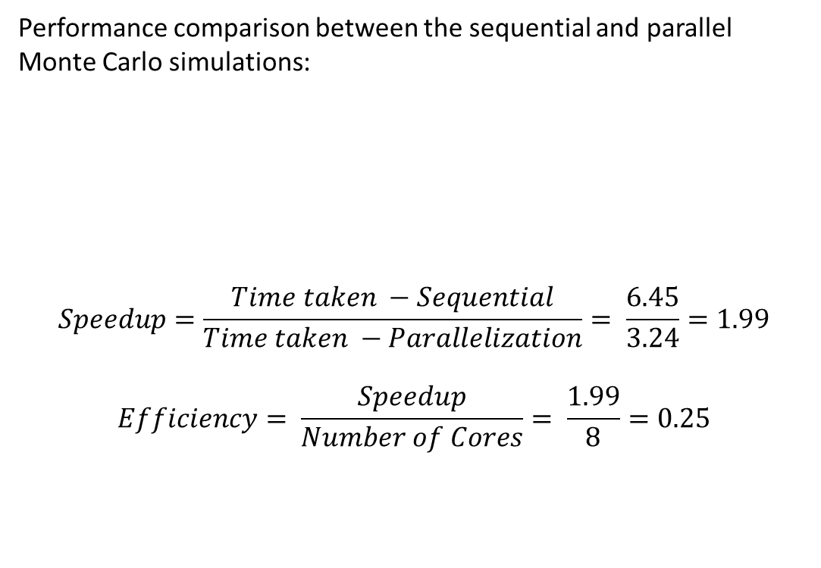
Sequential vs Parallelization
Performance comparison between the sequential and parallel Monte Carlo simulations:
$$Speedup=\frac{Time taken −Sequential}{Time taken −Parallelization}= \frac{6.45}{3.24}=1.99$$
$$Efficiency= \frac{Speedup}{Number of Cores}= \frac{1.99}{8}=0.25$$
Method | Execution time (in seconds)
Sequential | 6.45
Parallelization | 3.24

Slide 9

Potential Improvements
Advanced Simulation Techniques: Explore copula methods like Black-Litterman for enhanced realism in simulations, improving the modeling of dependencies between assets.
Risk Management Strategies: Implement dynamic portfolio adjustments using stop-loss orders to mitigate portfolio volatility in response to market fluctuations.
Real-Time Data Integration: Integrate real-time data feeds for up-to-date market insights, enabling dynamic adjustments in portfolio weights based on current market conditions.

Slide 10

Implications
Empowering Investment Decisions: Parallel Monte Carlo optimization equips investors with valuable insights into potential market scenarios, facilitating the identification of optimal portfolio strategies aligned with individual financial goals and risk tolerance.
Informed Decision-Making: Leveraging this approach ensures more data-driven investment decisions, integrating robust strategies derived from simulations into the investment process for increased effectiveness.

Slide 11
Conclusion
The study explores combining parallel Monte Carlo simulations with Markowitz portfolio optimization, offering a potent asset allocation strategy.
Parallelization accelerates analysis speed for extensive datasets and multiple assets, aiding in constructing diverse portfolios.
Recognizing limitations regarding the parameter’s sensitivity and historical data's predictability is crucial.
Integrating parallel computing with portfolio optimization enables sophisticated analysis, aiding decision-making amid diverse risk-return trade-offs.
Future research could refine simulations, explore alternative models, and leverage machine learning for adaptive risk management in dynamic markets.

Slide 12
References
[1] Yahoo! Finance. https://finance.yahoo.com/
[2] Shaw, W (2010). Monte Carlo Portfolio Optimization for General Investor Risk-Return Objectives and Arbitrary Return Distributions: A Solution for Long-Only Portfolios
[3] Nomad. (2023). Portfolio Optimization with Monte Carlo Simulation: Maximizing Returns and Minimizing Risk. https://medium.com/coinmonks/portfolio-optimization-with-monte-carlo-simulation-maximizing-returns-and-minimizing-risk-2f106feaa44d
[4] Kommadi, B. (2019). Massively Parallel Monte Carlo Simulation. https://medium.com/@thisismetis/what-is-a-monte-carlo-simulation-part-1-32c01b48cc49
[5] Virines, F., & Trumper, M. (2021). Improving Monte Carlo Simulations for Portfolio Risk Analysis.
[6] Dospatliev, L., & Ivanova, I. (2018). APPLICATION OF MARKOWITZ PORTFOLIO OPTIMIZATION ON THE BULGARIAN STOCK EXCHANGE. International Research Journal of Finance and Economics, 32(1), 131-137.
[7] Torris, L. (2023). Portfolio Optimization: The Markowitz Mean-Variance Model. https://medium.com/latinxinai/portfolio-optimization-the-markowitz-mean-variance-model-c07a80056b8a
[8] Kulali, I. (2016). Portfolio Optimization Analysis with Markowitz Quadratic Mean-Variance Model
[9] Quantpedia. (n.d.). Case Study - Markowitz Portfolio Optimization. https://quantpedia.com/case-study-markowitz-portfolio-optimization/
[10] Zhu, L., & Li, J. (2018). Portfolio Optimization with Transaction Costs and Estimation Risk. Journal of Banking & Finance, 94, 148-166.

Slide 13


