Slide 1

  UrbanGuardian AI- Smart Citizen Grievence Detection with Kafka Based Resolution and Automated Escalation
SOA Project Review-1
20 August 2026
Team Members : T. Dhanya Sri 2420030338 N. Veda Samhita 2420030468 Bhagyalaxmi Murude 2420030700
 | Under the Guidance of Dr.Neelima Gogineni SOA Professor, Department of Computer Science and Engineering, KLH CSE Bowrampet Campus

Slide 2

Outline of Project Work
Focus
Introduction
Literature Survey
Challenges
Research Objectives
Conclusion & Future Work
References
Publications Details

Slide 3
Problem Statement
Citizen grievances related to roads, garbage, streetlights, drainage, water supply, and other civic issues are often difficult to report, track, and resolve efficiently. Citizens may face delays in receiving responses, limited visibility into complaint status, and difficulties in identifying the appropriate department for their concerns.
At the administrative level, complaints may pass through multiple departments, creating communication gaps, repeated manual follow-ups, and delays in taking appropriate action. Traditional grievance handling methods rely heavily on manual classification, department assignment, status updates, and monitoring, which can lead to unresolved complaints, inefficient resource utilization, and reduced transparency. As the number and variety of civic complaints increase, there is a need for a more intelligent and coordinated approach that can understand complaints, route them appropriately, monitor their progress, and ensure timely action.
Problem:
The absence of an intelligent and centralized grievance management system makes it difficult to understand unstructured complaints, identify the correct department, coordinate resolution, track complaint status, and ensure timely escalation. This results in delays, communication gaps, and unresolved civic issues, reducing the efficiency and responsiveness of public grievance management.

Slide 4
Focus
The core focus of UrbanGuardian AI is to intelligently understand citizen grievances, route them to the appropriate department, and ensure timely resolution through automated monitoring and escalation.
The project mainly focuses on:
AI-Based Grievance Understanding – Citizens describe their civic issues in natural language, and the AI identifies the type, category, and priority of the grievance.
Smart Grievance Routing – Automatically route complaints to the appropriate department or service based on the detected grievance category and priority.
Automated Resolution Coordination – Coordinate complaint assignment, department responses, status updates, and resolution activities through interconnected services.
Real-Time Event Processing – Use Apache Kafka to handle grievance events, notifications, status changes, and inter-service communication efficiently.
Automated Escalation – Monitor unresolved complaints and automatically escalate them to higher authorities when the defined resolution time is exceeded.
End-to-End Grievance Flow – Manage the complete flow from
grievance submission → AI analysis → department routing → resolution → status tracking → automated escalation.

Slide 5
Introduction
UrbanGuardian AI is an intelligent smart-civic grievance detection and resolution platform designed to make the process of reporting, managing, and resolving citizen complaints more efficient and transparent. Citizens can describe civic issues such as garbage accumulation, road damage, streetlight failures, drainage problems, water supply issues, and other public-service concerns through a simple interface.
The system uses AI and LLM-based analysis to understand the citizen's complaint, identify the grievance category and priority, and route it to the appropriate department. This reduces manual classification and helps ensure that complaints reach the correct authority quickly.
The project mainly includes:
AI-Based Grievance Detection – Understands complaints written in natural language and identifies their category and priority.
Smart Department Routing – Automatically forwards grievances to the appropriate department or service.
Apache Kafka – Enables real-time event-driven communication for complaint creation, assignment, updates, notifications, and escalation.
Spring Boot & Spring Cloud – Provides a modular, scalable, and service-oriented backend architecture.
React.js – Provides an interactive interface for citizens and authorities to submit, manage, and track grievances.
PostgreSQL – Securely stores citizen details, complaints, departments, status information, and resolution records.
Spring Security with JWT – Provides secure authentication and role-based authorization for citizens, staff, and administrators.
Automated Escalation – Automatically escalates unresolved complaints to higher authorities when the defined resolution time is exceeded.
Docker – Containerizes application services for consistent and simplified deployment.

Slide 6
Literature Survey
Authors | Title of the Paper | Methodology | Inferences | Limitation/Future work
Kim & Hong (2021) | Automatic Classification of Citizen Requests for Transportation Using Deep Learning: Case Study from Boston City | •Uses deep learning for automatic classification of citizen requests • Applies text preprocessing and classification techniques • Addresses large volumes of unstructured citizen complaints | • Automatic classification can reduce manual effort • Helps improve complaint handling and reduce misclassification • Deep learning is effective for categorizing citizen requests | •Focusesmainlyon transportation-related requests• Does not provide complete end-to-end grievance resolution• Does not address real-time event-driven processing or automated escalation
Shama et al. (2024) | CitySolution: A Complaining Task Distributive Mobile Application for Smart City Corporation Using Deep Learning | • Provides citizen and authority applications • Uses deep learning for automatic complaint categorization • Allows authorities to monitor complaint location and status | • Automated categorization improves complaint management • Status monitoring improves transparency • Digital platforms can improve smart-city complaint handling | • Primarily focuses on complaint reporting and categorization• Limited automated coordination between services• Does not implement Kafka-based real-time event processing or automated escalation
Suganthi et al. (2026) | AI Based Smart Civic Complaint Management System | • Uses AI, ML, NLP, and image processing • Accepts text, image, and location-based complaints • Automates complaint analysis and management | • AI can reduce manual complaint processing • Multimodal analysis can improve identification of civic issues • Supports faster and more efficient grievance handling | • Focuses mainly on AI-based complaint management• Does not specifically address service-oriented microservices• Real-time event streaming and automated escalation can be further explored

Slide 7
Challenges
Citizen grievance handling is often fragmented, making it difficult for citizens to report civic problems, identify the responsible department, receive timely updates, and ensure that complaints are resolved. Issues such as damaged roads, overflowing garbage, broken streetlights, drainage problems, and water-supply concerns may involve multiple departments, leading to delays and communication gaps.
The primary challenges addressed by UrbanGuardian AI are:
Understanding Unstructured Complaints – Citizens may describe the same civic issue differently, making manual classification and understanding difficult.
Correct Department Routing – Complaints need to be automatically directed to the appropriate department to avoid unnecessary forwarding and delays.
Communication Gaps – Coordination between departments and system services can be difficult when complaint updates are handled manually.
Real-Time Complaint Tracking – Citizens need clear visibility into whether their complaint is received, assigned, being processed, or resolved.
Delayed Resolution & Escalation – Unresolved complaints may remain unnoticed without continuous monitoring and automatic escalation when deadlines are exceeded.

Slide 8
Objectives
Intelligent Grievance Detection – Understand citizen complaints using AI and LLM-based analysis and identify the relevant civic issue.
Automatic Complaint Classification – Categorize grievances such as roads, garbage, streetlights, drainage, water supply, and other civic services based on the complaint description.
Smart Department Routing – Automatically route each grievance to the appropriate department or authority, reducing manual intervention and unnecessary delays.
Real-Time Event Processing – Use Apache Kafka to process complaint creation, assignment, status updates, notifications, and escalation events in real time.
Automated Escalation – Monitor unresolved complaints and automatically escalate them to higher authorities when the defined resolution time is exceeded.
Scalable SOA Architecture – Develop independent and scalable services using Spring Boot and Spring Cloud to support efficient service-to-service communication.
Secure User Access – Implement Spring Security and JWT for secure authentication, authorization, and role-based access for citizens and authorities.
Efficient Data Management – Use PostgreSQL to securely store citizen details, grievances, departments, complaint status, and resolution records.
User-Friendly Grievance Tracking – Provide a responsive React.js interface that allows citizens to submit complaints and track their progress easily.
Improve Accountability and Resolution – Reduce manual effort and communication gaps while ensuring that every grievance is tracked, acted upon, and escalated when necessary.

Slide 9
Conclusion & Future Work
UrbanGuardian AI provides a smart and service-oriented approach to civic grievance management by combining AI-based grievance detection, Kafka-driven real-time communication, and automated escalation. The system reduces manual intervention, intelligently routes complaints to the appropriate departments, and keeps citizens informed throughout the resolution process. By using Spring Boot, Spring Cloud, Apache Kafka, React.js, PostgreSQL, and secure JWT authentication, the platform offers a scalable, responsive, and reliable architecture for modern smart-city services.
Overall, UrbanGuardian AI aims to transform grievance handling from a manual, fragmented process into an intelligent, transparent, and accountable resolution workflow.
FUTURE WORK
Multimodal Grievance Detection – Accept images, voice, and text to identify civic issues more accurately.
Predictive Complaint Analysis – Predict recurring or high-risk civic issues and help authorities take preventive action.
AI-Based Priority Scoring – Dynamically determine complaint urgency based on severity, location, impact, and citizen reports.
Smart SLA Prediction – Use historical data to estimate resolution time and improve escalation decisions.
Geospatial Intelligence – Use maps and location data to identify complaint hotspots and recurring problem areas.
AI Citizen Assistant – Introduce a conversational AI assistant that can guide citizens while reporting and tracking grievances.
Advanced Analytics Dashboard – Provide authorities with insights into department performance, resolution trends, recurring issues, and escalation rates.
Scalable Cloud Deployment – Extend the system with cloud-native deployment and orchestration for handling large-scale city-wide grievance traffic.

Slide 10
References
Spring Cloud Documentation. Spring Cloud Reference Documentation. Spring Cloud Documentation
Spring AI Documentation. Spring AI Reference Documentation. Spring AI Documentation
Apache Kafka Documentation. Apache Kafka Documentation. Apache Kafka Documentation
React Documentation. React – The Library for Web and Native User Interfaces. React Documentation
PostgreSQL Documentation. PostgreSQL Official Documentation. PostgreSQL Documentation
Spring Security Documentation. Spring Security Reference. Spring Security Documentation
Docker Documentation. Docker Documentation. Docker Documentation
OpenAI. API Documentation. OpenAI API Documentation
Richardson, C. Microservices Patterns: With Examples in Java. Manning Publications, 2018.
Spring Boot Documentation. Spring Boot Reference Documentation. Spring Boot Documentation
Kleppmann, M. Designing Data-Intensive Applications. O’Reilly Media, 2017.

Slide 11
Publication Details
Newman, S. (2021). Building Microservices: Designing Fine-Grained Systems. 2nd Edition. O'Reilly Media. ISBN: 978-1492034018.
Richardson, C. (2018). Microservices Patterns: With Examples in Java. Manning Publications. ISBN: 978-1617294549.
Walls, C. (2018). Spring in Action. 5th Edition. Manning Publications. ISBN: 978-1617294945.
Narkhede, N., Shapira, G., & Palino, T. (2017). Kafka: The Definitive Guide. O'Reilly Media. ISBN: 978-1491936160.
Spilca, L. (2024). Spring Security in Action. 2nd Edition. Manning Publications. ISBN: 978-1633437975.
Kleppmann, M. (2017). Designing Data-Intensive Applications. O'Reilly Media. ISBN: 978-1449373320.
These six map very well to your project: Microservices → Spring Boot → Kafka → Security → Distributed data → scalable architecture. Your Spring AI/LLM component can additionally be supported by the official Spring AI documentation.

Slide 12
Problem Gap Identification
Problem:
Existing civic grievance systems often rely on manual classification, department assignment, follow-ups, and status updates, causing misrouting, delayed resolution, poor prioritization, and limited transparency.
Gap:
There is a lack of an integrated platform that combines AI/LLM-based complaint understanding, priority detection, automatic department routing, real-time event processing, secure role-based access, and automated escalation.
Proposed
Solution:
UrbanGuardian AI bridges this gap by providing an intelligent, event-driven grievance lifecycle—from complaint submission → AI analysis → department routing → real-time updates → SLA monitoring → escalation → resolution.
UrbanGuardian AI addresses these gaps by integrating AI/LLM-based grievance understanding, automatic category and priority detection, smart department routing, real-time event processing through Apache Kafka, secure JWT-based role authorization, complaint tracking, and automated escalation within a scalable Spring Boot and Spring Cloud architecture. The platform provides a unified workflow from complaint submission to final resolution, improving routing accuracy, response coordination, transparency, and accountability.

Slide 13
Innovation, Creativity, and Novelty
UrbanGuardian AI introduces an intelligent, real-time approach to civic grievance resolution by combining LLM-based complaint understanding with event-driven automation. Unlike traditional complaint portals, citizens can describe issues naturally, while AI identifies the grievance category, priority, and responsible department. The system then uses Apache Kafka to trigger real-time assignment, notifications, status updates, and escalation. Its unique AI-to-Action pipeline connects complaint analysis directly to resolution workflows, while SLA-based automatic escalation ensures overdue or high-priority complaints receive timely attention.
Key Novel Features:
LLM-Based Grievance Understanding – Understands complaints in natural language.
AI Priority & Department Detection – Automatically determines urgency and responsible department.
Real-Time Kafka Events – Handles assignment, updates, notifications, and escalation.
SLA-Based Auto Escalation – Escalates unresolved complaints automatically.
End-to-End Grievance Lifecycle – Complaint → AI Analysis → Routing → Tracking → Escalation → Resolution.
Secure Role-Based Access – Separate access for citizens, staff, and administrators.
Scalable Microservices Architecture – Spring Boot & Spring Cloud enable independent service scaling.

Slide 14
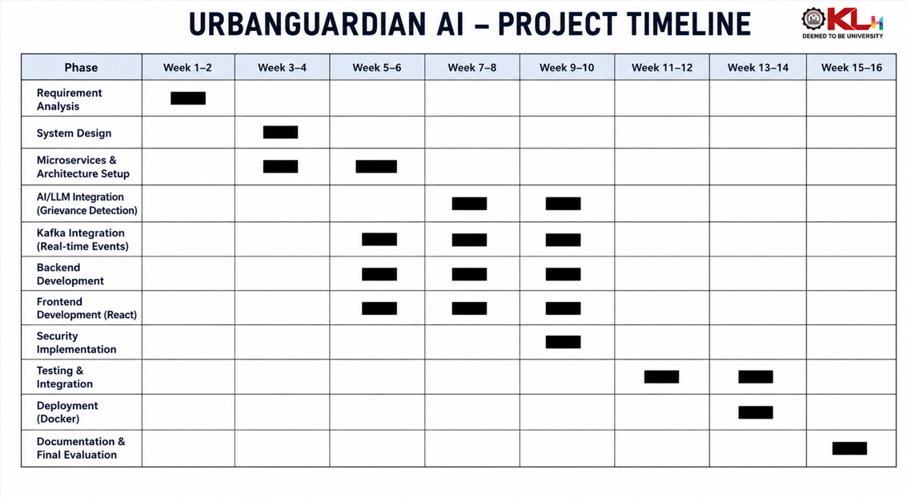
Feasibility and Project Plan

