Slide 1

  UrbanGuardian AI- Smart Citizen Grievence Detection with Kafka Based Resolution and Automated Escalation
SOA Project Review-2
 | Under the Guidance of Dr. NEELIMA GOGINENI Assistant Professor, Department of Computer Science and Engineering, KLH CSE Bowrampet Campus
Team Members T.Dhanya Sri - 24200300338 N.Veda Samhita – 2420030468 Bhagyalaxmi - 2420030700

Slide 2
Project Design
UrbanGuardian AI is designed as a modular, service-oriented and event-driven platform in which individual citizen grievance management functions are implemented as independent microservices.
1. Presentation Layer
Citizen grievance submission interface
Complaint tracking dashboard
Authority/Admin dashboard
Complaint status, priority and progress visualization
2. Application & Intelligence Layer
API Gateway
Authentication & role-based access
Complaint Management Microservice
→ AI-based grievance classification and priority detection
Intelligent department routing
Automated escalation and notification services
Analytics and monitoring services
3. Data & Communication Layer
PostgreSQL databases
REST APIs for service communication
Apache Kafka for real-time event streaming ,Event-driven complaint updates and notifications
Design Goal: To create a scalable, loosely coupled and intelligent grievance-resolution platform where services can be developed, managed while AI and Kafka enable automated classification, routing, real-time updates and escalation.
Notes:
The design consists of three main layers.
The first is the Presentation Layer, which includes the citizen complaint submission interface, complaint tracking dashboard, and authority dashboard.
The second is the Application and Intelligence Layer, which contains the API Gateway, authentication, complaint management, AI-based grievance classification, priority detection, department routing, and automated escalation.
The third is the Data and Communication Layer, which includes PostgreSQL databases, REST APIs, and Apache Kafka for real-time event streaming.

Slide 3
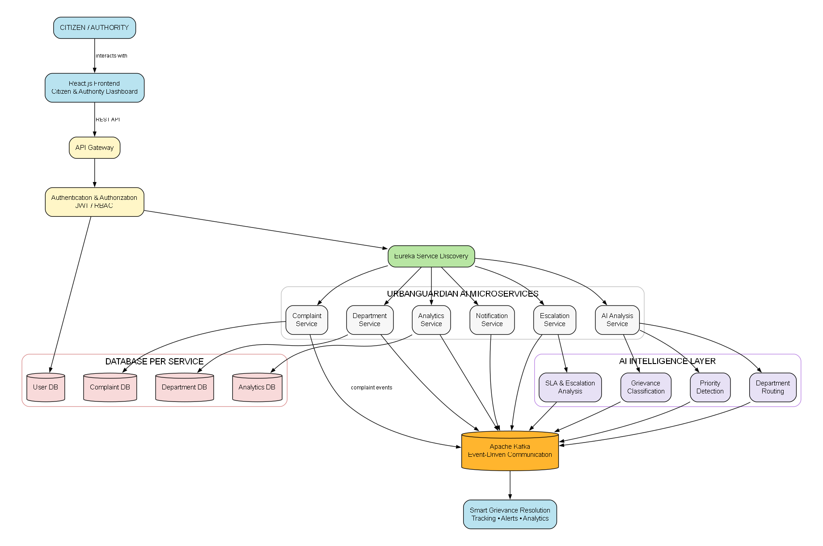
System Architecture
Notes:
Citizens use the frontend to submit complaints and track their progress.
Requests pass through the API Gateway to the Complaint Service, where AI identifies the complaint’s category and priority.
The Department Service then routes it to the appropriate authority. REST APIs handle immediate communication, while Kafka manages updates, notifications, and escalations.

Slide 4
Component Design
Component | Responsibility
Frontend | Citizen complaint submission, tracking, and dashboards
API Gateway | Central entry point for all service requests
Authentication Service | Manages users, login, roles, and secure access
Complaint Service | Handles complaint creation, tracking, status, and lifecycle
AI Analysis Service | Classifies grievances and determines category and priority
Department Service | Routes complaints to the appropriate department
Notification Service | Sends complaint updates, alerts, and escalation notifications
Analytics Service | Provides grievance statistics and performance insights
Eureka Server | Provides service discovery for microservices
Apache Kafka | Handles asynchronous complaint events and real-time communication
Database - PostgreSQL | Stores service-specific application data

Slide 5
Development Methodology
Methodology Characteristics : -
Modular Development —
Each microservice is developed and maintained independently.
Incremental Integration —
Services are integrated and tested progressively.
API-First Communication —
REST APIs provide structured communication between services.
AI-Driven Processing —
AI is used for grievance classification, priority detection, and intelligent routing.
Event-Driven Processing —
Kafka supports asynchronous complaint events, updates, notifications, and escalation.
Requirement Analysis
↓
System Design
↓
Service Decomposition
↓
API Development
↓
AI Analysis Development
↓
Kafka Event Integration
↓
Service Integration
↓
Testing & Validation
↓
System Refinement
Notes:
This slide explains our methodology and how the system is developed step by step.
We follow modular development, where each microservice is built independently. Through incremental integration, services are progressively combined and tested.
REST APIs enable structured communication, while AI handles grievance classification, priority detection, and routing. Kafka supports event-driven tasks such as updates, notifications, and escalation.
The development process begins with requirement analysis and system design, followed by service decomposition, API and AI development, Kafka integration, testing, and finally system refinement.”

Slide 6
System Execution Workflow
Citizen Registration / Login
↓
Complaint Submission
↓
AI Grievance Analysis
↓
Category & Priority Detection
↓
Department Identification
↓
Automatic Complaint Routing
↓
Complaint Processing
↓
Real-Time Status Updates
↓
SLA Monitoring
↓
Automatic Escalation (if delayed)
↓
Resolution & Citizen Notification
↓
Analytics & Performance Monitoring
Notes:
First, the citizen registers and submits a complaint. AI analyzes it to identify its category and priority, after which the complaint is automatically routed to the appropriate department.
The department processes the complaint, while the citizen receives real-time status updates. SLA monitoring tracks delays, and if a complaint is not resolved on time, it is automatically escalated.
Finally, the complaint is resolved, the citizen is notified, and the collected data is used for analytics and performance monitoring.”

Slide 7
Service Communication Methodology
Synchronous Communication
REST APIs
Request-response interaction between services
Used when an immediate response is required
Used for complaint submission, tracking, AI analysis, authentication, and data retrieval
Asynchronous Communication
Apache Kafka
Event-driven communication between microservices
Used for background processing and loose coupling
Handles complaint creation, assignment, status updates, notifications, and escalation events
Enables real-time service coordination
Notes:
“This slide explains the two communication methods used in our system.
REST APIs provide synchronous communication, where services send a request and receive an immediate response. They are used for tasks like complaint submission, tracking, authentication, and AI analysis.
Apache Kafka enables asynchronous, event-driven communication. It handles background events such as complaint assignment, status updates, notifications, and escalation. This keeps services loosely coupled and allows them to coordinate in real time.”

Slide 8
Technology Stack & Implementation
Technology Stack
Frontend
React.js
HTML
CSS
JavaScript
Backend
Spring Tool Suite (STS)
Maven
Java 21
Spring Boot
REST APIs
Architecture
Spring Cloud
API Gateway
Eureka Service Discovery
Independent Microservices
AI
Spring AI
Grievance Classification
Priority Detection
Messaging
Apache Kafka , Event-driven communication
Database
PostgreSQL
Security
Spring Security
JWT Authentication
Development & Deployment
Maven
Git & GitHub

Slide 9
Technical Validation & Testing
Test Area | Validation
API Testing | Verify request and response correctness
Service Testing | Validate individual microservices and their functionality
Database Testing | Verify complaint data storage, updates and retrieval
Integration Testing | Verify communication between Gateway, Complaint and AI services
AI Analysis Testing | Validate grievance category, priority and department identification
Service Discovery Testing | Ensure microservices register and communicate through Eureka
Gateway Testing | Verify requests are correctly routed to appropriate services
Error Handling | Check handling of invalid requests and service failures

Slide 10
Thank You

