Slide 1


Customer Segmentation using clustering
Presented by Jinka Veda Sree
Batch: AI & ML
(Jan 2026- Mar 2026)

Slide 2

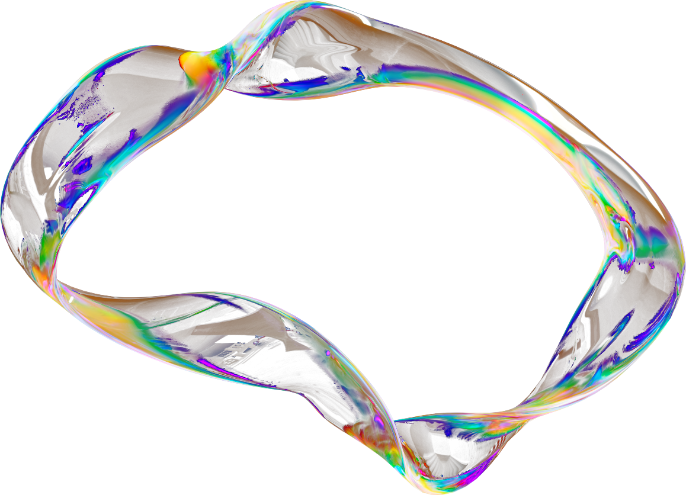

01
Origin of the creative idea
The idea originated from the need to understand customer behavior and purchasing patterns in modern businesses
02
“The idea for this project came from real-world business challenges where companies don’t fully understand their customers. I wanted to use machine learning to segment customers and help businesses make better decisions.”
Many companies struggle to identify valuable customers and target them effectively
Inspired by real-world applications of data analytics in retail and marketing
03
The concept of customer segmentation using machine learning provided a data-driven solution
Aim was to convert raw customer data into actionable business insights

Slide 3
01.
Develop a data-driven system to understand customer behavior
Project vision and mission
02.
Apply clustering techniques to segment customers effectively
“The vision of my project is to help businesses understand their customers using data-driven techniques. The mission is to apply clustering algorithms to segment customers and generate insights that improve marketing and decision-making.”
03.
Enable better business decisions through actionable insights

Slide 4
01
Inspiration & creativity
Inspired by the need to understand customer behavior in real-world businesses
02
The inspiration for this project came from the growing importance of data-driven decision-making in modern businesses. Many organizations struggle to understand customer behavior effectively, which impacts their marketing and retention strategies. This project creatively applies machine learning techniques, particularly clustering, to transform raw customer data into meaningful insights, helping businesses make smarter and more strategic decisions.
Converted raw data into actionable insights for business growth
03
Applied machine learning (clustering) in a creative way to solve the problem

Slide 5
Ideation Process
01
02
03
04
Problem Identification
Identified the challenge of understanding customer behavior and segmentation
Research & Analysis
Studied existing solutions like clustering and customer analytics techniques
Solution Design
Planned to use machine learning (K-Means, etc.) for customer segmentation
Implementation & Refinement
Applied algorithms, evaluated results, and improved model performance

Slide 6
Creation Process
The creation of this project followed a structured machine learning workflow. It began with collecting and understanding the dataset, followed by thorough data preprocessing to handle missing values, remove outliers, and scale features. Exploratory Data Analysis (EDA) was performed to identify patterns and relationships in the data. Feature engineering techniques, including RFM analysis, were applied to enhance the dataset. Multiple clustering algorithms such as K-Means, Hierarchical Clustering, DBSCAN, and Gaussian Mixture Models were implemented and evaluated using metrics like the Elbow Method and Silhouette Score. Finally, Principal Component Analysis (PCA) was used for visualization, and meaningful customer segments were identified to derive business insights and recommendations.

Slide 7

01.
📊 1. Data Collection
Collected customer dataset from reliable source
Data includes income, age, and spending score
Ensured dataset is relevant to business problem
Verified data structure and format
Checked for completeness of records
Prepared dataset for further processing
04.
⚙️ 4. Feature Engineering
Created new meaningful features
Applied RFM (Recency, Frequency, Monetary)
Improved data quality and representation
Reduced irrelevant or redundant features
Enhanced model performance
Prepared optimized dataset
Mind Map
02.
2. Data Preprocessing
Handled missing or null values
Removed outliers using statistical methods
Converted categorical data into numerical form
Applied feature scaling for uniformity
Cleaned inconsistent and noisy data
Prepared dataset for model input
05.
🤖 5. Clustering Models
Applied K-Means clustering algorithm
Tested Hierarchical clustering
Used DBSCAN for density-based clustering
Applied Gaussian Mixture Models (GMM)
Compared performance of models
Selected best model based on metrics
03.
📈 3. Exploratory Data Analysis (EDA)
Visualized data using graphs and plots
Analyzed distribution of features
Studied relationships between variables
Identified patterns and trends
Detected anomalies and clusters
Gained insights before modeling
06.
💡 6. Insights & Recommendations
Identified different customer segments
Analyzed behavior of each cluster
Derived business insights from results
Suggested targeted marketing strategies
Improved customer retention ideas
Provided data-driven recommendations

Slide 8
Weaknesses
Threats
The model relies on limited features such as income and spending score, which may not capture the full complexity of customer behavior. It also depends on data quality, and any noise or missing data can affect performance. Additionally, clustering results may vary based on parameter selection.
Changes in customer behavior over time may reduce the effectiveness of the model. Competitors using more advanced analytics tools may gain better insights. Data privacy and security concerns can also limit access to customer data, affecting model performance.
Strengths
Opportunities
The project effectively uses machine learning techniques to segment customers based on their behavior. It provides clear and actionable insights that can help businesses improve marketing strategies, customer retention, and decision-making. The model is simple, interpretable, and scalable for real-world applications.
The project can be expanded by incorporating more data sources such as customer feedback, online activity, and transaction history. It can also be integrated with real-time systems and deployed as a business tool. Advanced techniques like deep learning can further improve segmentation accuracy.

Slide 9
Final reflections & future steps
This project provided valuable insights into the practical application of machine learning techniques for solving real-world business problems. It helped in understanding the complete data science workflow, from data preprocessing to model building and interpretation of results. The use of clustering algorithms enabled the identification of meaningful customer segments, highlighting the importance of data-driven decision-making. Through this project, strong analytical and problem-solving skills were developed. As a future step, the model can be enhanced by incorporating more diverse and real-time data, applying advanced techniques such as deep learning, and deploying the solution as a scalable application with interactive dashboards for business use.

Slide 10

The End

