Slide 1
LAB5: Fast and Reliable File Transfer
Team members:
Veda Shyam Kadam (vedashyk@usc.edu)
Sukruth Lokesh Babu (slbabu@usc.edu)

Slide 2
Goals of Lab:
Reliable file transfer
File size 1GB
Error free
Work on 100Mbps link with 200ms delay and 20% loss
Throughput achieved should be greater than 20Mbps
Check file authenticity using md5

Slide 3
Sender Side:
Steps:
Creating a 1GB file
Adding delay 200ms and loss 20% using netem
Making link to 100Mbps using ethtool
Running client file with 1GB file name as argument

Slide 4
Working: Sender
Sender creates multiple threads for sending data on different ports
We first create UDP and TCP sockets. UDP sockets are used for file transfer and TCP sockets are used for NACKS(negative acknowledgement)
We send the file by dividing and sequencing the whole 1GB file in a packet structure with DATA and PAYLOAD fields using UDP
We wait for a COUNT packet on TCP socket which tells us how many packets were lost
Then we wait for NACKs equal to COUNT number on TCP socket
As we receive NACK for a particular sequence number, we immediately send data of that sequence using UDP
This process is iterated until the COUNT received is 0

Slide 5
Working: Receiver
Receiver also creates multiple threads for sending data on different ports
We first create UDP and TCP sockets. UDP sockets are used for file reception and TCP sockets are used for NACKS(negative acknowledgement)
We receive the file on packet basis in the same packet structure with DATA and PAYLOAD fields defined at sender using UDP
We check which all sequence numbers are missing and send a COUNT to sender
Then we send for NACKs equal to COUNT number on TCP socket
We wait for UDP packets of those missing sequence numbers
This process is iterated until the COUNT received is 0

Slide 6
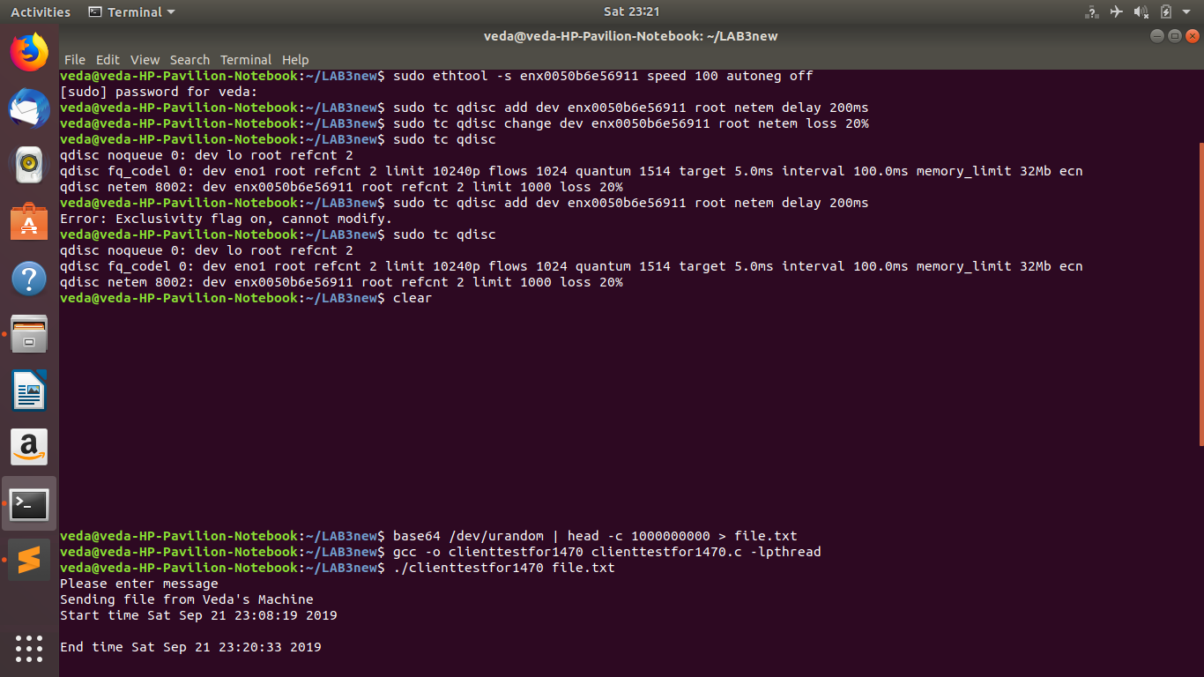
Sender Side screenshot

Slide 7
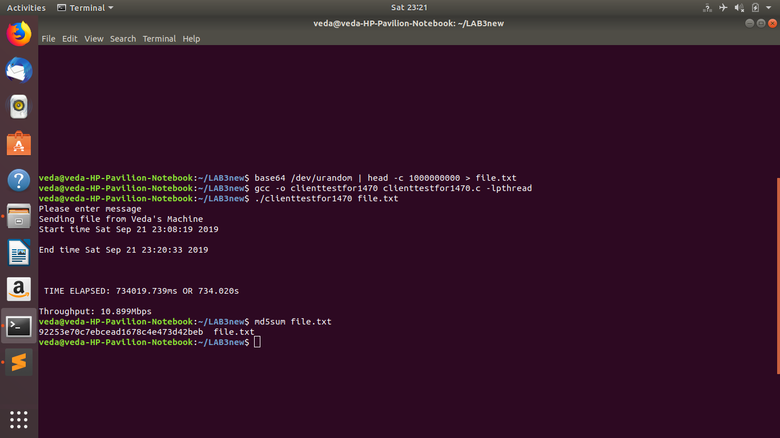
Sender Side screenshot

Slide 8
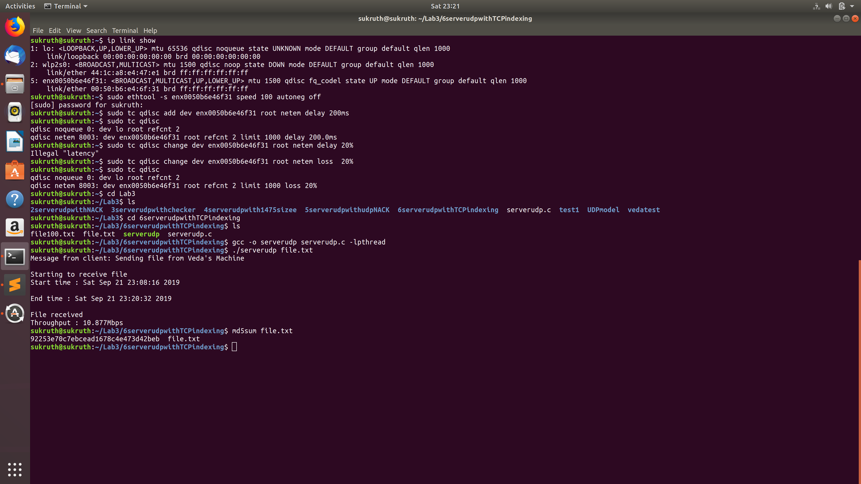
Receiver screenshot

