Slide 1


Department of Information Technology V R Siddhartha Engineering College
Mobile-Based AI System for Lung Disease Diagnosis
Deep learning
B.Tech in Information Technology
Major Project Review Presentation
PRESENTED BY
Ms. Veda Sameera Jalasutram(228W1A1263)
Ms. Chandi priya Kethavath(228W1A1227)
Under the guidance of
Dr. Y.SANDEEP,
ASSISTANT PROFESSOR

Slide 2
AGENDA:
Introduction
Problem Statement
Objectives & Outcomes of the project
Literature Survey
Datasets and Requirements specifications
Algorithms involved
Architecture diagram
Complete Results Obtained
Result Analysis & Observations
Conclusion & Future Work
References

Slide 3
INTRODUCTION
The rapid advancement of artificial intelligence and deep learning has opened new possibilities in medical image analysis for diagnosing lung diseases. Lung diseases such as Pneumonia, Tuberculosis are among the leading causes of mortality worldwide, requiring timely and accurate diagnosis. Traditional diagnosis methods rely on radiologists to manually analyze chest X-rays, which is time-consuming and prone to human error. This project presents a Mobile-Based AI System using MobileNetV2 with CBAM attention mechanism to automatically classify chest X-ray images into five lung disease categories and generate AI-powered medical reports through an Android application.

Slide 4
PROBLEM STATEMENT
Accurate interpretation of chest X-ray images requires skilled radiologists who are often unavailable in rural and resource-limited areas. The growing number of lung disease cases globally demands automated, fast, and reliable diagnostic systems. Existing solutions lack mobile accessibility, support limited disease categories, and do not provide comprehensive medical reports. Therefore, there is a strong need for an intelligent mobile-based system that can automatically classify multiple lung diseases from chest X-rays and generate meaningful medical reports to assist patients and healthcare professionals in making timely decisions.

Slide 5
OBJECTIVES | OUTCOMES
To develop a lung disease detection system using MobileNetV2. | The system successfully predicts lung diseases with good accuracy.
To accurately classify diseases from chest X-ray images. | Users receive instant results through the mobile application.
To design a mobile application for easy image upload and result display. | Automated reports provide basic diagnostic information and guidance.
To generate automated medical reports based on prediction results. | The solution improves accessibility to early disease detection.

Slide 6
LITERATURE REVIEW
S.NO | TITLE | TYPE | ALGORITHMS USED | RESULTS | LIMITATIONS
1. | Advancing Chest X-ray Diagnostics: A Novel CycleGAN-Based Preprocessing Approach for Enhanced Lung Disease Classification | Journal Paper (Elsevier) | K-Means, CycleGAN, DenseNet-121, CBAM. | Achieved 83.87% AUC accuracy using clustering + CycleGAN + CBAM with clinical features. | Requires high computation and complex preprocessing (CycleGAN + clustering).
2. | Deep Learning for Lung Disease Classification Using Transfer Learning and a Customized CNN Architecture with Attention | ICARC -Conference paper(IEEE) | Transfer learning with SqueezeNet, VGG11, ResNet18, DenseNet, and MobileNetV2. | The model achieved an accuracy of 93.3% on classification. | May overfit and depends heavily on large labeled datasets.
3. | AI-Assisted Severity Assessment of COVID-19 from Chest X-rays Using Explainable Deep Learning Models. | BIBM-conference paper(IEEE) | DenseNet121, Explainable AI techniques (Grad-CAM) | The AI-assisted model achieved 92% accuracy in classifying chest X-rays. | Limited generalization to diseases other than COVID-19.
4. | Lung Cancer Detection Using Deep Learning and Explainable Artificial Intelligence Models | ICICS-Conference paper(IEEE) | (InceptionV3, ResNet50), XAI techniques ( LIME, Grad-CAM) | The model achieved an accuracy of 97.43% in lung cancer detection. | Explainable AI methods increase complexity and slow down the model.
5. | Unified Synergistic Deep Learning Framework for Multimodal 2-D and 3-D Imaging Data in Lung Infection Detection | Journal paper(IEEE Journal) | Synergistic Deep Learning Framework integrating 2-D and 3-D CNNs. | The multimodal achieved an AUC of 89.7% for lung infection detection. | Needs multiple data types (2D & 3D), which are not always available.

Slide 7
LITERATURE SUMMARY
Existing research shows that deep learning models like DenseNet, ResNet, MobileNet, and CNNs provide high accuracy in lung disease classification.
CycleGAN-based preprocessing and clustering techniques improve image quality by removing noise and artifacts.
Attention mechanisms such as CBAM help the model focus on important regions in X-ray images.
Explainable AI techniques like Grad-CAM and LIME improve interpretability by highlighting affected areas.
However, most existing systems:
Focus on individual tasks like classification or preprocessing only
Require large labeled datasets and high computational resources
Have limited generalization across different diseases
Increase complexity when using explainable AI
Therefore: There is a need for an integrated system that combines preprocessing, deep learning, attention mechanisms, and AI for accurate and efficient lung disease diagnosis, which is addressed in our project.

Slide 8
DATASETS AND REQUIREMENTS
The dataset used in this project is collected from Kaggle and contains over 10,000 labeled lung images. It includes chest X-ray images categorized into multiple classes such as pneumonia, tuberculosis, COVID-19, and normal. The dataset is preprocessed and split into training, validation, and testing sets to ensure accurate model performance.
Software Requirements
Operating System: Windows 10/11 or Ubuntu 20.04
Programming Language: Python 3.8+, Java (Android)
Deep Learning Framework: TensorFlow 2.x / KerasIDE
Model Training: Google Colab / Jupyter Notebook
Mobile App: Android Studio
Libraries: OpenCV, NumPy, Scikit-learn, Matplotlib
Hardware Requirements
System with minimum 8GB RAM
Intel i5 processor or above
GPU ( for faster training)
Smartphone (Android/iOS) for mobile application

Slide 9
Algorithm Involved- MobileNetV2
Step 1: Input of X- ray image
Preprocessed chest X-ray image of size 224×224 is fed into the model.(original- 1365 x 1024)
Step 2: Initial Convolution
Extracts basic features like edges and textures from the X-ray.
Step 3: Depthwise Convolution & Pointwise Convolution
Apply one filter per channel for depthwise and combines all channels in pointwise.
Step 4: Inverted Residual Blocks
Expands, processes, and compresses features to retain key lung disease patterns.
Step 5: Linear Bottleneck
Prevents loss of important feature information during compression.
Step 6: CBAM Attention
Highlights relevant lung regions and suppresses unnecessary background areas.
Step 7: Global Average Pooling & Dense Layer
Converts features into a vector and learns high-level disease patterns.
Step 8: Output & Prediction — Softmax outputs probabilities for 5 classes and the highest one is the final predicted disease.

Slide 10
CBAM (Convolutional Block Attention Module)
Step 1: Input Feature Map — The output feature map from MobileNetV2 is passed as input to the CBAM block.
Step 2: Channel Attention Generation — Global Average Pooling and Global Max Pooling are applied on the feature map and passed through a shared Dense layer to learn channel importance.
Step 3: Channel Attention Output — Both outputs are added and passed through Sigmoid activation to generate channel weights, highlighting the most important feature channels.
Step 4: Spatial Attention Generation — Average and Max values are computed along the channel axis, concatenated, and passed through a Convolution layer to capture spatial information.
Step 5: Spatial Attention Output — Sigmoid activation generates spatial weights that focus on the most diagnostically relevant lung regions in the feature map.
Step 6: Final Refined Output — The feature map is multiplied with both channel and spatial attention weights and the final refined map is passed to classification layers for lung disease prediction.

Slide 11
K-MEANS
1. Load and Preprocess Images
X-ray scan images are loaded, resized to 224×224, and converted to grayscale.
Histogram equalization is applied to enhance image quality.
2. Extract Features
HOG is used to extract texture and edge features.
Images are converted into numerical feature vectors.
3. Apply K-Means (K = 2)
K-Means clustering is applied with K = 2.
Images are grouped into 2 clusters based on similarity.
4. Assign Cluster Labels
Each image gets a cluster label (0, 1).
These labels represent similar lung patterns.
5. Interpret Clustered Patterns
Analyze grouped images to understand feature similarities
Use clustering insights to support further model development

Slide 12
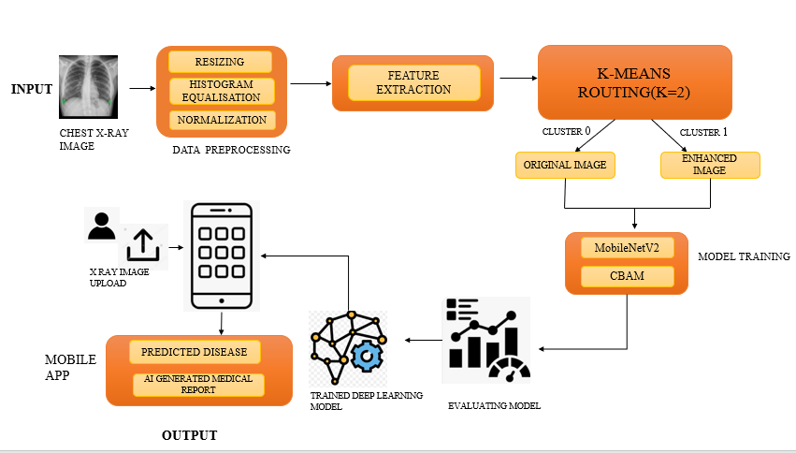
ARCHITECTURE DIAGRAM
Normal
Abnormal

Slide 13
IMPLEMENTATION STEPS
1. Dataset Collection & Preparation:
Collected chest X-ray images across 5 classes: Bacterial Pneumonia, Viral Pneumonia, COVID-19, Tuberculosis, and Normal. Split into train, validation, and test sets.
2. Data Preprocessing:
Histogram Equalization to enhance contrast, Image Resizing to 224×224 pixels for MobileNetV2 compatibility, Normalization to scale pixel values to [0–1], and Standardization using StandardScaler to normalize extracted features to zero mean and unit variance.
3. Feature Extraction & Clustering:
Extracted HOG features, and pixel intensity ratios from preprocessed images. Used K-Means clustering to group images by complexity for smarter and more adaptive data handling.
4. Model Architecture (MobileNetV2 + CBAM):
Used MobileNetV2 pretrained on ImageNet as the base model with frozen layers. Added a CBAM (Channel + Spatial Attention) block for focused feature learning, followed by Dense and Dropout layers with a 5-class softmax output.

Slide 14
5. Model Training:
Trained for 20 epochs using a custom Data Generator that dynamically loads and preprocesses batches of X-ray images during training.
6. Model Evaluation & Performance Analysis:
Evaluated the trained model on the test set by measuring accuracy, loss. Visualized real, generated, and reconstructed image comparisons to validate model quality.
7. Android Mobile Application Development:
Designed and developed a user-friendly mobile application using Android Studio with user input, image upload, and result display. The app integrates the trained MobileNetV2 model locally, handles real-time inference, and provides a seamless interface connecting all components.
8. Disease Prediction & AI Medical Report Generation:
The model classifies the X-ray into one of 5 lung disease categories and generates an AI-powered medical report summarizing the diagnosis, presented to the user within the mobile app.

Slide 15
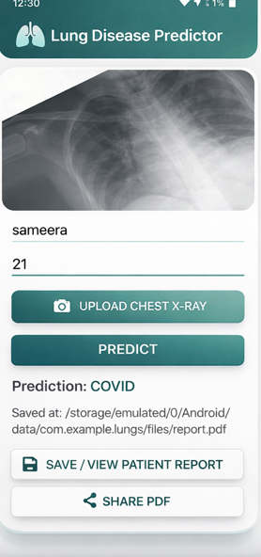
RESULTS OBTAINED:
Web Interface of LungScan AI for X-ray Image Upload

Slide 16
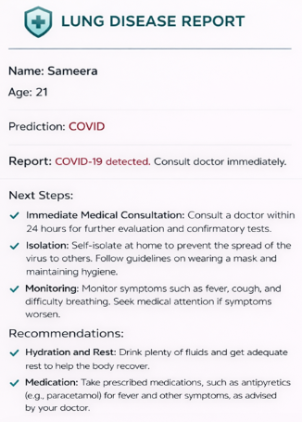
Medical report for patient

Slide 17
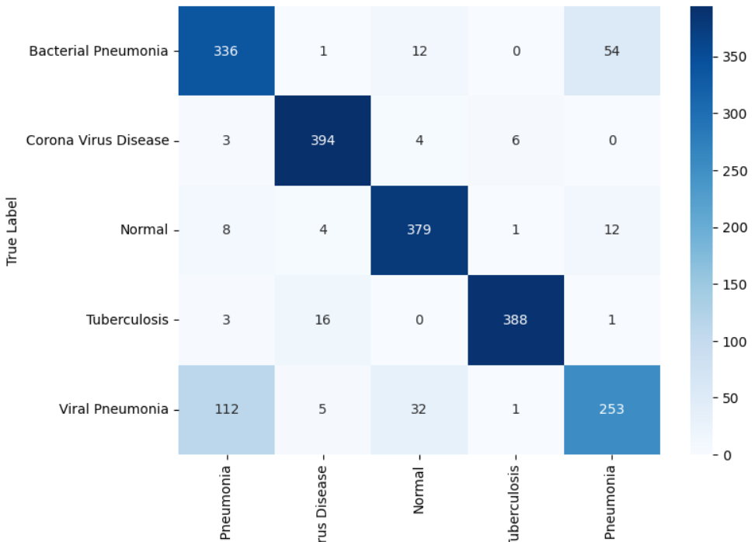
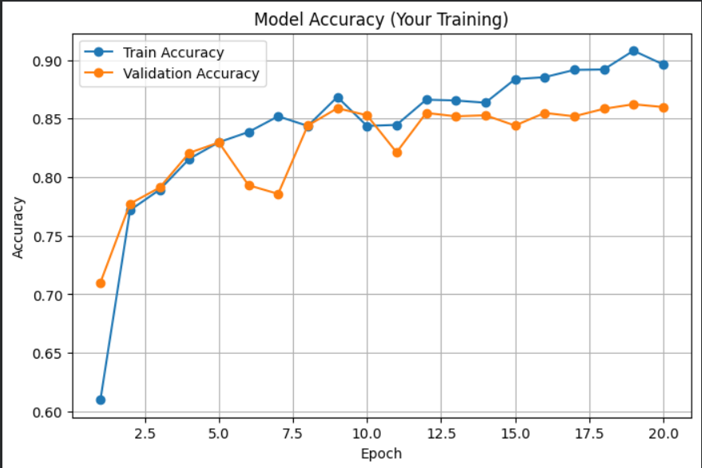
Result Analysis:
Confusion Matrix And Model Accuracy for MobileNetV2

Slide 18
Result Analysis:
1. Confusion Matrix — The model correctly classified most X-ray images across all 5 classes. Bacterial Pneumonia (336), Corona Virus Disease (394), Normal (379), and Tuberculosis (388) showed high accuracy. Viral Pneumonia had slight misclassification with 112 samples confused with Bacterial Pneumonia due to visual similarity between the two classes.
2. Accuracy Graph — The model achieved a training accuracy of around 90% and validation accuracy of 90% over 20 epochs. The steady improvement and small gap between train and validation accuracy confirms the model learned well without overfitting.
3. Mobile Application Output — The app successfully took user input of name and age, uploaded a chest X-ray, and predicted the disease instantly. The result was displayed on screen with options to save and share the patient report as a PDF.
4. AI-Generated Medical Report — The generated report displayed patient details, predicted disease, next steps, and recommendations including immediate medical consultation, symptom monitoring, hydration, and medication, providing a complete and clinically meaningful diagnosis summary to the user.

Slide 19
CONCLUSION:
This project successfully developed a Mobile-Based AI System for Lung Disease Diagnosis using MobileNetV2 with CBAM attention mechanism, achieving a training accuracy of 90% and validation accuracy of 86% across five lung disease categories. The Android application enables users to upload chest X-ray images and instantly receive disease predictions along with AI-generated medical reports containing clinical recommendations.
FUTURE SCOPE:
Support for More Lung Diseases : The model can be extended to detect additional lung conditions such as Lung Cancer, Asthma, Pleural Effusion, and COPD by expanding the dataset and retraining the model with more disease classes.
Integration with CT Scans and MRI : Future versions can support not just X-ray images but also CT scans and MRI images, providing more accurate and detailed diagnosis for complex lung conditions.
Wearable and IoT Device Integration : The system can be extended to integrate with wearable health monitoring devices and IoT sensors to continuously monitor respiratory health and trigger early warnings for lung conditions.

Slide 20
References:
[1] H. Wedisinghe and T. G. I. Fernando, "Explainable AI for Early Lung Cancer Detection: A Path to Confidence," 2024 4th International Conference on Advanced Research in Computing (ICARC), Belihuloya, Sri Lanka, 2024, pp. 13-18, doi: 10.1109/ICARC61713.2024.10499787.
[2] T. Ruga, E. Vocaturo and E. Zumpano, "Explainable Deep Learning for Chest X-Ray Classification," 2024 IEEE International Conference on Bioinformatics and Biomedicine (BIBM), Lisbon, Portugal, 2024, pp. 6561-6566, doi: 10.1109/BIBM62325.2024.10822683.
[3] A. Alomar, M. Alazzam, H. Mustafa and A. Mustafa, "Lung Cancer Detection Using Deep Learning and Explainable Methods," 2023 14th International Conference on Information and Communication Systems (ICICS), Irbid, Jordan, 2023, pp. 1-4, doi: 10.1109/ICICS60529.2023.10330443
[4] M. Owais, M. Zubair, L. Seneviratne, N. Werghi and I. Hussain, "Unified Synergistic Deep Learning Framework for Multimodal 2-D and 3-D Radiographic Data Analysis: Model Development and Validation," in IEEE Access, vol. 12, pp. 159688-159705, 2024, doi: 10.1109/ACCESS.2024.3487575.
[5] Akter S, Shamrat FMJM, Chakraborty S, Karim A, Azam S. “COVID-19 Detection Using Deep Learning Algorithm on Chest X-ray Images”. Biology (Basel). 2021 Nov 13;10(11):1174. doi: 10.3390/biology10111174. PMID: 34827167; PMCID: PMC8614951.
[6] K. Vij, S. Thakur, A. Sharma and R. Mohana, "Lung Disease Classification using X-Ray Imaging with Ensemble Learning," 2023 11th International Conference on Intelligent Systems and Embedded Design (ISED), Dehradun, India, 2023, pp. 1-5, doi: 10.1109/ISED59382.2023.10444592.
[7] X. Liu, Z. Yu and L. Tan, "Deep Learning for Lung Disease Classification Using Transfer Learning and a Customized CNN Architecture with Attention," 2024 IEEE 2nd International Conference on Sensors, Electronics and Computer Engineering (ICSECE), Jinzhou, China, 2024, pp. 341-346, doi: 10.1109/ICSECE61636.2024.10729291.

Slide 21
Thank You

