Slide 1
SECURE DATA HIDING IN IMAGES USING STEGANOGRAPHY
CAPSTONE PROJECT
Presented By:
Student Name : Veda Bhavishya Gudivaka
College Name & Department : Shri Vishnu Engineering College for Women , AI & ML

Slide 2
OUTLINE
Problem Statement
Technology used
Wow factor
End users
Result
Conclusion
Git-hub Link
Future scope

Slide 3
Problem Statement
In today's digital world, keeping data private and secure is a big challenge. Normal encryption methods can look suspicious and might attract hackers. This project, "Secure Data Hiding in Images Using Steganography," helps hide secret messages inside images so that no one can easily detect them. By storing information in the image’s colors (RGB channels), it ensures safe and hidden communication without changing how the image looks.

Slide 4
Technology used
Python – Core programming language used for implementation.
OpenCV – For image processing and pixel-level data embedding.
Steganography Techniques – LSB (Least Significant Bit) method for hiding data in images.
OS Module – To handle file operations like saving and opening images.
String Module – Used for character mapping and manipulation in encryption.
File Handling – To store and retrieve encrypted messages and passwords securely.

Slide 5
Wow factors
🔹 Undetectable Security – Hides data inside images without changing their appearance, making it invisible to unauthorized users.
🔹 Dual Protection – Combines image steganography with a passcode, adding an extra layer of security.
🔹 Lightweight & Versatile – Works with different image formats and can be used for secure messaging, watermarking, and copyright protection.

Slide 6
End users
🔹 Individuals & Organizations – People who need to send confidential messages without drawing attention.
🔹 Cybersecurity Professionals – For secure communication and protecting sensitive data.
🔹 Journalists & Whistleblowers – To safely share information without being detected.
🔹 Government & Defense Agencies – For covert communication and secure data exchange.
🔹 Content Creators & Businesses – For watermarking and protecting digital assets from unauthorized use.

Slide 7
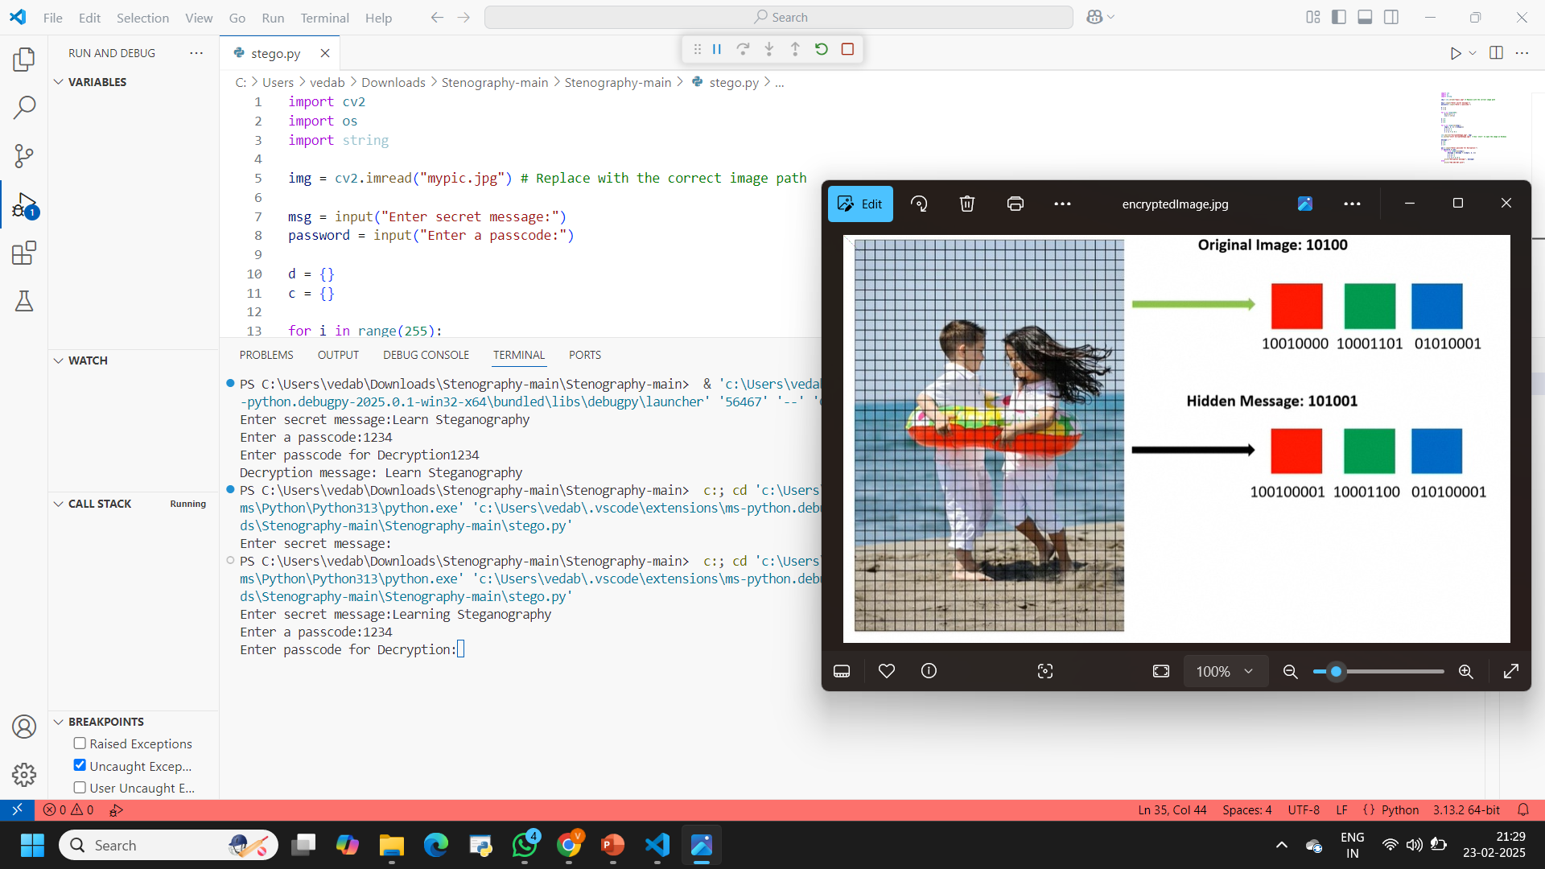
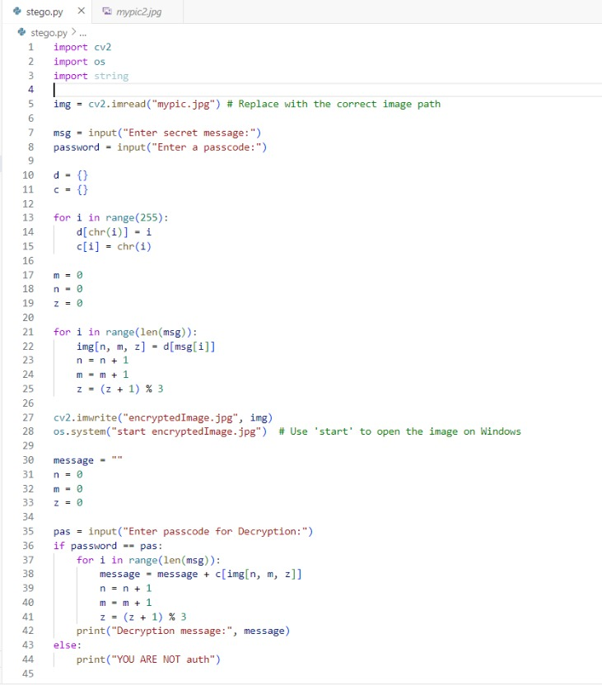

Results

Slide 8
Conclusion
This project successfully addresses the challenge of secure digital communication by using steganography to hide data within images. Unlike traditional encryption, which may attract unwanted attention, this method ensures invisible yet secure message transmission. By embedding information in the RGB channels of an image and adding a passcode layer, it provides a safe, untraceable, and efficient way to protect sensitive data. This makes it a valuable solution for confidential messaging, cybersecurity, and digital rights protection in today’s digital world.

Slide 9
GitHub Link
Github Repository Name: Steganography
Github Repository Link: https://github.com/Vedabhavishya/Steganography.git

Slide 10
THANK YOU

