Slide 1
Debutanizer Column
Predicting the Butane(CH₄) Content
Anusha Khare – 2022CHB1044
Vedang Sakpal – 2022CHB1056

Slide 2
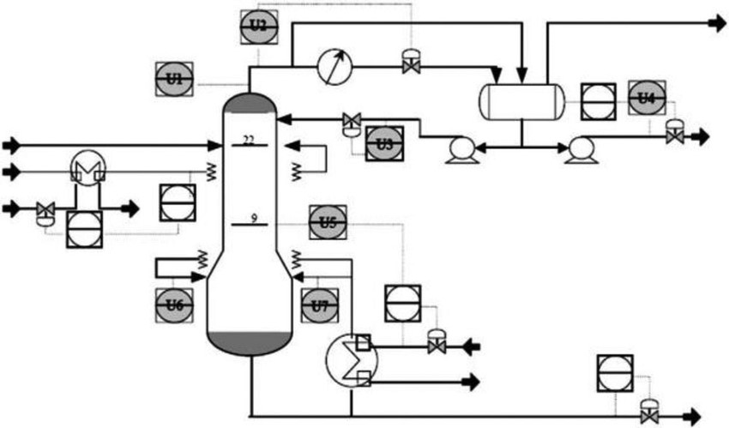
Algorithms Applied
Multi-Linear Regression
Lasso Regression
Polynomial regression
Regression After Feature selection
PCA (Principle Component Analysis)

Slide 3
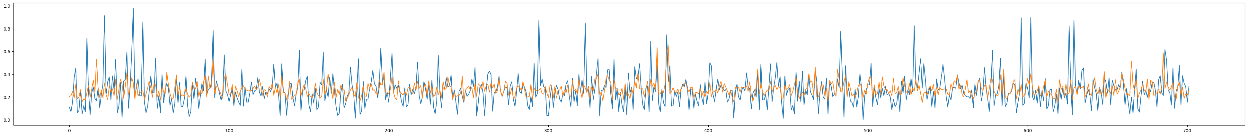
Multi-Linear Regression
Predictive Performance | Values
Sum of squared errors (SSE) | 0.01657
R² | 0.19781
Akaike Information Criterion (AIC) | -5472.74712
Bayesian Information Criterion (BIC) | -5440.86958
Coefficients
β₀ | β₁ | β₂ | β₃ | β₄ | β₅ | β₆ | β₇
0.427 | 0.42 | -0.03 | -0.12 | 0.23 | -0.59 | -0.41 | 0.59

Slide 4

Lasso Regression
Predictive Performance | Values
Sum of squared errors (SSE) | 0.01657
R² | 0.19781
Akaike Information Criterion (AIC) | -5472.74712
Bayesian Information Criterion (BIC) | -5440.86958
Coefficients
β₀ | β₁ | β₂ | β₃ | β₄ | β₅ | β₆ | β₇
0.427 | 0.42 | -0.03 | -0.12 | 0.23 | -0.59 | -0.41 | 0.59

Slide 5
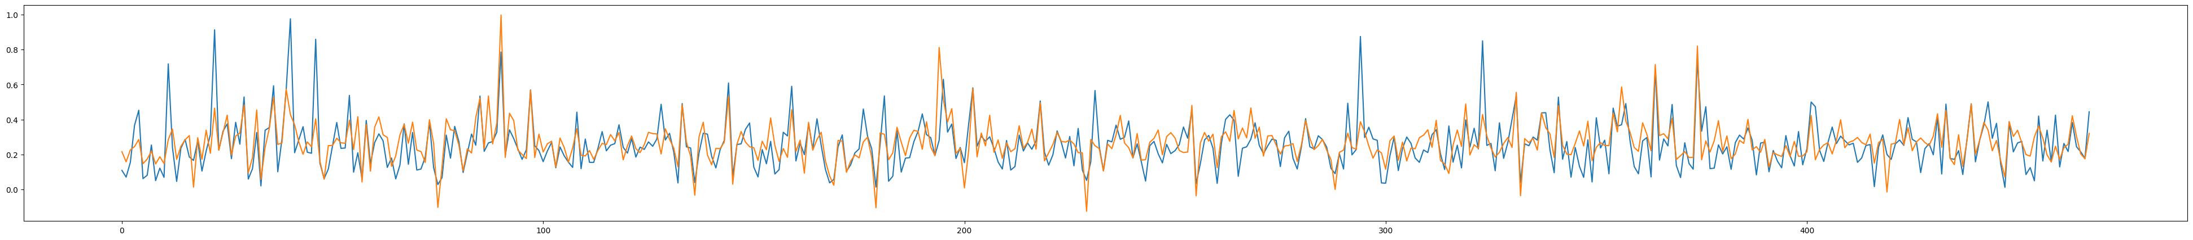
Polynomial Regression
Predictive Performance | Values
Sum of squared errors (SSE) | 0.01161
R² | 0.43467
Akaike Information Criterion (AIC) | -3620.45726
Bayesian Information Criterion (BIC) | -3591.41798

Slide 6

Feature Selection
In this by seeing the correlation values of the Variable with target variable we have removed the U₇ due to very less correlation i.e. 0.00094
Predictive Performance | Values
Sum of squared errors (SSE) | 0.01664
R² | 0.19423
Akaike Information Criterion (AIC) | -5473.61858
Bayesian Information Criterion (BIC) | -5450.84891
Coefficients
β₀ | β₁ | β₂ | β₃ | β₄ | β₅ | β₆ | β₇
0.42797 | 0.42 | -0.06 | -0.16 | 0.24 | -0.53 | 0.16 | 0

Slide 7

PCA and Linear regression
Using principle Component Analysis(PCA) the Features are reduced to a count of 5. Here we have applied Multi-linear Regression on the reduced features
Predictive Performance | Values
Sum of squared errors (SSE) | 0.01658
R² | 0.19723
Akaike Information Criterion (AIC) | -5476.24040
Bayesian Information Criterion (BIC) | -5453.47073
Coefficients
β₀ | β₁ | β₂ | β₃ | β₄ | β₅
0.266 | -0.02 | 0.23 | 0.18 | 0.17 | 0.67

Slide 8
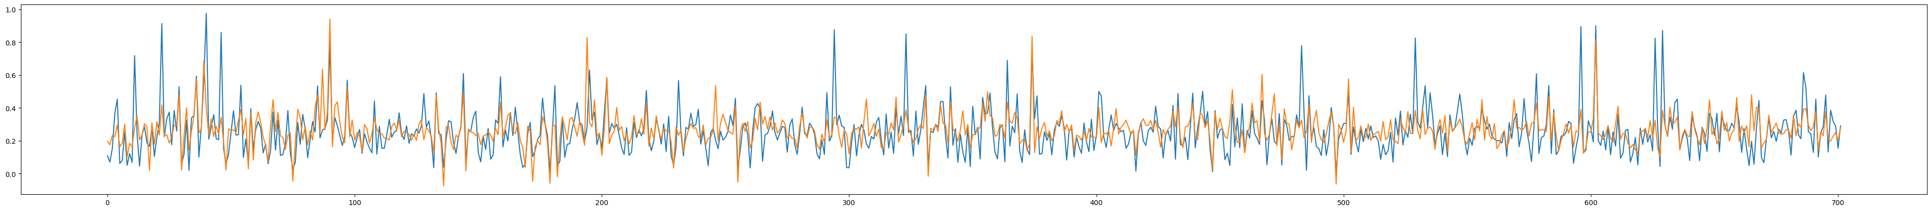
PCA and Polynomial regression
Using principle Component Analysis(PCA) the Features are reduced to a count of 5. Here we have applied Polynomial Regression on the reduced features.
Predictive Performance | Values
Sum of squared errors (SSE) | 0.01303
R² | 0.36905
Akaike Information Criterion (AIC) | -5645.30659
Bayesian Information Criterion (BIC) | -5622.53692

Slide 9
Comparing all the results
Algorithms | Sum of squared errors (SSE) | R² | Akaike Information Criterion (AIC) | Bayesian Information Criterion (BIC)
Multi-Linear Regression | 0.01657 | 0.19781 | -5472.74712 | -5440.86958
Lasso Regression | 0.01657 | 0.19781 | -5472.74712 | -5440.86958
Polynomial Regression | 0.01161 | 0.43467 | -3620.45726 | -3591.41798
Feature selection | 0.01664 | 0.19423 | -5473.61858 | -5450.84891
PCA and Multi-Linear Regression | 0.01658 | 0.19723 | -5476.24040 | -5453.47073
PCA and Polynomial Regression | 0.01303 | 0.36905 | -5645.30659 | -5622.53692

