Slide 1

Vivekanand Education Society’s Institute Of Technology
Department Of Information Technology
Project Review
Sem: III Academic Year :2022-23
Title : Event Management System
Domain: Event Management
Group Members:
Member1 : Shamaila Ansari
Member 2: Swarali Dhobale
Member 3: Vedang Khandagale
Member 4: Sneha Sumbe
Mentor Name: Prof. Vinita Mishra

Slide 2

CONTENTS
Introduction
Problem Statement
Objective of the project
Functionalities
Literature Survey
Requirements of the system (Hardware, software)
ER diagram/flow chart/architecture diagram of the proposed system
References in IEEE format

Slide 3
Introduction
So our project is based on the domain of event management. The main objective is to provide all services under one website necessary for any event. It can be any event, one has to look for different services at different places which are required for the event. It can be a tedious and time taking task. Therefore, the aim is to provide one stop solution for any event, one is planning for

Slide 4
Problem Statement
We all have visited many events like birthday parties, marriages, etc. But conducting such events is a stressful task.
To conduct an event successfully we have to contact various venue organizers catering services and decorators. After that we have to manage each of them separately which is a time consuming and tedious task.
There is not a proper system to efficiently handle all of them simultaneously. So usually people tend to stress while managing a big event such as wedding and sometimes they end up making wrong decisions which directly or indirectly affects the event

Slide 5

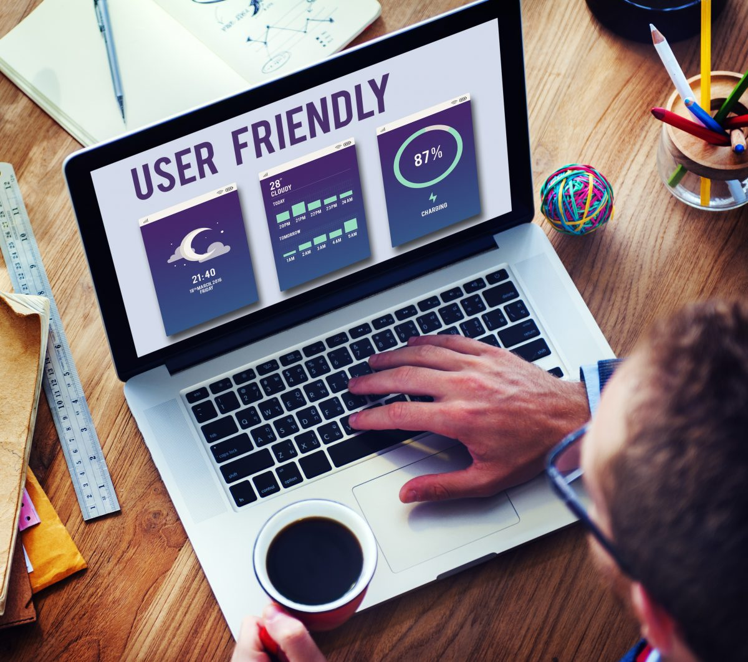
Objective of the project
To understand the process of event management.
To determine the factors affecting quality of service in event management.
The proposed system aims to bridge the gap between vendors and users and provide them a platform to interact and manage events.
To provide user-friendly software.

Slide 6
Functionalities
Allows only registered users to login
Unregistered users are allowed to register on the website.
After registration is done, the customer can choose their venue, nearest caterers and decorators depending upon the city
The system will then show the all inclusive price of the same, both online and offline payments will be available.

Slide 7
Literature Survey
Sr. No | Author | Title | Year | Finding,Links
1. | Rahul Kumar Singh, Pardeep Singh, Gourav Bathla | User-Review Oriented Social Recommender System for Event Planning | 2020 | In this paper, wedding planner recommender system has been proposed based hybrid approach i.e., content-based and collaborative filtering approach. https://scholar.google.com/scholar?hl=en&as_sdt=0%2C5&q=User-Review+Oriented+Social+Recommender+System+for+Event+Planning&btnG=
2. | Sachin AjayKumar Pasi, Prof. Altaf Taher Shah, Prof. Dr. Amol B. Kasture | A study and implementation of event management system using smartphone | 2018 | They made attempt to effectively introduce the concept of event management system already existing in society & online systems which are present. They further describe the proposed system. It can be further refined with innovations. https://www.ijirmps.org/special-issues/1/18.pdf
3. | Akash Verma , Gunjan Srivastava, Himanshu Verma, Mayank Johri,Ms. Archana Bhalla | Study on Event Management Applications | 2017 | The proposed system aims to bridge the gap between vendors and users and provide them a platform to interact and manage events. The proposed system can be said to be a successful when it delivers a proper channel to easily and effectively manage their event and provide a good quality of service to the customers in real time https://ijisrt.com/wp-content/uploads/2017/04/Study-on-Event-Management-Applications.pdf
4. | Assist. Prof. Khalil Pinjari, Khan Nur | Smart Event Management System | 2016 | The project will help the respective events to manage and automate to the entire database in the network http://www.ijcstjournal.org/volume-4/issue-2/IJCST-V4I2P29.pdf

Slide 8

Literature Survey
Do you like to take item recommendation for your wedding so that your Wedding preparation would be easy?
Do you like to take seasonal recommendation so that you can enjoy your Wedding?
Do you like to take location based recommendation so that your time will be saved and you can utilize your time in other important work?
Do you want to save your money by getting items in cheaper rate or in discounted price?
Do you want to get recommendations of new items (new in market) for which you are not aware before?

Slide 9
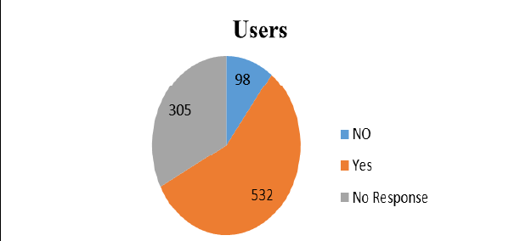
Literature Survey
Based on the responses given by the users, they have
57% positive feedback

Slide 10



Requirements of the system (Hardware, software)
Hardware System Configuration:
System: Pentium i3 Processor
Hard Disk: 500 GB
Monitor :Standard LED Monitor
Input Devices: Keyboard, Mouse
Ram: 4 GB
Software System Configuration:
Operating system: Windows 7/8/10.
Available Coding Language: JAVA, HTML
Database: MYSQL

Slide 11
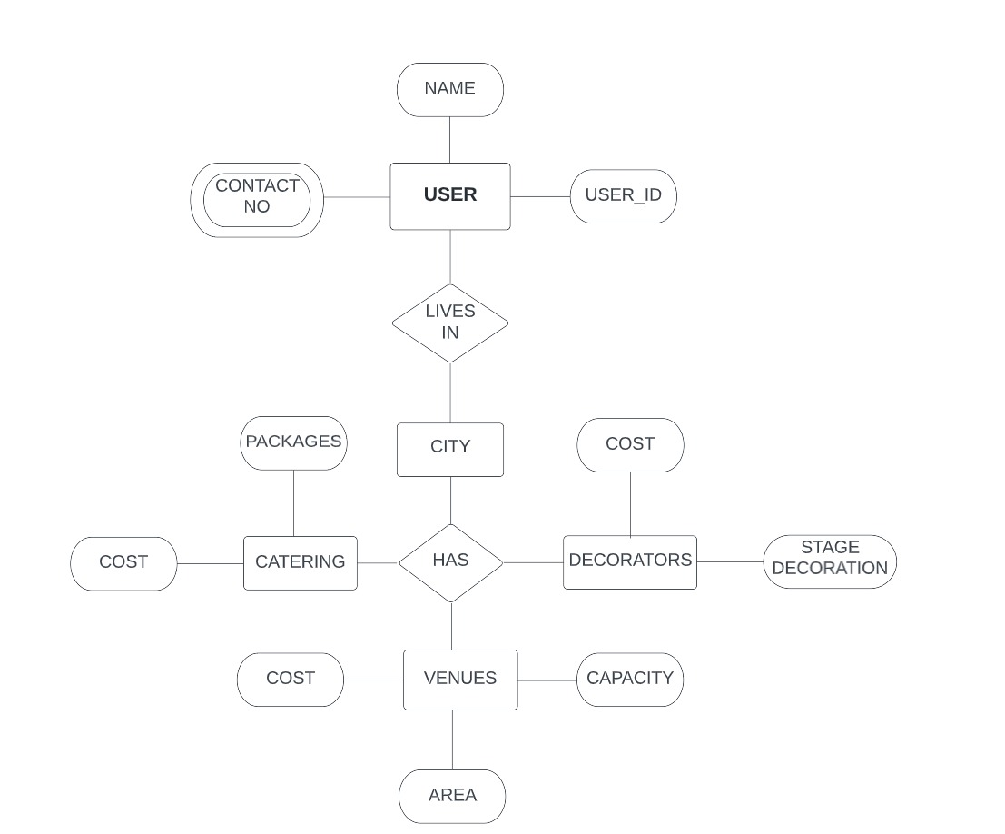
ER diagram of the proposed system

Slide 12
References in IEEE format
Himanshu Verma Mayank Johri Ms. Archana Bhalla Akash Verma, Gunjan Srivastava. Study on event management applications. volume 2, 2017.
Khalil Pinjari and Khan Nur. Smart event management system. International Journal of Computer Science Trends and Technology, 4(2):161{164, 2016.
Prof. Dr. Amol B. Kasture Sachin AjayKumar Pasi, Prof. Altaf Taher Shah. A study and implementation of event management system using smartphone. IJIRMPS, 6, 2018.
Rahul Kumar Singh, Pardeep Singh, and Gourav Bathla. User-review oriented social recommender system for event planning. Ingenierie des Systemes dInf.,25(5):669{675, 2020.

Slide 13
THANK YOU!

