Slide 1
Automatic Water Dispenser
Ronit Santwani(48) Vedang Wajge(62)

Slide 2
Table of Contents
1
Introduction
6
Implementation Steps
2
Objectives
7
Arduino Code(Snippet)
3
Components Used
8
Applications
4
Circuit Connection
9
Conclusion
5
Working Principles

Slide 3
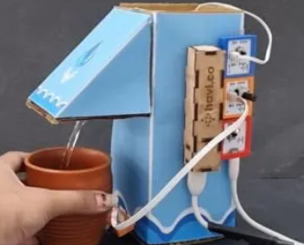
Introduction
Automatic water dispensers provide a contactless and hygienic method for dispensing water. This project uses Arduino UNO, HC-SR04 ultrasonic sensor, and a servo motor to simulate a smart tap system. Water is dispensed automatically when a hand is detected.

Slide 4
Objectives
Develop a contactless water dispensing system
Use ultrasonic sensing for hand detection
Control dispensing using a servo motor
Ensure efficient, hygienic water delivery

Slide 5
Components Used
1. Arduino UNO
A 5V microcontroller board (ATmega328P) with 14 digital I/O pins, used to control components like sensors and motors in embedded systems.
2. HC-SR04 Ultrasonic Sensor
A distance sensor with a 2–400 cm range (±3 mm accuracy), emits ultrasonic waves and detects echo to measure proximity.

Slide 6
3. SG90 Servo Motor
A 4.8V–6V micro servo with 0°–180° rotation, controlled by PWM signals for precise angle movement in lightweight automation.
4. Jumper Wires
Flexible, solderless wires (male/female) used to connect electronic components on breadboards or between modules..

Slide 7
5. 9V Battery with Clip
A portable 9V power source for Arduino boards, regulated to prevent overvoltage in standalone applications.
6. Breadboard
A solderless prototyping platform to organize and connect electronic components safely and efficiently.

Slide 8
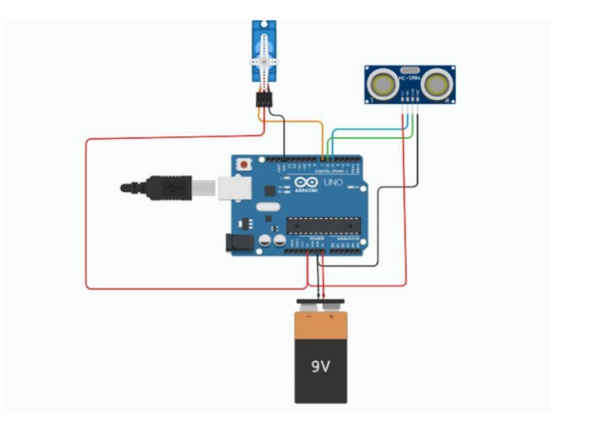
Circuit Connection

Slide 9
Working Principle
Connect the components as per the diagram
Upload the Arduino code via USB
Open Serial Monitor (9600 baud)
Bring glass near the sensor
Servo opens and closes simulating water flow

Slide 10
Implementation
Connect the components as per the diagram
Upload the Arduino code via USB
Open Serial Monitor (9600 baud)
Bring glass near the sensor
Servo opens and closes simulating water flow

Slide 11
Arduino Code (Snippet)
#include <Servo.h>
#define trigPin 10
#define echoPin 11
#define servoPin 9
Servo waterServo;
void setup() {
Serial.begin(9600);
waterServo.attach(servoPin);
pinMode(trigPin, OUTPUT);
pinMode(echoPin, INPUT);
waterServo.write(0);
}
void loop() {
float distance = measureDistance();
if (distance > 0 && distance < 10) {
waterServo.write(90);
delay(1000);
waterServo.write(0);
delay(1000);
}
}

Slide 12
Applications
Public washrooms
Hospitals and clinics
Restaurants and kitchens
Smart homes

Slide 13
Conclusion
This project successfully demonstrates a simple and effective automatic water dispenser system. It highlights the use of sensors and actuators in real-world automation solutions, encouraging further development in contactless technology

