Slide 1
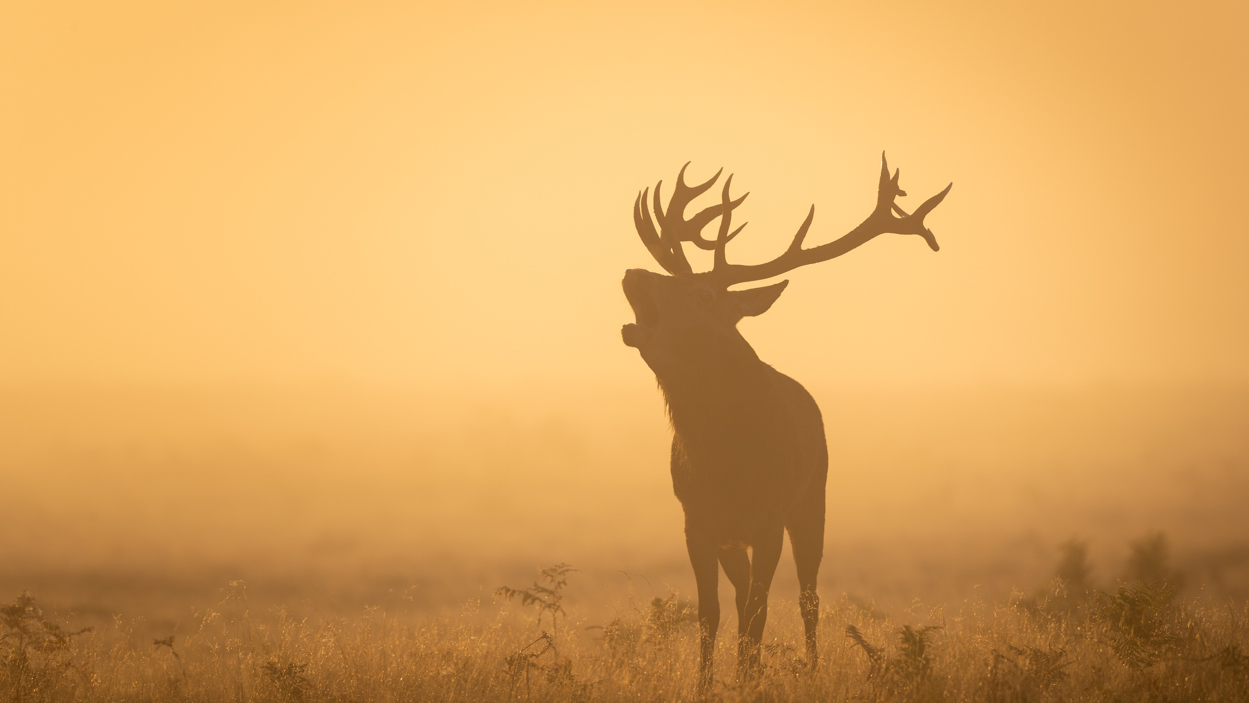

WILDCARETECH
UNLOCKERS
BRINDA P-21 BCE 0900
VAANI KOHLI-21 BCE 0892
VEDANSH KESHARI-21 BCE 0944

Slide 2
INTRODUCTION
WILDCARETECH" COMBINES THE WORDS "WILDLIFE" AND "CARE" WITH "TECH" AS A SHORTENED FORM OF TECHNOLOGY. IT SIGNIFIES THE COMPANY'S FOCUS ON PROVIDING INNOVATIVE SOLUTIONS FOR THE WELL-BEING OF WILD ANIMALS USING ADVANCED TECHNOLOGY
WILDLIFE CAMERAS: SET UP MOTION-ACTIVATED WILDLIFE CAMERAS IN STRATEGIC
WILDCARETECH
LOCATIONS TO CAPTURE IMAGES OR VIDEOS OF ANIMALS PASSING THROUGH. THESE
CAMERAS OFTEN HAVE BUILT-IN TIME STAMPS AND CAN HELP IDENTIFY THE ANIMALS'
ROUTES AND HABITS.
WILDLIFE CAMERAS ARE VALUABLE TOOLS FOR STUDYING AND MONITORING WILDLIFE
POPULATIONS. THEY PROVIDE RESEARCHERS WITH INSIGHTS INTO THE BEHAVIOR, ABUNDANCE, AND DISTRIBUTION OF VARIOUS SPECIES. BY CAPTURING IMAGES OR VIDEOS, SCIENTISTS CAN GATHER DATA ON ANIMAL MOVEMENTS, ACTIVITY PATTERNS, FEEDING HABITS, AND INTERACTIONS WITH OTHER SPECIES.

Slide 3
Remote Monitoring and Surveillance:
Image processing enables us to remotely monitor wildlife
WILDCARETECH
populations in their natural habitats. Through cameras and
sensors t
s rategically placed in different locations, we can
capture images and videos of animals, which can then be analyzed using image processing algorithms. This allows us to monitor behavior patterns, detect signs of distress or illness, and identify any potential threats to their well-being.

Slide 4
Population Surveys and Census
Traditional wildlife population surveys and censuses
can be time-consuming and logistically challenging.
T
WILDCARETECH
Image pr
ocessing simplifies this
proc
ess by auto
mating
the identification and counting of animals in images or
videos. By utilizing machine learning algorithms, we can train models to recognize specific species or individuals, estimate population sizes, and monitor population dynamics over time.

Slide 5

Tracking and Behavior Analysis
Image processing plays a crucial role in tracking wildlife
movements and studying their behavior. By analyzing
D
WILDCARETECH
imag
es cap
ture
d from d
ifferent
angles and time
intervals, we can create 3D models of animal trajectories
and understand their migration patterns, foraging behaviors, and social interactions. This information helps in assessing the overall health of a population and identifying any changes that may require intervention

Slide 6
PROCESS
Centralized Appointment Management
A dedicated app serves as a centralized platform, allowing stakeholders like wildlife rehabilitators, agencies, and veterinary specialists to efficiently access and manage wildlife animal appointment schedules.
Species-specific Expertise
The booking app should have a database of wildlife specialists with specific expertise, facilitating easy access for wildlife caregivers to find the right professionals for their animals.
Emergency and Urgent Care
The wildlife emergency booking app should allow caregivers to quickly schedule urgent care for injured or critically ill wildlife, ensuring timely veterinary attention in critical situations.

Slide 7
Geolocation and Mapping:
The app can use geolocation and mapping features to help wildlife caregivers find the nearest veterinary specialists, rehabilitation centers, or hospitals, reducing transportation time and stress for the animals.
Medical Records and Documentation:
The app should store and access medical records, treatment histories, and diagnostic reports for each animal, enabling efficient record-keeping and informed decision-making by specialists.
Communication and Notifications
The app facilitates secure messaging for caregivers, specialists, and support staff to communicate with veterinary professionals. It enables sharing updates, asking questions, and receiving notifications about appointments, test results, and treatment plans, streamlining communication in animal care.

Slide 8
In conclusion, image processing in wildlife healthcare offers a wide range of applications, from remote
monitoring and disease detection to population surveys
WILDCARETECH
and co
nservation
effo
rts. By h
arnessin
g the po
wer of
advanced technologies, we can enhance our
understanding of wildlife health, improve conservation strategies, and ensure the well-being of our precious wildlife populations.

