Slide 1

Investment Analysis
Project by: Vedansh Tyagi
E-mail: tyagivedansh2001@gmail.com
GitHub Link for the Project: https://github.com/Vedansh-Tyagi08/Investment-Analysis
Tools used: SQL, Power BI

Slide 2
Task 1: Data Overview
Understand the data structure.
SELECT *
FROM data;
Overview observations:
Rows = 40
Columns = 24
Columns = gender, age, investment avenues, mutual fund, equity market, debentures, government bonds, fixed deposit, ppf, gold, stock market, factor, objective, purpose, duration, investment monitor, expect, avenue, saving objectives, reason equity, reason mutual, reason bonds, reason fd, source.

Slide 3
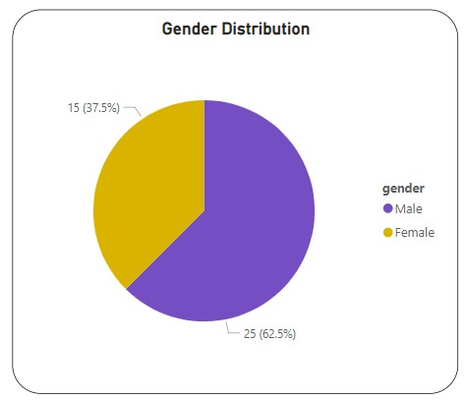
Task 2: Gender Distribution
Distribution of genders in the dataset.
SELECT gender, COUNT(gender) AS gender_count
FROM data
GROUP BY gender;

Slide 4
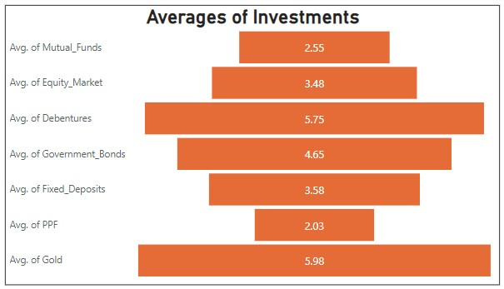
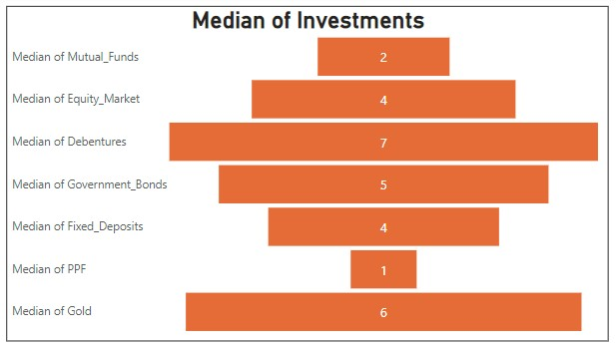
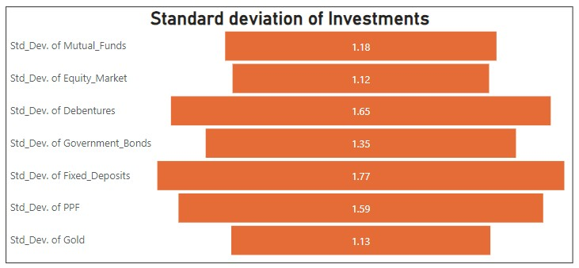
Task 3: Descriptive Analysis
Use statistical functions (e.g., mean(), median(), std()) to calculate the mean, median, and standard deviation for each numerical column.
AVERAGE:
SELECT ROUND(AVG(mutual_funds),2) AS avg_mutual_funds,
ROUND(AVG(equity_market),2) AS avg_equity_market,
ROUND(AVG(debentures),2) AS avg_debentures,
ROUND(AVG(government_bonds),2) AS avg_government_bonds,
ROUND(AVG(fixed_deposits),2) AS avg_fixed_deposits,
ROUND(AVG(ppf),2) AS avg_ppf, ROUND(AVG(gold),2) AS avg_gold
FROM data;
MEDIAN:
WITH cte AS(
SELECT age, mutual_funds, equity_market, debentures, government_bonds, fixed_deposits, ppf, gold,
ROW_NUMBER() OVER() AS rn
FROM data
ORDER BY age ASC
)
SELECT age, mutual_funds, equity_market, debentures, government_bonds, fixed_deposits, ppf, gold
FROM cte
WHERE rn = (SELECT COUNT(rn)/2 FROM cte);
STANDARD DEVIATION:
SELECT ROUND(STDDEV_POP(mutual_funds),2) AS std_dev__mutual_funds,
ROUND(STDDEV_POP(equity_market),2) AS std_dev__equity_market,
ROUND(STDDEV_POP(debentures),2) AS std_dev__debentures,
ROUND(STDDEV_POP(government_bonds),2) AS std_dev__government_bonds,
ROUND(STDDEV_POP(fixed_deposits),2) AS std_dev__fixed_deposits,
ROUND(STDDEV_POP(ppf),2) AS std_dev__ppf,
ROUND(STDDEV_POP(gold),2) AS std_dev__gold
FROM data;

Slide 5
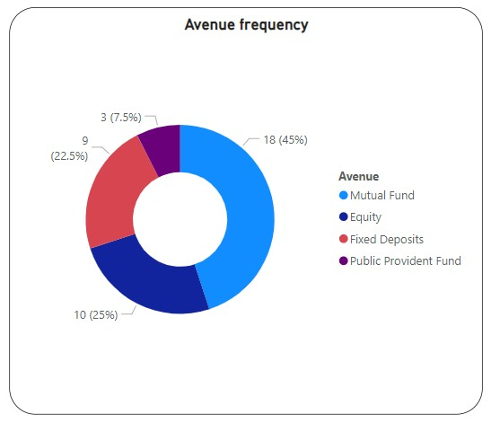
Task 4: Most preferred investment Avenue
Determine the investment avenue with the highest frequency or occurrence.
SELECT avenue, COUNT(avenue) AS avenue_count
FROM data
GROUP BY avenue
ORDER BY avenue_count DESC;

Slide 6
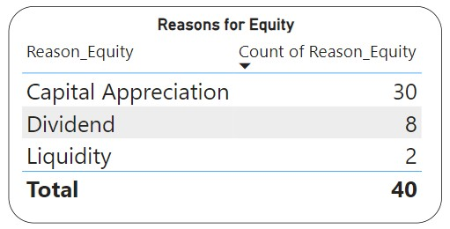
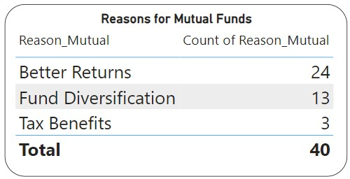
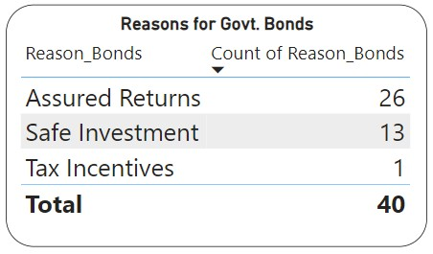
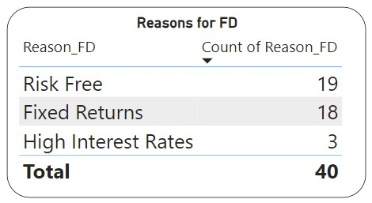
Task 5: Reasons for Investment
Identify recurring reasons and provide a summary.
Reason for Equity:
SELECT reason_equity, COUNT(reason_equity) AS equity_reasons
FROM data
GROUP BY reason_equity
ORDER BY equity_reasons DESC;
Reason for Mutual Fund:
SELECT reason_mutual, COUNT(reason_mutual) AS mutual_fund_reasons
FROM data
GROUP BY reason_mutual
ORDER BY mutual_fund_reasons DESC;
Reason for Government Bonds:
SELECT reason_bonds, COUNT(reason_bonds) AS bond_reasons
FROM data
GROUP BY reason_bonds
ORDER BY bond_reasons DESC;
Reason for Fixed Deposit (FD):
SELECT reason_fd, COUNT(reason_fd) AS fd_reasons
FROM data
GROUP BY reason_fd
ORDER BY fd_reasons DESC;

Slide 7
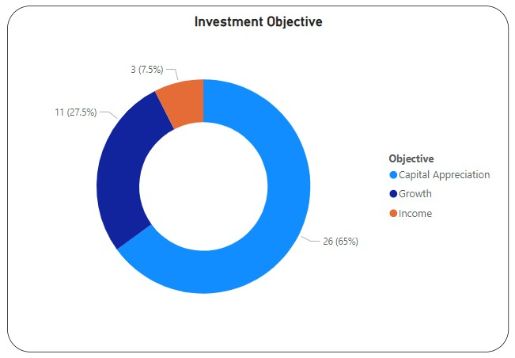
Task 6: Savings Objectives
Describe the main savings objectives mentioned by participants.
SELECT objective, COUNT(objective) AS objective_count
FROM data
GROUP BY objective
ORDER BY objective_count DESC;

Slide 8
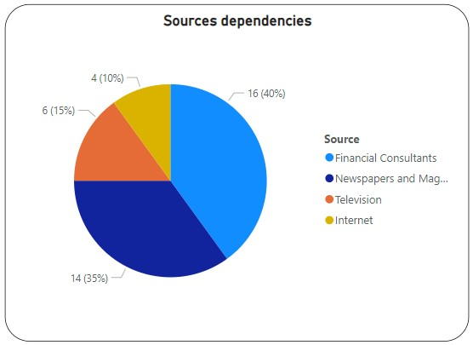
Task 7: Common Information Sources
Analyze the data to identify and summarize the most common sources participants rely on.
SELECT source, COUNT(source) AS source_count
FROM data
GROUP BY source
ORDER BY source_count DESC;

Slide 9
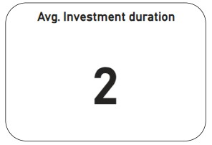
Task 8: Investment Duration
Calculate the average investment duration.
WITH cte5 AS(
WITH cte4 AS(
WITH cte3 AS(
WITH cte2 AS(
WITH cte AS(
SELECT duration,
CASE WHEN duration = 'Less than 1 year' THEN 0 END AS less_than_1_yr,
CASE WHEN duration = '1-3 years' THEN 1 END AS minimum_1_yr,
CASE WHEN duration = '3-5 years' THEN 3 END AS minimum_3_yrs,
CASE WHEN duration = 'More than 5 years' THEN 5 END AS minimum_5_yrs
FROM data
)
SELECT duration,
CONCAT(less_than_1_yr, minimum_1_yr, minimum_3_yrs, minimum_5_yrs)::INT AS approx_duration_yrs
FROM cte
)
SELECT duration, COUNT(approx_duration_yrs) AS total_people
FROM cte2
GROUP BY duration
)
SELECT *,
CASE WHEN duration = 'Less than 1 year' THEN total_people*0 END AS total_less_than_1_yr,
CASE WHEN duration = '1-3 years' THEN total_people*1 END AS total_minimum_1_yr,
CASE WHEN duration = '3-5 years' THEN total_people*3 END AS total_minimum_3_yrs,
CASE WHEN duration = 'More than 5 years' THEN total_people*5 END AS total_minimum_5_yrs
FROM cte3
)
SELECT duration, total_people,
CONCAT(total_less_than_1_yr, total_minimum_1_yr, total_minimum_3_yrs, total_minimum_5_yrs)
AS total_duration_years
FROM cte4
)
SELECT SUM(total_duration_years::INT)/(SELECT COUNT(user_id) FROM data) AS avg_investment_duration_yrs
FROm cte5;

Slide 10
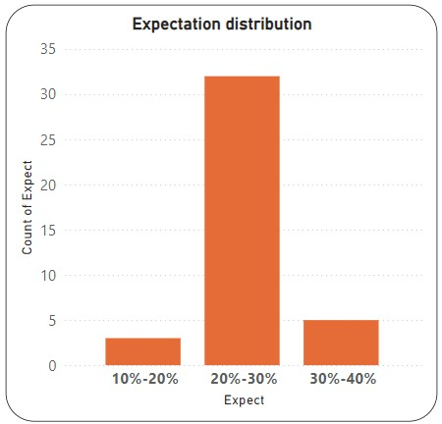
Task 9: Expectations from Investments
Create a list and describe the common expectations mentioned by participants.
SELECT expect, COUNT(expect) expect_count
FROM data
GROUP BY expect
ORDER BY expect ASC;

Slide 11
Conclusions:
Males invest more than Females.
Gold & Debentures are the top long term holdings.
Mutual Fund is the most preferred avenue for investment, Equity s second preferred avenue followed by Fixed Deposit & Public Provident Fund.
Capital Appreciation is the major objective for investments followed by Growth & Income.
Common Sources – Financial Consultants > Newspapers & Magazines > Television > Internet.
Average Investment Duration is 2 years. { NOTE: Considered – “Less than 1 Year” = 0 years, “1-3 Years” = 1 year, “3-5 Years” = 3 year, “More than 5 Years” = 5 years }
20-30% Returns is the expectation of 32 investors.

