Slide 1
DATA-DRIVEN IMPROVEMENTS
IN EDUCATION
A Power BI Business Intelligence Project
Prepared By: [Your Name]
Tool: Microsoft Power BI
Notes:
Welcome the audience. Introduce the project as a Power BI case study analyzing education data across states to support Ministry of Education decision-making.

Slide 2
Business Problem, Objectives & Scope
Business Problem
Objectives
The Ministry of Education lacks a consolidated, evidence-based view of how teaching quality, infrastructure, attendance, and household background jointly influence secondary-school outcomes.
Consolidate five data sources into one analytical model
Quantify each factor's relationship with student scores
Surface state-level disparities needing attention
Deliver a self-serve interactive dashboard
Project Scope
Data: student performance, attendance, teacher profiles, school infrastructure, socio-economic background (1.65M combined records)
Platform: Microsoft Power BI — data modeling, DAX measures, three-page interactive dashboard
Output: documented insights and recommendations for policy and resource-allocation decisions
Data-Driven Improvements in Education
2
Notes:
Frame the problem as a data-gap issue, not a performance crisis. Emphasize objectives are about visibility and evidence, not blame.

Slide 3
Dataset Overview
Five source tables, 1.65 million combined records
Table | Rows | Key Columns
Student Performance | 500,000 | Student ID, Subject, Score
Attendance Data | 500,000 | Student ID, Month, Attendance
Socio-Economic Data | 500,000 | Student ID, School ID, Parent Education, Family Income
Teacher Data | 100,000 | Teacher ID, State, Qualification, Experience, Training
School Infrastructure | 50,000 | School ID, State, Classrooms, Computers, Internet, Library
Data Model
Star-schema approximation: Student Performance as the central fact table
Attendance and Socio-Economic Data join via Student ID
School Infrastructure joins via School ID
Teacher Data joins only at State level (no direct student/school key)
Data-Driven Improvements in Education
3
Notes:
Note the Teacher Data limitation explicitly — it becomes important later in the Key Findings slide.

Slide 4
Data Cleaning & Validation
1
2
3
Power Query Processing
Duplicate Check
Missing Values
All five tables loaded and transformed via Power Query prior to modeling
Zero duplicate primary keys found across Student, School, and Teacher IDs
Full null-scan across 1.65M records returned zero missing values
4
5
Formatting
Data Validation
Trim/Clean applied to all text fields; Month standardized to Date type
State names and categorical values (Qualification, Income, Education) checked for consistent spelling
Data-Driven Improvements in Education
4
Notes:
Walk through each card briefly. Emphasize the dataset was already analysis-ready — zero missing values, zero duplicates.

Slide 5
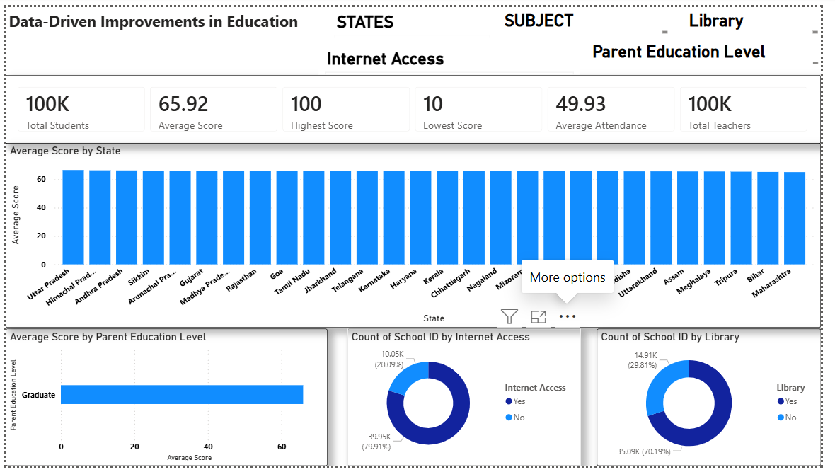
Dashboard — Executive Overview
Page 1 of 3
Key KPIs
100K Total Students / 100K Total Teachers
Average Score: 65.92 | Range: 10–100
Average Attendance: 49.93%
Charts & Filters
Average Score by State (28-state ranking)
Average Score by Parent Education Level
School coverage: Internet Access & Library (donuts)
Slicers: State, Subject, Library, Internet Access, Parent Education
Data-Driven Improvements in Education
5
Notes:
This is the landing page — walk through the KPI strip first, then the state ranking chart, then the two donut charts on the bottom row.

Slide 6
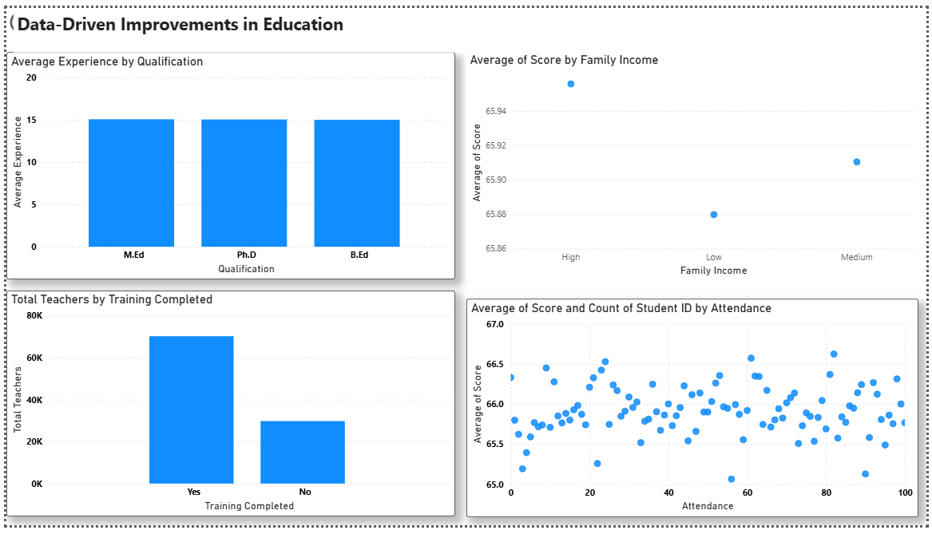
Dashboard — Teacher & Socio-Economic Analysis
Page 2 of 3
Teacher Analysis
Average experience nearly identical across B.Ed / M.Ed / Ph.D (~15 years)
70% of teachers have completed training; 30% have not
Attendance & Socio-Economic Analysis
Score vs. Attendance scatter shows no meaningful relationship (r ≈ 0.0006)
Score vs. Family Income shows a marginal gradient only (r ≈ 0.0015)
Data-Driven Improvements in Education
6
Notes:
Highlight the near-zero correlation on the attendance scatter — this is a key, slightly counter-intuitive finding to flag to the audience.

Slide 7
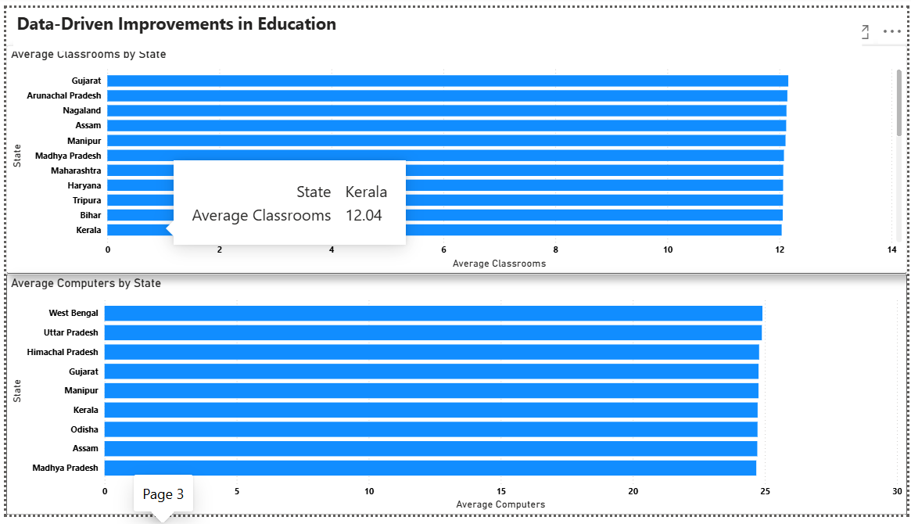
Dashboard — Infrastructure & State Analysis
Page 3 of 3
Infrastructure Analysis
Average Classrooms by State (Kerala leads at 12.04)
Average Computers by State (West Bengal, Uttar Pradesh lead)
Fleet average: 12.02 classrooms and 24.45 computers per school
State Analysis
Cross-filters with the State slicer from Page 1 for consistent comparison across all three pages
Data-Driven Improvements in Education
7
Notes:
Point out the tooltip example (Kerala = 12.04 average classrooms) as an example of the drill-down interactivity available.

Slide 8
Key Findings
Average score is stable at 65.92/100 across 500,000 students
State scores range narrowly: 65.60 (Rajasthan) to 66.19 (Goa)
Attendance shows no measurable correlation with score (r = 0.0006)
Family income shows only a marginal gradient (r = 0.0015)
Internet access and library availability show no measurable score impact
Teacher qualification does not correspond to differing experience levels
30% of teachers have not completed training
Training completion is the only factor with even a weak positive link to state performance (r ≈ 0.17)
No direct key links Teacher Data to individual students or schools
Scores stay in a narrow band across every tested factor — disparities appear diffuse, not concentrated
Data-Driven Improvements in Education
8
Notes:
This is the punchline slide. Emphasize finding #10 as the overarching takeaway before moving to recommendations.

Slide 9
Business Recommendations
Add a Teacher ID / School ID key to enable individual-level teacher-effectiveness analysis
Prioritize training completion for the remaining 30% of teachers
Commission a root-cause review in Rajasthan, Bihar, and Andhra Pradesh
Document and share practices from Goa, Mizoram, and Himachal Pradesh
Re-validate the attendance-performance link on a second data cycle before changing policy
Expand performance data beyond Mathematics to Science and English
Add Median, Standard Deviation, and Outlier-Flag DAX measures
Build explicit Score-by-Internet-Access and Score-by-Library visuals
Continue infrastructure rollout to remaining schools despite no current score link
Commission a data-quality audit before using findings for funding decisions
Data-Driven Improvements in Education
9
Notes:
Group these mentally into three buckets: data-model fixes, policy actions, and dashboard enhancements.

Slide 10
Project Learnings
Power BI
Power Query
Data Modeling
End-to-end dashboard build: data import, modeling, visuals, publishing
Cleaning, trimming, type correction, and consistency validation at scale
Star-schema design, relationship management, and grain limitations in practice
DAX
Dashboard Design
Business Analysis
Aggregation measures (AVERAGE, MAX, MIN, DISTINCTCOUNT) and KPI design
Multi-page navigation, slicers, cross-filtering, and layout for stakeholders
Translating chart output into decision-ready insight and recommendations
Data-Driven Improvements in Education
10
Notes:
Frame this as personal/team upskilling relevant to a BI analyst role.

Slide 11
Future Scope
AI-Assisted Insights
Predictive Analytics
Use Copilot-style narrative generation to auto-summarize dashboard changes for non-technical stakeholders
Forecast at-risk students using historical score and attendance trends
Machine Learning
Real-Time Dashboards
Build a classification model to flag schools likely to underperform, using infrastructure and staffing features
Connect to live student information systems (SIS) for continuously refreshed reporting instead of static extracts
Data-Driven Improvements in Education
11
Notes:
Keep this forward-looking and aspirational — a natural place to invite questions about scaling the project.

Slide 12
Conclusion
The project delivers a working relational data model, nine core DAX measures, and a three-page interactive dashboard consolidating five previously siloed education data sources into a single evidence base for the Ministry of Education.
The analysis shows a system with fairly uniform outcomes rather than sharp, single-cause disparities — with teacher training completion as the one concrete, actionable lever surfaced by the data.
Thank You
Data-Driven Improvements in Education
12
Notes:
Close by reiterating the project objective was achieved and invite questions.

