Slide 1

Title of the Project
AI-Powered Student Project Repository & Similarity Detection Portal
Roll Number | Name of the Student
23R21A05DT | Shyamala
23R21A05EX | Vedansh
23R21A05EF | Ankith
23R21A05DL | Roshan
MP_TG10
Dr. D.B.K Kamesh
Professor

Slide 2

Contents
Introduction
SIH-2026 Mapping ID
SDGs of the project
Abstract
Literature Survey
Research gaps identified
Problem Statement
Objectives
Existing and proposed system
Proposed methodology
System architecture
Google sign-in and verification
Self-service plagiarism check
Requirements from the college
Implementation and screenshots
Results and graphs
Future enhancements
Conclusion
References

Slide 3
Introduction
Final year projects are a core part of academic evaluation, but institutions lack an intelligent system to track and manage them.
With growing numbers of students, manually checking whether a project idea is original has become nearly impossible.
This project proposes an AI-powered web portal that stores, organizes, and intelligently analyzes all student projects in one place.
The system uses AI-based similarity detection to help faculty and students identify repeated or overlapping project ideas instantly.

Slide 4
SIH-2026 Mapping ID
SIH-2026 Mapping ID :SIH26147
Artificial Intelligence (AI) & Education Technology – Smart Education / Academic Integrity
Mapped Problem Area:
Project Repository Management, Similarity Detection & Academic Originality
Project Alignment:
Academic Integrity: Detects duplicate and overlapping project titles and abstracts.
Smart Search: AI-assisted keyword and semantic search of past projects.
Decision Support: Originality scores assist faculty approval decisions.
Institutional Records: Centralized, searchable repository with role-based access.

Slide 5
SDGs of the project
SDG 4 – Quality Education
Supports fair, transparent evaluation of student projects.
Encourages original thinking and discovery of new topics.
SDG 9 – Industry, Innovation and Infrastructure
Builds digital infrastructure for academic institutions.
Supports innovation through AI-based tools.
SDG 16 – Peace, Justice and Strong Institutions
Improves transparency and accountability in approvals.
Provides records for audit and accreditation.
Primary SDGs: SDG 4 and SDG 9

Slide 6
Abstract
This project presents an AI-integrated centralized portal for managing final year student projects across departments and years.
Core features: project upload, categorized browsing, keyword/domain-based search, and faculty approval workflow.
An AI-driven similarity detection module (TF-IDF with cosine similarity, or sentence embeddings) compares new project titles and abstracts against the existing database.
The AI model flags potential duplicates automatically, reducing manual review effort and improving accuracy.
Goal: use AI to ensure project originality while helping students discover unexplored, innovative topics.
Students sign in with Google and run iThenticate plagiarism checks themselves, without going to faculty for every draft; each result has a verifiable report code.

Slide 7
Literature Survey
S.No | Title of the Paper | Objective/Methods | Outcome of the paper | Limitations
1. | A Web-Based Final Year Students Project Duplication Detection System | Flags new project topics containing keywords already present in previously submitted titles. | Provides an automated, keyword-based way to check topic originality before approval. | Relies mainly on keyword matching; may miss semantically similar but reworded titles.
2 | Academic Project Information Management System – 2021 | Automates end-to-end management of final year projects: student groups, supervisors, and submissions. | Centralizes project data and streamlines tracking of students, supervisors, and submissions. | Focuses on administrative workflow only; lacks similarity or plagiarism detection.
3 | Development of a Final Year Project Management System for IT Programmes | Builds a records management system that stores completed projects for supervisor reference. | Helps supervisors identify repetitive topics and guide students toward unexplored areas. | Duplicate checking is manual; no AI/ML-based automated comparison.
4 | Plagiarism Detection in Students' Theses Using the Cosine Similarity Method | Applies TF-IDF preprocessing with cosine similarity to compare new titles/abstracts against a repository. | Flags textually similar submissions once similarity crosses a set threshold. | Sensitive to paraphrasing; struggles with semantically similar but reworded text.
5 | AI-Based Plagiarism Checking: Ease of Use and Applicable System for Teachers – 2023 | Combines text comparison with syntactic and semantic checking in an easy-to-use interface. | Gives faculty a practical, low-effort tool for detecting similarity in submissions. | Semantic-checking accuracy depends heavily on the underlying NLP model.

Slide 8
Researched Gaps Identified
No centralized, searchable repository of past and current projects across departments.
Keyword-only duplicate checks miss semantically similar, reworded titles.
Project management systems handle administration but lack similarity detection.
Duplicate checking is mostly manual and depends on supervisors' memory.
TF-IDF and cosine methods are sensitive to paraphrasing.
Semantic-check accuracy depends heavily on the underlying NLP model.
No originality score to support consistent faculty approval decisions.
Students get no insight into overused topics before proposing ideas.
Limited AI-verified evidence of project originality for NAAC/NBA.
Students must go to faculty for every plagiarism check.

Slide 9
Problem Statement
No centralized, intelligent repository exists for tracking final year projects in most institutions.
Faculty manually judge project originality with no AI or automated support, relying on memory or scattered records.
Students often unknowingly propose ideas that AI-based analysis could easily flag as repeats.
Lack of an AI-driven duplicate/similarity check leads to inconsistent, slow, and error-prone approval processes.
Students depend on faculty for every iThenticate plagiarism check, causing repeated visits.

Slide 10
Objectives
To design and develop a centralized, AI-enabled web portal to store and manage all student project records.
To enable faculty and students to search and browse past projects using AI-assisted keyword and semantic search.
To build an AI-based similarity-detection module (NLP/ML) to compare new titles and abstracts against the existing database.
To provide role-based access with AI-generated originality scores to assist faculty approval decisions.
To use AI to reduce topic duplication and promote innovative, original project selection.
To let students sign in with Google and run self-service iThenticate checks with verifiable report codes.

Slide 11
Proposed and Existing system
Existing System:
Final year projects tracked manually or in scattered records.
Originality judged from faculty memory, with no AI support.
Keyword-only or manual duplicate checks miss reworded titles.
Slow, inconsistent, and error-prone approval process.
Proposed System:
AI-powered portal acts as a centralized project repository.
Detects duplicate and overlapping project ideas using AI similarity.
Provides AI-assisted search and originality scores for faculty.
Role-based access with faculty approval workflow.
Google sign-in and self-service iThenticate checks with verifiable report codes.

Slide 12
Proposed Methodology
Project Submission
↓
Text Pre-processing
↓
Feature Extraction
(TF-IDF, Sentence Embeddings)
↓
Similarity Matching
↓
Originality Score
↓
Faculty Review & Approval
↓
Repository Update & Analytics

Slide 13
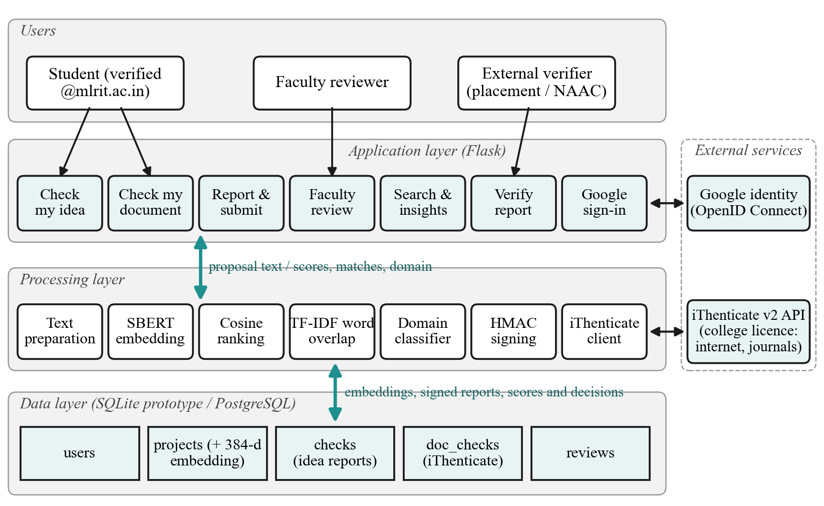
System Architecture

Slide 14
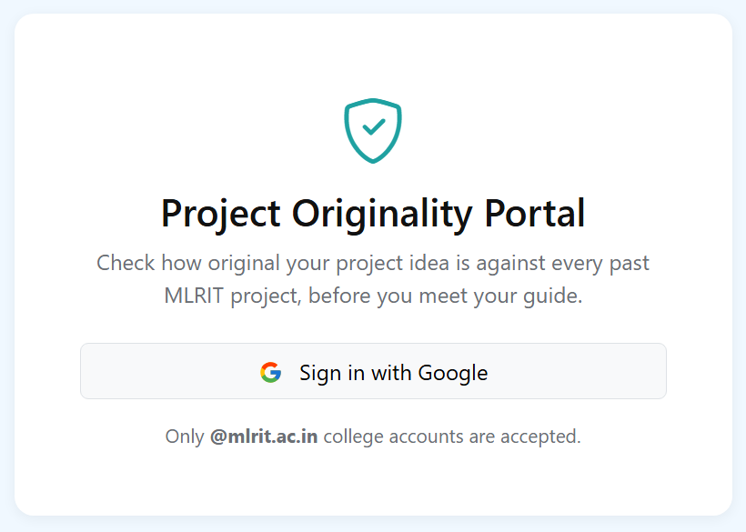
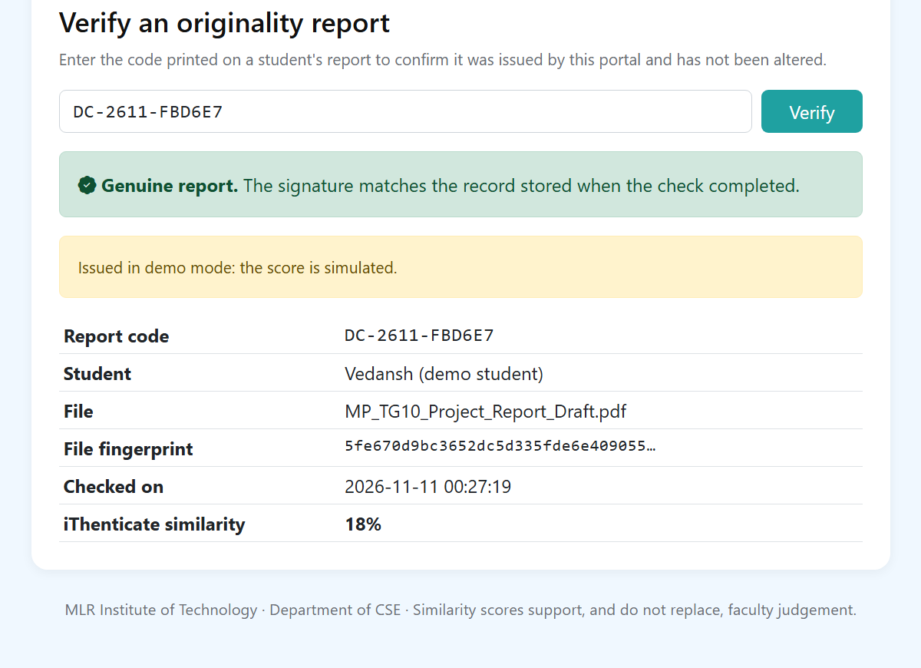
Google Sign-In and Report Verification
Sign in with the college Google account; no new passwords.
Only verified @mlrit.ac.in accounts are allowed.
Student role by default; faculty role from an admin list.
Every result gets a signed report code (OR- idea, DC- document).
Anyone can verify a code online; edited records show as altered.

Slide 15
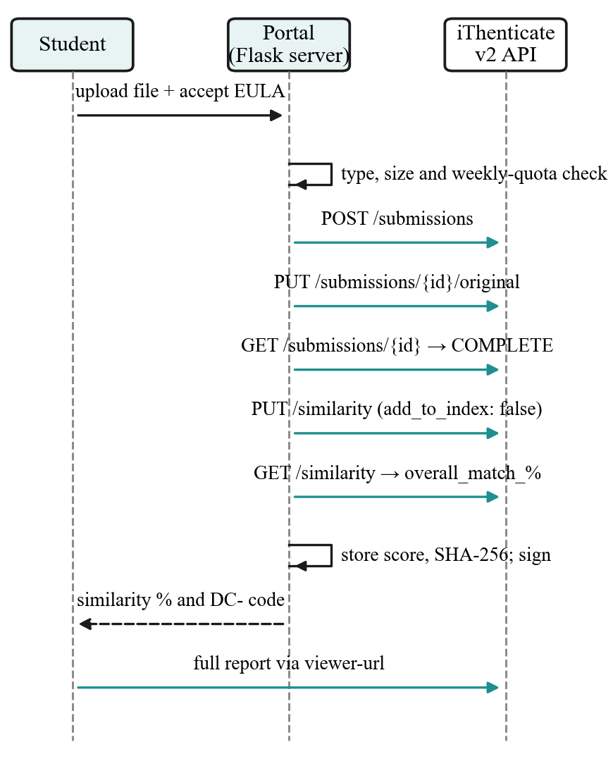
Self-Service Plagiarism Check (iThenticate)
Today: every draft goes to faculty for an iThenticate check.
Portal: the student uploads; the server calls the iThenticate v2 API and shows the similarity %.
Checks the internet, journals and submitted work.
API key stays on the server; no faculty login is shared.
Drafts are not stored in iThenticate's repository.
3 checks per student per week protect the licence.

Slide 16
Requirements from the College
iThenticate administrator: enable API access, create an API key (test key first) and share the tenant URL.
Quota: number of checks each student may run per week.
Written approval from HOD / library to use the licence through the portal.
Google Workspace admin: allow the portal's sign-in for @mlrit.ac.in accounts.
Past project records (title, abstract, domain, year) as an Excel sheet.
Not needed: any faculty username or password.

Slide 17
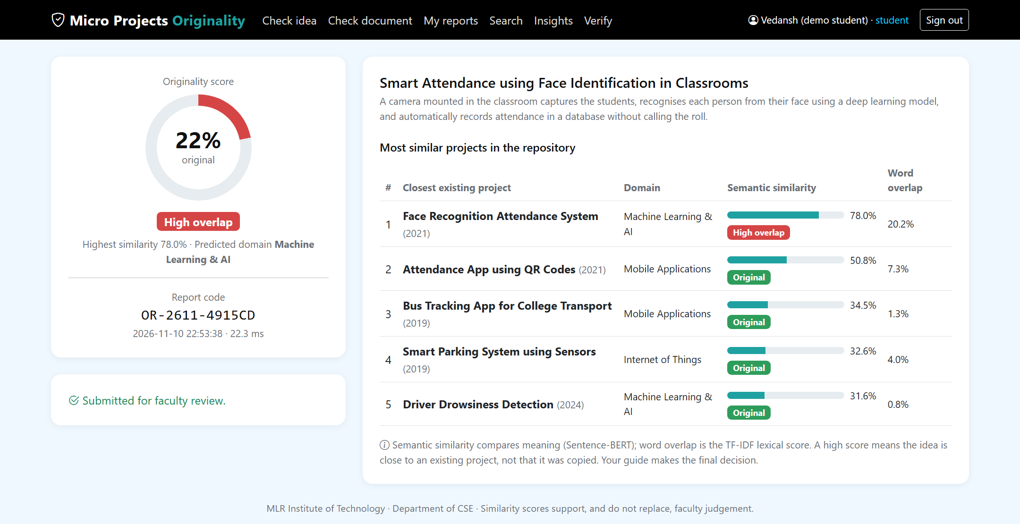
Implementation: Idea Check Report
Student report: 78% similar in meaning to an existing project but only 20% word overlap, so it is flagged as High overlap (22% original).

Slide 18
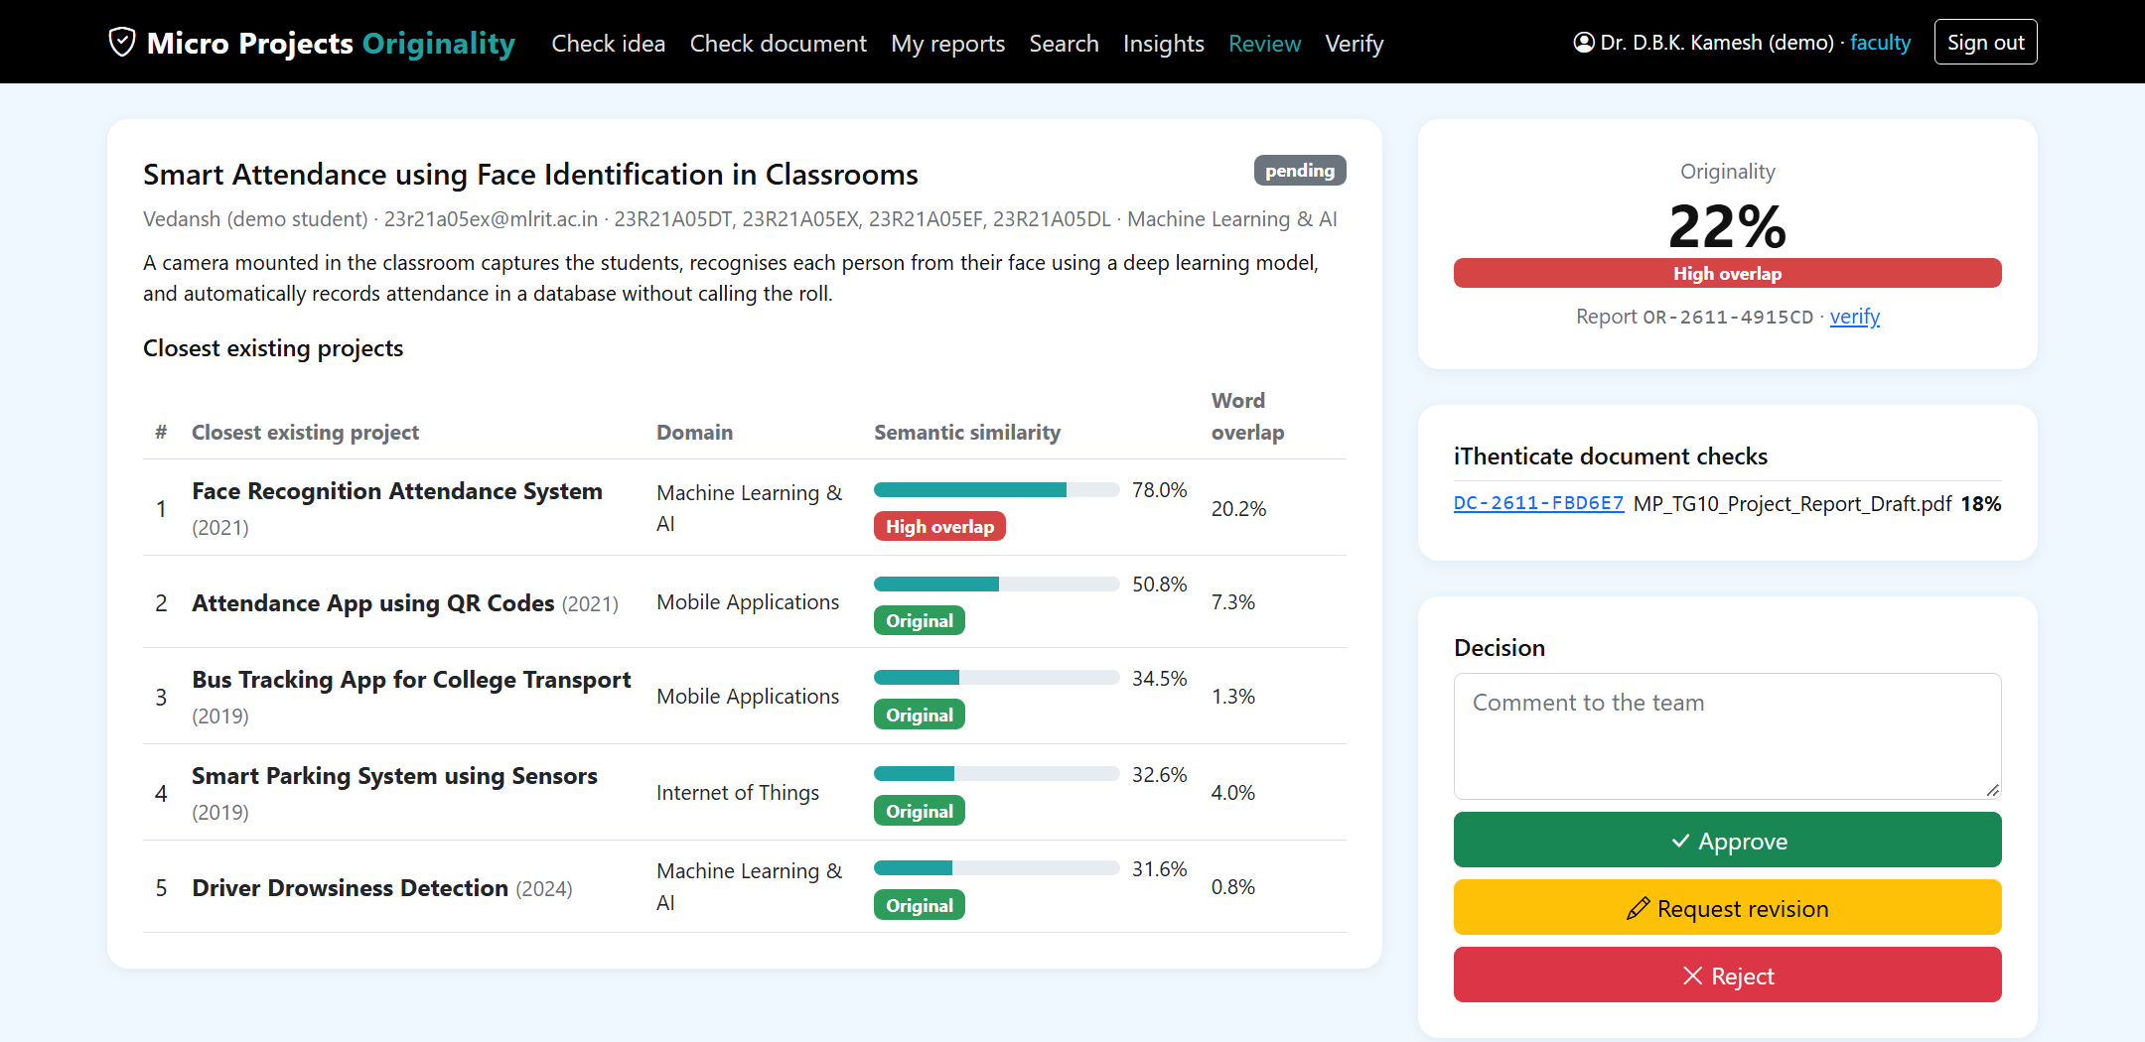
Implementation: Faculty Review
Faculty review: closest projects, the student's iThenticate document checks, and Approve / Revise / Reject.

Slide 19
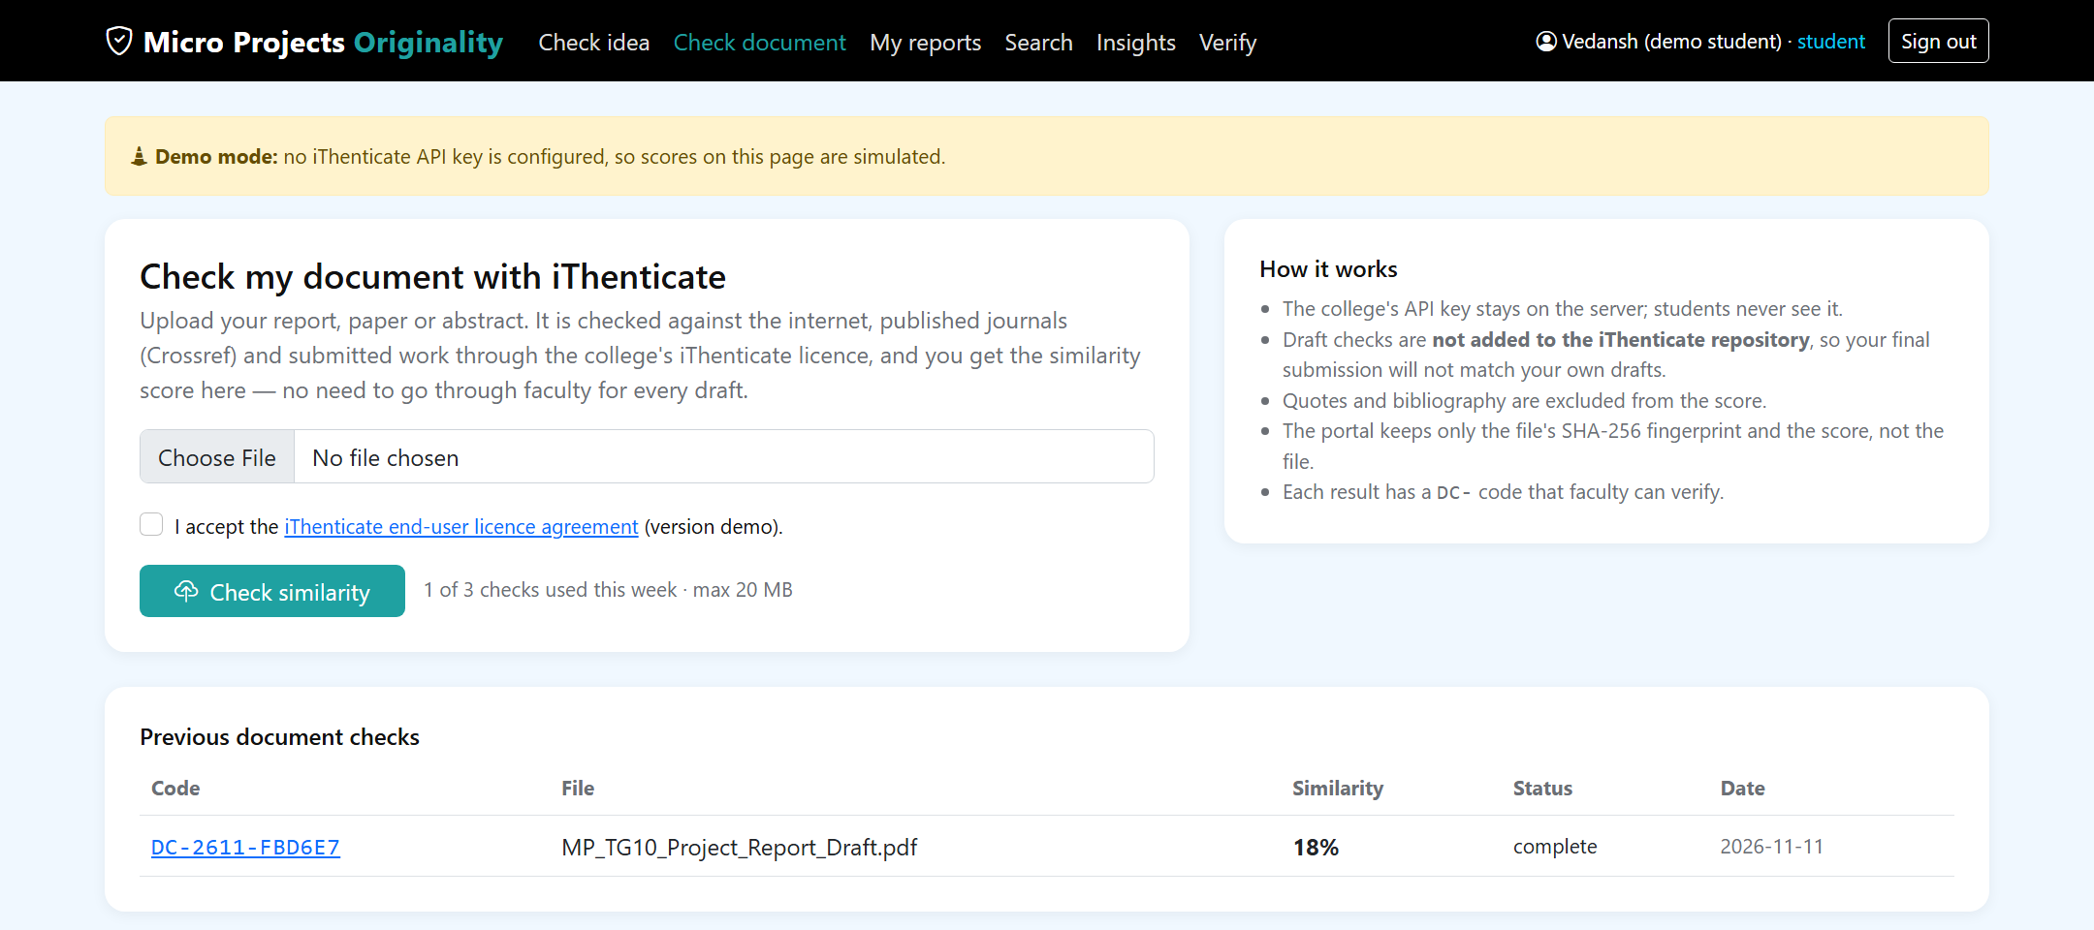
Implementation: Document Check Upload
Upload page: the student accepts the iThenticate agreement; the weekly quota is shown.

Slide 20
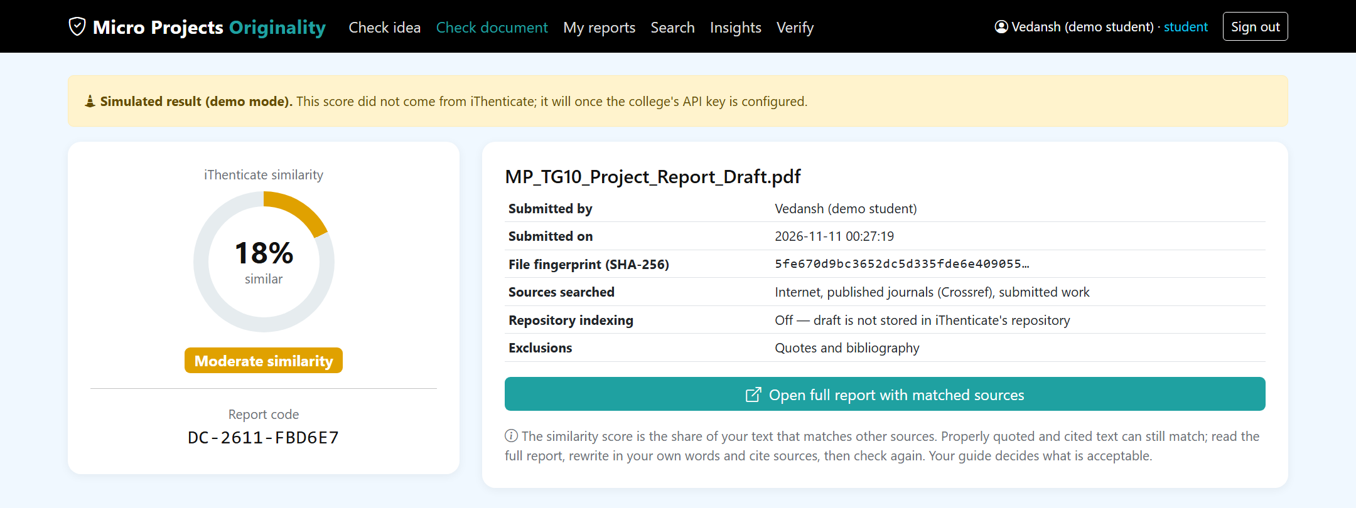
Implementation: Document Check Result
Result: similarity %, report code, file fingerprint and link to the full iThenticate report. Demo mode: score simulated until the college's API key is configured.

Slide 21
Expected Outcomes and Graphs
Functional Portal: A searchable database of past and current projects.
Reduced Duplication: Measurable reduction in project title duplication through AI-based similarity checks.
Faster Approvals: Faculty get an AI-generated originality score for data-backed decisions.
Student Insights: Students see overused ("hot") topics, guiding them toward original ideas.
Reusable Engine: A scalable similarity-detection engine adaptable to institution-wide use.
Fewer Faculty Visits: Students run iThenticate checks on their own drafts.
Measured Results: Sentence-BERT found 16/16 reworded projects (TF-IDF 11/16); precision 0.94, recall 1.00; 18 ms per check.

Slide 22
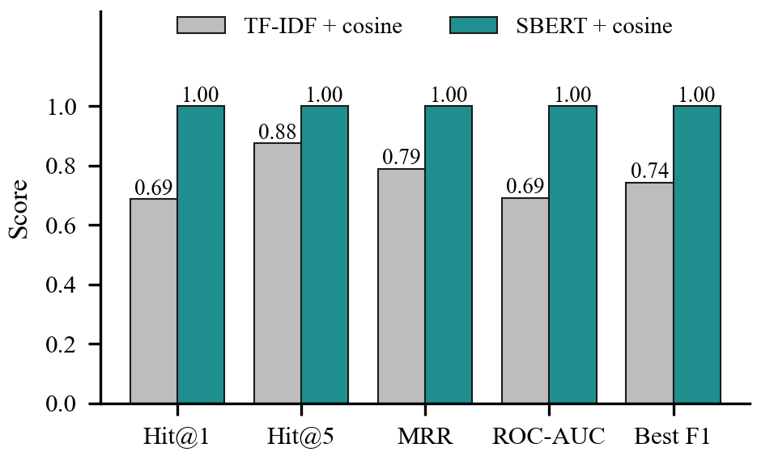
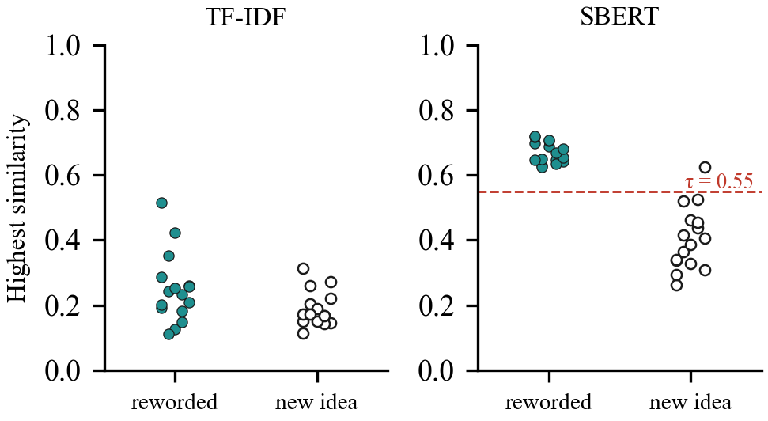
Graph 1: TF-IDF vs Sentence-BERT (measured)
Benchmark of 96 projects (8 domains) and 32 test proposals; 16 reworded, 16 new ideas.
Graph 2: Highest similarity per test proposal (measured)
Filled = reworded existing project, hollow = new idea; dashed line = 0.55 threshold.

Slide 23
Future Enhancements and Applications
Live iThenticate Key: Connect the college's API key and pilot with one batch.
Topic Trend Analytics: Show overused and unexplored project domains.
AI Chatbot Guidance: Guide students toward trending or unexplored project domains.
Research and Thesis Repositories: Extend the engine to research papers, theses, and internship projects.
Plagiarism Checks: Extend the self-check to assignments and internship reports.
NAAC / NBA Support: Provide AI-verified records of project originality and diversity.
Multi-Department Rollout: Deploy across engineering and CS departments.
Institution-Wide Scale: Reusable engine for all departments and years.
Real Records: Load past MLRIT projects and recalibrate thresholds.

Slide 24
Conclusion
The AI-Powered Student Project Repository & Similarity Detection Portal lets students do on their own what they previously had to request from faculty. They sign in with their college Google account, check whether their idea already exists using Sentence-BERT similarity against all past projects, and check their report for plagiarism through the college's iThenticate licence. Every result carries a signed code that faculty and auditors can verify, and the final approval stays with faculty. On our benchmark, semantic matching found every reworded project that keyword matching missed, in about 18 ms per check.

Slide 25
References
Jumoke, S., & Folashade, O. I. A Web-Based Final Year Students Project Duplication Detection System. International Journal of Computer Applications. https://www.researchgate.net/publication/312523925
Academic Project Information Management System. IEEE Conference Publication (2021). https://ieeexplore.ieee.org/document/9544565/
Plagiarism Detection in Students' Theses Using The Cosine Similarity Method. https://www.academia.edu/65392049/
AI Based Plagiarism Checking: Ease of Use and Applicable System for Teachers to Find Similarities in Students' Assessments. IEEE Conference Publication (2023). https://ieeexplore.ieee.org/document/10046379/
Fast and Reliable Plagiarism Detection System. IEEE Conference Publication. https://ieeexplore.ieee.org/document/4417860/
Reimers, N., & Gurevych, I. (2019). Sentence-BERT: Sentence Embeddings using Siamese BERT-Networks. EMNLP-IJCNLP. https://arxiv.org/abs/1908.10084
Pedregosa, F., et al. (2011). Scikit-learn: Machine Learning in Python. Journal of Machine Learning Research, 12, 2825–2830. https://jmlr.org/papers/v12/pedregosa11a.html
Salton, G., & Buckley, C. (1988). Term-weighting approaches in automatic text retrieval. Information Processing & Management, 24(5), 513–523.
Wang, W., et al. (2020). MiniLM: Deep Self-Attention Distillation for Task-Agnostic Compression of Pre-Trained Transformers. NeurIPS.
Turnitin. Turnitin Core API (iThenticate v2 API) documentation. https://developers.turnitin.com
Sakimura, N., et al. (2014). OpenID Connect Core 1.0. OpenID Foundation.

