Slide 1

Title of the Project
AI-Powered Student Project Repository & Similarity Detection Portal
Roll Number | Name of the Student
23R21A05DT | Shyamala
23R21A05EX | Vedansh
23R21A05EF | Ankith
23R21A05DL | Roshan
MP_TG10
Dr. D.B.K Kamesh
Professor

Slide 2

Contents
Introduction
SIH-2026 Mapping ID
SDGs of the project
Abstract
Literature Survey
Research gaps identified
Problem Statement
Objectives
Existing and proposed system
System architecture
Future enhancements
Expected outcomes and graphs
Conclusion
References

Slide 3
Introduction
Final year projects are a core part of academic evaluation, but institutions lack an intelligent system to track and manage them.
With growing numbers of students, manually checking whether a project idea is original has become nearly impossible.
This project proposes an AI-powered web portal that stores, organizes, and intelligently analyzes all student projects in one place.
The system uses AI-based similarity detection to help faculty and students identify repeated or overlapping project ideas instantly.

Slide 4
SIH-2026 Mapping ID
SIH-2026 Mapping ID :SIH26147
Artificial Intelligence (AI) & Education Technology – Smart Education / Academic Integrity
Mapped Problem Area:
Project Repository Management, Similarity Detection & Academic Originality
Project Alignment:
Academic Integrity: Detects duplicate and overlapping project titles and abstracts.
Smart Search: AI-assisted keyword and semantic search of past projects.
Decision Support: Originality scores assist faculty approval decisions.
Institutional Records: Centralized, searchable repository with role-based access.

Slide 5
SDGs of the project
SDG 4 – Quality Education
Supports fair, transparent evaluation of student projects.
Encourages original thinking and discovery of new topics.
SDG 9 – Industry, Innovation and Infrastructure
Builds digital infrastructure for academic institutions.
Supports innovation through AI-based tools.
SDG 16 – Peace, Justice and Strong Institutions
Improves transparency and accountability in approvals.
Provides records for audit and accreditation.
Primary SDGs: SDG 4 and SDG 9

Slide 6
Abstract
This project presents an AI-integrated centralized portal for managing final year student projects across departments and years.
Core features: project upload, categorized browsing, keyword/domain-based search, and faculty approval workflow.
An AI-driven similarity detection module (TF-IDF with cosine similarity, or sentence embeddings) compares new project titles and abstracts against the existing database.
The AI model flags potential duplicates automatically, reducing manual review effort and improving accuracy.
Goal: use AI to ensure project originality while helping students discover unexplored, innovative topics.

Slide 7
Literature Survey
S.No | Title of the Paper | Objective/Methods | Outcome of the paper | Limitations
1. | A Web-Based Final Year Students Project Duplication Detection System | Flags new project topics containing keywords already present in previously submitted titles. | Provides an automated, keyword-based way to check topic originality before approval. | Relies mainly on keyword matching; may miss semantically similar but reworded titles.
2 | Academic Project Information Management System – 2021 | Automates end-to-end management of final year projects: student groups, supervisors, and submissions. | Centralizes project data and streamlines tracking of students, supervisors, and submissions. | Focuses on administrative workflow only; lacks similarity or plagiarism detection.
3 | Development of a Final Year Project Management System for IT Programmes | Builds a records management system that stores completed projects for supervisor reference. | Helps supervisors identify repetitive topics and guide students toward unexplored areas. | Duplicate checking is manual; no AI/ML-based automated comparison.
4 | Plagiarism Detection in Students' Theses Using the Cosine Similarity Method | Applies TF-IDF preprocessing with cosine similarity to compare new titles/abstracts against a repository. | Flags textually similar submissions once similarity crosses a set threshold. | Sensitive to paraphrasing; struggles with semantically similar but reworded text.
5 | AI-Based Plagiarism Checking: Ease of Use and Applicable System for Teachers – 2023 | Combines text comparison with syntactic and semantic checking in an easy-to-use interface. | Gives faculty a practical, low-effort tool for detecting similarity in submissions. | Semantic-checking accuracy depends heavily on the underlying NLP model.

Slide 8
Researched Gaps Identified
No centralized, searchable repository of past and current projects across departments.
Keyword-only duplicate checks miss semantically similar, reworded titles.
Project management systems handle administration but lack similarity detection.
Duplicate checking is mostly manual and depends on supervisors' memory.
TF-IDF and cosine methods are sensitive to paraphrasing.
Semantic-check accuracy depends heavily on the underlying NLP model.
No originality score to support consistent faculty approval decisions.
Students get no insight into overused topics before proposing ideas.
Limited AI-verified evidence of project originality for NAAC/NBA.

Slide 9
Problem Statement
No centralized, intelligent repository exists for tracking final year projects in most institutions.
Faculty manually judge project originality with no AI or automated support, relying on memory or scattered records.
Students often unknowingly propose ideas that AI-based analysis could easily flag as repeats.
Lack of an AI-driven duplicate/similarity check leads to inconsistent, slow, and error-prone approval processes.

Slide 10
Objectives
To design and develop a centralized, AI-enabled web portal to store and manage all student project records.
To enable faculty and students to search and browse past projects using AI-assisted keyword and semantic search.
To build an AI-based similarity-detection module (NLP/ML) to compare new titles and abstracts against the existing database.
To provide role-based access with AI-generated originality scores to assist faculty approval decisions.
To use AI to reduce topic duplication and promote innovative, original project selection.

Slide 11
Proposed and Existing system
Existing System:
Final year projects tracked manually or in scattered records.
Originality judged from faculty memory, with no AI support.
Keyword-only or manual duplicate checks miss reworded titles.
Slow, inconsistent, and error-prone approval process.
Proposed System:
AI-powered portal acts as a centralized project repository.
Detects duplicate and overlapping project ideas using AI similarity.
Provides AI-assisted search and originality scores for faculty.
Role-based access with faculty approval workflow.

Slide 12
Proposed Methodology
Project Submission
↓
Text Pre-processing
↓
Feature Extraction
(TF-IDF, Sentence Embeddings)
↓
Similarity Matching
↓
Originality Score
↓
Faculty Review & Approval
↓
Repository Update & Analytics

Slide 13
Expected Outcomes and Graphs
Functional Portal: A searchable database of past and current projects.
Reduced Duplication: Measurable reduction in project title duplication through AI-based similarity checks.
Faster Approvals: Faculty get an AI-generated originality score for data-backed decisions.
Student Insights: Students see overused ("hot") topics, guiding them toward original ideas.
Reusable Engine: A scalable similarity-detection engine adaptable to institution-wide use.

Slide 14
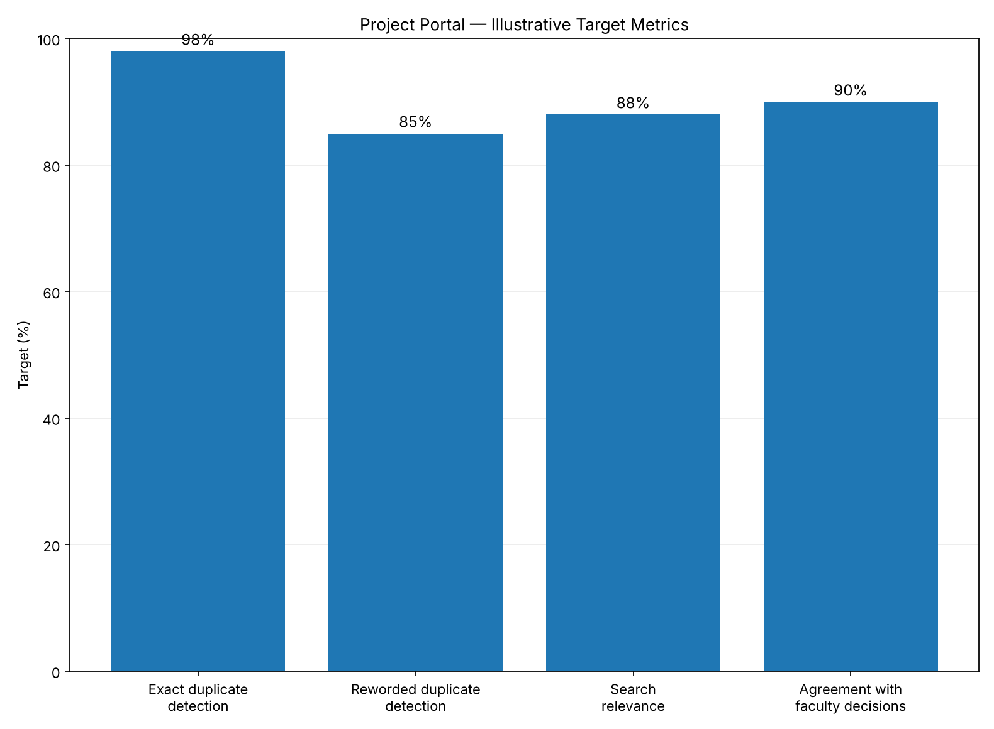
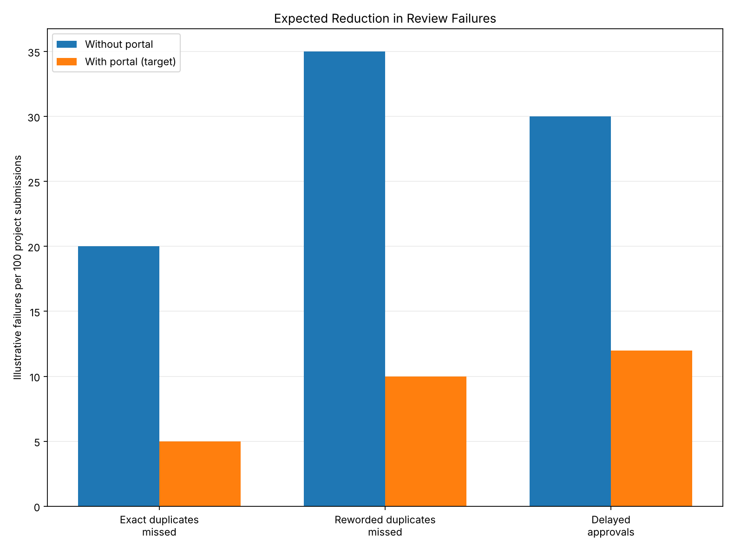
Graph 1: Target Performance Metrics
Illustrative targets — not actual experimental results.
Graph 2: Expected Reduction in Failures
Illustrative comparison per 100 project submissions.

Slide 15
Future Enhancements and Applications
Semantic Models: Improve detection of reworded ideas using sentence embeddings.
Topic Trend Analytics: Show overused and unexplored project domains.
AI Chatbot Guidance: Guide students toward trending or unexplored project domains.
Research and Thesis Repositories: Extend the engine to research papers, theses, and internship projects.
Plagiarism Checks: Adapt for assignments, reports, and journal submissions.
NAAC / NBA Support: Provide AI-verified records of project originality and diversity.
Multi-Department Rollout: Deploy across engineering and CS departments.
Institution-Wide Scale: Reusable engine for all departments and years.

Slide 16
Conclusion
The AI-Powered Student Project Repository & Similarity Detection Portal provides a centralized, searchable home for all final year projects. It flags repeated or overlapping ideas before approval, gives faculty an originality score for data-backed decisions, and guides students toward original topics. With role-based access, an approval workflow, and AI-based similarity detection, the system reduces manual effort and duplication, and makes project approval faster, more consistent, and more transparent. Overall, it enables institutions to manage final year projects in a smarter, more reliable, and more original manner.

Slide 17
References
Jumoke, S., & Folashade, O. I. A Web-Based Final Year Students Project Duplication Detection System. International Journal of Computer Applications. https://www.researchgate.net/publication/312523925
Academic Project Information Management System. IEEE Conference Publication (2021). https://ieeexplore.ieee.org/document/9544565/
Plagiarism Detection in Students' Theses Using The Cosine Similarity Method. https://www.academia.edu/65392049/
AI Based Plagiarism Checking: Ease of Use and Applicable System for Teachers to Find Similarities in Students' Assessments. IEEE Conference Publication (2023). https://ieeexplore.ieee.org/document/10046379/
Fast and Reliable Plagiarism Detection System. IEEE Conference Publication. https://ieeexplore.ieee.org/document/4417860/
Reimers, N., & Gurevych, I. (2019). Sentence-BERT: Sentence Embeddings using Siamese BERT-Networks. EMNLP-IJCNLP. https://arxiv.org/abs/1908.10084
Pedregosa, F., et al. (2011). Scikit-learn: Machine Learning in Python. Journal of Machine Learning Research, 12, 2825–2830. https://jmlr.org/papers/v12/pedregosa11a.html
Salton, G., & Buckley, C. (1988). Term-weighting approaches in automatic text retrieval. Information Processing & Management, 24(5), 513–523.

