Slide 1


SOFTWARE GROUP PROJECT CONTROL HOME APPLIANCES WITH SMART DEVICES
17CE122 KARTIK SUTARIYA
17CE124 KEYUR TALATI
17CE129 VEDANSHU TRIVEDI
GUIDED BY : PROF. AMRIN SHAIKH

Slide 2
AIM
To develop a Wi-Fi based home automation system with NodeMCU and an Android application.

Slide 3
OVERVIEW OF PROJECT
Automatic Room Lights System using Arduino is a very useful project as you need not worry about turning on and off the switches every time you want to turn on the lights. The main components of the Project are Room are nod MCU, and the Relay Module.

Slide 4
INTRODUCTION
To develop a Wi-Fi based home automation system with NodeMCU and an Android application.
Remote controlled home automation system provides a simpler solution with Android application technology.
Remote operation is achieved by any smartphone/Tablet etc., with Android OS, upon a GUI (Graphical User Interface) based touch screen operation

Slide 5
HARDWARE REQUIRED
Arduino board
Resistor
LED
NodeMCU
Breadboard
Relay Module
Connecting Wires
2.2 v power supply

Slide 6
SOFTWARE REQUIRED
Arduino IDE
Mobile application

Slide 7
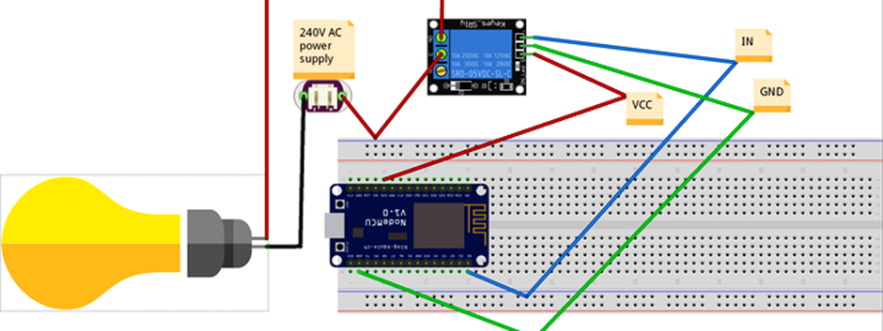
CIRCUIT DIAGRAM

Slide 8
ADVANTAGES
It is a robust and easy to use system.
There is no need for extra training of that person who is using it.
All the control would be in your hands by using this system.
This project can provide the facility of monitoring all the appliances with in the any range
The schematic of nodMCU is open source, for the future enhancement of the project board can be extended to add more hardware features.

Slide 9
DISADVANTAGES
If there is a problem with in the nodMCU than whole project will crash.
If someone have the same android application than they can also control home appliences with our your permission
With out internet connection you can not operate home appliences like fan and light

Slide 10
FUTURE ASPECTS
Automatic light on and off for a room {using PIR sensor}
Change the color of room lights with smart devices
Change fan speed with smart devices
AUTOMATIC ON / OFF lights{using light sensor}

Slide 11
THANK YOU

