Slide 1
The Tour of Swing
Delivered by:
Vaishali Tidake
vaishalitidake@yahoo.co.in

Slide 2
Topics Covered
JApplet, Icons and Labels , TextFields, Buttons, Combo Boxes, Tabbed Panes , Scroll Panes, Trees , Tables , Exploring the Swings

Slide 3
Introduction to Java
Process of Building and Running Java Application programs:
Text Editor
Java Source Code
Javac
Java Class File
Java
Java Program Output

Slide 4
Introduction to Java
Two Ways of using Java:
Java Source Code
Java Compiler
Java enabled
Web Browser
Java Interpreter
Output
Output

Slide 5


Slide 6

JFC – JavaTM Foundation Classes
Encompass a group of features for constructing graphical user interfaces (GUI).
Implemented without any native code.
“Swing” is the codename of the project that developed the first JFC components .
The name “Swing” is frequently used to refer to new components and related API.

Slide 7

JFC includes:
  The Swing Components
    Tabbed pane, Buttons, ...
  Pluggable Look and Feel (PLAF)
  Java 2 Platform only

Slide 8




Each picture shows the same program but with a different look and feel
javax.swing.plaf.metal.MetalLookAndFeel
javax.swing.plaf.motif.MotifLookAndFeel
Javax.swing.plaf.windows.WindowsLookAndFeel

Slide 9

Swing provides many standard GUI components such as buttons, lists, menus, and text areas, which you combine to create your program's GUI.
Swing provides containers such as:
  top level: frames, dialogs
  intermediate level: panel, scroll pane, tabbed pane, ...

Slide 10

Descendents of the java.awt.Container class
Components that can contain other components.
Use a layout manager to position and size the components contained in them.
Components are added to a container using one of the various forms of its add method
  Depending on which layout manager is used by the container
panel.add(component);

Slide 11
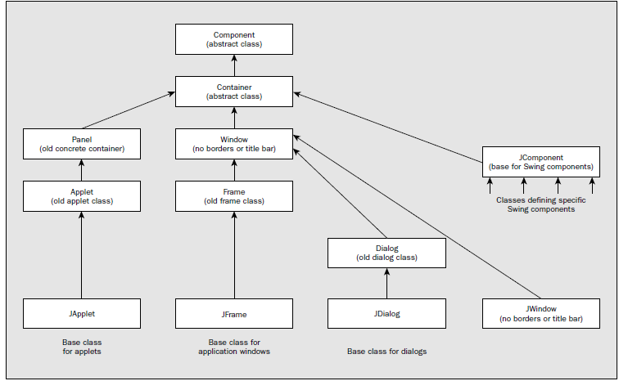

Slide 12

Every program that presents a Swing GUI contains at least one top-level container.
A Top level container provides the support that Swing components need to perform their painting and event-handling.
Swing provides four top-level containers:
  JFrame
  JDialog
  JApplet
  JWindow

Slide 13
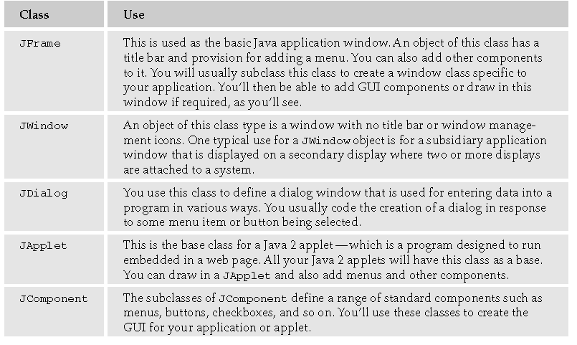

Slide 14

To appear on screen, every GUI component must be part of a containment hierarchy, with a top-level container as its root.
Each top-level container has a content pane that contains visible components in that top-level container’s GUI.
A top-level container can not contain another top level container.

Slide 15

A frame implemented as an instance of the JFrame class
It is a window that has decorations such as a border, a title and buttons for closing and iconifying the window.
Applications with a GUI typically use at least one frame.

Slide 16
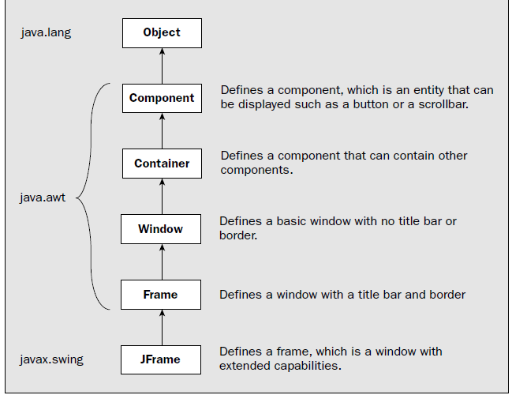

Slide 17


import javax.swing.*;
public class HelloWorldSwing {
public static void main(String[] args) {
JFrame frame = new JFrame("HelloWorldSwing");
JLabel label = new JLabel("Hello World");
frame.getContentPane().add(label); // 1.4
// OR USE THIS frame.add(label); JDK 5
frame.setDefaultCloseOperation(JFrame.EXIT_ON_CLOSE);
frame.setVisible(true);
}
}

Slide 18

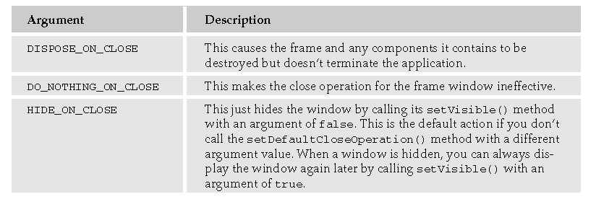

Slide 19

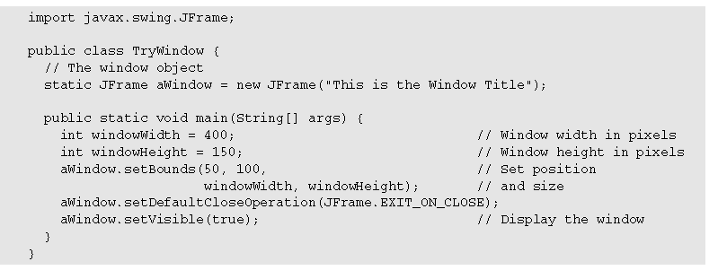

Slide 20

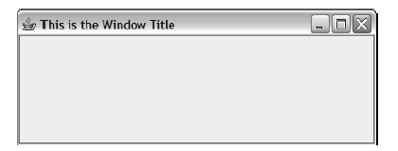

Slide 21

Position (x,y)
Name .setName() .getName();
Size
Foreground And Background Color
Font
State (setEnabled ([True/False])) isEnable()
Visible (setVisible([True/False])) isVisible()

Slide 22

Position is defined by x and y coordinates of type int, or by an object of type java.awt.Point.
Size is defined by width and height, also values of type int, or by an object of type java.awt.Dimension.
A Rectangle specifies an area in a coordinate space that is enclosed by the Rectangle object's upper-left point (x,y) in the coordinate space, its width, and its height.

Slide 23

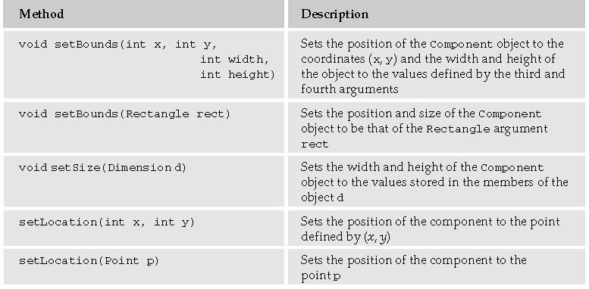

Slide 24

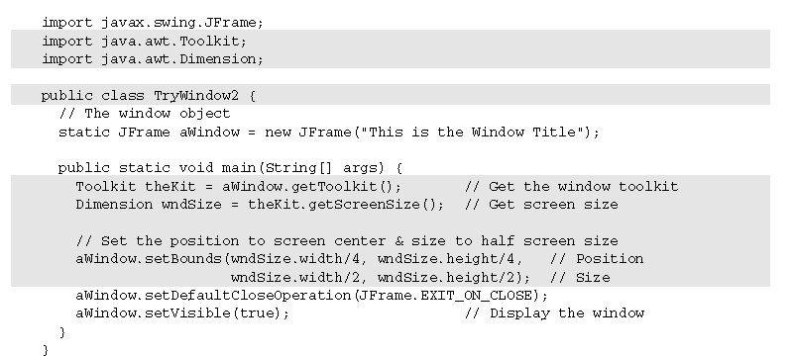

Slide 25

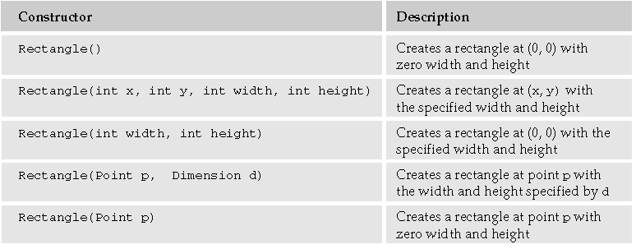
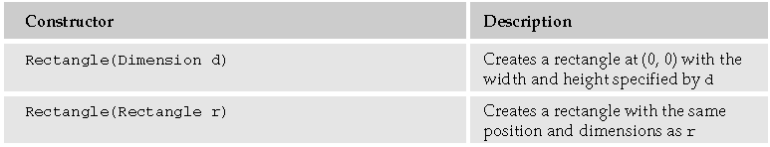

Slide 26
A Simple Example
import javax.swing.JFrame;
public class Simple extends JFrame {
public Simple() {
setSize(300, 200);
setTitle("Simple");
setDefaultCloseOperation(EXIT_ON_CLOSE);
}
public static void main(String[] args) {
Simple simple = new Simple();
simple.setVisible(true);
}
}

Slide 27
Anatomy
import javax.swing.JFrame;
    This is a top level container, which is used to place other components.
setDefaultCloseOperation(EXIT_ON_CLOSE);
    This method will close the window.

Slide 28
Adding Buttons to a Frame
import java.awt.event.ActionEvent;
import java.awt.event.ActionListener;
import javax.swing.JButton;
import javax.swing.JFrame;
import javax.swing.JPanel;
public class Buttons extends JFrame {
private Toolkit toolkit;
public Buttons() {
setTitle("Buttons");
setSize(300, 200);
setDefaultCloseOperation(EXIT_ON_CLOSE);
JPanel panel = new JPanel();
getContentPane().add(panel);
panel.setLayout(null);
//continued….

Slide 29
Adding Buttons – Contd…
JButton close = new JButton("Close");
close.setBounds(50, 60, 80, 30);
close.addActionListener(new ActionListener() { public void actionPerformed(ActionEvent event) { System.exit(0); } });
panel.add(close);
}
public static void main(String[] args) {
Buttons buttons = new Buttons();
buttons.setVisible(true);
}
}

Slide 30
Anatomy of buttons example
Three new things to notice
    Add Panel to a Frame
    Layout Management
    Event Handling

Slide 31
Buttons Example – Adding Panel
JPanel panel = new JPanel(); getContentPane().add(panel);
We create a panel using JPanel, and then add the panel to the Frame.
Note that getContentPane() is a method of Jframe class.
getContentPane() method returns an object of type Container.
To the returned container object, add a panel, using add method of Container class.
Components like textbox, button can be added to the panel

Slide 32
Button Example – Layout Management
panel.setLayout(null);
    A layout manager is used for laying out components.
    By default, a panel has FlowLayout Manager.
    setLayout(null) takes off layout manager from the panel. This means, we can layout components as we wish
JButton beep = new JButton("Beep"); beep.setBounds(150, 60, 80, 30);
panel.add(beep);
    1st line, creates a button.
    2nd line, places a button on the panel using setBounds method.
    3rd line, adds a button to the panel.

Slide 33
Button Example – Event Handling
beep.addActionListener(new ActionListener() {
public void actionPerformed(ActionEvent event) {
toolkit.beep();
}
});
ActionListener is an interfac.
Above is an example of anonymous inner-class
We are creating a class which has no name, but it implements ActionListener interface. Inorder to do so, it also provides implementation for the actionPerformed() method.
addActionLisener(), adds a Listener to the beep button.
Se next slide for explanation.

Slide 34
Button Example – Event Handling
beep.addActionListener(new ButtonActionListener());
class ButtonActionListener implements ActionListener{
public void actionPerformed(ActionEvent event){
System.out.println("beep called");
}
}
Create a new class ButtonActionListener, which implemetns Action Listener.
beep.addActionListener(new ButtonActionListener)
    this line adds a listener to the beep button, if an event occurs, an object of ButtonActionListener is created, and actionPerformed() method is invoked

Slide 35
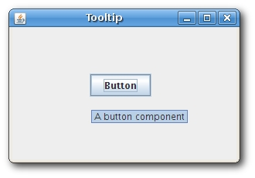
Adding Tooltip
In the previous example, add the following code
  button.setToolTipText("A button component");

Slide 36
Swing Layout Management
No Manager
Flowlayout Manager
Gridlayout Manager
Borderlayout Manager

Slide 37
No Layout Manager
This mean no layout manager is used.
Components are laid out using explicit values.
panel.setLayout(null);
    By default, a panel has FlowLayout Manager.
    setLayout(null) takes off layout manager from the panel. This means, we can layout components as we wish
JButton beep = new JButton("Beep"); beep.setBounds(150, 60, 80, 30);
panel.add(beep);

Slide 38
FlowLayout Manager
The manager puts component in a row, in the order they are added.
If they don’t fit in a row, they are appended on the next row.
Three constructors
  FlowLayout() //by default, centered, 5px spaces

Slide 39
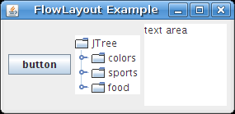
Example of FlowLayout Manager
public class FlowLayoutExample extends JFrame {
public FlowLayoutExample() {
setTitle("FlowLayout Example");
JPanel panel = new JPanel();
JTextArea area = new JTextArea("text area");
area.setPreferredSize(new Dimension(100, 100));
JButton button = new JButton("button");
panel.add(button);
JTree tree = new JTree();
panel.add(tree);
panel.add(area);
getContentPane().add(panel);
pack();
setDefaultCloseOperation(JFrame.EXIT_ON_CLOSE);
setVisible(true); }
public static void main(String[] args) { new FlowLayoutExample(); } }

Slide 40
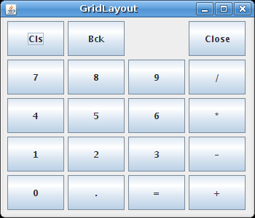
Grid Layout Manager
It makes a grid, and lays out components in that grid.
One component is placed in each rectangle.

Slide 41
Example: Grid Layout Manager
Get a panel object
  JPanel p = new JPanel()
Create grid layout manager
  GridLayout gl = new GridLayout()
Add gridlayout to the panel
  p.setLayout(gl)
Constructor
  GridLayout(int rows, int cols, int hgap, int vgap)

Slide 42
Example – Grid Layout Manager
public class GridLayoutExample extends JFrame {
public GridLayoutExample() {
setTitle("GridLayout");
JPanel panel = new JPanel();
panel.setBorder(BorderFactory.createEmptyBorder(5, 5, 5, 5)); panel.setLayout(new GridLayout(5, 4, 5, 5));
String[] buttons = { "Cls", "Bck", "", "Close", "7", "8", "9", "/", "4", "5", "6", "*", "1", "2", "3", "-", "0", ".", "=", "+" };
for (int i = 0; i < buttons.length; i++) {
if (i == 2) panel.add(new JLabel(buttons[i]));
else panel.add(new JButton(buttons[i]));
}
getContentPane().add(panel);
setSize(350, 300);
setDefaultCloseOperation(JFrame.EXIT_ON_CLOSE);
setVisible(true); }
public static void main(String[] args) { new GridLayoutExample(); } }

Slide 43
Border Layout Manager
Divides spaces into 5 regions
  North, West, South, East, and Centre
Can add only one component in one region
To add more than one component in one region, add a panel to that region

Slide 44
Example: Border Layout
public class BorderLayoutExample extends JFrame {
public BorderLayoutExample() {
setTitle("BorderLayout");
JMenuBar menubar = new JMenuBar();
JMenu file = new JMenu("File");
menubar.add(file);
setJMenuBar(menubar);
JToolBar toolbar = new JToolBar();
toolbar.setFloatable(false);
ImageIcon exit = new ImageIcon("eject.png");
JButton bexit = new JButton(exit);
toolbar.add(bexit);
getContentPane().add(toolbar, BorderLayout.NORTH);
//contd…

Slide 45
Example: Border Layout – Contd..
JToolBar vertical = new JToolBar(JToolBar.VERTICAL);
ImageIcon icon1 = new ImageIcon("delete.png");
ImageIcon icon2 = new ImageIcon("empty.png");
ImageIcon icon3 = new ImageIcon("cone_plus.png");
JButton b1 = new JButton(icon1);
JButton b2 = new JButton(icon2);
JButton b3 = new JButton(icon3);
vertical.add(b1);
vertical.add(b2);
vertical.add(b3);
getContentPane().add(vertical, BorderLayout.WEST);
//contd…

Slide 46
Example: Border Layout – Contd..
getContentPane().add(new JTextArea(), BorderLayout.CENTER);
JLabel statusbar = new JLabel(" Statusbar");
getContentPane().add(statusbar, BorderLayout.SOUTH);
setSize(350, 300);
setDefaultCloseOperation(JFrame.EXIT_ON_CLOSE);
setVisible(true);
}
public static void main(String[] args) {
new BorderLayoutExample();
}
}

Slide 47
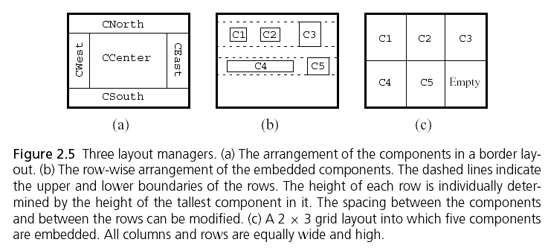
Layout Managers

Slide 48
Applets
An applet is typically embedded in a Web page and can be run from a browser
You need special HTML tags in the Web page to tell the browser about the applet
You write an applet by extending the class Applet

Slide 49
The genealogy of Applet
java.lang.Object
|
+----java.awt.Component
|
+----java.awt.Container
|
+----java.awt.Panel
|
+----java.applet.Applet

Slide 50
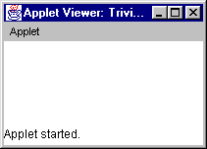
The simplest possible applet
TrivialApplet.java
import java.applet.Applet;
public class TrivialApplet extends Applet { }
TrivialApplet.html
<applet
code="TrivialApplet.class”
width=150 height=100>
</applet>

Slide 51
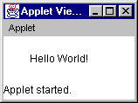
The simplest reasonable applet
import java.awt.*;
import java.applet.Applet;
public class HelloWorld extends Applet {
public void paint( Graphics g ) {
g.drawString( "Hello World!", 30, 30 );
}
}

Slide 52
Applet methods
public void init ()
public void start ()
public void stop ()
public void destroy ()
public void paint (Graphics)
Also:
public void repaint()
public void update (Graphics)

Slide 53
public void init ( )
This is the first method to execute
It is an ideal place to initialize variables
It is the best place to define the GUI Components (buttons, text fields, scrollbars, etc.), lay them out, and add listeners to them
Almost every applet you ever write will have an init( ) method

Slide 54
public void start ( )
Not always needed
Called after init( )
Called each time the page is loaded and restarted
Used mostly in conjunction with stop( )
start() and stop( ) are used when the Applet is doing time-consuming calculations that you don’t want to continue when the page is not in front

Slide 55
public void stop( )
Not always needed
Called when the browser leaves the page
Called just before destroy( )
Use stop( ) if the applet is doing heavy computation that you don’t want to continue when the browser is on some other page
Used mostly in conjunction with start()

Slide 56
public void destroy( )
Seldom needed
Called after stop( )
Use to explicitly release system resources (like threads)
System resources are usually released automatically

Slide 57
Methods are called in this order
init and destroy are only called once each
start and stop are called whenever the browser enters and leaves the page
do some work is code called by your listeners
paint is called when the applet needs to be repainted
init()
start()
do some work
stop()
destroy()

Slide 58
public void paint(Graphics g)
Needed if you do any drawing or painting other than just using standard GUI Components
Any painting you want to do should be done here, or in a method you call from here
Painting that you do in other methods may or may not happen
Never call paint(Graphics), call repaint( )

Slide 59
repaint( )
Call repaint( ) when you have changed something and want your changes to show up on the screen
repaint( ) is a request--it might not happen
When you call repaint( ), Java schedules a call to update(Graphics g)

Slide 60
update( )
When you call repaint( ), Java schedules a call to update(Graphics g)
Here's what update does:
  public void update(Graphics g) {
  // Fills applet with background color, then
  paint(g);
  }

Slide 61
Sample Graphics methods
A Graphics is something you can paint on
g.drawString(“Hello”, 20, 20);
Hello
g.drawRect(x, y, width, height);
g.fillRect(x, y, width, height);
g.drawOval(x, y, width, height);
g.fillOval(x, y, width, height);
g.setColor(Color.red);

Slide 62
Swing Applet
/* <applet code="SwingAppletExample1" width=200 height=200> * </applet> */
public class SwingAppletExample1 extends JApplet
{
JLabel label;
JButton press,close;
public void init()
{
try
{
SwingUtilities.invokeAndWait(new Runnable()
{
public void run()
{
makeGUI();
}
}
);
}
catch(Exception e)
{
System.out.println("cannot create applet: error...“ + e);
}
}

Slide 63
Swing Applet – Contd
private void makeGUI()
{
label=new JLabel("this is label");
press=new JButton("Press me");
press.addActionListener(new ActionListener()
{
public void actionPerformed(ActionEvent ae)
{
label.setText("u pressed me");
}
}
);
close = new JButton("Close");
getContentPane().setLayout(new FlowLayout());
getContentPane().add(label);
getContentPane().add(press);
getContentPane().add(close);
}
}

Slide 64
Swing Applet
Init() method initializes the swing components on the event dispatching threads by setting up a call to makeGUI().
Applets must use invokeAndWait() because the init() method should not return until the entire initialization process has been completed. GUI must be completely constructed before start() method is called.

Slide 65
JLabel
public JLabel(String text, Icon icon, int horizontalAlignment)
  Creates a JLabel instance with the specified text, image, and horizontal alignment. The text is on the trailing edge of the image.
Parameters:
  text - The text to be displayed by the label.
  icon - The image to be displayed by the label.
  horizontalAlignment - One of the following constants defined in SwingConstants: LEFT, CENTER, RIGHT, LEADING or TRAILING.

Slide 66
JTextField
Allows to edit ine line of text
When the user hits RETURN, the text field fires an action event.
public JTextField(String text, int columns)
  Constructs a new TextField initialized with the specified text and columns. A default model is created.
Parameters:
  text - the text to be displayed, or null
  columns - the number of columns to use to calculate the preferred width; if columns is set to zero, the preferred width will be whatever naturally results from the component implementation

Slide 67
JTextField - contd
When the user hits RETURN, the text field fires an action event.
JTextField textfield =new JTextField("Initial Text");
textfield.addActionListener(new MyActionListener());
class MyActionListener implements ActionListener {
public void actionPerformed(ActionEvent evt) {
JTextField textfield =(JTextField)evt.getSource();
process(textfield.getText());
}
}

Slide 68
JButton
public JButton(String text, Icon icon)
  Creates a JButton instance with the specified text, image. The text is on the trailing edge of the image.
Parameters:
  text - The text to be displayed by the label.
  icon - The image to be displayed by the label.

Slide 69
Creating a Checkbox Button
JCheckBox checkBox = new JCheckBox("Label");
checkBox.addActionListener(actionListener);
// Set the current state of the checkbox.
checkBox.setSelected(false);
// Get the current state of the checkbox.
boolean on = checkBox.isSelected();

Slide 70
Creating a Password Text Field
JPasswordField textfield = new JPasswordField("Initial Text");
textfield.setEchoChar('#');

Slide 71
Creating a Toolbar
This example adds an image button to the toolbar.
ImageIcon icon = new ImageIcon("image.gif");
JButton button = new JButton(icon);
button.addActionListener(actionListener);
JToolBar toolbar = new JToolBar();
toolbar.add(button);

Slide 72
JTabbedPane
A component that lets the user switch between a group of components by clicking on a tab with a given title and/or icon .
public void addTab(String title, Icon icon, Component component, String tip)
  Parameters:
    title - the title to be displayed in this tab
    icon - the icon to be displayed in this tab , can be null
    component - the component to be displayed when this tab is clicked
    tip - the tooltip to be displayed for this tab, can be null

Slide 73
JTabbedPane - contd
Steps-
Create an instance of JTabbedPane
Add each tab by calling addTab()
Add tabbedpane to the content pane

Slide 74
JScrollPane
use a scroll pane to display a component that is large
A JScrollPane manages a viewport(viewable area)
Automates vertical and horizontal scroll bars
public JScrollPane(Component comp)
  Parameters:
    comp - the component to be scrolled

Slide 75
JScrollPane - contd
Steps-
Create a component to be scrolled
Create JScrollPane object
Add component to scrollpane
Add scrollpane to the content pane

Slide 76
JComboBox
lets the user to choose one of several choices.
Combo boxes require little screen space.
addItem(string) is used to add items to combobox.

Slide 77
JTrees
displays a set of hierarchical data
Control can be expanded or collapsed .
does not actually contain your data; it simply provides a view of the data.
Every tree has a root node from which all nodes descend.
DefaultMutableTreeNode class is used to create nodes.

Slide 78
JTrees - contd
Steps-
Create an instance of a JTree
Create JScrollPane object
Add tree to scrollpane
Add scrollpane to the content pane

Slide 79
JTable
Presents data in tabular format
public JTable(Vector rowData, Vector columnNames)
  Constructs a JTable to display the values in rowData, with columnNames.
  Value of the cell at row 1, column 5 can be obtained with the following code:
  ((Vector)rowData.elementAt(1)).elementAt(5);
Parameters:
  rowData - the data for the new table
  columnNames - names of each column

Slide 80
JTable - contd
Steps-
Create an instance of a JTable
Create JScrollPane object
Add table to scrollpane
Add scrollpane to the content pane

Slide 81
The classpath
In Java, the classpath points to all directories containing class files to be used by the javac and java commands.
To specify a classpath one uses the –classpath option of these commands.
For example, suppose our class files are located in the directories ‘D:\Java\Project’, in ‘C:\Stuff\Java’, and in the current working directory, which is denoted by a dot (.). Suppose the main file is called mymain.java.
In order that the compile command finds the files one uses
javac -classpath .;D:\Java\Project;C:\Stuff\Java mymain.java
Still it might happen that the compiler complains that it cannot find some class files. This usually happens if an environment variable is set for the classpath. These are variables that determine the classpath for the whole computer.

Slide 82
Thank you
Any Queries?

