Slide 1

IITI-SoC 2026 Astronomy domain PS:- Modeling THE structure of PROTOPLANETARY DISCS TEAM Members :- VEDANT , YASH SHIVAM , samyak

Slide 2
INTRODUCTION

Slide 3
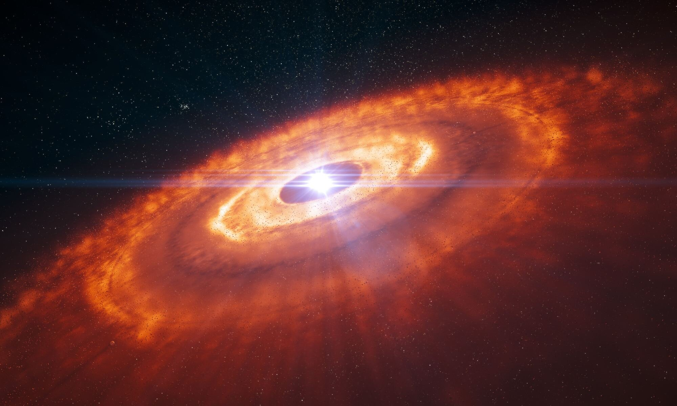
Modeling the Structure and Evolution of Protoplanetary Disks
Protoplanetary disks are rotating disks of gas and dust surrounding newly formed stars. These disks serve as the birthplaces of planets, moons, asteroids, and other planetary system components. Understanding their structure and evolution is one of the central problems in modern astrophysics and planetary science.

Slide 4
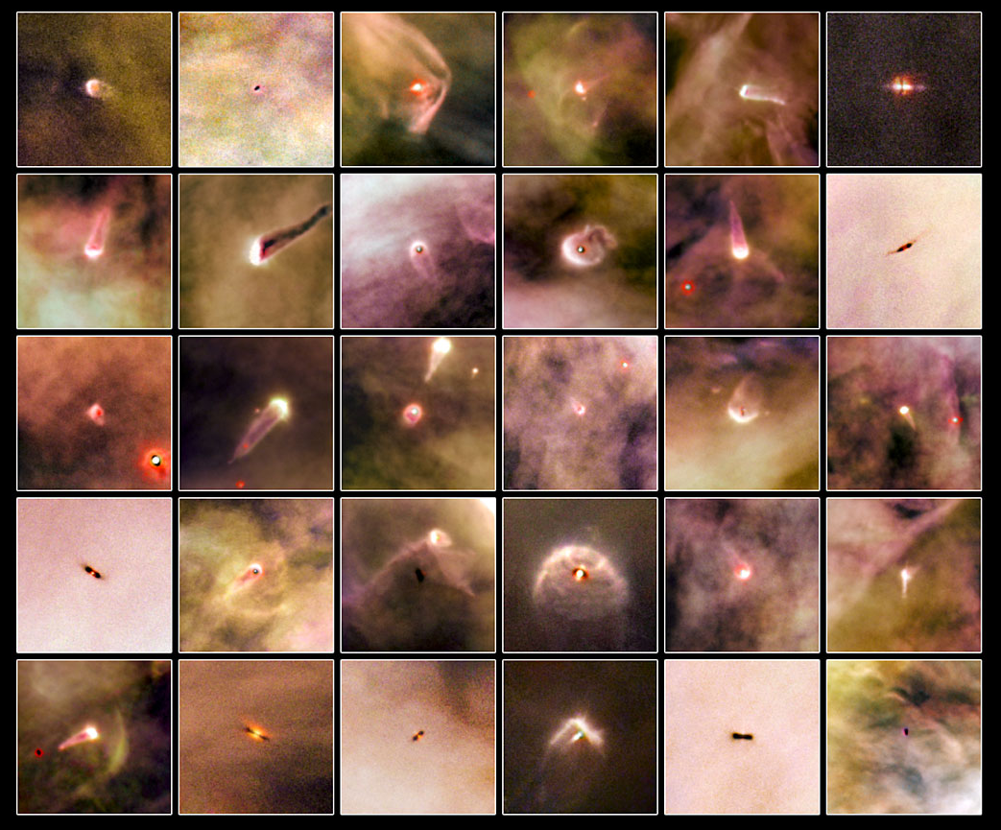
These disks typically survive for about 3 to 10 million years, during which dust grains grow, collide, form planetesimals, and eventually give rise to planets.
A typical protoplanetary disk consists of approximately 99% gas, primarily hydrogen and helium, and about 1% dust made of silicates, carbonaceous material, and various ices. The disk may extend from fractions of an astronomical unit (AU) close to the star to several hundred AU in the outer regions.

Slide 5
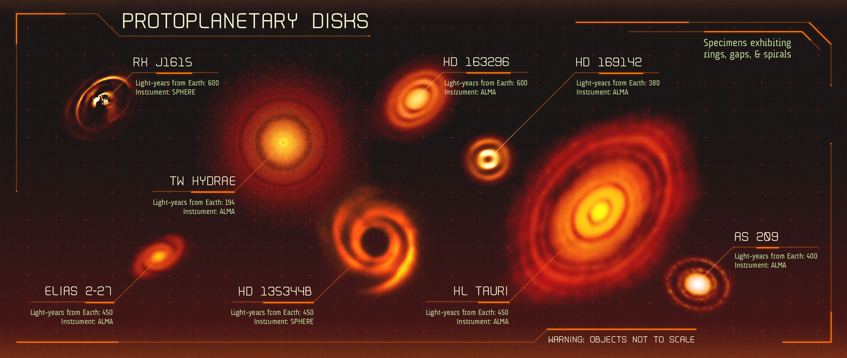

Slide 6
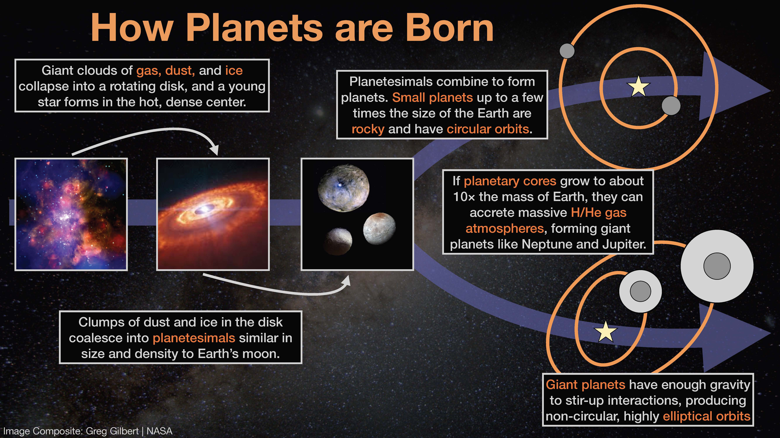

Slide 7
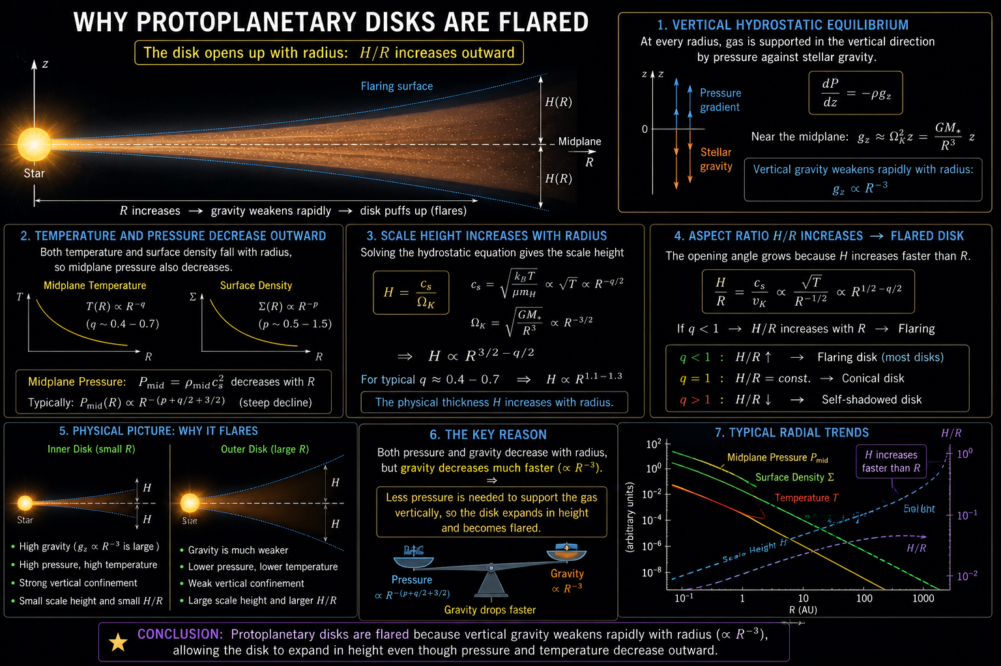

Slide 8
The present implementation models a static, axisymmetric, passively irradiated protoplanetary disk under the assumption of vertical hydrostatic equilibrium. The simulator computes the radial temperature profile, surface density distribution, pressure scale height, Keplerian rotational velocity, and the resulting two-dimensional gas density structure.
Complex physical processes such as radiative transfer, chemistry, magnetic fields, dust settling, planet–disk interactions, and time-dependent viscous evolution are excluded from the baseline implementation in order to maintain computational simplicity.
These features are identified as future extensions of the project.

Slide 9
Physical Assumptions

Slide 10
Axisymmetric Disk assumption
The disk is represented in a cylindrical coordinate system (R, ϕ, z), where R denotes the radial distance from the central star, ϕ represents the azimuthal angle, and z is the height above the disk midplane.
Owing to the approximately axisymmetric nature of most observed protoplanetary disks, The disk is assumed to possess rotational symmetry about the central star. Consequently, all physical quantities are considered independent of the azimuthal coordinate (ϕ) and depend only on the radial distance and height above the midplane,
ρ = ρ(R, z).
This assumption neglects spiral arms, vortices, warps and other localized asymmetries, reducing the problem to a two-dimensional (R, z) description.

Slide 11
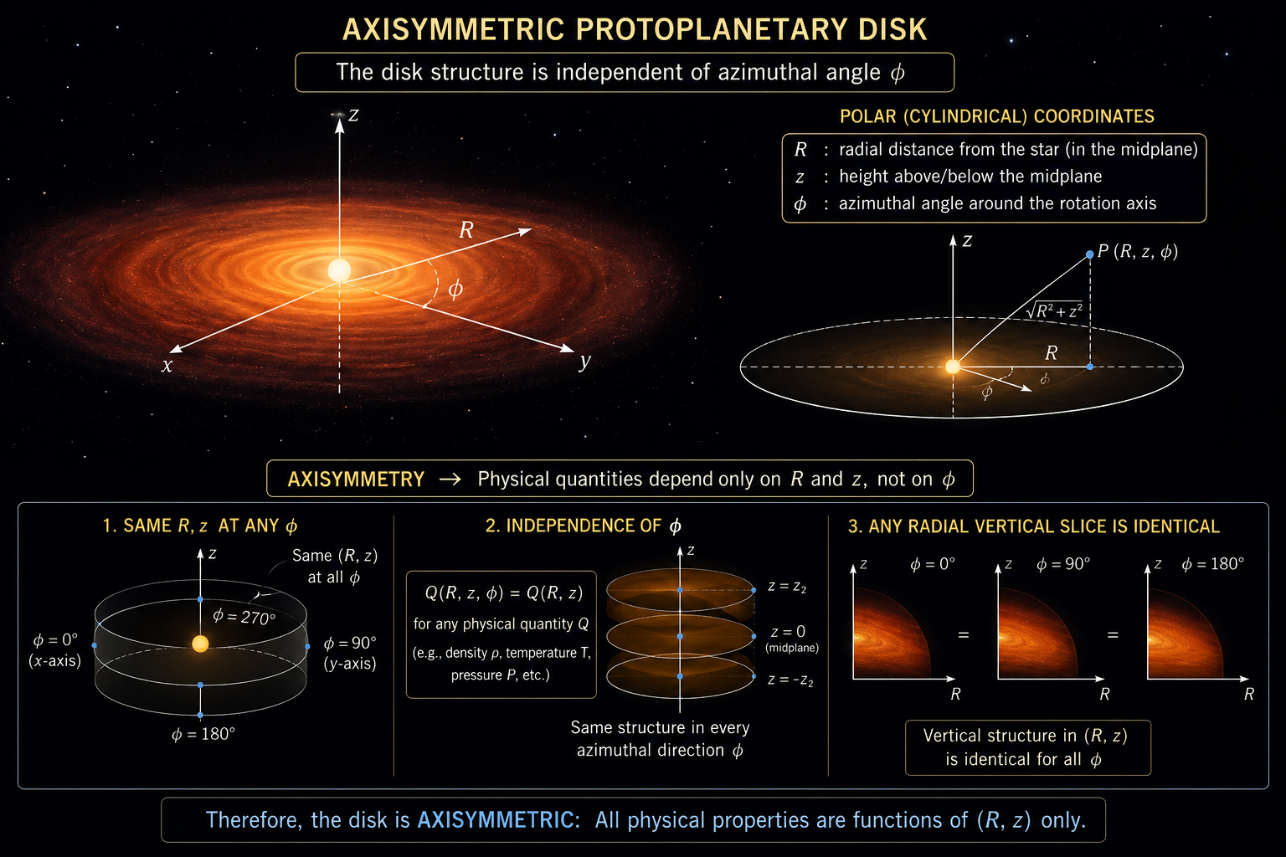

Slide 12
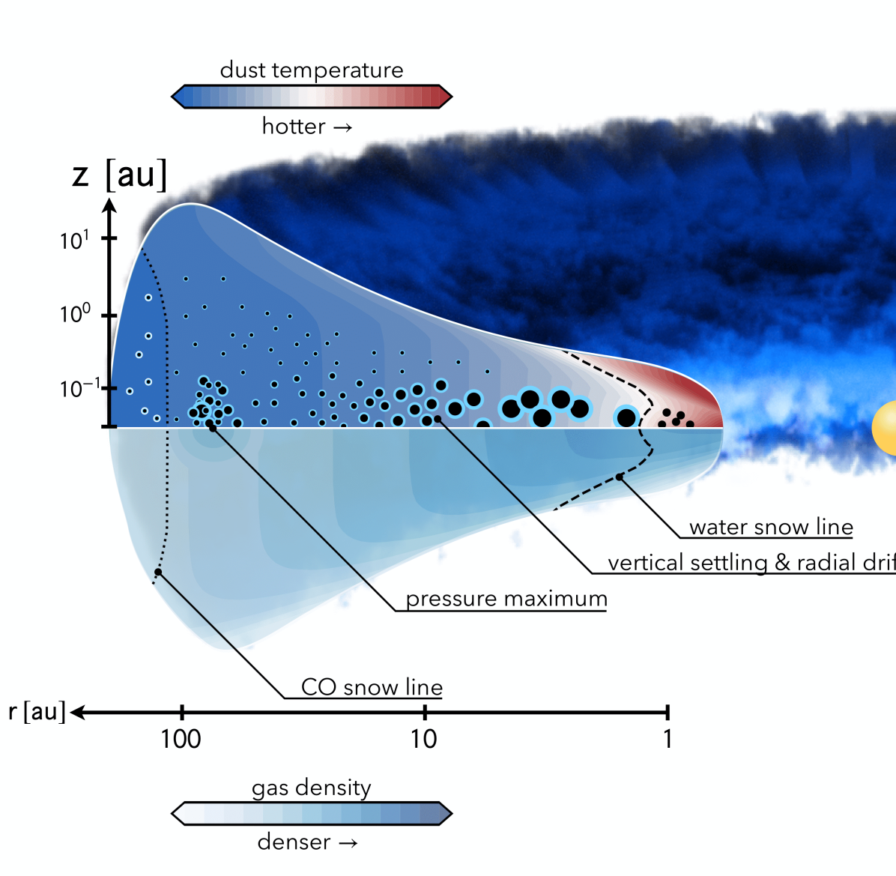
Geometrically Thin Disk Approximation
The disk is assumed to be geometrically thin, implying that its vertical extent is significantly smaller than its radial extent, i.e.,
H << R
where H is the pressure scale height and R is the cylindrical radius.
This assumption allows the radial and vertical structures of the disk to be treated independently to first order and is well justified for most observed protoplanetary disks

Slide 13
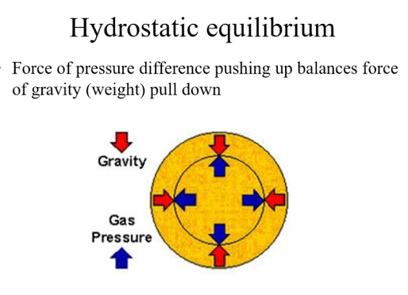
Static Disk Approximation
The present model represents a static snapshot of the disk. Time-dependent processes such as viscous evolution, accretion, photoevaporation and disk dispersal are neglected. This approximation allows the focus to remain on the equilibrium structure of the disk.
Vertical Hydrostatic Equilibrium
The vertical structure of the disk is obtained by assuming hydrostatic equilibrium. At every radius, the upward pressure gradient balances the vertical component of stellar gravity. This assumption naturally determines the pressure scale height and leads to the Gaussian density profile adopted in the present work.

Slide 14

Keplerian Rotation
The gravitational potential is assumed to be dominated by the central star, while the self-gravity of the disk is neglected. Under this assumption, the gas follows Keplerian rotation throughout the disk,
$$Ω=\sqrt{\frac{GM^{∗}}{R^{3}}}$$
This is a valid approximation for most protoplanetary disks whose masses are significantly smaller than the stellar mass.

Slide 15
Passive Irradiation
The disk is assumed to be heated primarily by stellar irradiation. Heating due to viscous accretion is neglected, making the disk a passive flared disk. Consequently, the temperature distribution is prescribed using a radial power-law profile and vertically isothermal rather than being obtained from detailed radiative transfer calculations.
Well-Mixed Gas and Dust
Gas and dust are assumed to remain perfectly coupled throughout the disk with a constant dust-to-gas mass ratio and mean molecular weight of 2.3 times mass of Hydrogen. Processes such as grain growth, radial drift, fragmentation and dust settling are beyond the scope of the current implementation.

Slide 16
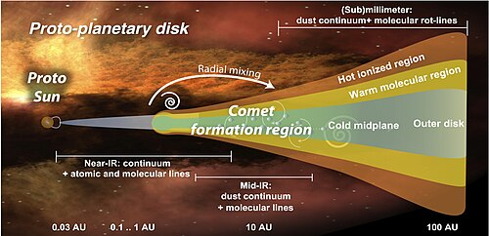

Slide 17
Mathematical model

Slide 18
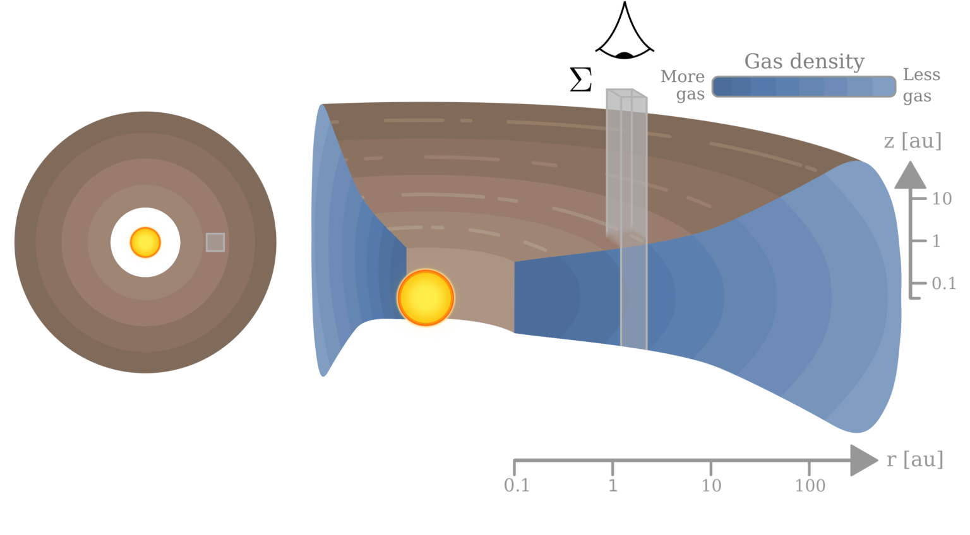
Surface Density Distribution
The surface density, denoted by Σ(R), represents the vertically integrated mass per unit area of the disk. It determines how material is distributed with increasing distance from the central star and directly influences the total disk mass, pressure structure, and vertical density distribution.

Slide 19
The present work adopts a widely used analytical self-similar surface density profile. This formulation naturally produces a power-law distribution in the inner disk while introducing an exponential taper towards the outer regions, closely matching observations of many protoplanetary disks.
The adopted surface density profile is
$$Σ\left(R\right)=Σc{\left(R/Rc\right)}^{\left(−γ\right)}exp\left[−{\left(R/Rc\right)}^{\left(2−γ\right)}\right]$$
Where :-
• Σc is the normalization constant,
• Rc is the characteristic radius,
• γ controls the radial density slope.
This equation forms the foundation for determining the total mass distribution throughout the disk.

Slide 20

Temperature Profile
The radial temperature profile is approximated using a simple power-law,
$$T\left(R\right)=T_{0}{\left(\frac{R}{1 \text{AU}}\right)}^{−q}$$
Where :-
• T0 is the reference temperature,
• R0 is the reference radius,
• q is the temperature exponent.
This relation captures the gradual cooling of the disk with increasing distance from
the star and provides the thermal input required for subsequent calculations.

Slide 21

Pressure Scale Height
The vertical thickness of the disk is governed by the balance between thermal pressure and stellar gravity. This characteristic thickness is quantified by the pressure scale height.
The first step is to determine the isothermal sound speed,
$$c_{s}=\sqrt{\frac{k_{B}T}{μm_{H}}}$$
Where :-
• kB is the Boltzmann constant,
• μ is the mean molecular weight,
• mH is the hydrogen mass.
The pressure scale height then follows directly from the condition of hydrostatic equilibrium,
$$H\left(R\right)=\frac{c_{s}}{Ω}$$

Slide 22
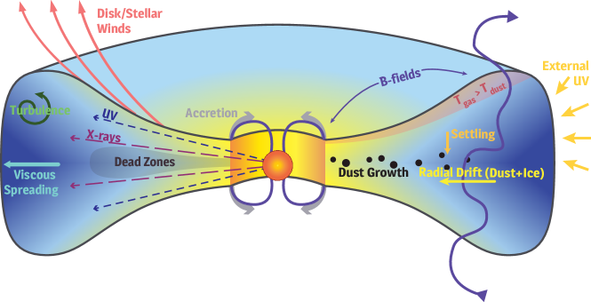
The radial increase in scale height naturally produces the flared geometry commonly observed in passive protoplanetary disks. The flared shape is a balance between stellar gravity pulling the material down and thermal gas pressure pushing it up. Because the star’s vertical gravitational pull weakens rapidly at larger distances, the thermal pressure allows the outer parts of the disk to expand vertically, creating the characteristic flared geometry.

Slide 23

Vertical Density Distribution
The three-dimensional density structure of the disk is reconstructed by assuming vertical hydrostatic equilibrium together with an isothermal vertical temperature profile.
Under these assumptions, the gas density follows a Gaussian distribution,
$$ρ\left(R,z\right)=\frac{Σ\left(R\right)}{\sqrt{2π}H\left(R\right)}\exp\left(−\frac{z^{2}}{2H{\left(R\right)}^{2}}\right)$$
The Gaussian profile concentrates the majority of the gas close to the disk midplane
while allowing the density to decrease smoothly with height. This equation is used
to generate the two-dimensional density maps and vertical cross-sectional visualizations
produced by the simulator.
Together, these equations form the mathematical foundation of the computational framework developed in this project. The mathematical framework presented is implemented as a modular Python-based simulation pipeline.

Slide 24
RESULTS, Plots and conclusions

Slide 25
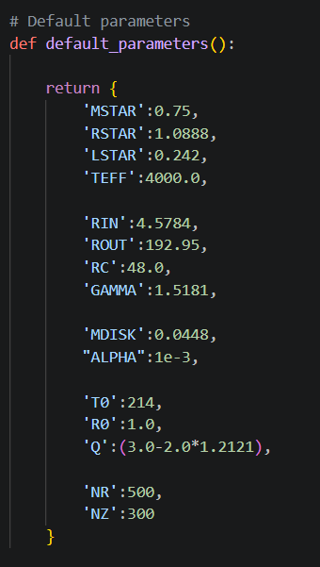
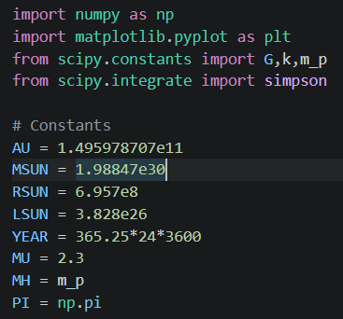
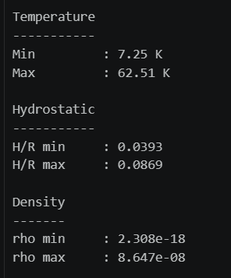

Slide 26
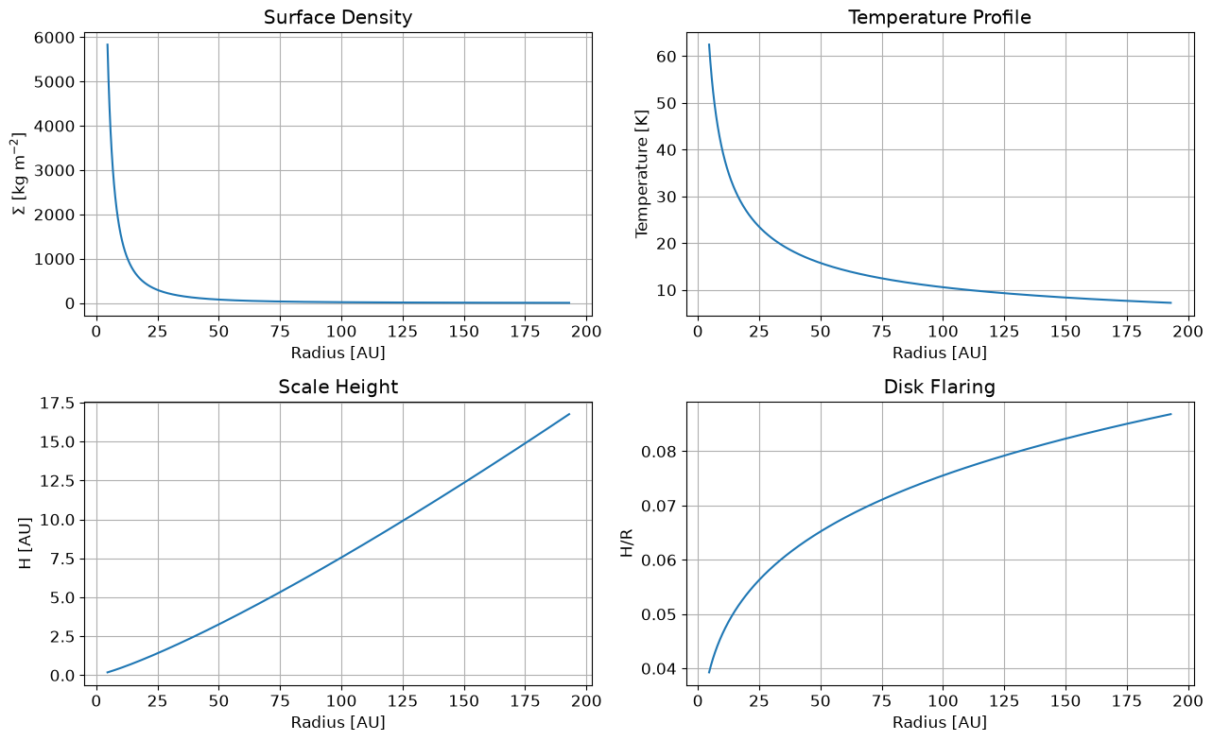

Slide 27
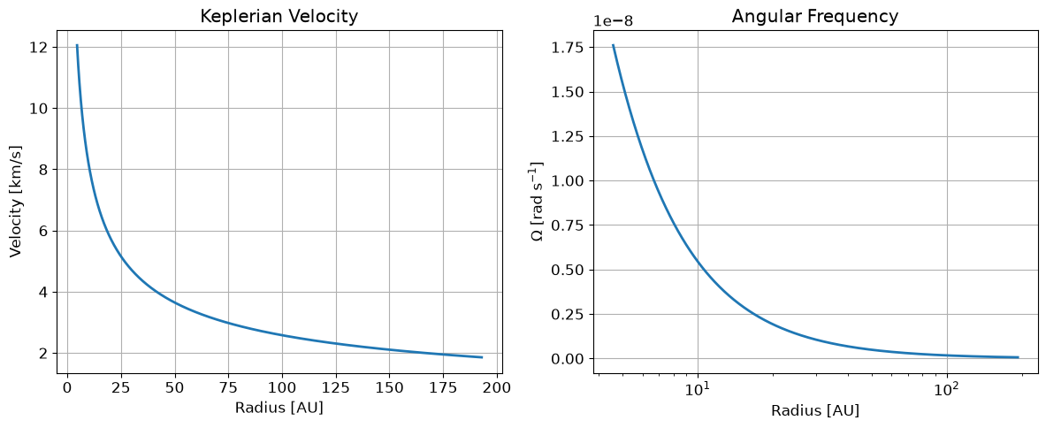
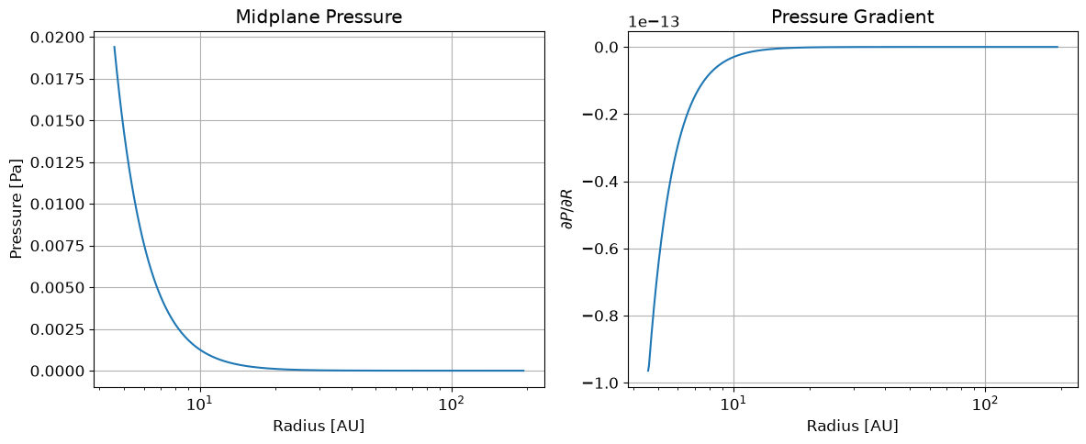

Slide 28
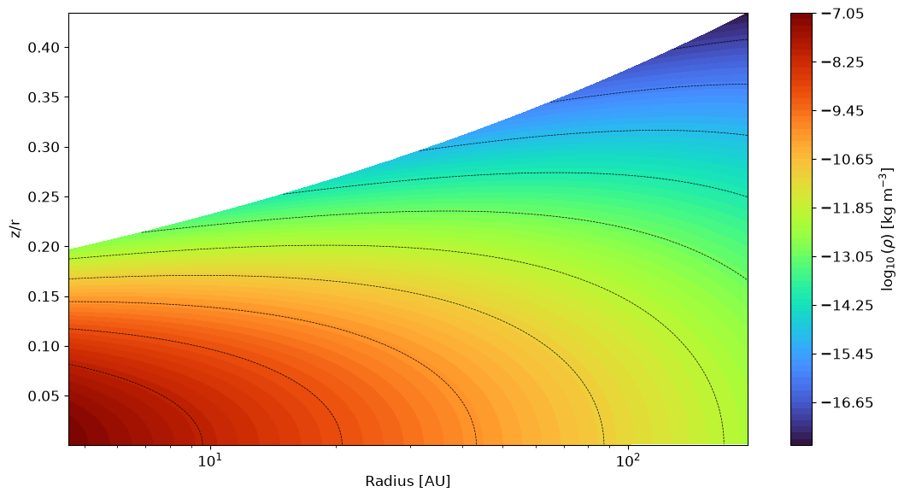

Slide 29
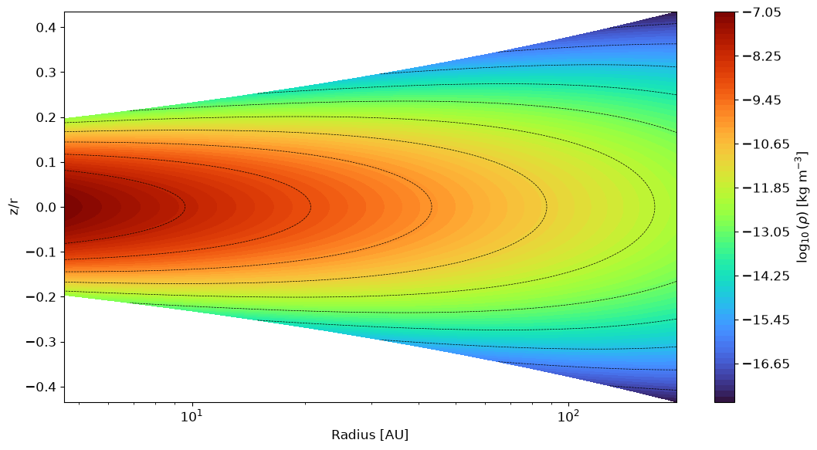

Slide 30
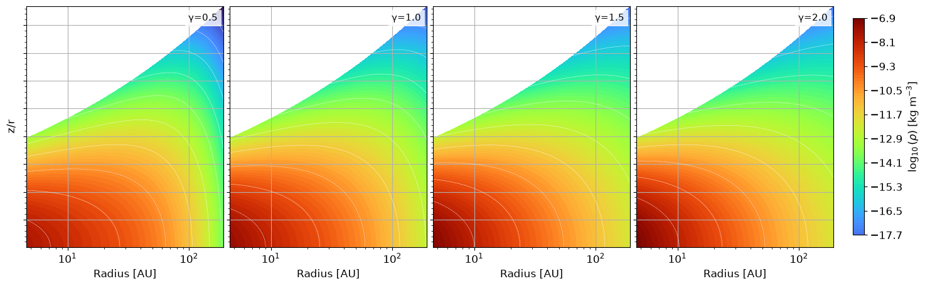
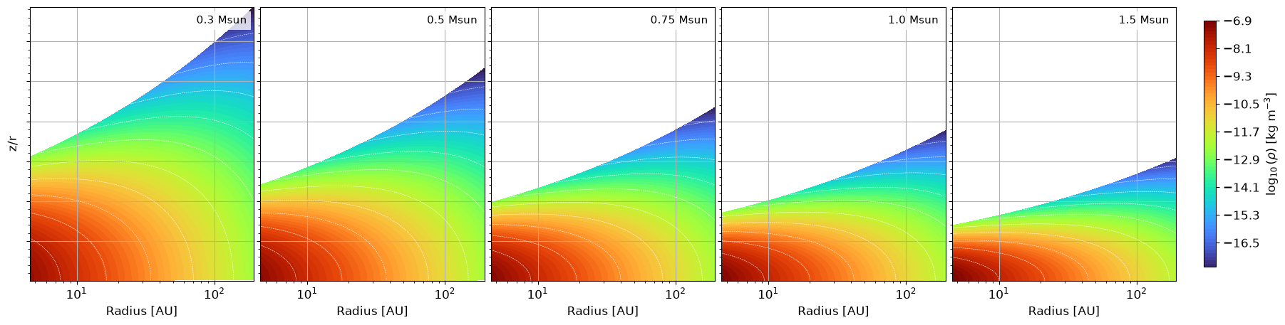

Slide 31
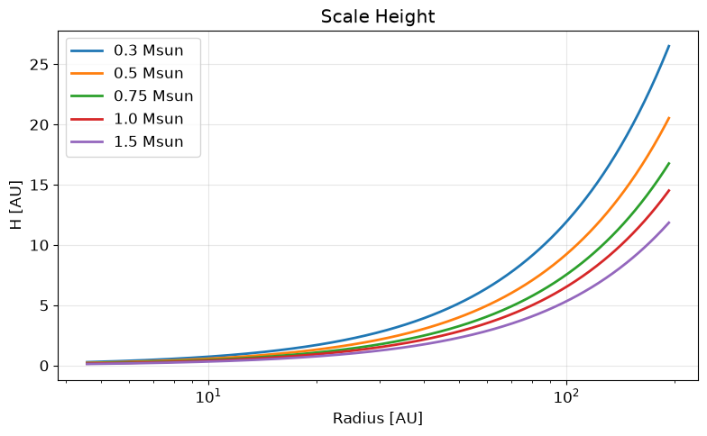
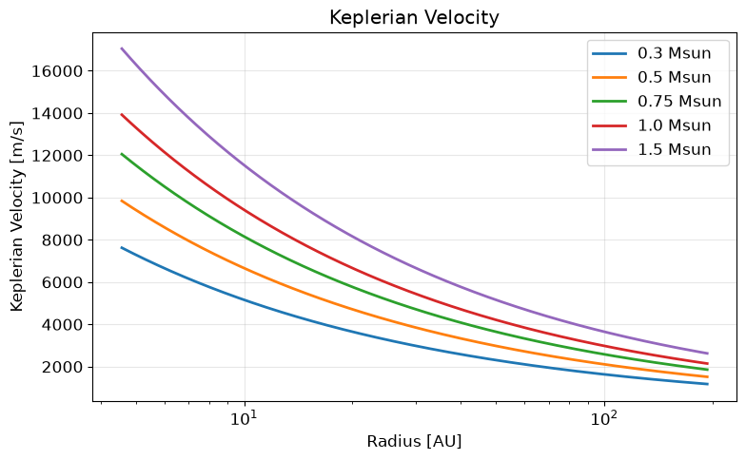

Slide 32
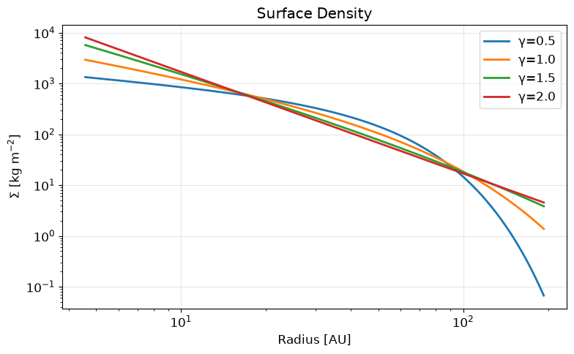
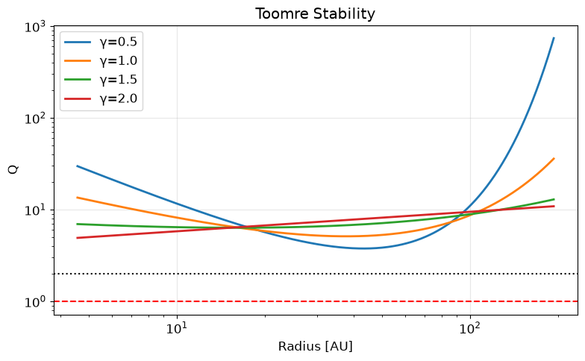

Slide 33
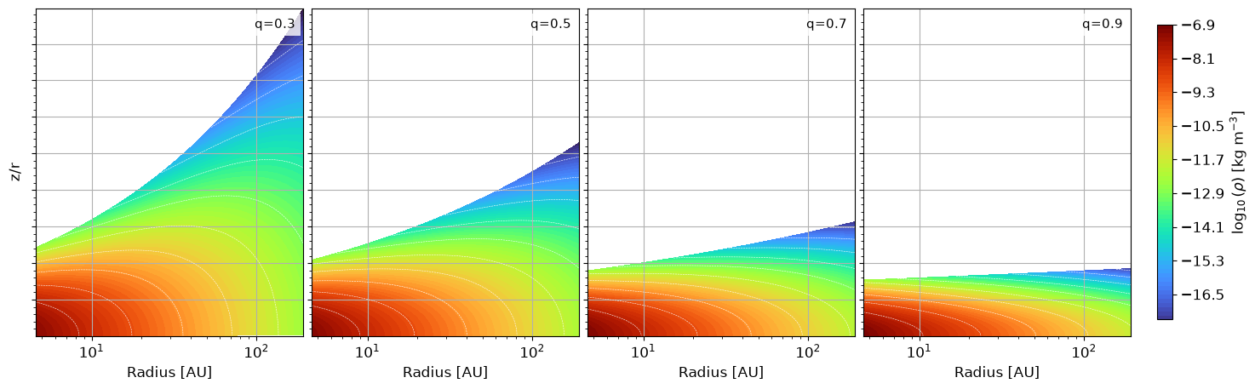
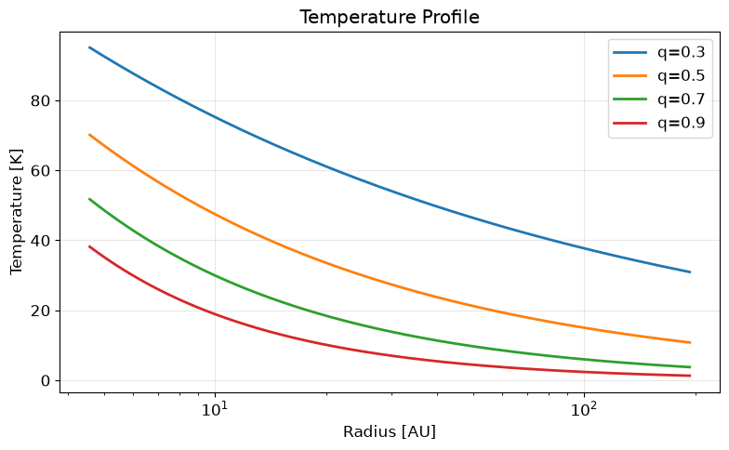
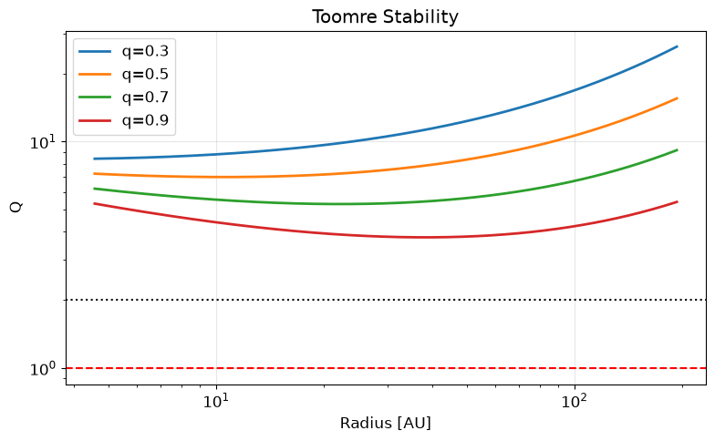

Slide 34
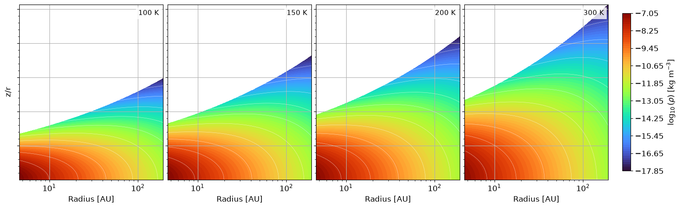

Slide 35
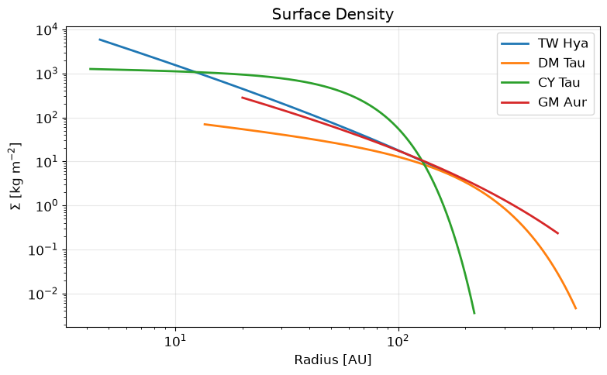
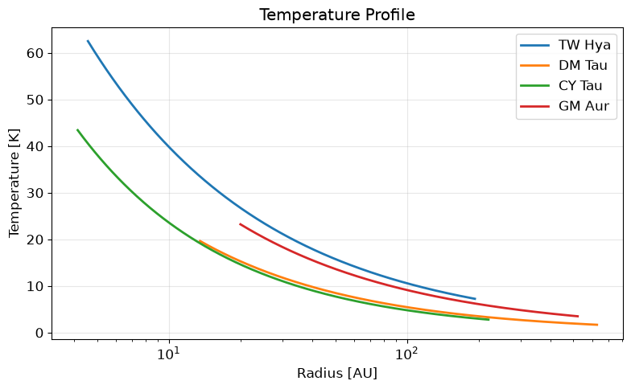

Slide 36
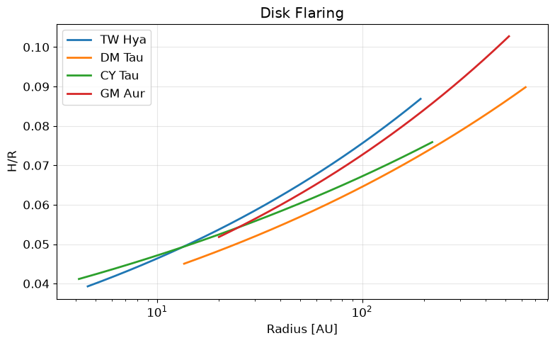
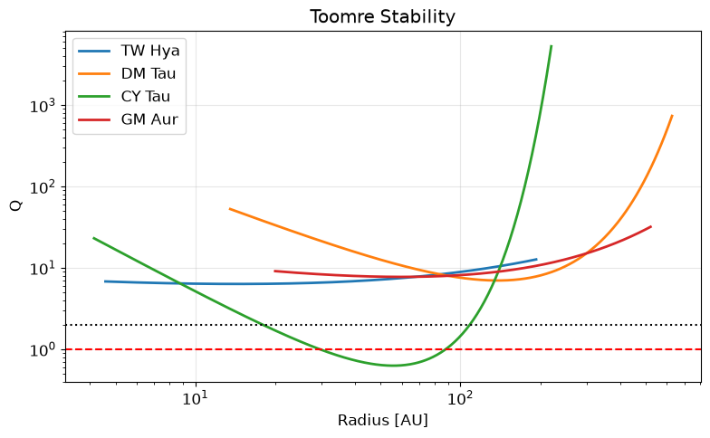

Slide 37
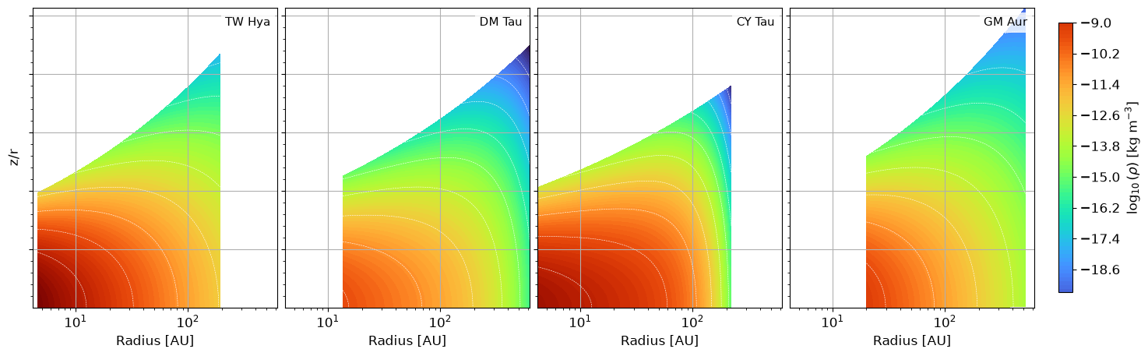

Slide 38
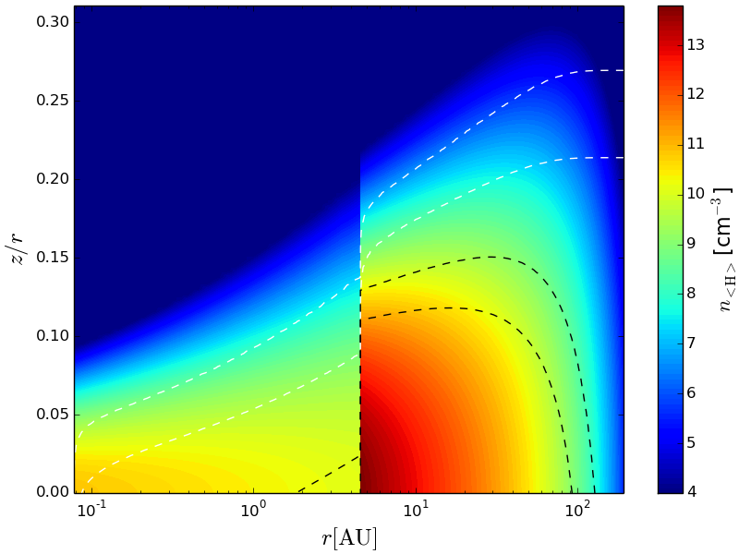
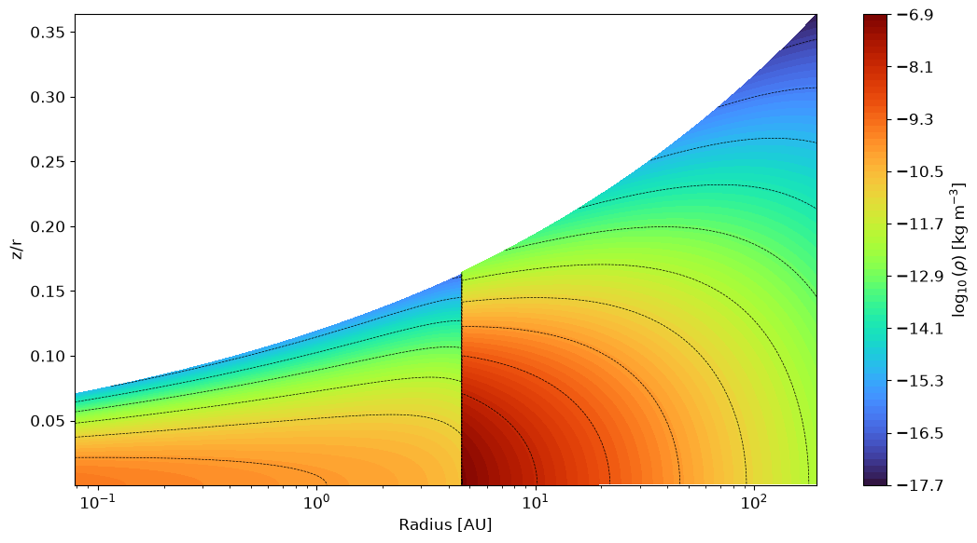

Slide 39
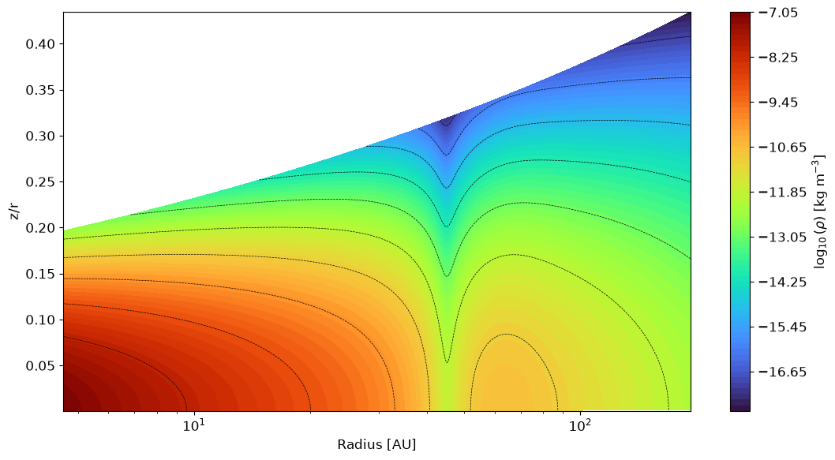

Slide 40
Thank you

