Slide 1
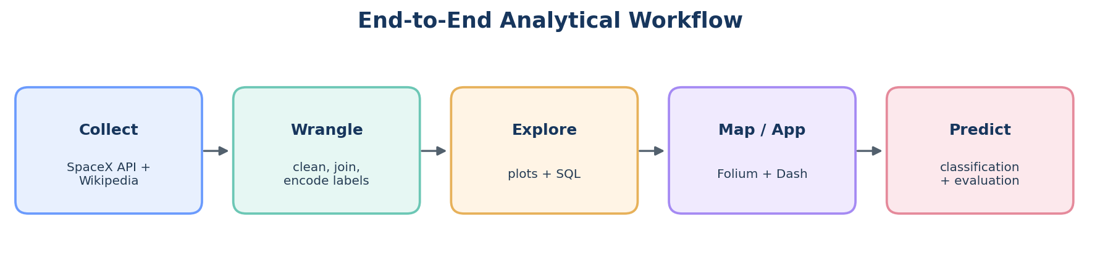
SpaceX Falcon 9 Data Science Capstone
CAPSTONE PROJECT • HISTORICAL LAUNCH ANALYSIS
Exploring launch outcomes and predicting first-stage landing success
• Research question: Can historical launch, payload, orbit, launch-site and booster features help predict first-stage landing success?
• Workflow: API collection • web scraping • wrangling • EDA • SQL • Folium • Dash • classification
• Historical course dataset reference period: 2010–2020 in the published baseline study.
Data sources and benchmark findings are attributed in the References slide. Current outputs are regenerated by the included code.
SpaceX Falcon 9 Capstone • Historical course-data analysis
01/16

Slide 2
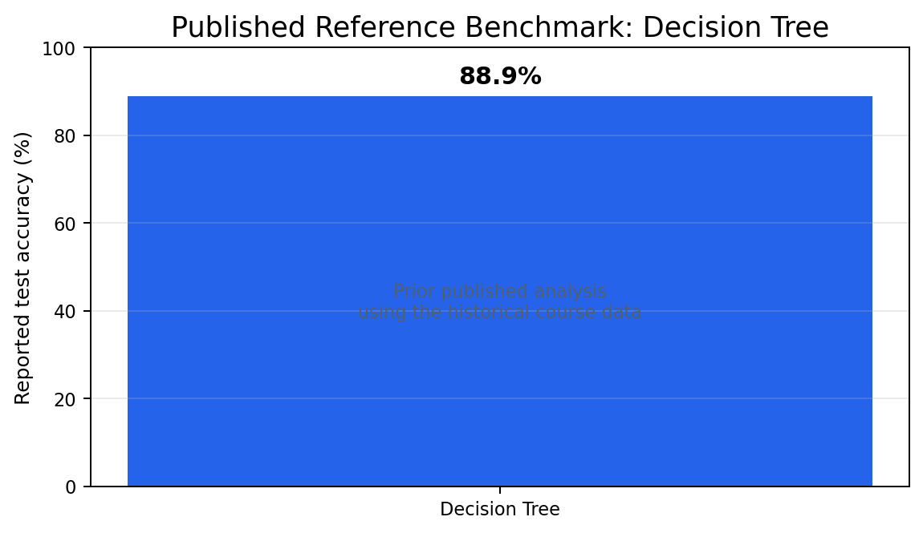
Executive Summary
The project combines two collection pathways (SpaceX API and launch-list web scraping) with a stable historical course dataset for reproducible evaluation.
Published reference analysis found launch-site, payload-mass and orbit differences; it reported improving landing success over time.
A prior analysis of this historical dataset reported a tuned Decision Tree accuracy of 88.9%. This is a reference benchmark, not a metric generated in this environment.
The supplied pipeline regenerates the cleaned dataset, figures, SQL tables, Folium map, model metrics and confusion matrix when run.
Reference: Daniel Eduardo López, IBM-SpaceX capstone repository (2022). Recompute metrics on your own run before submission.
SpaceX Falcon 9 Capstone • Historical course-data analysis
02/16

Slide 3
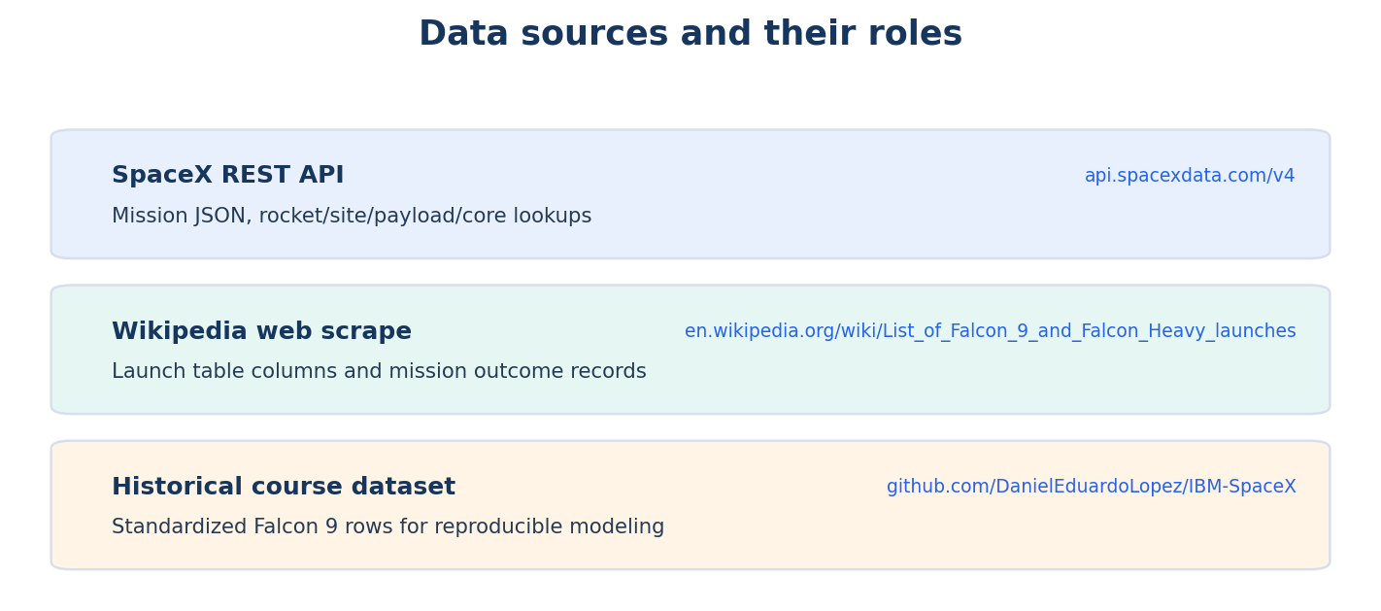
Introduction and Problem Statement
Falcon 9 first-stage reuse is an important operational lever because successful recovery can enable refurbishment and reuse.
Business question: Which historical mission features are associated with landing outcome, and how well can a classifier estimate landing success?
Target: `Class` (0 = unsuccessful landing; 1 = successful landing) in the historical course dataset.
Scope: descriptive analysis and prediction; associations do not establish that a feature causes a landing outcome.
Historical business context and research question follow the public capstone description; cited benchmark period ends in 2020.
SpaceX Falcon 9 Capstone • Historical course-data analysis
03/16

Slide 4
Data Collection — SpaceX API
Send GET request to `/v4/launches/past` and normalize JSON with `pandas.json_normalize`.
Enrich launch IDs through `/rockets`, `/launchpads`, `/payloads` and `/cores` endpoints.
Extract launch date, rocket/booster, payload mass and orbit, launch-site coordinates, recovery attempt and landing result where available.
Quality controls: check HTTP status, handle missing fields and save the raw/normalized files for traceability.
API endpoint: https://api.spacexdata.com/v4/launches/past
SpaceX Falcon 9 Capstone • Historical course-data analysis
04/16

Slide 5
Data Collection — Web Scraping
Request the Wikipedia List of Falcon 9 and Falcon Heavy launches page using `requests`.
Create a BeautifulSoup object, inspect `soup.title`, identify the launch table and parse it with `pandas.read_html`.
Save the extracted table as a versioned CSV for inspection and compare schema changes before reuse.
Web tables can change; the code checks status and records the table list rather than assuming a fixed table index.
Source: https://en.wikipedia.org/wiki/List_of_Falcon_9_and_Falcon_Heavy_launches
SpaceX Falcon 9 Capstone • Historical course-data analysis
05/16

Slide 6
Data Wrangling Methodology
Filter to Falcon 9 records for a consistent scope; standardize field names and types.
Parse dates and create numeric model inputs; inspect missing values and duplicates before treatment.
Impute missing predictor values inside a scikit-learn preprocessing pipeline.
One-hot encode categorical fields and scale numeric values where appropriate. Split train/test data with stratification; keep preprocessing within the training pipeline to limit leakage.
The raw collector, historical-data loader, and model code are included in the ZIP.
SpaceX Falcon 9 Capstone • Historical course-data analysis
06/16

Slide 7
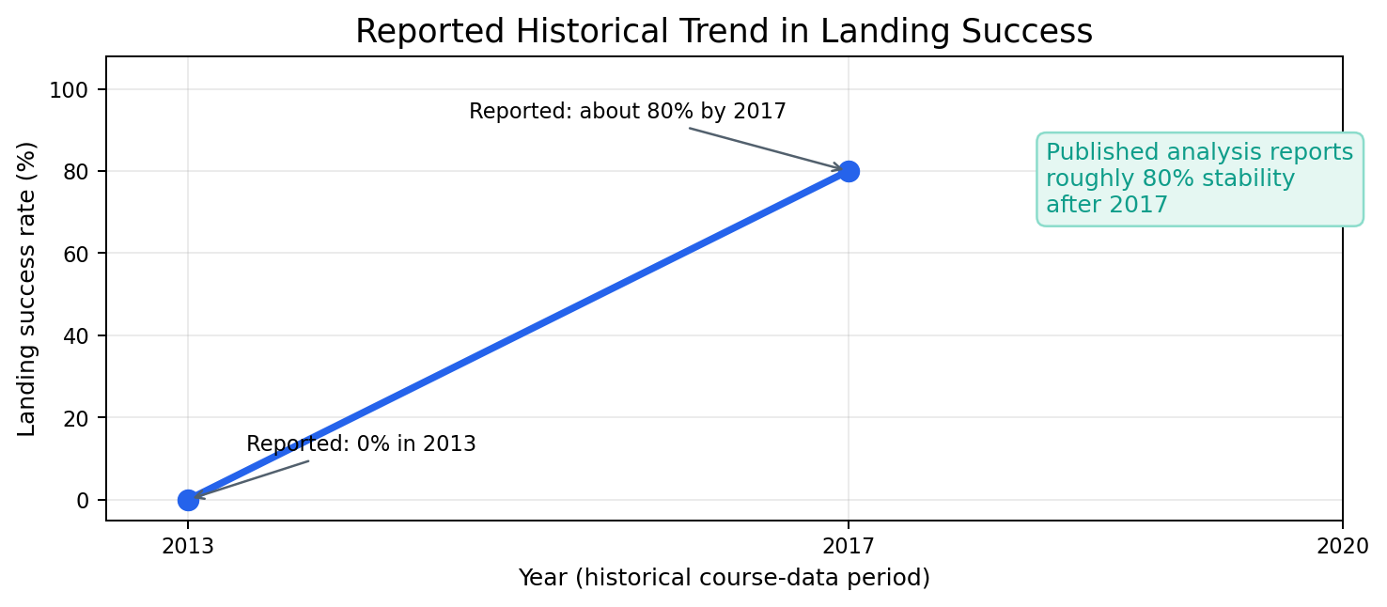
EDA with Data Visualization
Launch-site bar chart: compares sample size by site; it does not alone measure operational quality.
Landing-outcome pie chart: visualizes target imbalance and explains why accuracy should not be the only metric.
Payload scatter/strip plot: examines the distribution of payload mass across landing classes.
Rolling success trend and orbit counts reveal temporal and mission-type patterns. The included code regenerates all figures from the loaded dataset.
The trend shown is the attributed published benchmark; use generated outputs/ figures for your own run.
SpaceX Falcon 9 Capstone • Historical course-data analysis
07/16

Slide 8
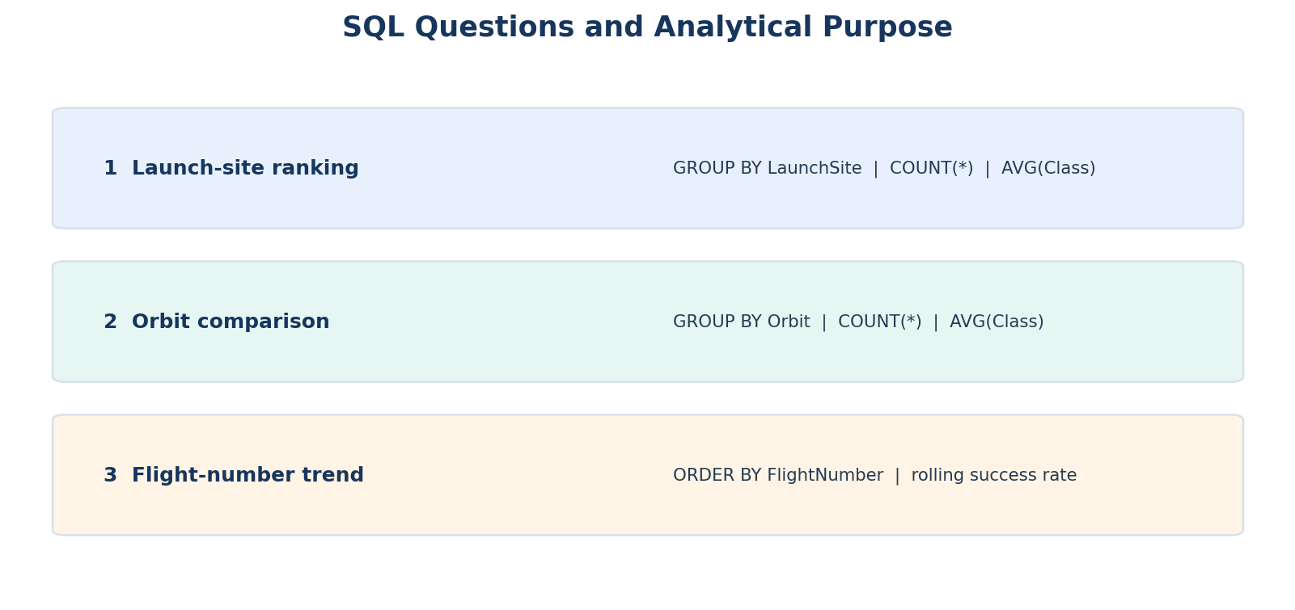
EDA with SQL
Load the cleaned launch-level data into SQLite so analysis is reproducible and queryable.
Query 1: `GROUP BY LaunchSite` for record count and mean landing class.
Query 2: `GROUP BY Orbit` for frequency and observed success rate; include counts so small groups are not overinterpreted.
Query 3: order launches by flight number to examine trend changes. The script exports each SQL result as a CSV.
Generated files: sql_launch_site_summary.csv, sql_orbit_summary.csv, sql_flight_summary.csv.
SpaceX Falcon 9 Capstone • Historical course-data analysis
08/16

Slide 9
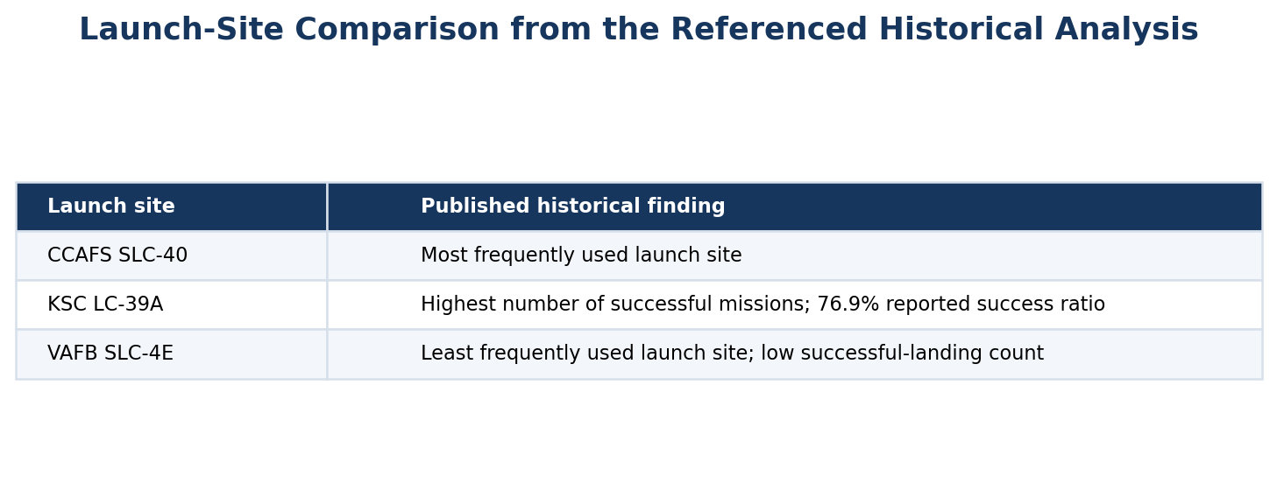
EDA Result — Launch-Site Comparison
Published baseline: CCAFS SLC-40 was the most frequently used launch site.
VAFB SLC-4E was reported as the least used site, with comparatively few successful landings.
KSC LC-39A was reported to have the highest count of successful missions and a 76.9% success ratio.
Key insight: launch volume and success ratio answer different questions; do not infer the best site from count alone.
All findings on this slide are reference findings from the published historical course-data analysis, not current SpaceX operational statistics.
SpaceX Falcon 9 Capstone • Historical course-data analysis
09/16

Slide 10
EDA Result — Success Trend over Time
The referenced study reported that landing success improved over the historical flight sequence.
Its summary described success rising from 0% in 2013 to about 80% by 2017, then staying near 80%.
The chart deliberately plots only the explicitly reported year/value points; the later plateau is described as a textual finding rather than inventing annual observations.
The code computes a rolling success rate directly from the selected CSV for an updated result.
Reference values: published IBM-SpaceX capstone analysis, not an independently re-run analysis.
SpaceX Falcon 9 Capstone • Historical course-data analysis
10/16

Slide 11
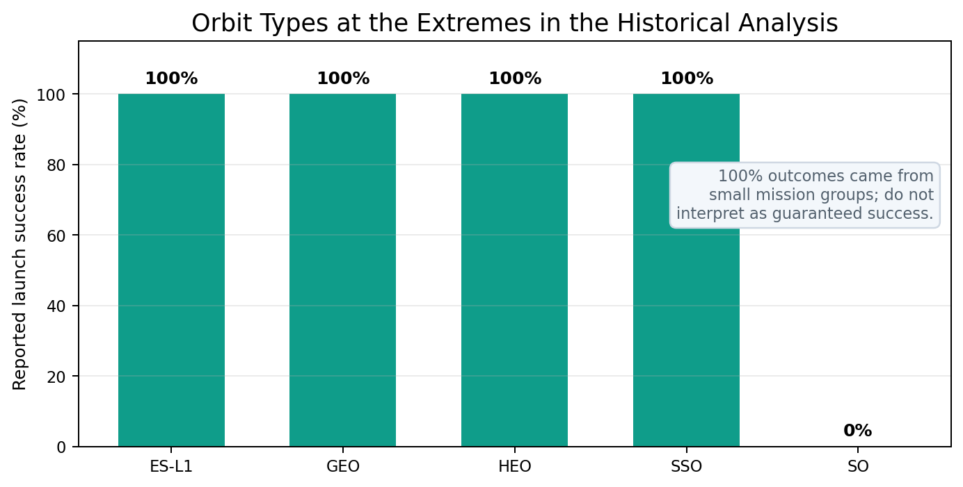
EDA Result — Payload and Orbit
Reported high-success payload range: 1,952–5,300 kg. This is an observed range, not a causal threshold or guarantee.
The reference analysis reported 100% observed success for ES-L1, GEO, HEO and SSO; the SO category was reported at 0%.
The same analysis cautioned implicitly through small counts that 100% categories can be based on very few missions.
The included code plots actual orbit counts and success rates with denominators, so small-sample effects can be assessed.
Use per-orbit counts alongside percentages when discussing uncertainty.
SpaceX Falcon 9 Capstone • Historical course-data analysis
11/16

Slide 12
SQL Results — What the Tables Tell Us
The historical reference analysis ranked CCAFS SLC-40 highest for launch usage and VAFB SLC-4E lowest.
KSC LC-39A appeared as the site with the highest success count and 76.9% reported success ratio.
Orbit summaries highlighted a mix of high observed success in a few low-frequency orbits and frequent mission types such as LEO, ISS, PO, GTO and VLEO.
The run script exports the actual grouped SQL outputs from the course dataset so these observations can be checked quantitatively.
SQL result CSVs are written beneath `outputs/` after execution.
SpaceX Falcon 9 Capstone • Historical course-data analysis
12/16

Slide 13
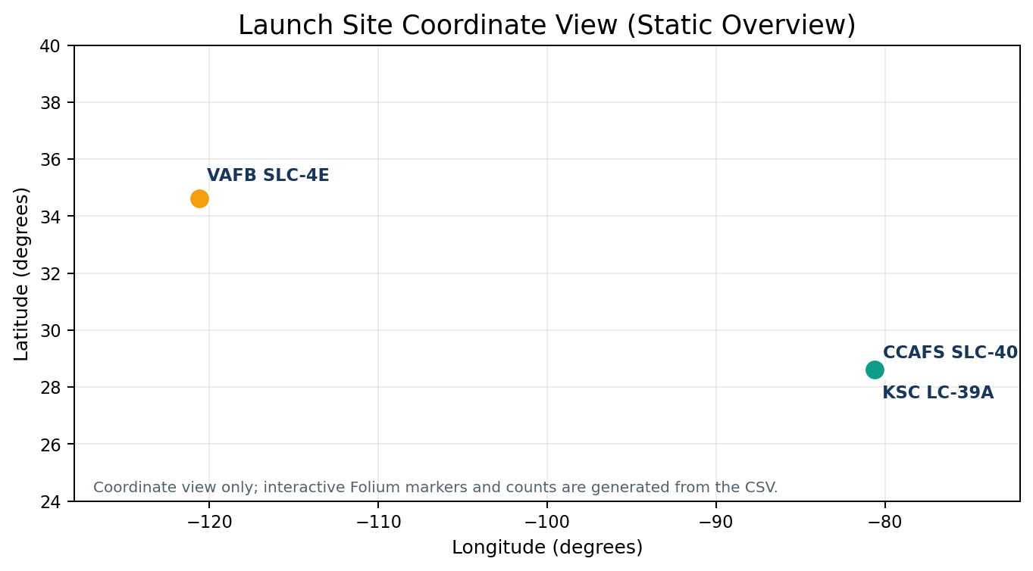
Interactive Visual Analytics — Folium
The map uses site latitude/longitude from the dataset and puts one marker at each launch-site location.
Marker popups show launch record count and observed landing success percentage.
The script exports pairwise Haversine distances between launch-site coordinates for a reproducible proximity comparison. A published historical analysis reported KSC LC-39A at about 6.46 km from the Atlantic Sea and 72.21 km from Orlando; such distances depend on the chosen reference point.
Run `python run_analysis.py` to create `outputs/spacex_launch_sites_map.html` and the pairwise distance CSV.
Actual interactive coordinate-based map is generated from the input CSV; this static view is only an overview.
SpaceX Falcon 9 Capstone • Historical course-data analysis
13/16

Slide 14
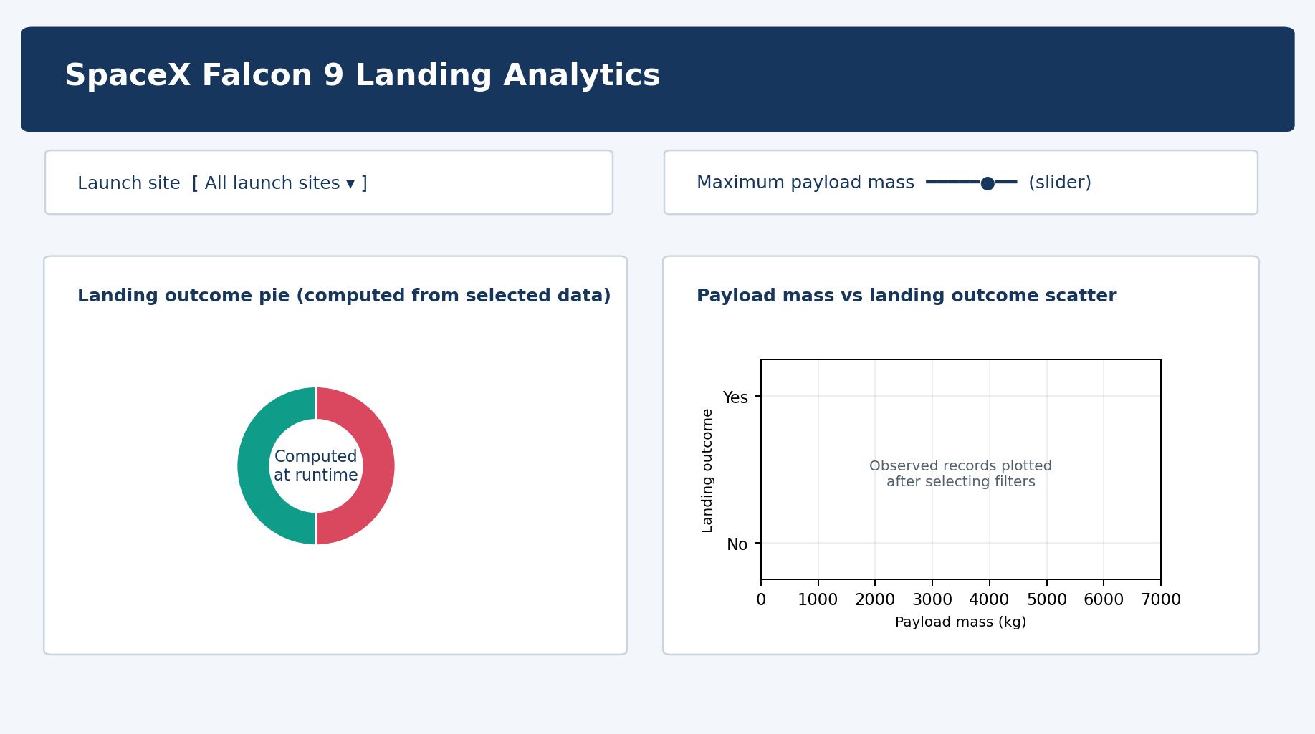
Interactive Visual Analytics — Plotly Dash
The provided Dash app includes a launch-site dropdown and payload-mass slider.
The pie chart dynamically summarizes successful versus unsuccessful landing outcomes for the selected site.
The scatter plot maps observed payload mass against landing class and colors points by booster version or site.
Run `python spacex_dash_app.py`, then open `http://127.0.0.1:8050/`. The slide image is a UI preview; live chart values come from the dataset.
Dashboard source file: spacex_dash_app.py. Use live screenshot from your own app if the course explicitly requires screenshots.
SpaceX Falcon 9 Capstone • Historical course-data analysis
14/16

Slide 15
Predictive Analysis — Classification and Results
Target: first-stage landing class. Candidate features include flight number, payload mass, orbit, site, booster version, reuse, grid fins, legs and block.
Models compared by code: Logistic Regression, Decision Tree, Random Forest and Support Vector Machine.
Published reference benchmark: a tuned Decision Tree reported 88.9% accuracy and performed better on successful than unsuccessful landings.
Your code calculates current accuracy, precision, recall and F1 on a held-out test split; it saves a numeric confusion matrix and tuned tree parameters.
Do not report the 88.9% as your own run result unless your run reproduces it. Use outputs/model_metrics.csv.
SpaceX Falcon 9 Capstone • Historical course-data analysis
15/16

Slide 16
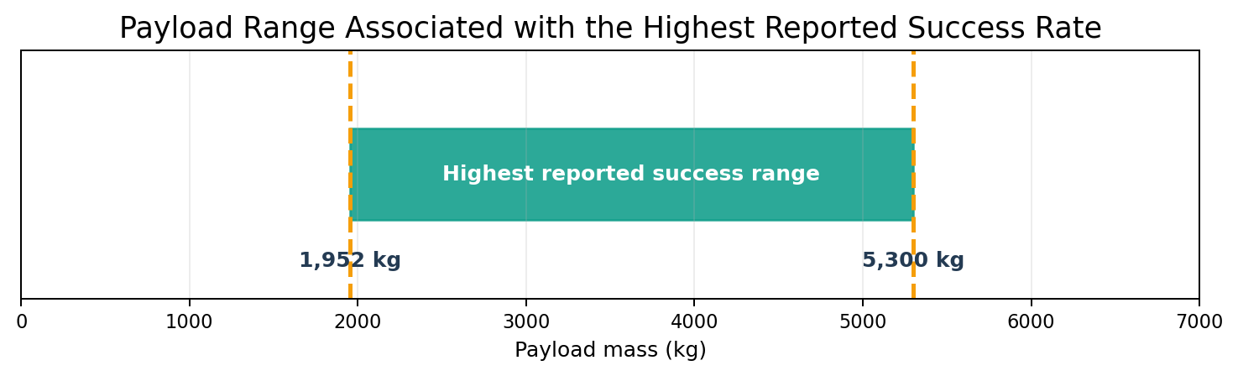
Conclusion, Limitations and Innovative Insight
Historical reference findings suggest landing success improved over the studied flight sequence and reached roughly 80% by 2017.
Launch volume and success ratio should be analyzed separately: the busiest site was not the site reported with the highest success ratio.
Orbit success percentages based on small samples can look perfect without being reliable; always display counts with rates.
Limitations: historical cutoff, missing labels, class imbalance, changing operations and dataset-source drift. Re-run the pipeline and replace benchmarks with your measured outputs before final submission.
References: SpaceX API v4; Wikipedia launch list; Daniel Eduardo López, IBM-SpaceX capstone repository.
SpaceX Falcon 9 Capstone • Historical course-data analysis
16/16

