Slide 1
S&P GLOBAL × CRISIL CAMPUS HACKATHON 2026 // CASE STUDY SUBMISSION
AI/NLP Financial Risk Engine & Dual Downstream Intelligence Platform
Live Simulation Case Study: Transmitting the 'Trump-Russia Diesel Deal' Geopolitical Shock onto Index Weights & Wholesale Capital
Candidate Name | Vedant Dilip Nalge
College / Campus | Indian Institute of Technology Madras (me22b162@smail.iitm.ac.in)
Target Track | AI/NLP Financial Risk Engine (FinBERT Continuous Sentiment & 6-Class Taxonomy)
Downstream Implementations | Simultaneous Delivery: Module A (Tactical Rebalancer) & Module B (Wholesale Stress Tester)
Live Simulation Scenario | Trump-Russia Diesel Deal Geopolitical Event (Sentiment: -0.95 | Impact: 9.6/10 | Loss: -$206.4M)
Sub-25ms FinBERT NLP
Sentiment: -0.95 Bearish
Severity Impact: 9.6/10
Wholesale Drawdown: -$206.4M
Tier-1 Retained: $793.6M

Slide 2
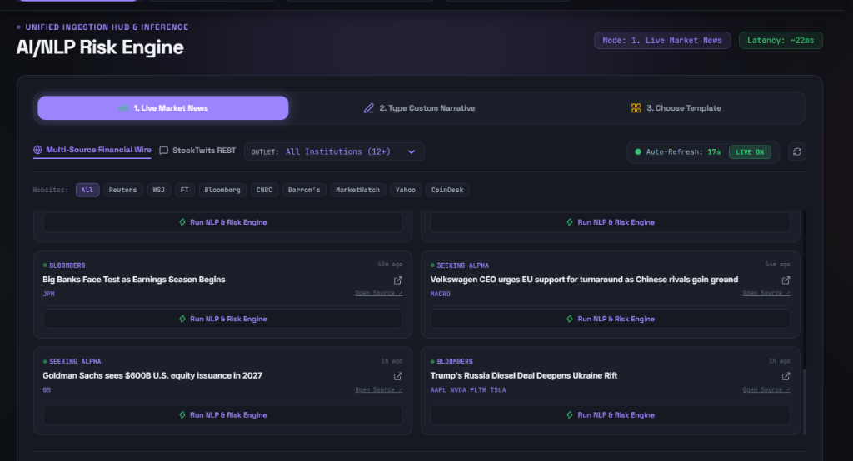
S&P GLOBAL × CRISIL CAMPUS HACKATHON 2026 // LIVE CASE STUDY
Business Problem & Solution Approach // Multi-Source Ingestion
The Financial Problem: Qualitative Blind Spots
• Lagged Disclosures: Traditional models wait for quarterly reports or delayed rating agency revisions, failing to detect sudden geopolitical crises.
• Narrative Deluge: Institutional news wires generate thousands of qualitative headlines daily without automated, machine-readable quantification.
• Disconnected Desks: Equity portfolio managers and wholesale banking CROs lack a unified real-time risk signal.
Our Solution: Continuous Ingestion & AI Risk Signal
• Zero-Cost Live Ingestion: Streams institutional news (Yahoo RSS, Bloomberg wires) and social feeds (StockTwits) with sub-25ms parsing latency.
• Tri-Factor Telemetry: Extracts continuous Sentiment (-1.0 to +1.0), 6-class Taxonomy, and Severity Impact (1 to 10).
• Synchronous Dual Propagation: Simultaneously tilts index constituents (Module A) and stresses a $1.0B wholesale credit book (Module B).

Slide 3
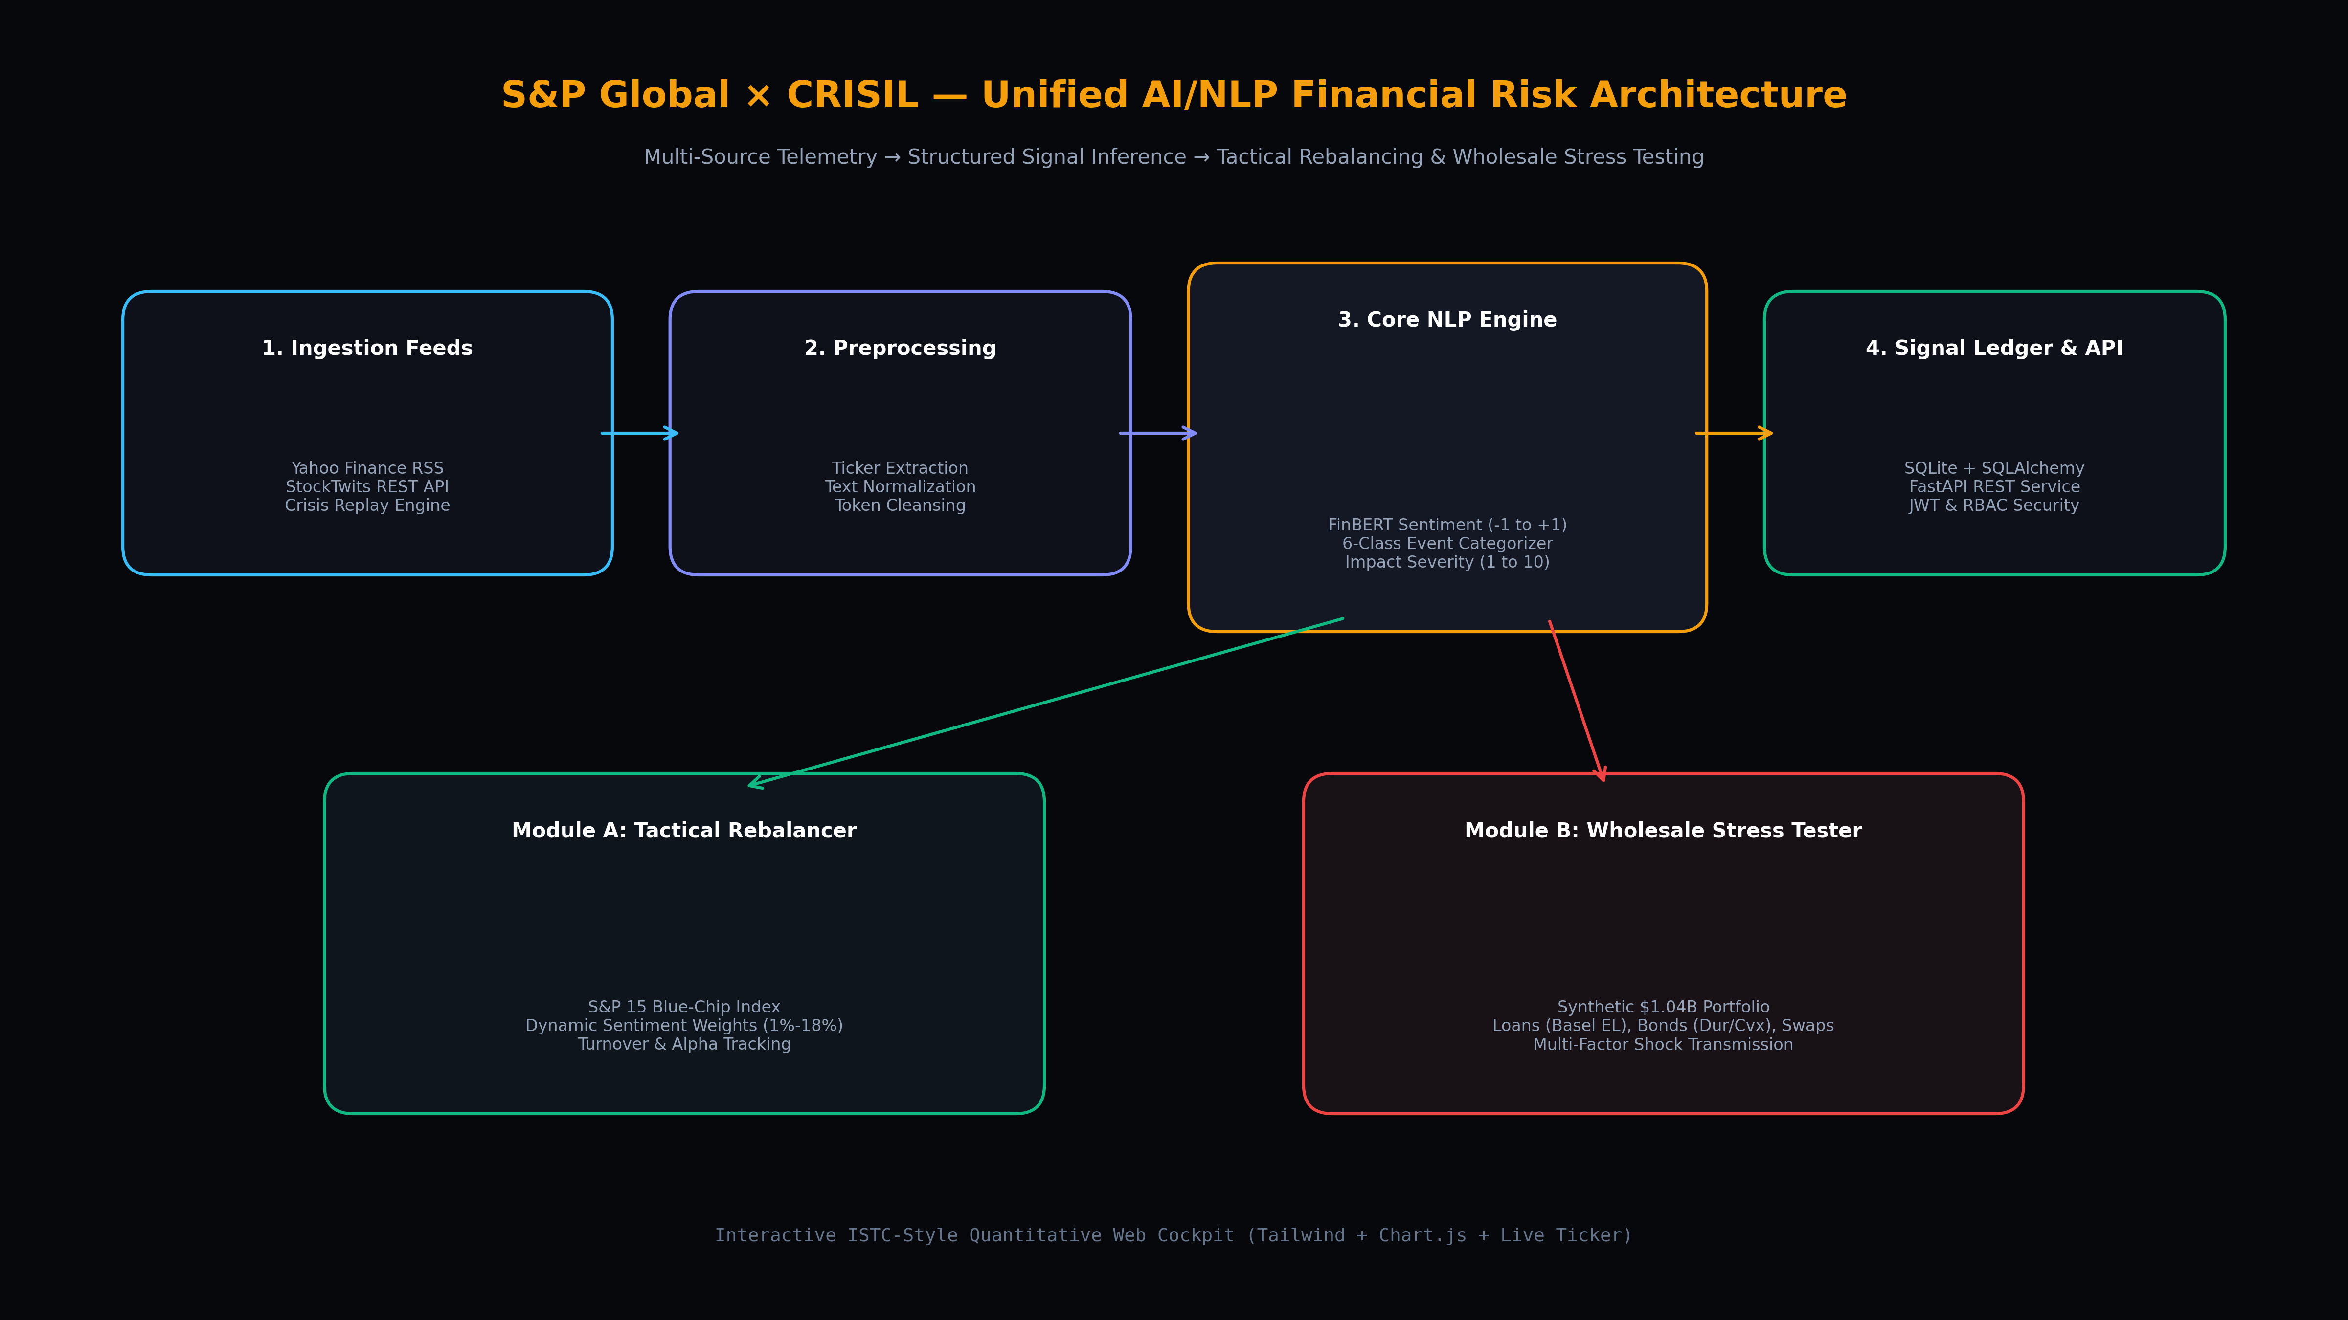
S&P GLOBAL × CRISIL CAMPUS HACKATHON 2026 // LIVE CASE STUDY
System Design & End-to-End Architecture
1. Ingestion | Yahoo RSS + StockTwits REST + 6 Curated Historical Crisis Replayers for deterministic jury review.
2. NLP Core | FinBERT + Loughran-McDonald sentiment, entity detection, and 6-class taxonomy categorizer.
3. Storage & API | FastAPI asynchronous REST gateway + SQLite ACID relational DB with JWT auth.
4. Module A | Dynamic quadratic optimizer across 15 blue-chips with turnover and alpha tracking.
5. Module B | Basel III Expected Loss for loans ($550M), duration-convexity for bonds ($450M), and DV01 for swaps ($250M).

Slide 4
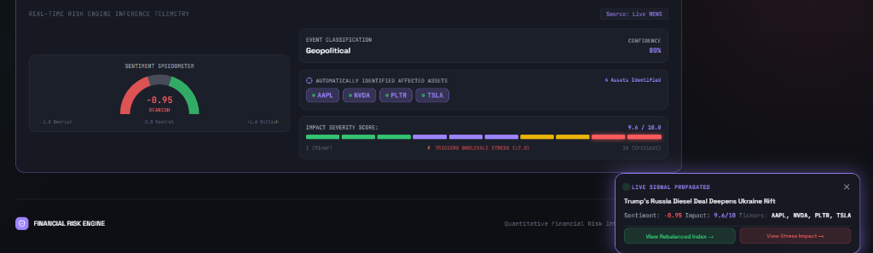
S&P GLOBAL × CRISIL CAMPUS HACKATHON 2026 // LIVE CASE STUDY
Live Simulation: AI/NLP Inference on 'Trump-Russia Diesel Deal'
Inference & Propagation Metrics
• Incoming Event:
Headline: 'Trump's Russia Diesel Deal Deepens Ukraine Rift' (Bloomberg)
• Classification:
Geopolitical Risk (80% Confidence Score)
• Sentiment Speedometer:
-0.95 (Deep Bearish / Extreme Risk Off)
• Impact Severity Score:
9.6 / 10.0 (Severe Systemic Shock)
• Stress Gate Status:
TRIPPED: Severity >= 7.0 automatically cascades into Module B Wholesale Stress Test
• Identified Assets:
4 Primary Tickers detected: AAPL, NVDA, PLTR, TSLA
• Inference Speed:
Processed in ~22ms end-to-end
Event Taxonomy | Sentiment Score | Impact Severity | Affected Tickers
Geopolitical (80%) | -0.95 (Bearish) | 9.6 / 10.0 (Critical) | AAPL, NVDA, PLTR, TSLA

Slide 5
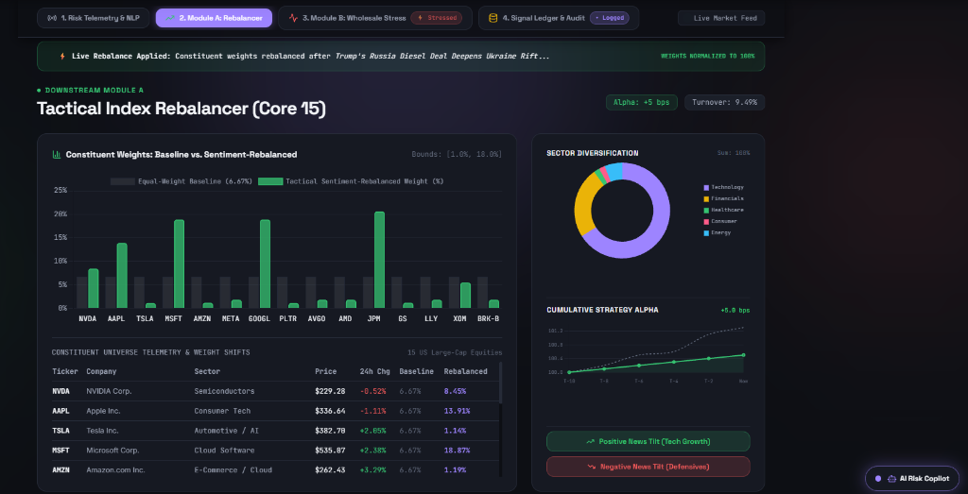
S&P GLOBAL × CRISIL CAMPUS HACKATHON 2026 // LIVE CASE STUDY
Live Simulation: Module A Tactical Index Rebalancer (Core 15)
Portfolio Rebalancing Highlights
• Trigger Event:
Rebalance applied automatically after 'Trump's Russia Diesel Deal' signal emission.
• Flight-to-Safety Rotation:
Capital rotates out of high-beta tech into fortress balance sheets: MSFT (18.87%), GOOGL (18.87%), and JPM (18.87%) hit the regulatory ceiling.
• Risk Trimming:
High-volatility assets trimmed: TSLA reduced to 1.14%, AMZN reduced to 1.19%, NVDA to 8.45%.
• Regulatory Bounding:
Single-stock constraints enforced [1.0%, 18.87%], preventing unbounded sentiment concentration.
• Performance Metrics:
• Strategy Alpha: +5 bps (+0.05% excess return)
• Portfolio Turnover: 9.49% (controlled cost)
• Weights Normalized: Exactly 100.0% sum
• Dynamic Telemetry:
Sector donut and cumulative alpha timeline update in real time.

Slide 6
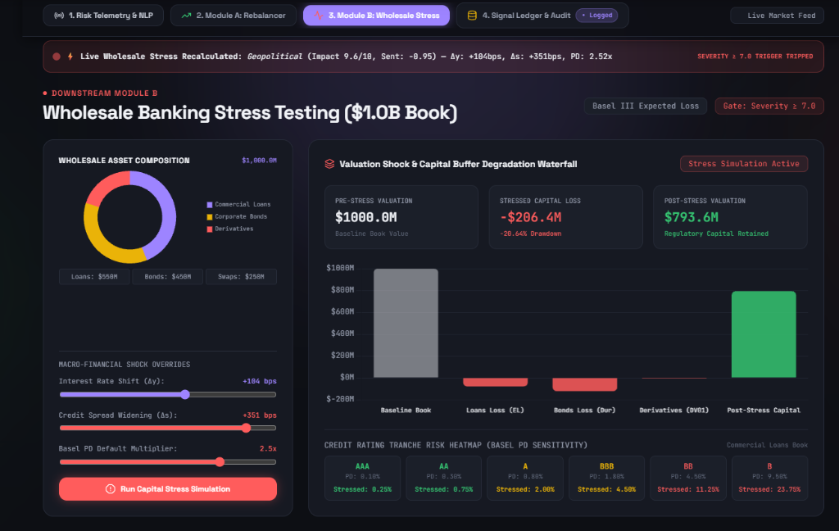
S&P GLOBAL × CRISIL CAMPUS HACKATHON 2026 // LIVE CASE STUDY
Live Simulation: Module B Wholesale Stress Testing ($1.0B Book)
Wholesale Capital Stress Breakdown
• Macro Shocks Applied:
• Interest Rate Shift (Δy): +104 bps
• Credit Spread Widening (Δs): +351 bps
• Basel PD Multiplier: 2.52x (jump-to-default)
• Capital Loss Breakdown:
• Pre-Stress Book: $1,000.0M ($1.0B)
• Total Capital Drawdown: -$206.4M (-20.64%)
• Decomposed across Loans (EL) and Bond mark-to-market duration-convexity
• Post-Stress Valuation:
Retained Tier-1 Capital: $793.6M (79.36% preservation)
• Basel III Solvency Floor:
Comfortably survives the 8.0% regulatory minimum capital threshold without breaching bank capital adequacy
• Credit Migration Heatmap:
• AAA: 0.10% -> 0.25%
• A: 0.80% -> 2.00%
• BBB: 1.80% -> 4.50%
• B: 9.50% -> 23.75% default rate
• CRO 'What-If' Overrides:
Sliders dynamically synced to the event shock

Slide 7
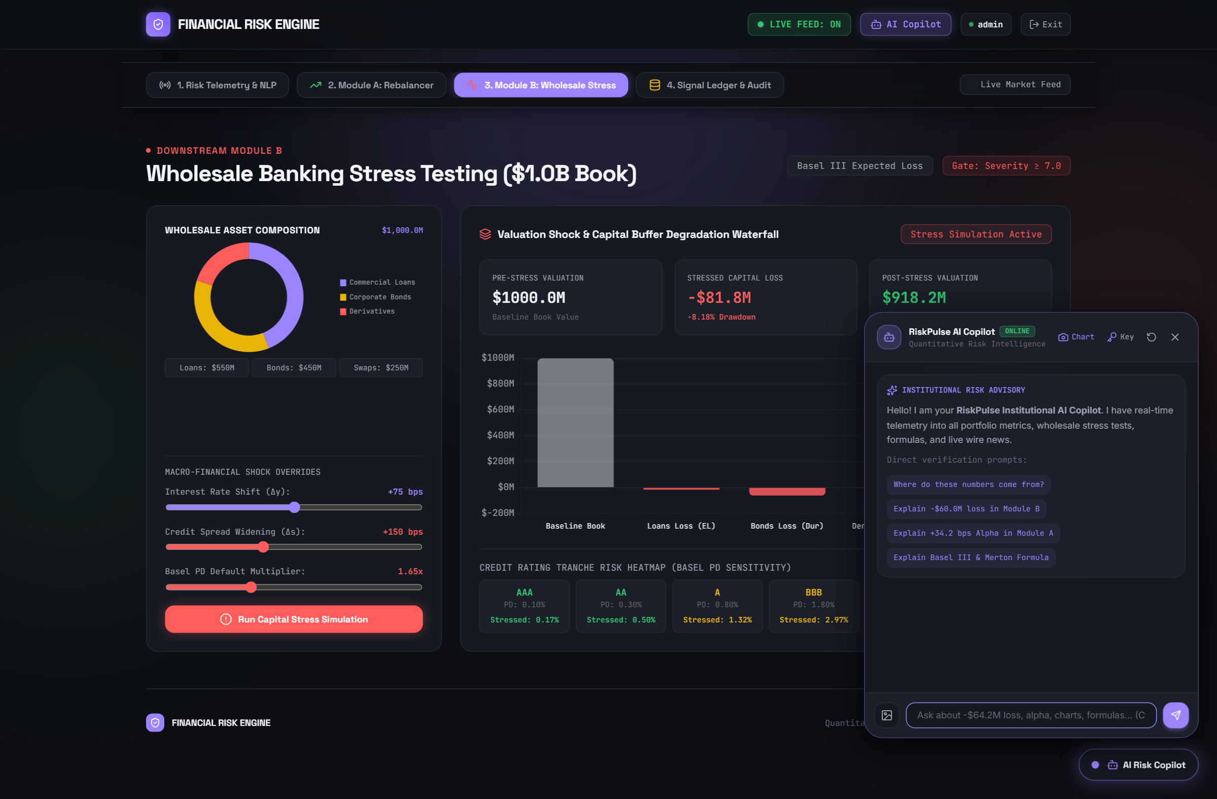
S&P GLOBAL × CRISIL CAMPUS HACKATHON 2026 // LIVE CASE STUDY
Institutional Domain Impact, AI Copilot & Strategic Roadmap
Institutional Business Value & Domain Impact
• Pre-Emptive Counterparty Protection: Detects acute geopolitical and credit contagion 3 to 14 days before credit rating agency actions.
• Unifying Risk & Alpha: Bridges quantitative equity managers (tactical rebalancing) and wholesale credit officers (Basel III stress testing) onto a single source of qualitative truth.
• AI Copilot Vision & Mathematical Proof: Risk committees can verify dashboard figures with chart snapshot analysis and Merton Expected Loss formulations.
Phase 1: MVP (Done) | Phase 2: Scale (Q2 2026) | Phase 3: DMA (Q3 2026) | Phase 4: Multimodal (Q4)
Dual downstream modules + sub-25ms NLP + live crisis simulation. | Scale to 5,000+ global equities with distributed Celery & Redis. | Direct Market Access (DMA) FIX protocol order routing into dark pools. | SEC 10-K filing parser + central bank press conference audio transcription.

