Slide 1
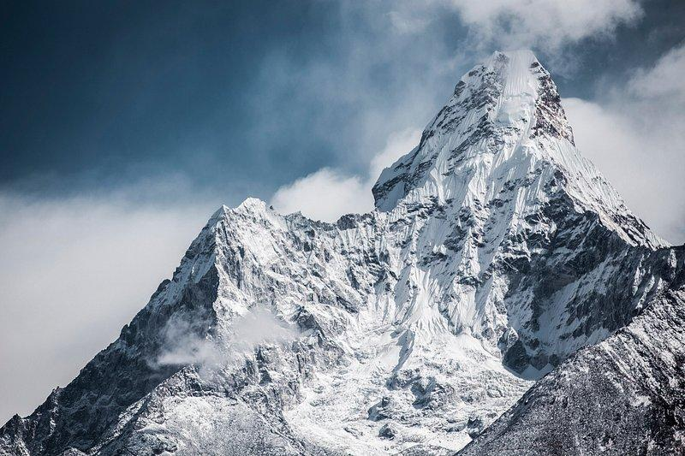
Summit Navigator
A Novel Approach for Local Maxima Extraction
Presented By:
Udan Vedant Ghanshyam
Karan sunil Kumbhar
Ahire Sandesh Naval

Slide 2

Introduction
What is Summit Navigator?
An algorithm designed to extract local maxima from histograms.
Inspired by strategies used by mountain explorers to determine dominant peaks.
Why is it Important?
Critical for image segmentation, especially in multi-thresholding tasks.
Automates peak detection without manual inputs or predefined parameters.
Histogram Thresholding Fuzzy C-Means
Gaussian kernel convolution
Otsu’s method
Notes:
Good morning, everyone.
Today, I’m excited to talk about Summit Navigator, a cutting-edge algorithm for local maxima extraction from histograms. This method is inspired by the strategies of mountain explorers, where determining dominant peaks guides the journey. Similarly, Summit Navigator identifies and extracts dominant peaks in histograms, a critical step for image segmentation.
Now, why is this important?
In image processing, extracting local maxima is essential for tasks like multi-thresholding, object segmentation, and background removal. Traditional methods, while effective in certain cases, have limitations:
Otsu’s method, for instance, is simple and consistent for bilevel thresholding but struggles with multi-thresholding tasks, often requiring manual adjustments.
Gaussian kernel convolution techniques can handle multi-modal histograms but depend heavily on user-defined parameters.
Fuzzy clustering approaches, like Histogram Thresholding Fuzzy C-Means (HTFCM), are computationally expensive and prone to over-segmentation in noisy datasets.
What makes Summit Navigator unique is its automation and adaptability. Unlike these traditional methods, it requires no manual tuning or predefined parameters, making it robust across a wide range of datasets. By introducing concepts like observability indices and recursive peak merging, it achieves high accuracy and consistency even in challenging conditions.
This innovation has practical applications, such as:
Detecting surface defects in industrial settings,
Background removal in complex images, and
Multi-object detection and segmentation in fields like robotics and autonomous systems.
.

Slide 3
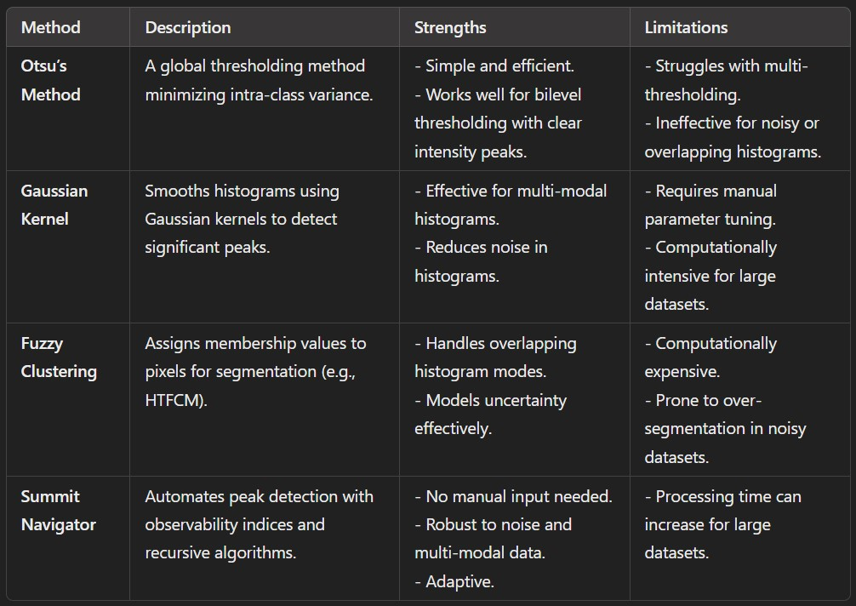
Other methods

Slide 4
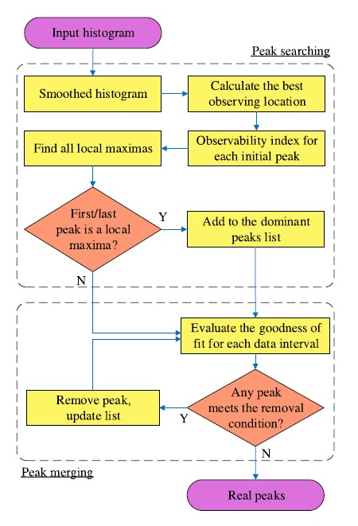
Methodology Overview
Summit Navigator’s Workflow:
Preprocessing: Smooths the input histogram to remove noise.
Peak Searching: Identifies observing locations and calculates an observability index to find dominant peaks.
Peak Merging: Removes false positives by analyzing the relationships between adjacent peaks.
Core Features:
Non-heuristic approach.
High accuracy with minimal computational overhead.
Adaptive to noisy data and complex histograms.
Notes:
The methodology comprises three main stages:
Preprocessing:
The input histogram is smoothed using a moving average filter to reduce noise while preserving peaks. Initial peaks are identified by comparing the intensity of a pixel with its immediate neighbors.
Peak Searching:
The heart of this approach is inspired by the journey of mountain explorers. The algorithm calculates an observability index for each peak, based on parameters like offset distance and peak height, to identify the most dominant peaks. This step ensures that the peaks selected are the ones with the best overall visibility from their surroundings.
Peak Merging:
To eliminate false positives and ensure accuracy, the detected peaks are refined. A regression-based technique is used to determine whether two consecutive peaks lie on the same unimodal region. Peaks on the same side of a mode are merged to produce a final set of true dominant peaks.
The entire process is recursive, allowing the method to adapt dynamically to the complexities of noisy or multi-modal datasets. Extensive experiments on datasets, including natural images and sunspot cycle data, demonstrate its superior performance in terms of accuracy, robustness, and computational efficiency compared to traditional methods
With this overview, we can appreciate how the Summit Navigator algorithm innovatively bridges a gap in histogram-based segmentation. Let us now dive deeper into Detailed methodology, as detailed in the rest of the presentation.

Slide 5
Preprocessing
Purpose:
Eliminate noise while preserving essential peaks.
Key Steps:
Use a moving average filter to smooth the histogram.
Identify initial peaks by comparing intensity values with neighboring points.
Mathematical Formula: h_{i}= (h_{i-1} + h_{i} + h_{i+1}) / 3
h_{i}: Intensity at level i
Output:
A smoothed histogram ready for peak analysis.

Slide 6
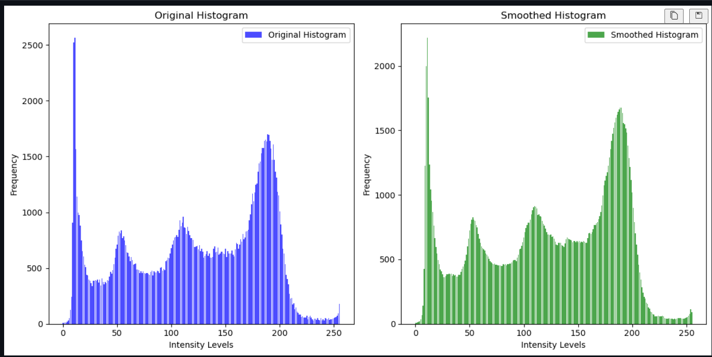
After Preprocessing

Slide 7
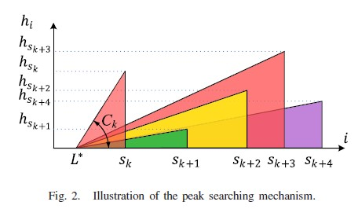
Peak Searching
Objective:
Identify dominant peaks using observability indices.
Key Concepts:
Observing Location: Determines the point with the best visibility of potential peaks.
Formula:
ΔL_{k} = [ h_{sk} × (s_{k} − s_{k−1}) ] / [ ε + |h_{sk} − h_{sk−1}| ]
Observability Index: Represents the prominence of a peak based on its height and location.
Formula: ​​C_{k} = h_{sk} / L_{k}, where:
h_{sk}​: Height of the peak.
L_{k}: Observing location.
Algorithm Highlights:
Iteratively calculates indices for all peaks.
Selects dominant peaks based on maximum observability.

Slide 8
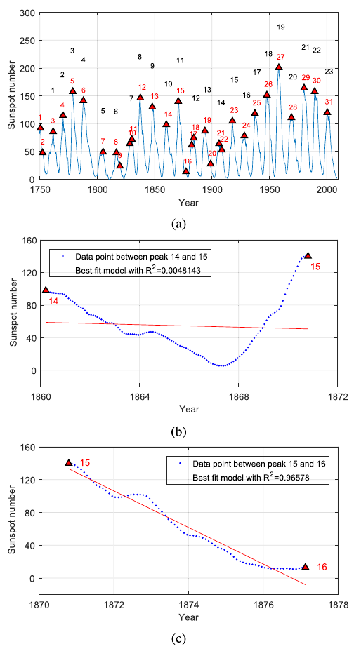
Peak Merging
Problem:
Noise at lower frequencies causes false peak detection, as seen in the NOAA sunspot dataset.
Example: 31 peaks detected instead of the ground truth of 23 due to incorrect detection of peaks 1, 2, 9, 10, 16, 17, 20, 22 (Fig. 3a).
Proposed Solution:
Peak Merging Process:
Segment histogram into unimodal intervals [a_{i},b_{i}]here each follows increasing and decreasing trends.
Use linear regression to analyze consecutive peaks and determine their relationship (increasing or decreasing side of a unimodal mode).

Slide 9
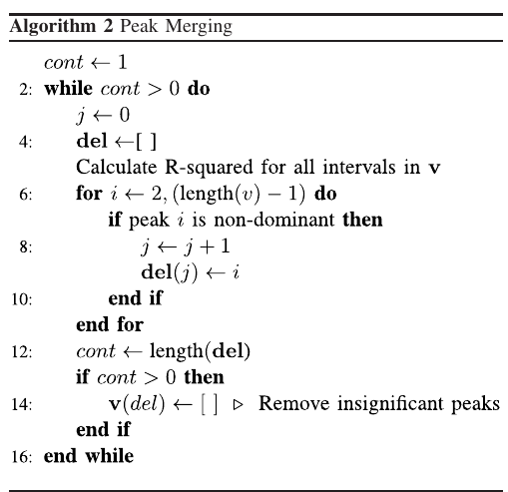
Peak Merging
Key Steps:
Calculate R-squared value (R²​) for each interval [v_{k},v_{k+1}]:
Peaks belong to the same mode if ​R²​ is high (Fig. 3c:R²​ = 96.6%).
Peaks belong to different modes if R²​ is low (Fig. 3b: R²​= 0.48%).
A peak is considered false if:
R²​​ is below a predefined threshold.
Peak height is smaller than neighboring peaks.
Results:
Effective reduction of false peaks while preserving dominant ones.

Slide 10
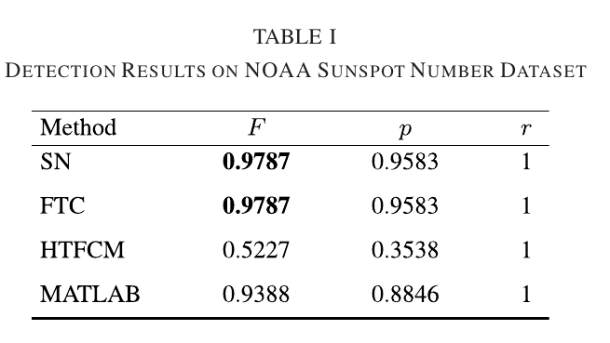
Result Metrics
Results of Summit Navigator - NOAA Dataset
Overview:
The NOAA dataset consists of sunspot numbers from 1749 to 2009 with 23 maximum cycles.
Ground truth data is used to evaluate peak detection performance.
Performance Highlights:
Summit Navigator (SN) and FTC:
Detected all 23 true peaks with 1 false positive each.
Achieved the highest F-measure and Precision.
MATLAB findpeaks function:
Good results with 3 false positives: F-measure = 0.9388, Precision = 0.8846.
Requires manual tuning for optimal results.
HTFCM:
Performed poorly with 42 false positives, yielding the lowest F-measure = 0.5227 and Precision = 0.3538.
Conclusion from NOAA Dataset:
Summit Navigator excels in accuracy and robustness with minimal false positives.

Slide 11
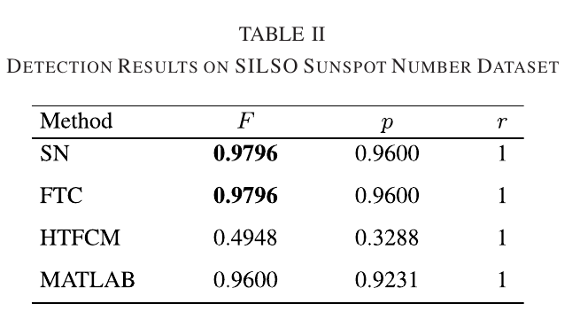
Result Metrics
Results of Summit Navigator - SILSO Dataset
Overview:
SILSO dataset contains sunspot numbers from 1749 to 2017 with 24 maximum cycles.
Ground truth data ensures comprehensive evaluation of peak detection methods.
Performance Highlights:
Summit Navigator (SN) and FTC:
Detected all 24 true peaks with 1 false positive each.
Achieved the highest F-measure and Precision.
MATLAB findpeaks function:
Good results with 2 false positives (with 7-year minimal peak distance).
HTFCM:
Poor performance with 49 false positives, highlighting inefficiency for large datasets.
Conclusion from SILSO Dataset:
Summit Navigator consistently outperforms MATLAB and HTFCM while maintaining FTC's level of accuracy.

Slide 12
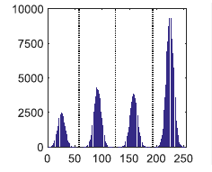
Thresholding
Determine Thresholds:
Identify the minimum intensity values between each pair of consecutive peaks.
If multiple minima exist between two peaks, compute the median of these minima to determine the threshold.
Adjust Intensity Values:
Replace all pixel intensity values between two thresholds with the corresponding peak intensity value.

Slide 13
Application
Industrial Use Cases:
Surface Inspection:
Identifying defects in manufacturing (e.g., capacitors, metal surfaces).
Drone-Based Vision:
Automated inspection of large surfaces (e.g., bridges, pipelines).
Medical Imaging:
Multi-Object Segmentation:
Accurate detection of tissues, cells, or abnormalities in medical scans.
Background Removal:
Enhancing image quality for further diagnostic analysis.
Automation and Robotics:
Object Detection:
Separating objects from background in vision-based systems.
Scene Segmentation:
Assisting robots in understanding complex environments.

Slide 14
Conclusion
Novel Peak Detection Method:
Introduced the Summit Navigator for accurately identifying true peaks in multi-modal gray-scale histograms without prior knowledge of modes or distances.
Innovative Techniques:
Utilized mountain exploration tactics, density analysis, and a merging mechanism with linear model fitting to handle false positives effectively.

Slide 15
Conclusion
Superior Performance:
Demonstrated higher accuracy and robustness compared to existing methods like HTFCM, FTC, and MATLAB on reputable datasets.
Promising Applications:
Applicable in vision-based diagnostics, robotics, and automation systems for surface inspection.

Slide 16
References
Include a brief reference to the IEEE paper:
Dinh, T. H., Phung, M. D., & Ha, Q. P. (2020). Summit Navigator: A Novel Approach for Local Maxima Extraction. IEEE Transactions on Image Processing.

Slide 17
Thank you for your Attention

Slide 18
Dataset
Our project doesn’t require dataset. As it doesn’t have model to train. It work on statistical basis.

