Slide 1
PsycheHealth
A free Mental Health analyzer for public welfare
Notes:
Illustrated by freepik

Slide 2


Team ByteHogs
Name - Vedant Kokane
Year - SE
College - PICT
Name - Ajit Abhyankar
Year - SE
College - PICT
Notes:
Illustrated by freepik

Slide 3
Problem Statement :
Mental health is a significant growing concern worldwide. Due to lack of awareness mental health issues are neglected and never really cured and prioritized.

Slide 4
Experiencing a mental health problem is often upsetting, confusing and frightening – particularly at first. If you become unwell, you may feel that it's a sign of weakness, or that you are 'losing your mind'.

Slide 5
Our Solution :
PsycheHealth aims to provide a mental health survey to users to detect whether they are experiencing mental health issues. With the help of machine learning if the survey indicates the user is mentally ill, then the app will offer relevant resources, such as blog posts and information about medical professionals and much more, to help the user find support and treatment.

Slide 6
What makes our solution a never before ?
This approach to mental health analysis and support has the potential to help users identify and address their mental health concerns and improve their overall well-being.

Slide 7
Explanation
User will login/register to PsycheHealth with email and password.
The user will asked for an mental health survey.
With the help of machine learning model the PsycheHealth app will determine whether the user is mentally ill or not.
If the user is mentally ill then the PsycheHealth app will provide necessary blogs regarding mental health, some music, and psychiatrist based user’s selected city.

Slide 8
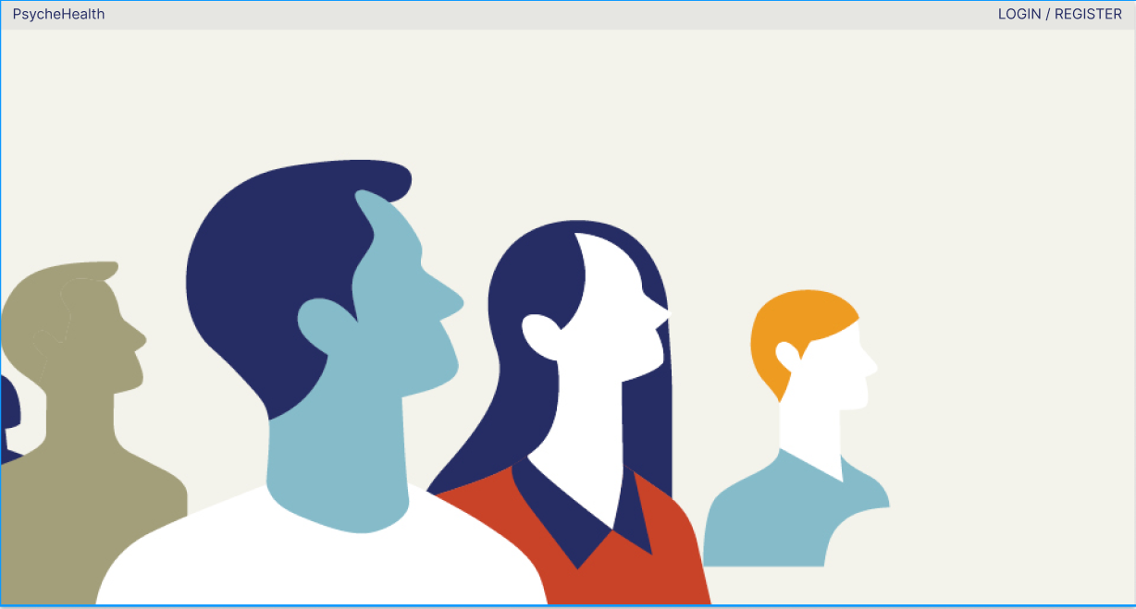
Prototype - made using figma

Slide 9
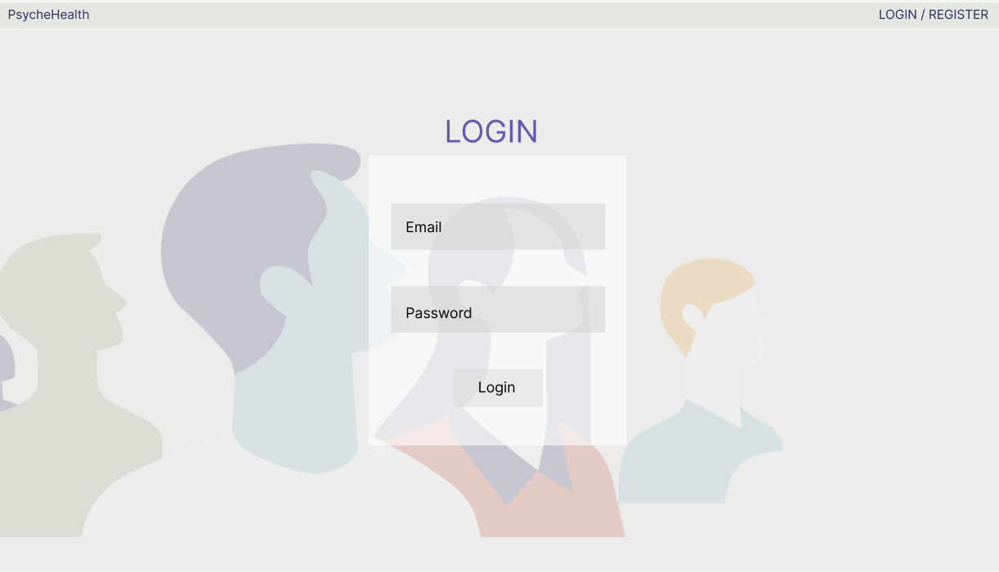
Prototype - made using figma

Slide 10
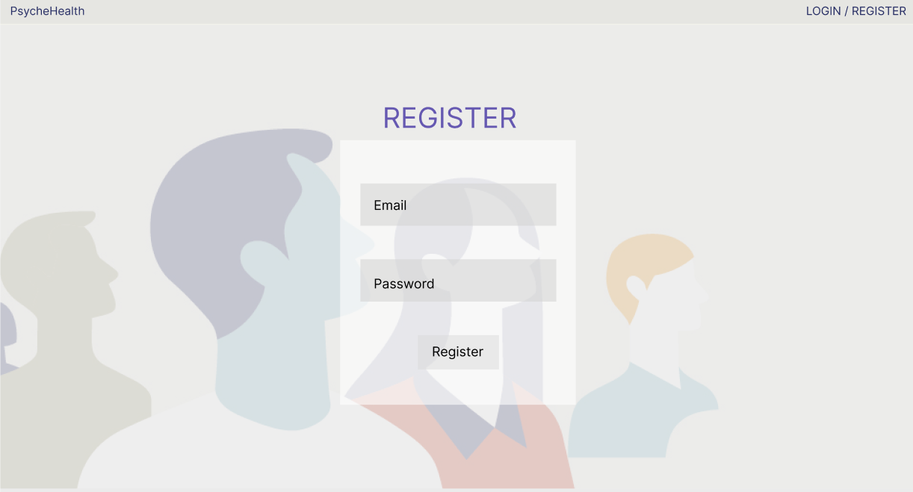
Prototype - made using figma

Slide 11
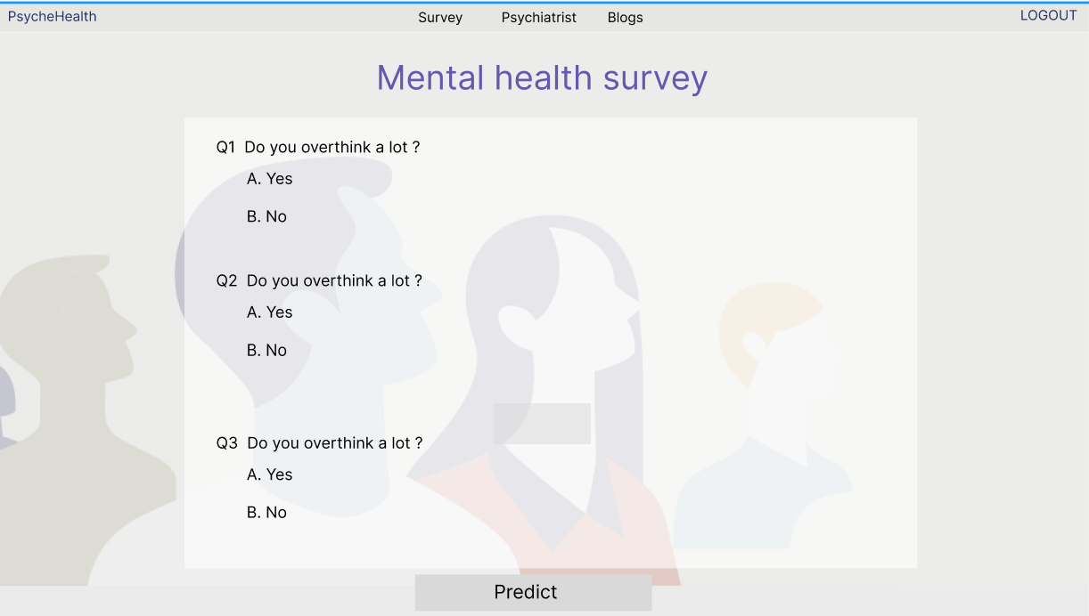
Prototype - made using figma

Slide 12
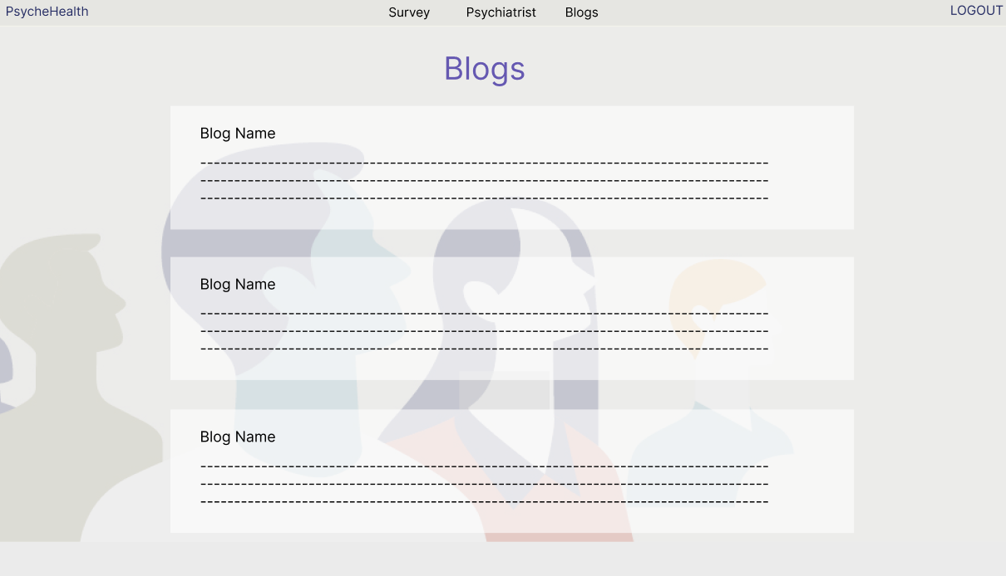
Prototype - made using figma

Slide 13
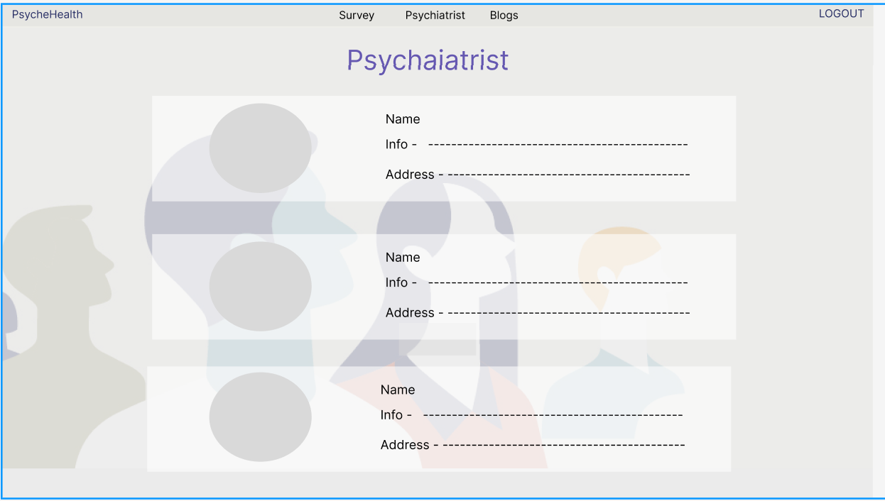
Prototype - made using figma

Slide 14
Tech Stack
For backend - Flask Server, Python
For frontend - Html, CSS, Javascript
For DataBase - Firebase / SQLite
For machine learning model- Kaggle’ mental health survey dataset.

Slide 15
Revenue Model
The PsycheHealth App will be completely free for the users. But we can generate revenue from other sources
70%
By Displaying Ads on PsycheHealth app
Use of Google Adsense for monetization of the website.
30%
By collecting platform fees from psychiatrist
we can collect commision from psychiatrist for showcasing their profiles whenever the user is detected to be mentally ill.
Notes:
Illustrated by freepik

Slide 16
Thank You !

