Slide 1
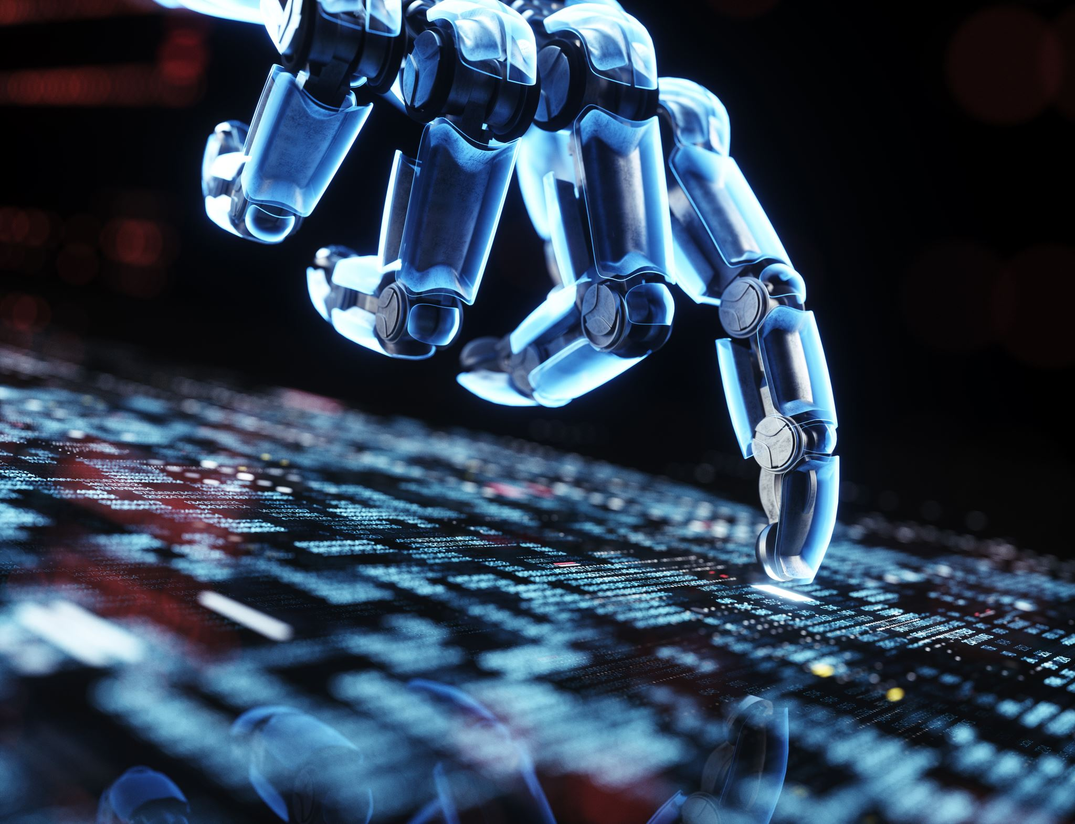

IMAGE CLASSIFICATION
BY
VEDANT RAI
RAJDEEP CHOUDHARY

Slide 2

Abstract
This project focuses on the development and deployment of a deep learning-based image classification system. Key stages include data curation, preprocessing, model selection, training, validation, testing, and deployment.We begin by curating a labeled dataset and preprocessing images for consistency and model generalization. A convolutional neural network (CNN) is selected as the model architecture for its effectiveness in image classification tasks.The model undergoes training using optimization algorithms to minimize loss, with validation ensuring prevention of overfitting. Rigorous testing on a separate dataset evaluates real-world performance and generalization.Through iterative refinement, we enhance the model's accuracy, robustness, and efficiency. Finally, the trained model is deployed for seamless integration into various applications and systems.

Slide 3
Introduction
Image Classification Defined:
Image classification is the task of categorizing images into predefined classes or labels. This typically involves training a deep learning model, such as a convolutional neural network (CNN), to learn patterns and features within images, enabling it to accurately assign labels to new unseen images based on their content.
Role of YOLOv8:
The role of YOLO (You Only Look Once) in the provided code is to perform object detection tasks. YOLO is a real-time object detection system that can detect multiple objects within an image and localize them with bounding boxes. It accomplishes this by dividing the image into a grid and predicting bounding boxes and class probabilities for each grid cell. YOLO's efficiency and speed make it suitable for various applications, including autonomous vehicles, surveillance, and image analysis.

Slide 4
Challenges/Motivation
dentification of Challenges:
As we delve into chatbot development, we encounter several challenges inherent in traditional systems.
One major challenge is the limited contextual understanding, where chatbots struggle to grasp the nuances of human language and context, leading to irrelevant or nonsensical responses.
Another challenge lies in response generation, as existing chatbots often produce generic or repetitive responses that fail to engage users in meaningful conversations.
Motivation for Integration:
These challenges serve as the driving force behind our integration of LLM and Seq2Seq algorithms.
By addressing the shortcomings of traditional chatbot systems, we aim to enhance the conversational capabilities and user experience of our chatbot.
The potential benefits of integrating advanced algorithms include improved contextual understanding, more coherent response generation, and ultimately, a more satisfying interaction for users.

Slide 5

Problem Statement
Real-time object detection is crucial for various applications like surveillance, autonomous vehicles, and image analysis.
Existing object detection algorithms often face challenges in balancing accuracy and speed
The need is to develop an efficient and accurate object detection model capable of real-time processing
The model should maintain high precision in detecting diverse object classes across different scenarios
YOLOv8 aims to address these challenges by leveraging advanced techniques and optimizations to achieve superior real-time performance in object detection tasks

Slide 6
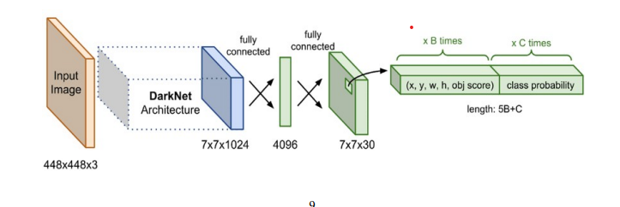
Literature Survey
YOLO was introduced to the computer vision community via a paper release in 2015 by Joseph Redmon et al titled ‘You Only Look Once: Unified, Real-Time Object Detection’. The paper reframed object detection, presenting it essentially as a single pass regression problem, initiating with image pixels and moving to bounding box and class probabilities. The proposed approach based on the ‘unified’ concept enabled the simultaneous prediction of multiple bounding boxes and class probabilities, improving both speed and accuracy. Since its inception in 2016 until the present year (2023), the YOLO family has continued to evolve at a rapid pace. Although the initial author (Joseph Redmon) halted further work within the computer vision domain at YOLO-v3 the effectiveness and potential of the core ‘unified’ concept have been further developed by several authors, with the latest addition to the YOLO family coming in the form of YOLO-v8. For implementation of object detection, each grid cell would predict bounding boxes along with the dimensions and confidence scores. The confidence score was indicative of the absence or presence of an object within the bounding box. Therefore, the confidence score can be expressed as Equation (1): confidence score =p(object)∗IoUtruth pred (1) Each bounding box consisted of five components (x,y,w,h, and the confidence score) with the first four components corresponding to center coordinates (x,y,width, and height) of the respective bounding box as shown in Figure:

Slide 7
Existing System/Work
YOLOv4:
YOLOv4 introduces advancements such as CSPDarknet53 backbone, PANet path-aggregation neck, and cross-stage partial connections (CSP), achieving state-of-the-art performance in object detection.
EfficientDet:
EfficientDet presents a scalable and efficient object detection model based on the EfficientNet backbone and compound scaling, achieving impressive performance across various resource constraints.
RetinaNet::
RetinaNet addresses class imbalance in object detection with a focal loss function, focusing training on hard examples and improving accuracy, particularly for rare object classes.
SSD (Single Shot MultiBox Detector:
SSD achieves real-time object detection by directly predicting bounding boxes and class probabilities from feature maps of different scales, efficiently integrating object detection and classification tasks.

Slide 8
Proposed System/Work
YOLOv8: This model builds upon the YOLO series of real-time object detection algorithms, aiming to enhance both efficiency and accuracy in object detection tasks. It leverages advancements in architecture design, training techniques, and optimization strategies to achieve superior performance.
YOLOv7: An earlier version that laid the groundwork for YOLOv8, focusing on improving model efficiency and speed while maintaining high accuracy in object detection.
Advanced Data Augmentation Techniques: Various works explore novel data augmentation methods to improve model robustness and generalization in real-time object detection tasks. These techniques include mixup, cutmix, and mosaic augmentation.
Model Pruning and Quantization: Research focuses on pruning and quantizing neural networks to reduce model size and computational complexity, enabling real-time inference on resource-constrained devices.
Adaptive Learning Rate Schedulers: Studies investigate adaptive learning rate scheduling techniques to improve training stability and convergence speed, facilitating faster model development and deployment

Slide 9

THANK YOU

