Slide 1
Lexical Analysis and Lex Implementation Demo
Presentation Objectives
Target Environment & Demo Scope
Understand how a lexer identifies tokens in source code.
Write Lex/Flex rules to recognize keywords, identifiers, operators and constants.
Run our scanner on a sample input and examine its output.
Demonstrate identifier-length error detection and symbol-table generation.
Scanner Generator: Flex (Lex-compatible)
Compiler: GCC
Input: C-style source code read from input.cpp
Output: Token classification, lexical error reporting and an identifier symbol table
Scope: Demonstrates a limited subset of C/C++ syntax; it is not a complete C++ compiler.
Notes:
~0:45. State the four objectives and the scope honestly: limited C-style subset, not a full C++ compiler.

Slide 2
Where Lexical Analysis Fits in a Compiler
Source Code
(character stream)
Lexical Analyzer
(scanner)
tokens
Syntax Analyzer
(parser)
Symbol Table: supporting structure used by relevant phases
1. Input: Source Code
2. Lexical Analyzer
3. Output and Next Phase
A program is read as a sequence of characters.
The stream contains identifiers, keywords, constants, operators, punctuation and possibly whitespace or comments.
Examines characters and groups them into lexemes.
Classifies recognised lexemes into token categories using defined patterns.
Ignores whitespace where specified by the scanner rules.
Produces a sequence of tokens for the syntax analyzer.
The syntax analyzer checks whether the token sequence follows grammatical rules.
A symbol table stores identifier information for use by relevant compiler phases.
Notes:
~1:00. General compiler pipeline only; our practical contains no parser. The symbol table is a supporting structure, not a stage after the parser.

Slide 3
From Character Streams to Tokens
1. Input
2. What the lexer does
3. Example Output
Raw source-code characters read from a file.
Includes meaningful lexemes and characters such as whitespace.
Example:
Recognises character sequences that match defined patterns.
Groups characters into lexemes.
Classifies each recognised lexeme into a token category.
Applies the rules specified in the scanner.
Illustrative token sequence:
IDENTIFIER(a) →
ASSIGN(=) →
IDENTIFIER(count) →
PLUS(+) →
INTEGER(50) →
SEMICOLON(;)
a = count + 50;
Example token sequence for illustration; actual output depends on our Lex rules.
Notes:
~0:45. Walk a = count + 50; through the scanner. Stress the labels are illustrative; our program prints its own categories.

Slide 4
Understanding the Building Blocks of Lexical Analysis
Token
Lexeme
Pattern
Attribute
An abstract category assigned to a recognised lexeme, such as KEYWORD, IDENTIFIER or INTEGER_CONSTANT.
The actual character sequence found in the source code, such as int, count or 10.
A rule describing which character sequences belong to a token category.
Optional information associated with a token, such as a numeric value or a symbol-table reference.
Example: int count = 10;
Lexeme | Token category | Explanation
int | Keyword | A language keyword
count | Identifier | A name used in the program
= | Operator | Assignment operator
10 | Integer constant | An integer literal
; | Delimiter | Terminates the declaration
Notes:
~0:50. Four terms, then the table. Pattern is the rule; lexeme is the matched text; token is the category; attribute is optional extra data.

Slide 5
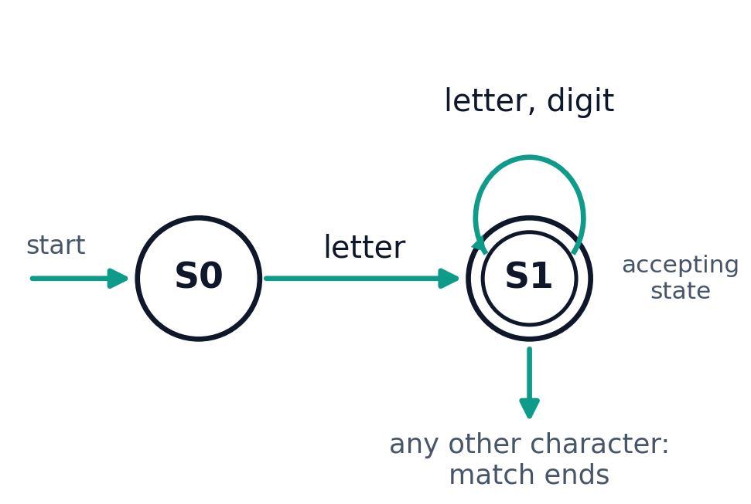
Regular Expressions Describe Patterns; Finite Automata Recognise Them
Regular Expressions
Finite Automata
A notation for describing sets of strings.
Used in Lex/Flex rules to describe patterns such as identifiers and integers.
A finite automaton processes an input string through states and transitions.
A DFA has one defined next state for each state and input symbol.
Accepting states indicate that the consumed input matches the recognised pattern.
Illustrative patterns
Integer: [0-9]+
Identifier: [A-Za-z_][A-Za-z0-9_]*
Illustrative identifier recogniser, not a screenshot of Flex’s internal implementation.
Identifiers may begin with a letter or underscore.
Exercise-specific rule: our practical additionally flags identifiers longer than eight characters. This length restriction belongs to this exercise and is not a universal C/C++ rule.
Mishra & Chandrasekaran, Chapter 3, 3.2, p. 73; Chapter 5, 5.1–5.2, pp. 136–140.
Notes:
~1:00. Regex describes, automaton recognises. Our program does not construct automata by hand; Flex generates the scanner from the patterns. The 8-character limit is an exercise rule.

Slide 6
From a Flex Specification to an Executable Scanner
1. Definitions
2. Rules
3. User Subroutines
Header files, declarations and optional named patterns.
Code between %{ and %} is copied into the generated scanner.
Rules contain patterns followed by actions; a matching pattern runs its action.
Flex selects the longest match; if two rules match equally long text, the earlier rule wins.
Supporting C functions, such as a symbol-table helper.
main() may open the input file and call yylex().
cpp_lexer.l
flex
lex.yy.c
gcc
cpp_lexer
Build commands
Illustrative rule example
flex cpp_lexer.l
gcc lex.yy.c -o cpp_lexer
./cpp_lexer input.cpp
%%
"int" { printf("Keyword\n"); }
[0-9]+ { printf("Integer\n"); }
%%
Notes:
~1:00. Three sections separated by %%. Pipeline: flex generates lex.yy.c, gcc builds the executable. The snippet is illustrative, not our source.

Slide 7
Implementing a Source-Code Lexer with Flex
1. Token recognition rules
3. Symbol table and flow
"auto"|"bool"|"break"| ... |"while"|"std" {
print_token(yytext, "Keyword");
}
{INTEGER} { print_token(yytext, "Integer constant"); }
add_symbol() adds each valid identifier once; duplicates are skipped.
Flagged: identifiers over 8 characters are reported and not added.
Table: Name, Type and Value; Value is “-” (no runtime values).
main(): opens the input file, calls yylex(), then prints the symbol table.
2. Identifier-length check (more than 8 characters)
{IDENTIFIER} {
if (yyleng > 8) {
print_token(yytext, "Lexical error: identifier > 8 chars");
} else {
print_token(yytext, "Identifier");
add_symbol(yytext);
}
}
Scope:This is a basic lexer for selected C-style tokens, not a complete C++ lexer. It does not check grammar or variable declarations. The eight-character identifier limit is a rule for this exercise.
Known limitation:Our keyword list includes “std”, although it is not a C++ keyword. Since “std” does not appear in our sample input, it does not affect the demonstrated output.
Notes:
~1:00. Walk the four excerpts: token rules, the >8 identifier check, add_symbol (unique entries), and main opening input.cpp then calling yylex(). Mention that std is listed in the keyword rule but is a namespace, a known limitation; it is not in the sample input.

Slide 8
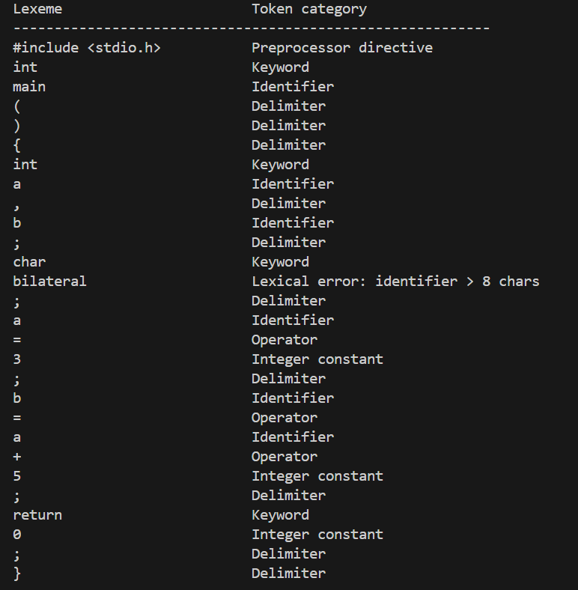
Lexer Execution: Token Output
Commands and Input File
Observed
flex cpp_lexer.l
gcc lex.yy.c -o cpp_lexer
./cpp_lexer input.cpp
Keywords: int, char, return
Identifiers: main, a, b
Integer constants: 3, 5, 0
Operators: =, +
Flagged: bilateral exceeds the eight-character limit
input.cpp (as supplied)
#include <stdio.h>
int main() {
int a, b;
char bilateral;
a = 3;
b = a + 5;
return 0;
}
Notes:
~1:15. Genuine terminal output from the team run, scanning the same input.cpp that was supplied. Read the table top to bottom against the input; point out bilateral. Commands shown are the README commands.

Slide 9
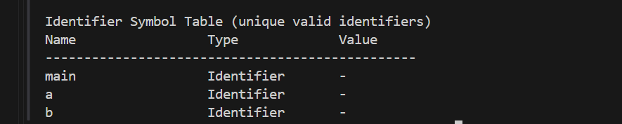
Lexer Execution: Identifier Symbol Table
Symbol Table Output
Reading the Table
Entries: main, a and b, each recorded once.
Excluded: bilateral, because it was flagged as a lexical error.
Value column (-): this implementation does not store runtime values.
What This Run Shows, and What It Does Not
Shows: token classification of a C-style input, detection of the exercise-specific identifier-length error, and an identifier symbol table.
Does not show: statement grammar validation or checking whether identifiers are declared; those need later compiler phases.
Notes:
~0:45. main is in the table because it is an identifier. bilateral is absent because it was rejected. The dash means no runtime values are stored.

Slide 10
Conclusion and References
Key Takeaways
References
Lexical analysis converts a character stream into a sequence of tokens.
Flex generates a scanner from regular-expression rules and associated actions.
Our lexer recognizes selected C-style tokens, detects identifiers exceeding the eight-character limit, and builds a symbol table.
It does not check complete statement grammar or verify whether identifiers have been declared.
1. K. L. P. Mishra and N. Chandrasekaran, Theory of Computer Science: Automata, Languages and Computation, 3rd ed., Prentice-Hall of India. Ch. 3, 3.2, p. 73; Ch. 5, 5.1, pp. 136–139; Ch. 5, 5.2, from p. 140.
2. A. V. Aho, R. Sethi and J. D. Ullman, Compilers: Principles, Techniques, and Tools, Pearson Education.
3. J. R. Levine, T. Mason and D. Brown, Lex & Yacc, O’Reilly Media.
4. College Laboratory Manual, LEX and YACC, Experiment 1: “Lexical Analyzer for HLL Using LEX,” pp. 1–4.
5. The Flex Manual, documentation for Flex scanner specifications and generated scanner functions.
Notes:
~0:30. Summarise, then invite questions.

