Slide 1
Diabetes Outcome Classification
TYBCA · MACHINE LEARNING PROJECT (CCA2) · PROBLEM STATEMENT 8
768
patients analysed
4
algorithms compared
Predicting diabetes from 8 health measurements and comparing 4 classification algorithms
74%
Presented by Vedant and Tarang
of diabetic patients caught (recall)
Dataset: Pima Indians Diabetes Database · Python · scikit-learn
Notes:
Good morning. Our project is Diabetes Outcome Classification, Problem Statement 8.
We used 768 patient records, compared four machine learning algorithms, and our final model correctly catches 74% of diabetic patients in the test set.
Tools: Python, pandas, scikit-learn, matplotlib and seaborn.

Slide 2
Problem and Dataset
Problem
768
8
35%
Diabetes often goes unnoticed until complications appear. Can a model flag at-risk patients early from routine health measurements?
patients
input features
have diabetes
Objectives
Input features
Pregnancies
Glucose
Blood pressure
Skin thickness
Insulin
BMI
Diabetes pedigree
Age
Clean and explore the data (EDA)
Train and compare 4 classifiers
Maximise recall: miss as few diabetic patients as possible
Find which health factors matter most
Target: Outcome (1 = diabetes, 0 = no diabetes)
Source: Pima Indians Diabetes Database (NIDDK), kaggle.com/datasets/uciml/pima-indians-diabetes-database
Notes:
Problem: predict whether a patient has diabetes (Outcome = 1) or not (Outcome = 0). This is binary classification, a supervised learning task.
Dataset: Pima Indians Diabetes Database from the National Institute of Diabetes and Digestive and Kidney Diseases. 768 patients, all women of Pima Indian heritage aged 21 or older. 8 numeric features, 1 target. 268 patients (35%) have diabetes and 500 (65%) do not.
Diabetes pedigree function = a score of diabetes risk based on family history.

Slide 3
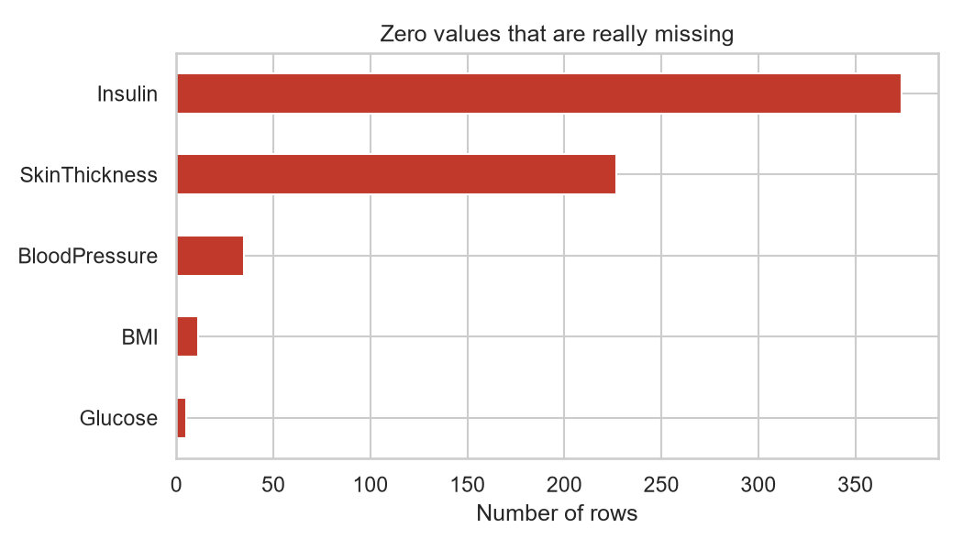
Data Preprocessing
1
No duplicate rows found
2
Impossible zeros → missing (NaN)
3
Missing values → column median
4
Features scaled (StandardScaler)
5
Stratified 80/20 split (614 / 154)
A glucose, blood pressure or BMI of 0 is impossible, so zeros mean "not recorded". Insulin is missing in 49% of rows, skin thickness in 30%.
6
Class weights balanced (65:35)
Imputer and scaler are fitted on training data only (inside a Pipeline) to avoid data leakage.
Notes:
1. Checked duplicates: none.
2. Hidden missing values: Glucose, BloodPressure, SkinThickness, Insulin and BMI contain zeros, which are medically impossible. We replaced them with NaN (missing).
3. Filled missing values with the median of the column. Median is better than mean here because the data is skewed and has outliers.
4. StandardScaler: (value - mean) / standard deviation, so every feature has mean 0 and std 1. Needed for KNN and Logistic Regression, which are sensitive to scale.
5. Stratified split keeps the same 65:35 ratio in train and test sets.
6. class_weight='balanced' makes mistakes on the smaller diabetes class cost more.
Outliers were kept: they are real patients, and tree models are robust to them.
Data leakage: the median and scaling are learned from the training data only, so the test set stays unseen.

Slide 4
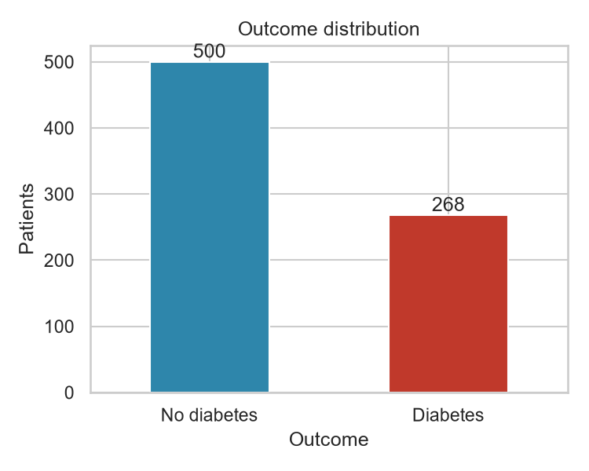
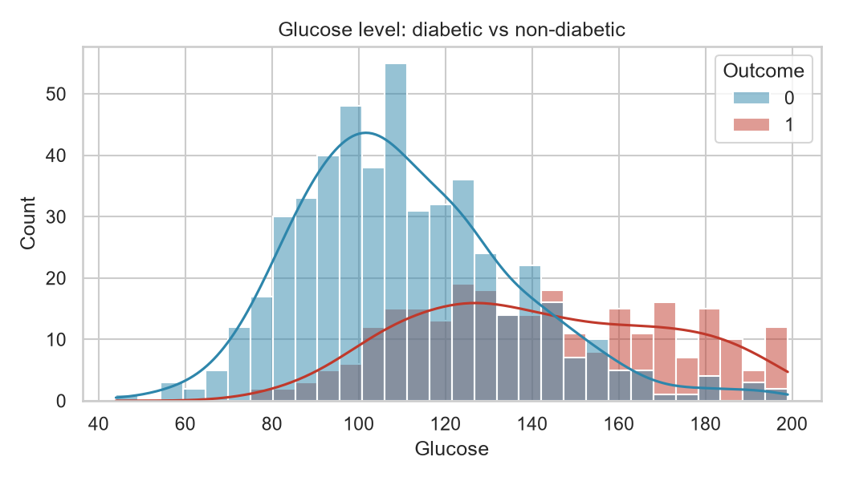
EDA: Class Balance and Glucose
500 without vs 268 with diabetes. The data is imbalanced, so accuracy alone can mislead; we focus on recall and F1.
Diabetic patients have much higher glucose (median 140 vs 107 mg/dL). Glucose has the strongest link to the outcome (correlation 0.49).
Notes:
Chart 1, class balance: 65% of patients do not have diabetes. A useless model that always says 'no diabetes' would already be 65% accurate. That is why accuracy alone is not enough and we look at recall and F1-score.
Chart 2, glucose: the red (diabetic) distribution sits clearly to the right. Glucose is the single most useful feature, which the Random Forest also confirms later.

Slide 5
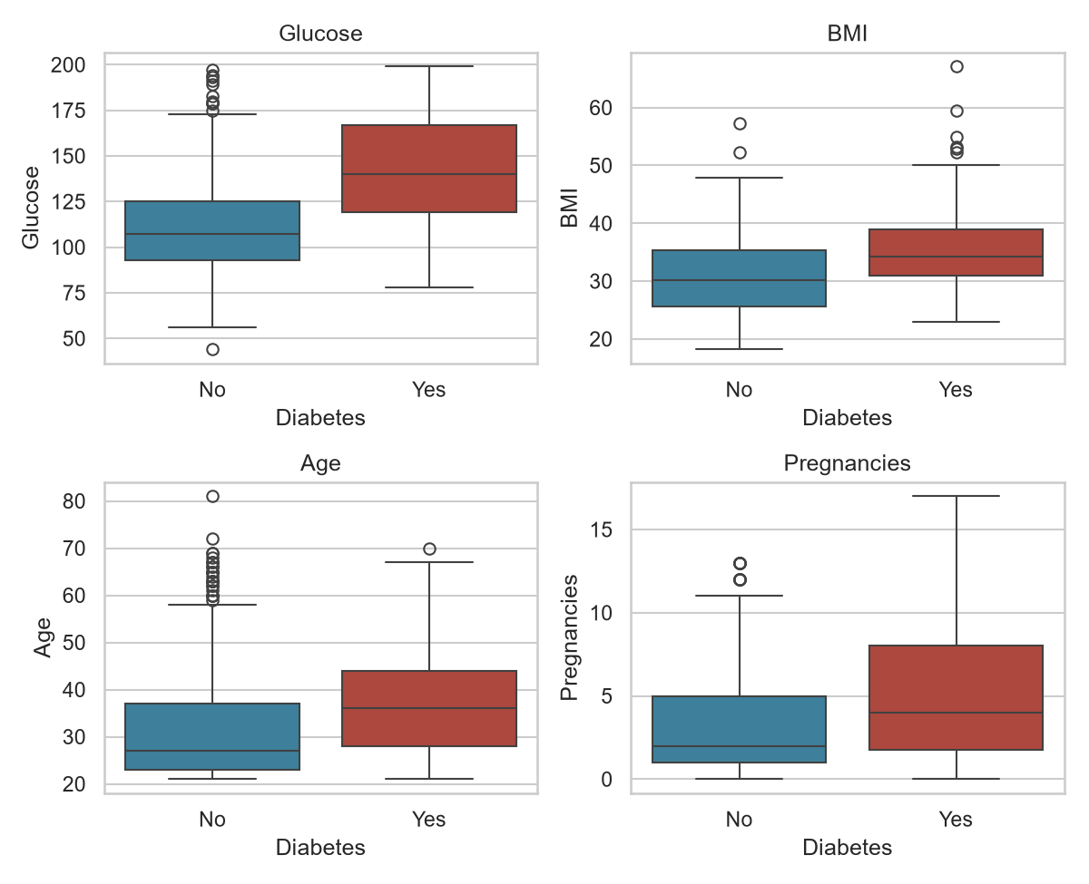
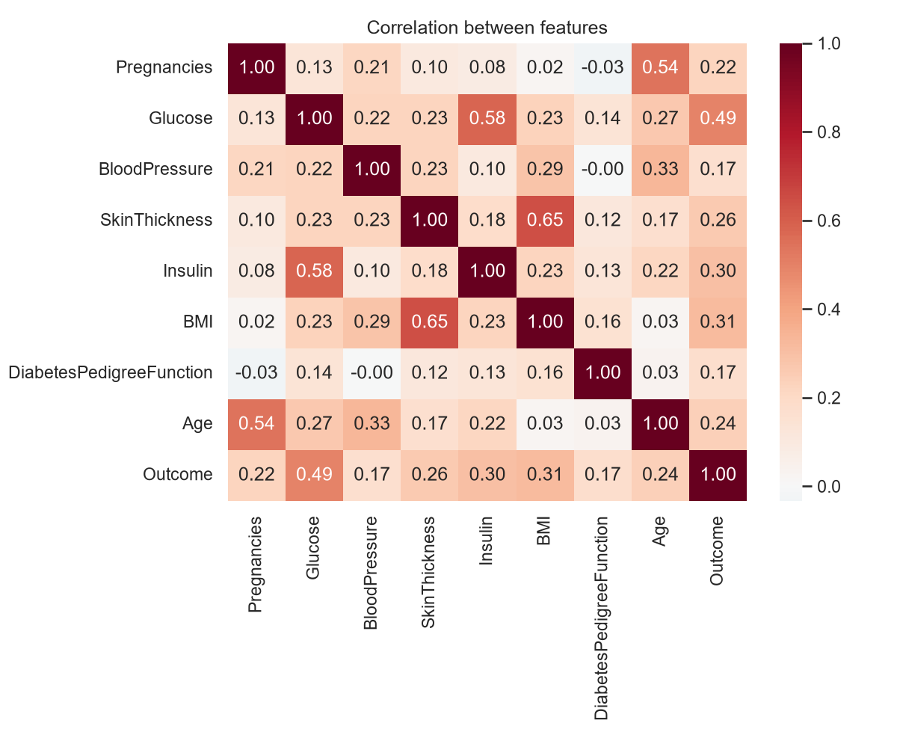
EDA: Feature Patterns
Diabetic patients are older (median age 36 vs 27), have higher BMI (34 vs 30) and more pregnancies.
Glucose (0.49), BMI (0.31) and Insulin (0.30) relate most to Outcome. The highest feature pair is SkinThickness–BMI (0.65), so all 8 features were kept.
Notes:
Chart 3, box plots: the box shows the middle 50% of patients and the line is the median. For all four features the diabetic group (red) is higher.
Chart 4, correlation heatmap: values range from -1 to +1. Glucose has the strongest correlation with Outcome (0.49). No two input features are extremely correlated (highest is 0.65), so we did not need to drop any feature.
Correlation only shows linear relationships, and correlation does not mean causation.

Slide 6
Method and Algorithms
Load data
›
Clean
›
Split 80/20
›
Impute + scale
›
Train 4 models
›
Evaluate
1
Logistic Regression
pipe = Pipeline([
("imputer", SimpleImputer(strategy="median")),
("scaler", StandardScaler()),
("model", RandomForestClassifier(
n_estimators=200, max_depth=6,
class_weight="balanced")),
])
cv_f1 = cross_val_score(pipe, X_train,
y_train, cv=5, scoring="f1").mean()
pipe.fit(X_train, y_train)
y_pred = pipe.predict(X_test)
S-shaped curve that outputs a probability of diabetes
2
KNN (k = 11)
Labels a patient like its 11 most similar patients
3
Decision Tree (depth 4)
Series of yes/no questions, e.g. Glucose > 127?
4
Random Forest (200 trees)
Many trees vote; less overfitting than one tree
Notes:
Workflow: load, clean, split, then impute and scale inside a scikit-learn Pipeline, train four models and evaluate.
Logistic Regression: linear model + sigmoid function, outputs a probability between 0 and 1.
KNN: finds the 11 nearest patients (Euclidean distance) and takes a majority vote. Needs scaling.
Decision Tree: splits data with if/else rules chosen by Gini impurity. Limited to depth 4 to avoid overfitting.
Random Forest: an ensemble of 200 decision trees, each trained on a random sample of rows and features (bagging). The majority vote is more stable than one tree.
Cross-validation: training data is split into 5 parts; the model is trained on 4 and tested on 1, five times. We pick the final model by average F1 across the 5 folds.

Slide 7
Results: Model Comparison
FINAL MODEL
Random Forest
0.697
cross-validated F1, best of 4
74%
of diabetic patients caught
Chosen by 5-fold CV, which is more reliable than one small test set. Decision Tree had higher test recall but the most false alarms.
Notes:
Full results (test set):
Logistic Regression: CV F1 0.672, accuracy 0.734, precision 0.603, recall 0.704, F1 0.650
KNN: CV F1 0.611, accuracy 0.734, precision 0.633, recall 0.574, F1 0.602
Decision Tree: CV F1 0.637, accuracy 0.708, precision 0.556, recall 0.833, F1 0.667
Random Forest: CV F1 0.697, accuracy 0.721, precision 0.580, recall 0.741, F1 0.650
Precision = of the patients we said have diabetes, how many really do. Recall = of the patients who really have diabetes, how many we caught. F1 = harmonic mean of precision and recall.
Why Random Forest: highest average F1 over 5-fold cross-validation (0.697). The test set is only 154 patients, so one split can be lucky or unlucky; CV is more reliable. Decision Tree had higher test recall (0.83) but lower precision (0.56) and lower CV F1, so it is less consistent.
KNN was weakest because it cannot use class weights, so it favours the majority class.

Slide 8
Random Forest: Errors and Key Features
Confusion matrix (test set)
Feature importance (Random Forest)
Predicted: No
Predicted: Yes
Actual: No
71
29
true negatives
false alarms
Actual: Yes
14
40
missed (false negatives)
true positives
14 of 54 diabetic patients were missed. This is the most harmful error: they would go untreated. A false alarm only means one extra blood test.
Notes:
Confusion matrix for Random Forest on the 154 test patients:
True negatives 71: healthy, predicted healthy. True positives 40: diabetic, predicted diabetic.
False positives 29: healthy, but predicted diabetic. Consequence: an unnecessary follow-up test, some worry.
False negatives 14: diabetic, but predicted healthy. Consequence: disease goes untreated, which can lead to heart, kidney and eye damage. This is why we care most about recall.
Recall = 40 / (40 + 14) = 0.74. Precision = 40 / (40 + 29) = 0.58.
Feature importance: Glucose is by far the most important (0.32), then BMI and Age. This matches medical knowledge and our EDA. Importance in Random Forest = how much each feature reduces Gini impurity across all trees.

Slide 9
Conclusion and Limitations
Conclusion
Limitations
Future work
Random Forest gave the best balance: CV F1 0.697, recall 0.74
Glucose, BMI and Age are the strongest predictors
Class weights raised Random Forest recall from 0.52 to 0.74
Small dataset (768) from one group: Pima Indian women, 21+
Insulin and skin thickness mostly imputed (49% / 30% missing)
Not a diagnosis tool: a doctor must confirm
Larger, more diverse patient data
Tune hyperparameters with GridSearchCV
Simple Streamlit app for live predictions
Notes:
Conclusion: all four models work reasonably well. Random Forest is the most reliable, catching 74% of diabetic patients. Glucose is the strongest indicator.
Effect of class weights on Random Forest: recall went from 0.52 without balancing to 0.74 with balancing.
Limitations: the data is small and from one specific population, so the model may not work for men or other populations. Many Insulin values were missing and had to be filled in. The model is a screening aid, not a replacement for a doctor.
Thank you. We are happy to take questions.

