Slide 1


IOT Based Voltage, Current, Power Consumption monitoring
Capstone Project
Under Guidance:- Gajanan Deshpande
Prof.Shilpa Shitole Parth Kalekar
Vedant Panse

Slide 2
Contents
Introduction
Motivation
Literature Survey
Problem Definition
Block Diagram ,Activity Diagram and Circuit Diagram
Hardware/ Software Design
Simulation Results
Advantages/Disadvantages/ Applications
Conclusions

Slide 3
Introduction
Building management systems (BMS), proved to be a game-changer. The availability of a computer-based control system that could automatically monitor and manage a building’s largest and costliest operational components helped facilities managers do their jobs better.
Building automation systems saved time and money, reduced energy waste, and gave facilities managers a way to better monitor their operations.
In our Project, We are focusing on developing the Intelligent Building so that We can reduce the Voltage Fluctuation Risk and Minimizing the Power Consumption by using IOT

Slide 4
Objectives
To monitor the Voltage level in the Building
Notifying the Authorized Person if Voltage Fluctuates to prevent Damage
Monitoring Current consumption of Building
Calculating Units consumption of the Building and sending the data to Mobile App.
Providing interface on Desktop.

Slide 5
Motivation
People now are dealing with an increase in their power bills.
They lack their own mechanism for monitoring current and voltage usage.
As a result, we're building a system that will allow consumers to track their consumption and volume at home.
Keep track of the number of persons who have entered the building.

Slide 6
Literature Survey
Year | Paper Name | Author | Conclusion
2018 | An IOT-based Remote Monitoring System for Electrical Power Consumption via LED Module | Darwin Alulema , Mireya Zapata | Energy is a valuable nonrenewable natural resource, and managing it allows the grid to operate more efficiently. A monitoring electrical circuit is included in the proposed prototype
2020 | Internet of Things (IOT) based Energy Tracking and Bill Estimation System | Rishi Mathur , Kamlesh Kalbande | IOT based energy tracking and bill estimation system discussed in this paper with various sections is successful in building awareness about electricity usage by displaying realtime estimated electricity consumption

Slide 7
Problem Definition
Problem Definition:- As part of the challenge, the Developer have to build an IOT device that converts a conventional building into a Smart Building, which can automate the lights in a room based on the occupants.
The Smart Building System using IOT should satisfy the following criteria:
The Smart Building System using IOT should be completely autonomous and be driven by Arduino Uno, an open-source hardware and software platform
The Smart Building System using IOT should count the number of person entered in building
The Smart Building System using IOT should also monitor current and voltage.

Slide 8
Block Diagram
Power Supply
.
Voltage Sensor
ESP WIFI Controller
Current Sensor
Building Load (Lights and Fans)
IR Sensor
Mobile App.

Slide 9
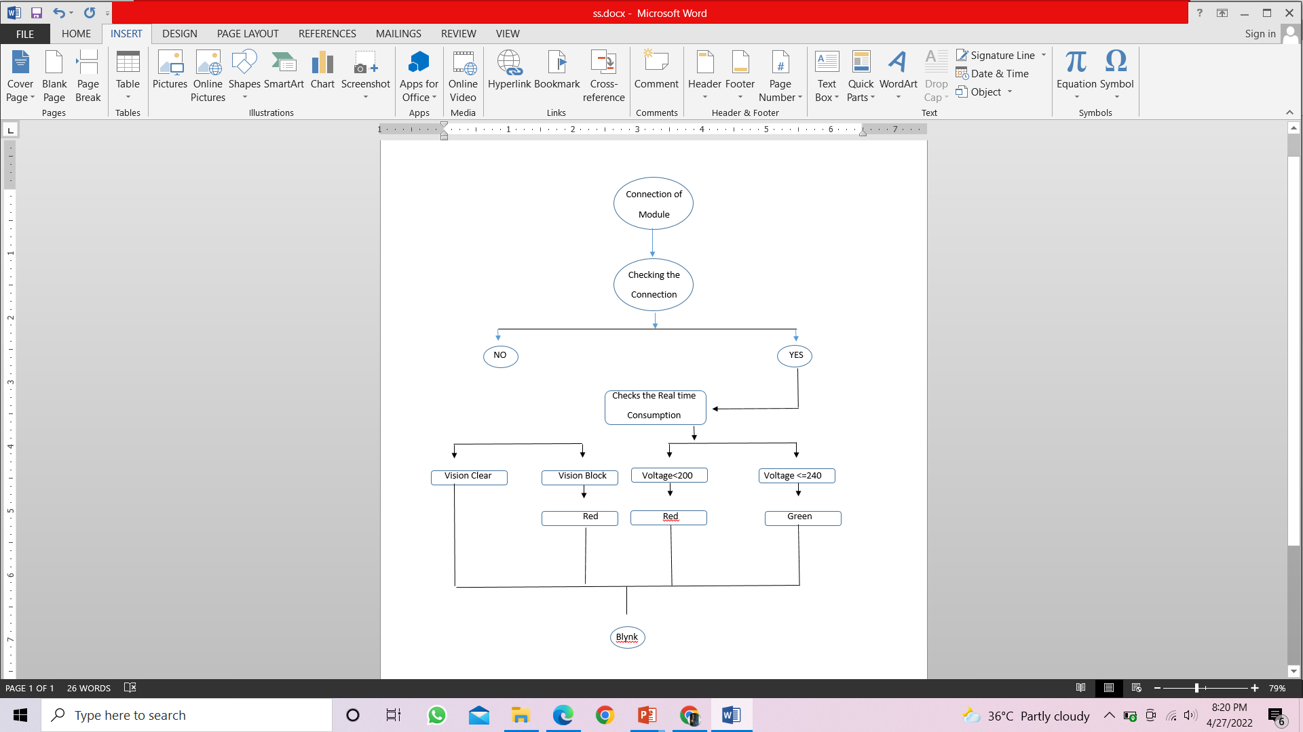
Activity Diagram

Slide 10
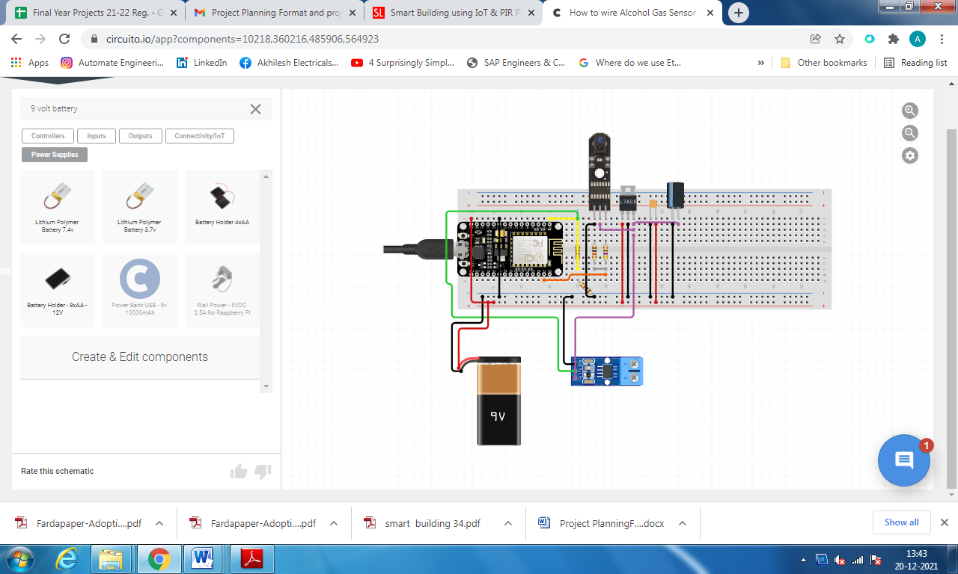
Circuit Diagram

Slide 11
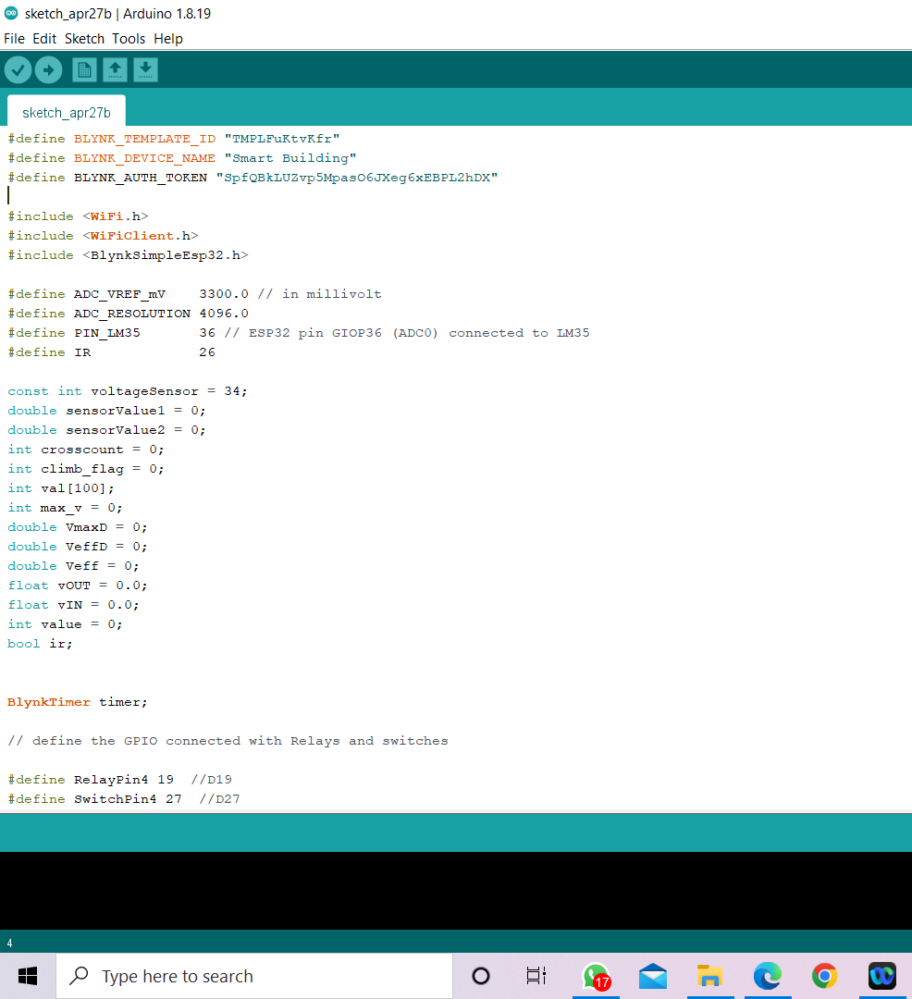
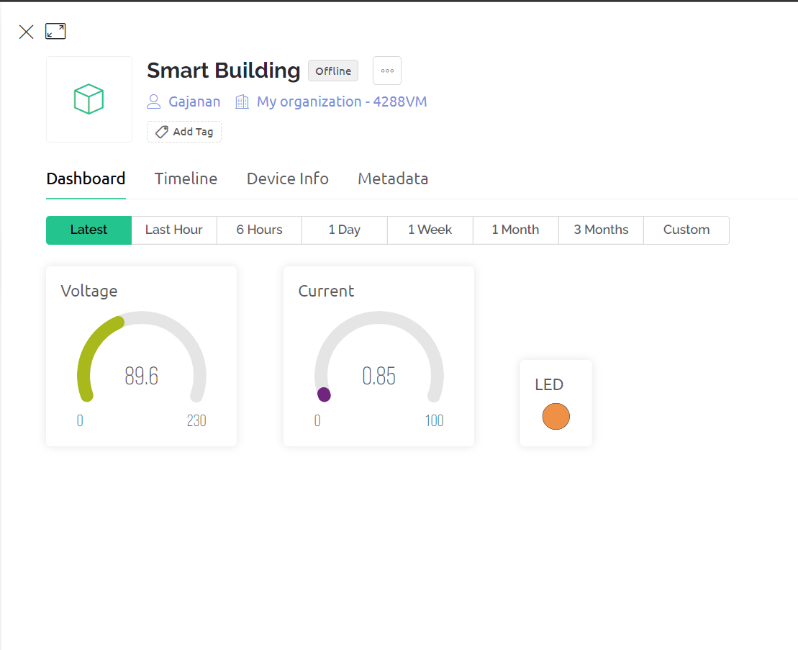
Project Execution

Slide 12
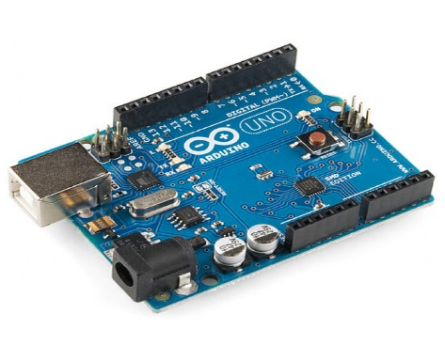
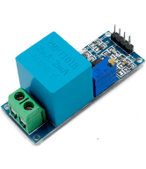
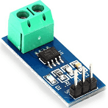
Resources
Arduino WIFI ESP Control
1) Heart and Brain of the System
2) Accepts the Real-time Input from Sensors, Compares it to the Code entered and
Takes the Action in from of sending data to interface.
Voltage Sensor
1) Monitors the Line Voltage in series with Building Load
Current Sensor
1) Monitors the Line Current in series with Building Load
Blynk
1) It Monitors and Display output

Slide 13
Explanation Of Block Diagram
Power Supply-
Provides Operating Power to the Controller and Sensors
Building Load-
We have taking Lights or Fan as the Building Load
System
It Monitor and send the input to the Application
Mobile App.
It Monitors the Vtg, Current, Product Count and Displays it in a
Spinner Progress Bar Form

Slide 14
Pros and Con
Advantages-
Electricity Cost Saving
Transparency
Low Cost of Development
Disadvantage-
Should be kept in a metal case
Overheating can damage the IC

Slide 15
Conclusion
The conclusion of this project is that we can use Atmega Controller to control the System without Human Interference.
And the Sensor connected to it gives the Real time value on the handy device ,which makes the process comfortable.

Slide 16
References
1. An IOT-based Remote Monitoring System for Electrical Power Consumption via Web-site Application:-Darwin Alulema ,
Mireya Zapata
2. Internet of Things (IOT) based Energy Tracking and Bill Estimation System:-Rishi Mathur , Kamlesh Kalbande
3. The model for home automation using bluetooth via PC:-N. Sriskanthan
4. Designed a prototype electrical device control system using Web:-Muhammad Izhar Ramli

Slide 17


