Slide 1
Drive Safe
“Drive Safe | DriveEZ”

Slide 2
Introduction
To minimize the risk of accidents caused due to the use of cellphones while driving, this application uses a variety of strategies to keep the driver’s eyes on the road. The application incorporates various features that makes it the best partner for every road trip.

Slide 3
Motivation
To overcome the problem regarding accidents caused due to handling of phones while driving, we propose a Drive Mode Road Safety Android Application. A modern survey says that 75% of Indian population uses Android smartphones. So, considering that, we have created an Android application that will help to minimize the risk of accidents caused due to the use of cellphones while behind the wheels. This application uses a variety of strategies to keep the driver’s eyes on the road.

Slide 4
Requirements
System Requirements:
Software requirements- Android version 5.0 and above.
Hardware requirements- RAM 1GB (min).
Technology used in Android app:
Googles Android API.
Googles Map API.
SQLite Database.

Slide 5
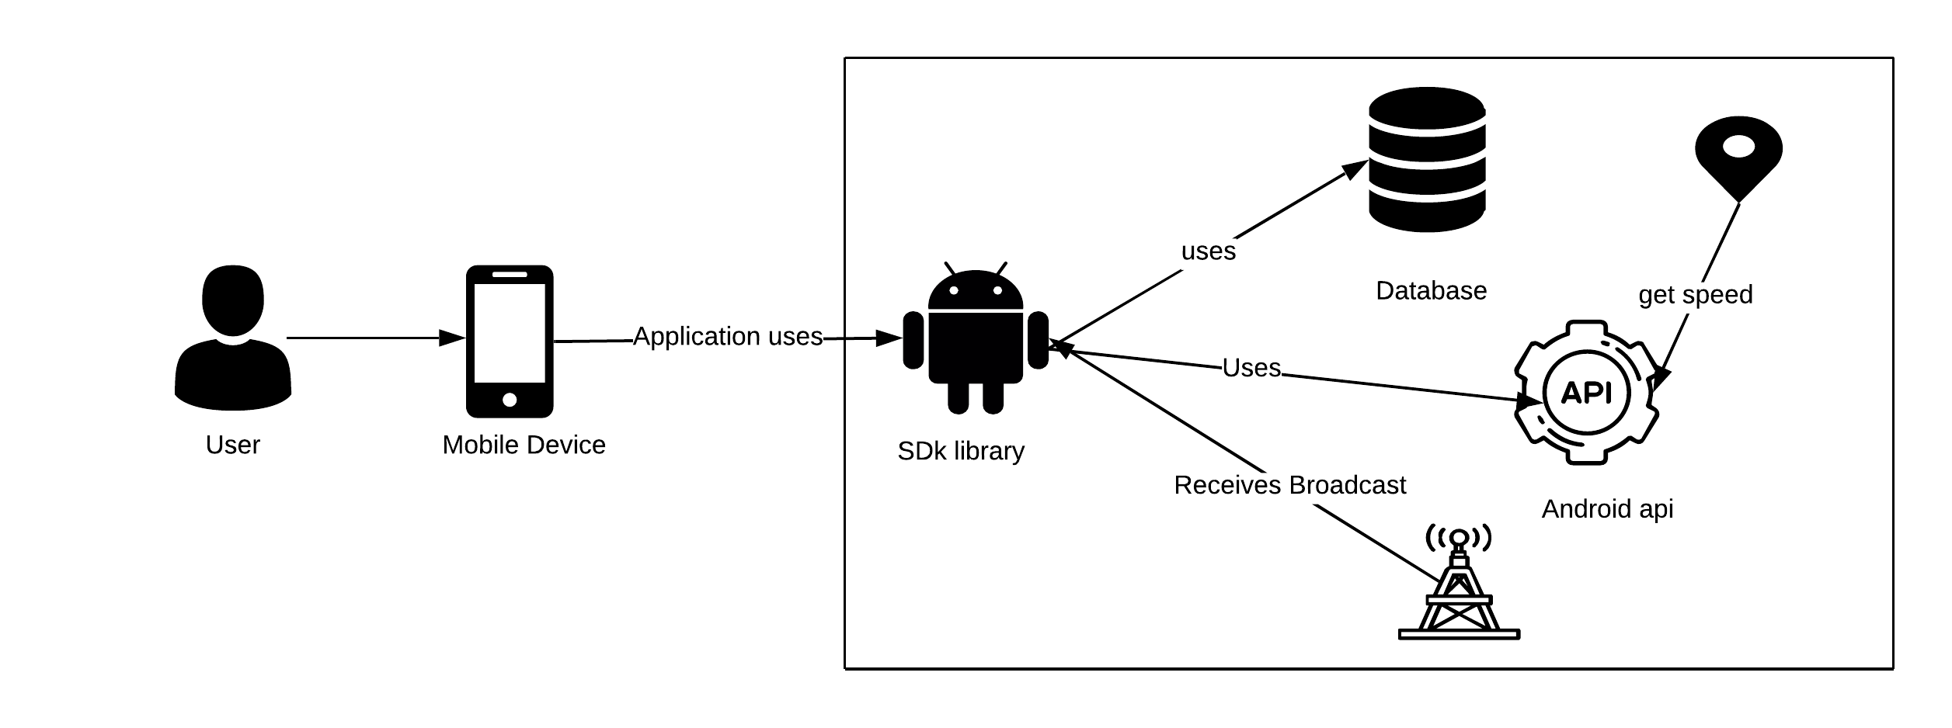
Architecture

Slide 6
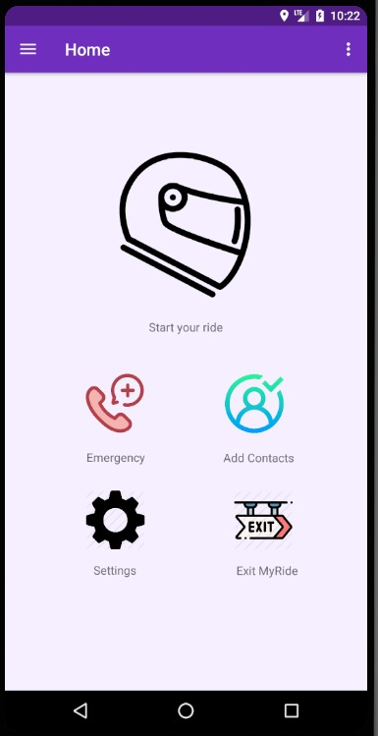
Click on Helmet Button to enable Drive Mode

Slide 7
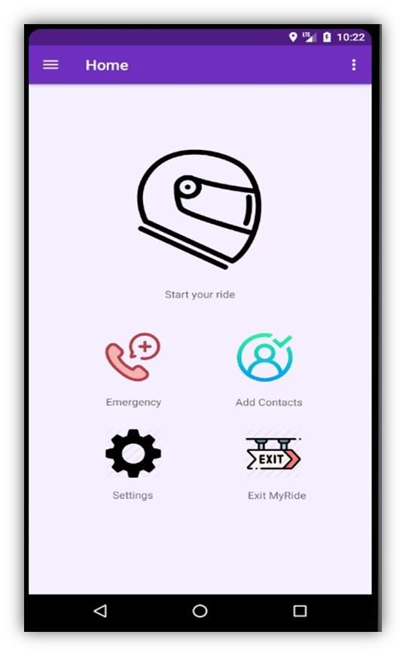
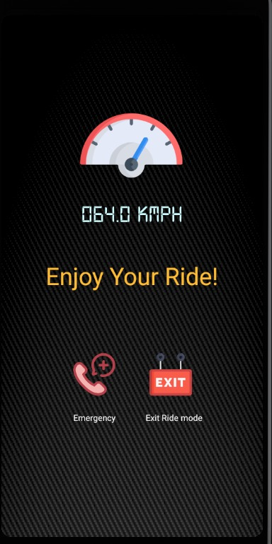
Drive Mode is now Disabled . Driver will be notified about all the Blocked Calls and Messages received during the journey automatically.
Drive Mode is now Enabled.All the Calls and Message notifications will be blocked automatically, leading to uninterrupted Driving experience .

Slide 8
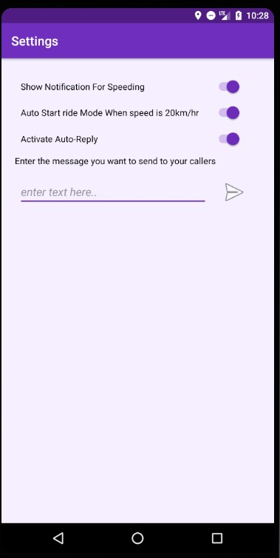
Select “Auto Start Ride Mode” to auto-enable Drive mode when the speed exceeds 20km/hr.

Slide 9
You can change Default auto reply message by just selecting the “Activating Auto reply” and Enter your own Text message.

Slide 10
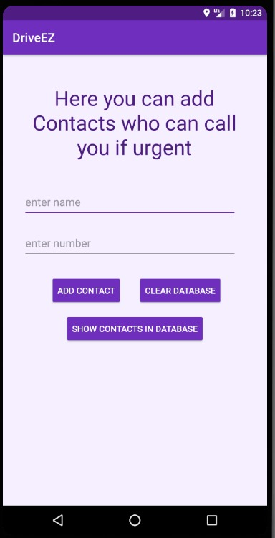
User can Add Emergency contact numbers. If the caller is from emergency number then call will not get blocked.

Slide 11
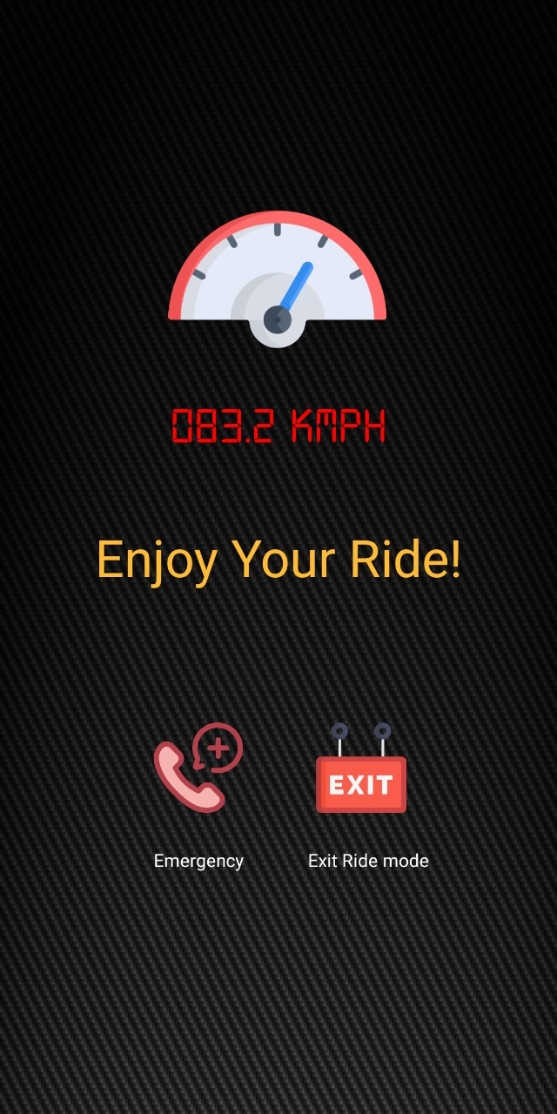
When Speed get above limit Speed meter will turn Red and phone will start vibrating. This will tell user that you are exceeding speed limit.

Slide 12
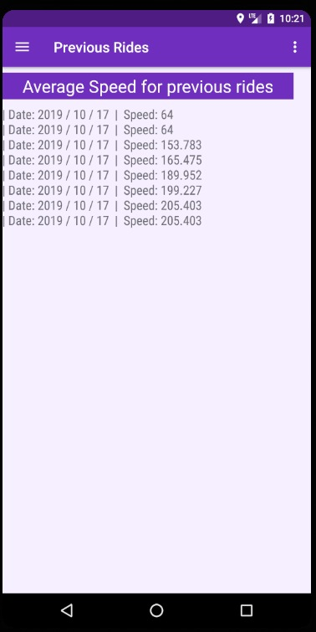
User can see Previous Ride details such as average speed and time for trip.

Slide 13
Future Scope
Android wear support
Parental Controls i.e. Parent will be able to keep track of speed of their children’s driving.
Car mode with navigational features.
Fuel tracking based on distance travelled and speed.

Slide 14
Conclusion
Hereby, as far as our knowledge of this project goes, we assert that the mini-project on
Successful implementation would help the drivers to drive safely without any distraction.
This will help to reduce accident percentage and help in road safety.

Slide 15
Thank You
Created By:
Chaitanya Deshpande
Vedant Deshpande
Jay Dixit

