Slide 1
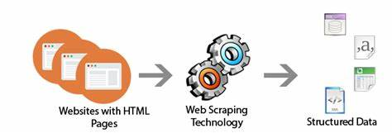
WEB SCRAPPING

Slide 2
Python Based Webscrapping
In this project we have used PYCHARM as editor.
It is useful for creating Virtual enviorment.
With the help of virtual envirment we can run scarpy files.
It backend is mainly programmed in python.
And GUI based interface with tkinter library in python.

Slide 3
Instructions
Step 1:check all python files in crawler/spider
We have created following files to scrape:
Amazon.py
Shopclues.py
Flipkart.py
>Pycharm will automatically creates structures of its
scrapy Files.
>Check the above file it will gives data of following webpages selected for scrapping.
>We have select webpages of Mobile-products in all three websites.

Slide 4
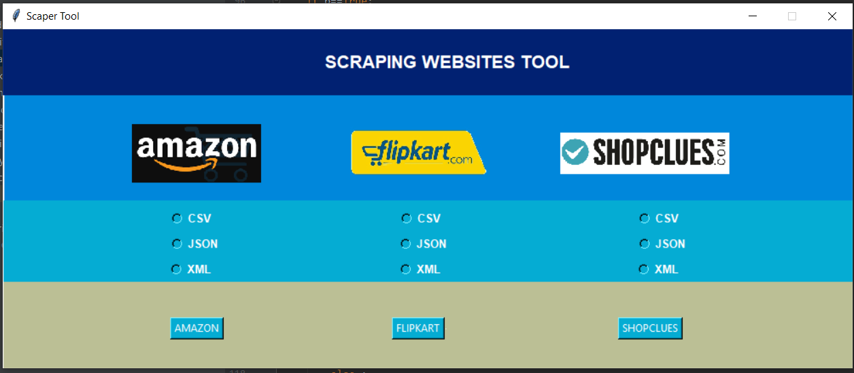
Step 2:- Now run tk.py file in your system.
It will open GUI interface.
>Now click on any of following and its particular file.And run it by click on its button.

Slide 5
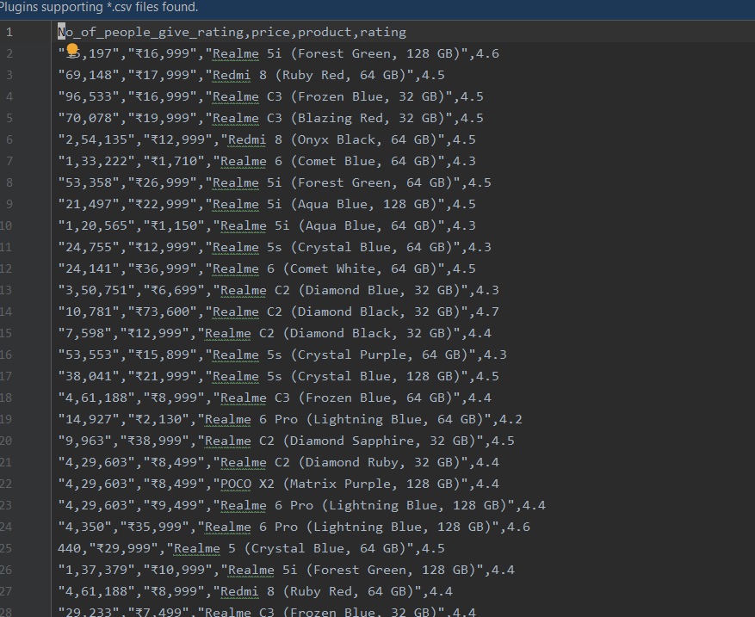
Now if you want the csv file of flipkart.
Click on CSV and flipkart.
Output will be in Crawler/flipkart.csv.It will scrape details of flipkart Mobile details and its price.

Slide 6
Similarly you can get details of amazon,shopclues in all three formats.
CSV
JSON
XML

