Slide 1
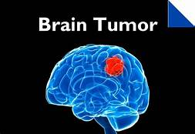
BRAIN TUMOR DETECTION FUNDAMETAL OF IMAGE AND VIDEO PROCESSING
ROLL NO:
18BCE144
18BCE152

Slide 2
OVERVIEW
What is Brain tumor?
Types of Brain tumor.
Steps for detection of Brain tumor.
MRI image of Brain
Image Enhancement
Image Segmentation
Conclusion
References

Slide 3
What is Brain tumor?
A brain tumor, known as an intracranial tumor, is an abnormal mass of tissue in which cells grow and multiply uncontrollably, seemingly unchecked by the mechanisms that control normal cells.
More than 150 different brain tumors have been documented, but the two main groups of brain tumors are termed primary and metastatic.

Slide 4
Types of Brain Tumor
Primary brain tumors include tumors that originate from the tissues of the brain or the brain's immediate surroundings.
Types of primary Tumor: benign or malignant
Metastatic brain tumors include tumors that arise elsewhere in the body (such as the breast or lungs) and migrate to the brain, usually through the bloodstream.
Metastatic tumors are considered cancer and are malignant

Slide 5
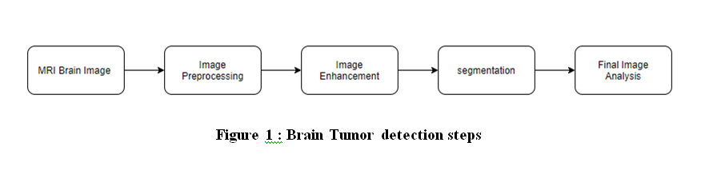
Steps for detection of Brain tumor
The proposed method divided into two part. (1) Image enhancement
(2) Image segmentation.

Slide 6
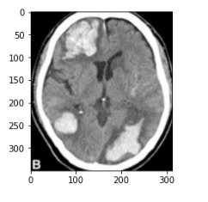
MRI Brain Image
This is the first step in our proposed project .This information provided is magnetic resonance imaging (MRI) collected in its original format (.jpg, .png).
cv2.imread()
plt.imshow()

Slide 7
IMAGE ENHANCEMENT
Image enhancement is the procedure of improving the quality and information content of original data before processing.
Image enhancement starts by first applying median filter.
After that we got smoothed image. To sharpen image apply laplacian filter

Slide 8
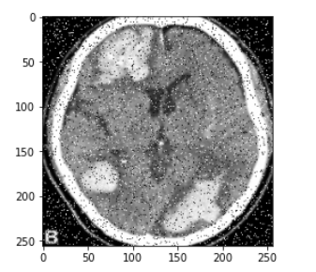
IMAGE EHANCEMENT: ADD NOISE
Add Salt and pepper noise in the given image.
Here we have added 10% salt and pepper noise to the image.
Here Salt and pepper noise to added because it will lead to smoothing operation.

Slide 9
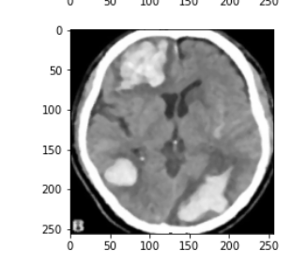
IMAGE EHANCEMENT: APPLY MEDIAN FILTER
In this we have applied Median Filter to image
Because it will robust to salt and pepper noise
And gave output with smooth image.

Slide 10
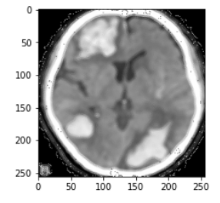
IMAGE EHANCEMENT :LAPLACIAN FILTER
Laplacian Filter is the final part of image processing.
It create the Laplacian Mask which we have to subtract from the original image.
Due to this we will have Sharpen image.
Here we have used negative kernel.

Slide 11
IMAGE SEGMENTATION
By segmentation in this project means the partition of pictures into many segments however the most difficult task is with the degree of pictures are non-inheritable.
In 2D pictures every activity is termed as element. In 3D pictures , it is referred to as voxels.
We have use two method for segmentation.
1.Thresolding.
2.Sobel Filter

Slide 12
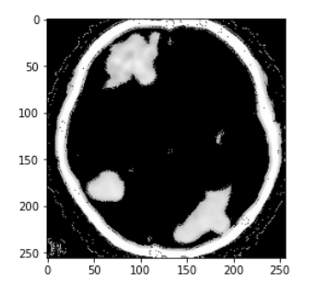
Threshold Segmentation
Thresholding methodology is the most basic image segmentation technique.
A threshold value is used to transform a gray-scale featured image to a binary image in this technique.
Here we have used threshold value 168.

Slide 13
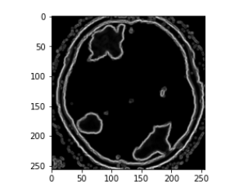
Sobel Filter
The Sobel operator, also known as the Sobel–Feldman operator or Sobel filter, is a tool used in image processing and computer vision, especially in edge detection algorithms.
In this paper for edge detection we have used two types of sobel filter.
First one of kernel size=3
Second one of kernel size=5

Slide 14
CONCLUSION
A brain tumor is an abnormal development of tissues in the brain that interferes with normal brain functions.
Medical image processing's main objective is to distinguish correct and relevant information from photographs with the least amount of error possible.
Because of the brain's size, identifying brain tumors by MRI images is challenging.
Here we have designed to detect tumor and segment it using Image processing.

Slide 15
References
National institute of biomedical imaging and bioengineering (https://www.nibib.nih.gov/scienceeducation/science-topics/magnetic-resonance-imaging-mri).
Amrutha Ravi, “Medical Image Segmentation”, Computer Methods And Programs In Biomedicine .
https://www.researchgate.net/publication/252069542_Brain_Image_Segmentation.
https://ijmter.com/published_special_issues/07-02-2015/image-segmentation-techniques-for-brain-mri-images-a-survey.pdf
DATASETS: https://www.kaggle.com/navoneel/brain-mri-images-for-brain-tumor-detection

Slide 16
THANK YOU

