Slide 1

CS-224 Week 2
Today: Generalization in ML
Regularizer for regression
Modern ML: transfer learning and self-supervised learning
Wednesday – Intro HW 1 plus minimal natural language processing (NLP) background
Friday (zoom only) – torch models + NLP demo (for HW 1)

Slide 2
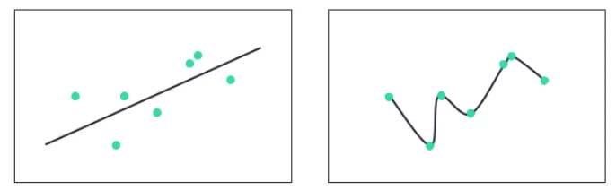
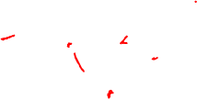
Overfitting on training data?
y
x
x

Slide 3
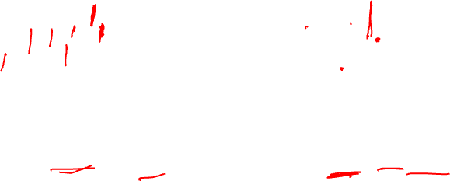
Error on “held out” validation/test data?
y
x
x
L_{train} = 0.5 L_{val} = 0.5
L_{train} = 0 << L_{val} = 1.5

Slide 4
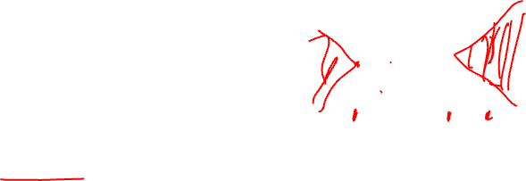
Regularization
L_{train} = 0.5 L_{val} = 0.5
L_{train} = 0 << L_{val} = 1.5
Why a generalization gap between training and test data?
Overfitting (model matches noise in training data)
Model unconstrained in areas where there are no training examples
Regularization = any method to reduce the generalization gap
Usually means adding terms to loss function

Slide 5
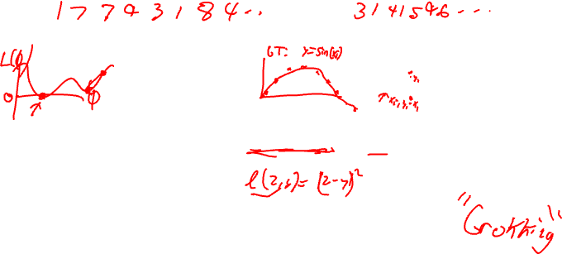
Complexity penalty? “Occam’s Razor” prefer the simplest models
Simple
“Complex”?
Strength
“hyper-parameter”
Regularizer
E.g. count the number of nonzero parameters (not practical)
Most common: ”L₂” regularization
Bayesian interpretation (later in course)
“L₂” regularization also called Tikhonov regularization, ridge regression
In neural networks, called weight decay

Slide 6
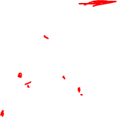
L₂ regularization for nonlinear regression

Slide 7
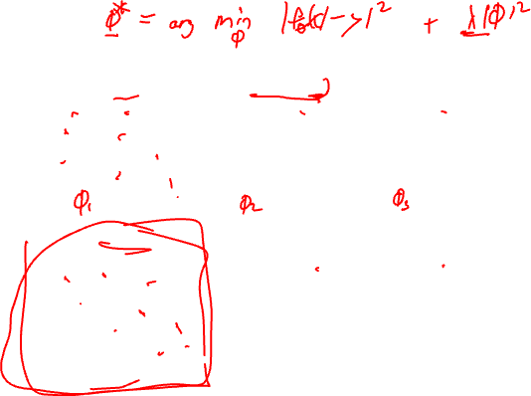
L₂ regularization for nonlinear regression

Slide 8
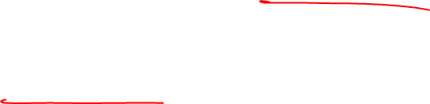
Linear regression can overfit!
Remember we added a constant column, x_{d+1} = 1, then let w_{d+1} = b
After this modification, we have:

Slide 9
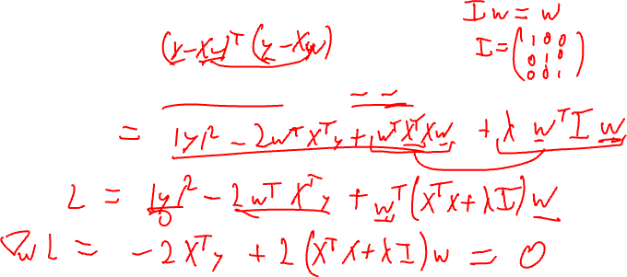
Linear regression with L2 regularization
Add an “L2” regularizer

Slide 10
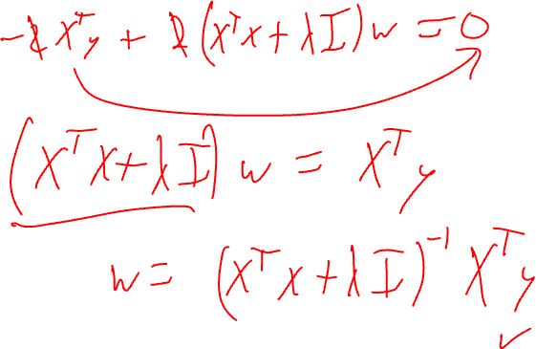

Slide 11
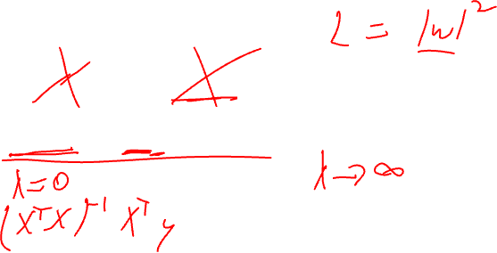
Analytic solution
Let’s check the limits…

Slide 12
Modern machine learning paradigms
- Transfer learning
- Self supervised learning
Notes:
Usually you will not be building architectures from scratch – you’ll start with a good architecture and modify it.
Need to understand what is an appropriate architecture
Need to know the ingredients, so they don’t conflict with what you are trying to do.

Slide 13
Transfer learning – the number one most useful thing to do if it’s possible
Vision: Pre-train on ImageNet (large dataset)
Natural Language Processing (NLP): Start with a pre-trained BERT/GPT model (on large dataset)
The pre-training task (data and objective) may differ from our target task – but some of the benefit “transfers”

Slide 14
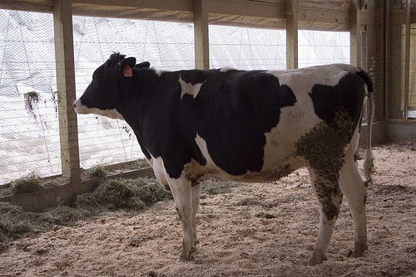
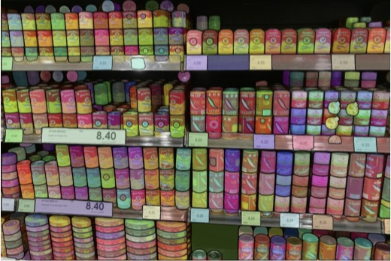
“cow”
h
Train a model to recognize objects
Fine-tune on different data, and a totally different task. For example, count objects
“Transfer” weights
And keep training with new data/task
57
h

Slide 15
Self-supervised learning
i.e. train a supervised loss on some made up task, then do transfer learning

Slide 16
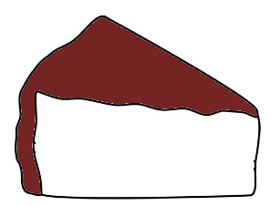
The Supervised Learning Cake
Chocolate frosting = Labels to predict
Random
Variables (Features)
Samples
Notes:
We have many variables that we observe over time. This is the cake.
The frosting on this cake is chocolate, and represents the labels we’d like to predict.
Supervised learning tunes a huge model to predict the labels. In other words, supervised learning, like any five year old child, is focused almost exclusively on the frosting.
To get enough frosting it might take one million slices of cake How is unsupervised learning different?

Slide 17
Unsupervised: no frosting?
Chocolate frosting = Labels to predict
Random
Variables (Features)
Samples
Notes:
What happens in the unsupervised case? One way to look at it is that it is cake with no frosting, the worst kind of cake there is.

Slide 18
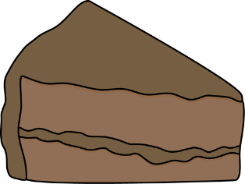
Self-supervised: it’s all frosting
Unsupervised / self-supervised: Predict any variables from any others…
From that point of view some people say “self-supervised”…
Notes:
But another way to look at it… we haven’t specified which row is the labels, therefore any row could be considered the labels to predict. In fact, we could try to predict all rows from any other rows. From that point of view, the entire cake is made out of frosting!
The ALL FROSTING cake should be more delicious than supervised learning cake.
To get enough frosting, we don’t need a million pieces of cake, it would be fine to have a few really thick pieces. This analogy is getting a little excessive, but the implication is that, because we get more frosting, learning should be better in some ways.

Slide 19
”Unsupervised” vs “Self-supervised”
Semantics, but “self-supervised” emphasizes a particular point of view:
Neural nets are good at prediction problems with lots of labels.
Let’s make every problem look like that (even if we don’t have any labels).

Slide 20
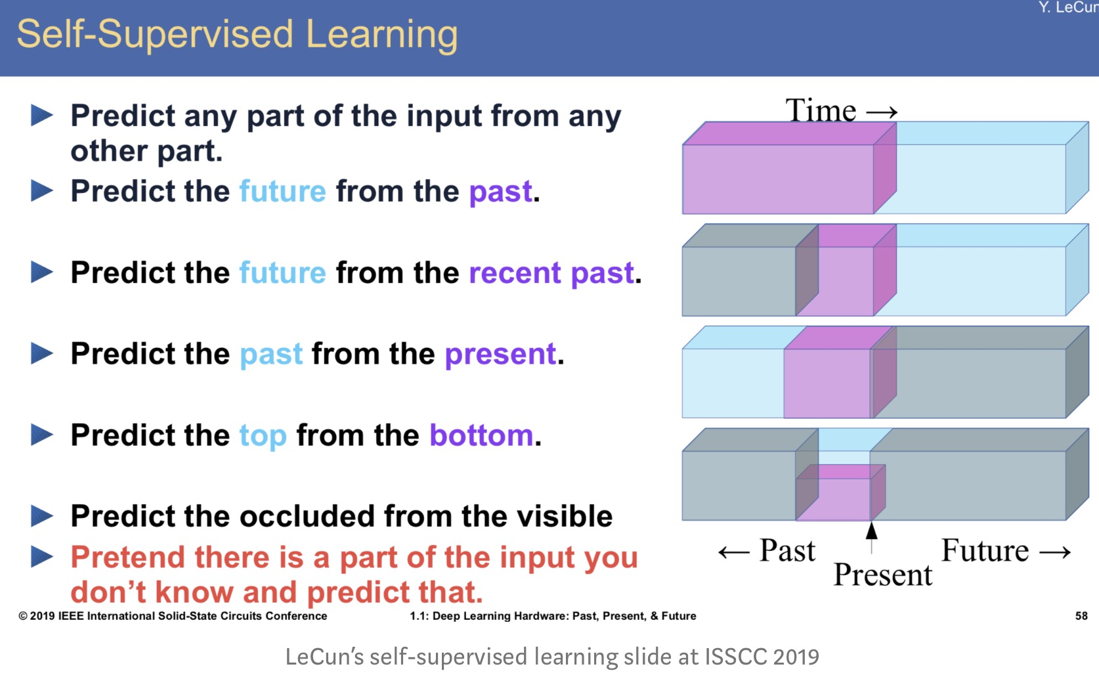

Slide 21
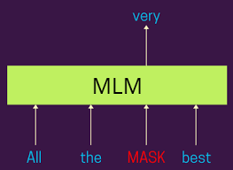
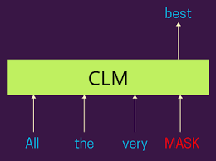
Self-supervision in Natural Language Processing (NLP)
Causal language modeling, i.e. next word prediction, is another self-supervised task (used to train GPT models)
Masked language modeling (MLM)
Option 1: Self-supervision then transfer learning, or…

Slide 22

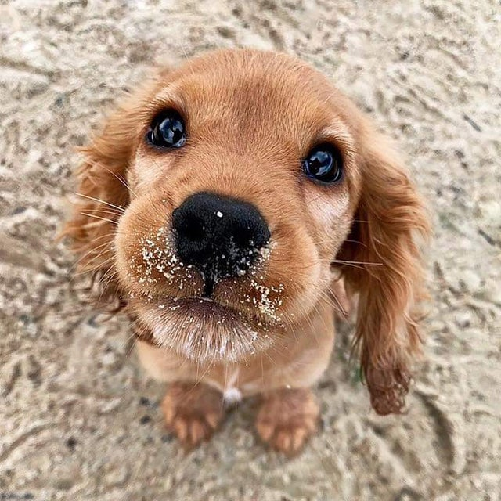

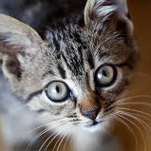
Option 2: self-supervision to learn “useful” embeddings
X
Z
Learned embedding
(no labels)
.
.
.
.
Classes are linearly separable in learned space
(If we picked a good self-supervision task!)

Slide 23
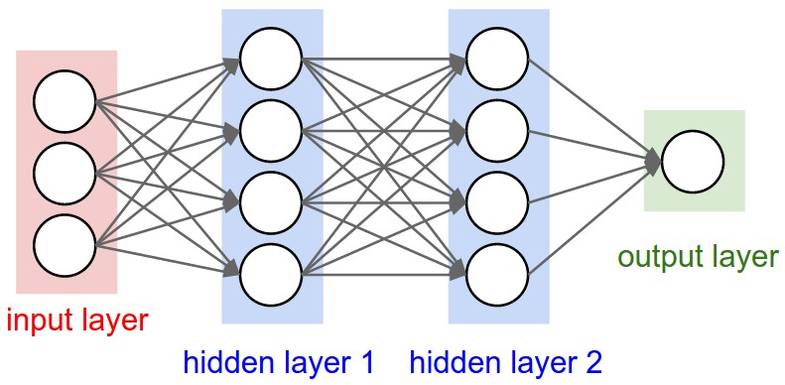

Self-supervised pipeline evaluation
(1) Self-supervised training
(2) Transfer to target task
Self supervised, or “pretext” classification task
Train linear model using z, to predict target task
$$\hat{y}=W z+b$$
z
This is how self-supervised methods are evaluated in literature
And this is how we’ll do HW 1

Slide 24
Wednesday: Finish HW 1 background, NLP basics

