Slide 1


This title slide brought to you by Nano Banana

Slide 2
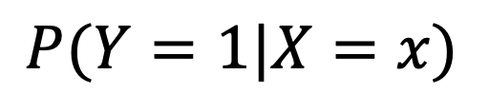
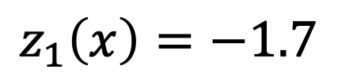
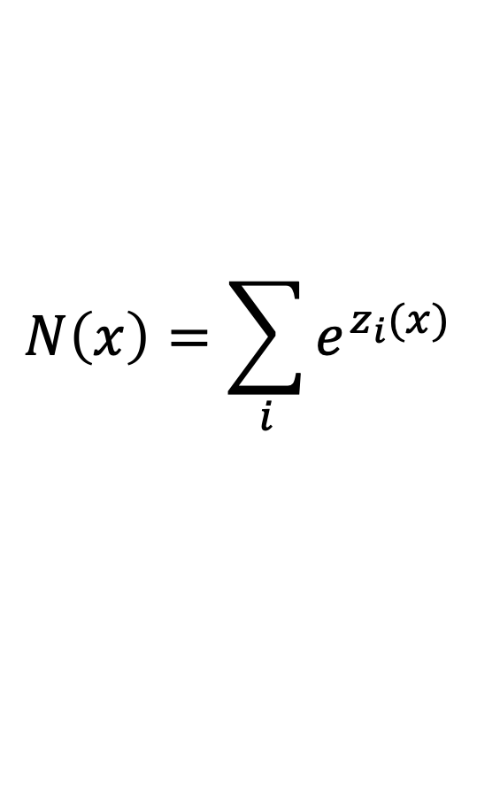
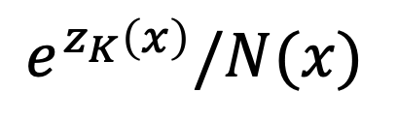

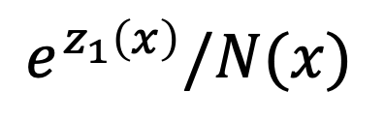
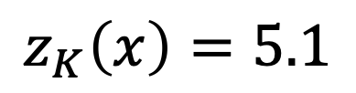
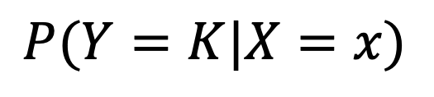
Predict a probability distribution with a neural net
Neural network
Output
(“logits”)
Can interpret as probabilities
Softmax
Input
$$z_{1}\left(x\right)=−1.7$$
Softmax
$$e^{z_{1}\left(x\right)}/N(x)$$
$$P(Y=1|X=x)$$
x
…
$$e^{z_{K}\left(x\right)}/N(x)$$
$$P(Y=K|X=x)$$
$$z_{K}\left(x\right)=5.1$$
$$N\left(x\right)=\sum_{i}{e^{z_{i}(x)}}$$

Slide 3

z = t.randn(4) # no restrictions!
p = t.softmax(z, dim=0) # output normalized probs
is tensor([-0.18, -0.13, 0.39, -0.96])
is tensor([0.23, 0.25, 0.41, 0.11])
Is it normalized? Yes, sum of p = 1.
z
p

Slide 4
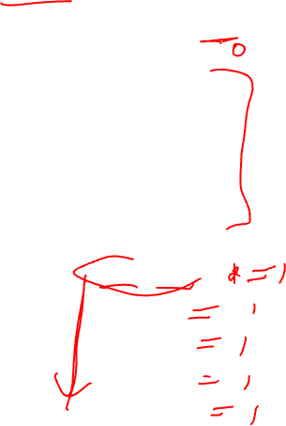
z = t.randn(5,2)
p = t.softmax(z, dim=1)
tensor([[ 0.24, 0.61],
[-0.74, 0.29],
[-0.99, 1.19],
[ 0.09, 0.43],
[-0.24, 1.39]])
tensor([[0.41, 0.59],
[0.26, 0.74],
[0.10, 0.90],
[0.41, 0.59],
[0.16, 0.84]])
z
Normalized across this dimension
p

Slide 5
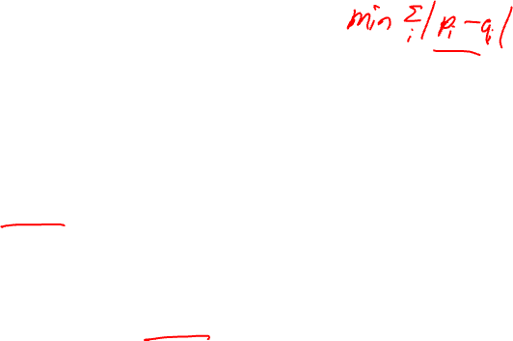
How to construct loss functions
Model predicts output y given input x
Model predicts a conditional probability distribution:
P(y | x)
over outputs y given inputs x.
Use “Softmax” to turn (unconstrained) “logits” into probabilities
Loss function aims to make the TRUE y’s have high probability

Slide 6
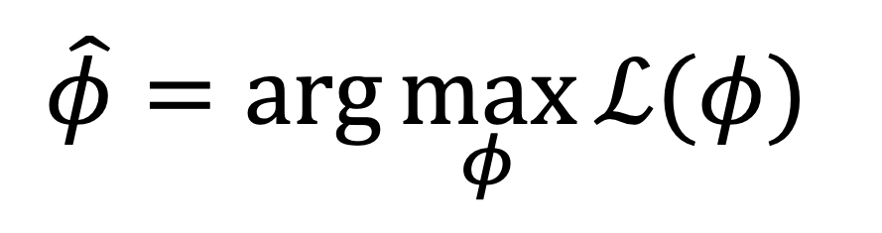
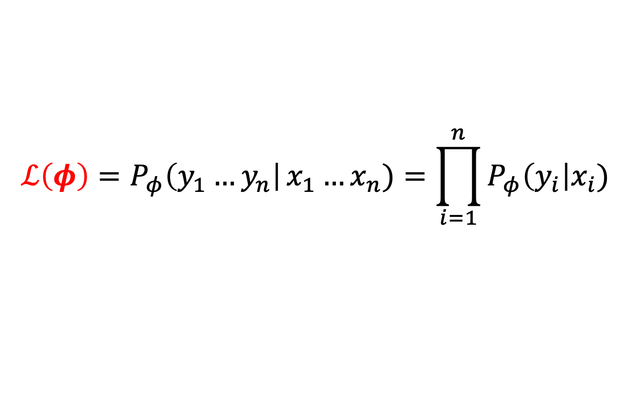

The likelihood function
$$ℒ\left(φ\right)=P_{φ}\left(y_{1}…y_{n}\right|x_{1}…x_{n})=\prod_{i=1}^{n}{P_{φ}\left(y_{i}\right|x_{i}) }$$
Maximum Likelihood Criteria
$$\hat{φ}=\arg{\max_{φ}{ℒ(φ) }}$$

Slide 7
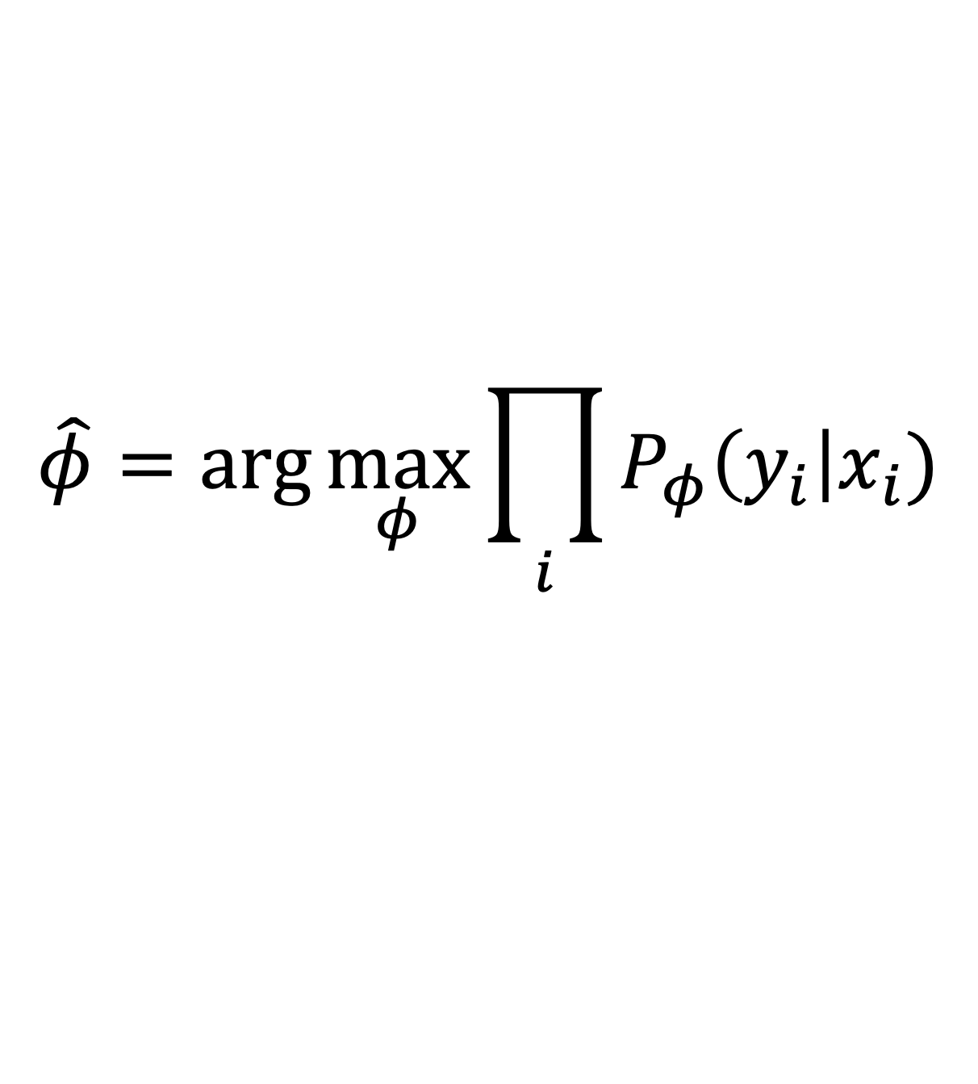
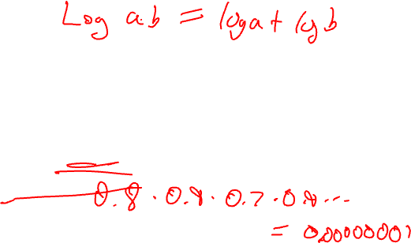
One more problem:
$$\hat{φ}=\arg{\max_{φ}{\prod_{i}{P_{φ}\left(y_{i}\right|x_{i})}}}$$
Product of small numbers becomes too small to represent

Slide 8
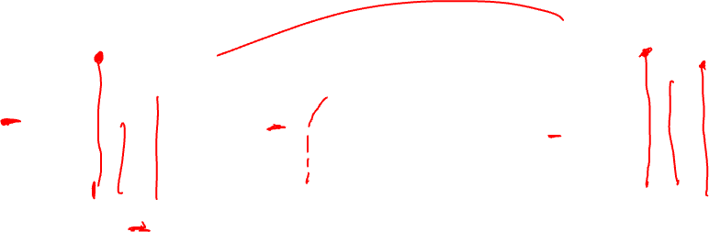
Spice up your optimization problem with a monotonic transform!
(or any strictly monotonic function)
Maximum of the logarithm of a function is in the same place as maximum of function

Slide 9
Maximum log likelihood
Now it’s a sum of terms, so doesn’t matter so much if the terms are small

Slide 10


Minimizing “negative log likelihood”
By ML convention, we minimize things (i.e., a loss)

Slide 11






The loss could look like this
$$L\left(φ\right)=\min{−\log{P_{φ}\left(Y=”cat” \right|X= )}}$$
$${−\log{P_{φ}\left(Y=”dog” \right|X= )}}$$
$${−\log{P_{φ}\left(Y=”dog” \right|X= )}}$$
$${−\log{P_{φ}\left(Y=”cat” \right|X= )}}$$
How to implement this model, concretely?

Slide 12
Linear classifier (known as logistic regression 😫)

Slide 13
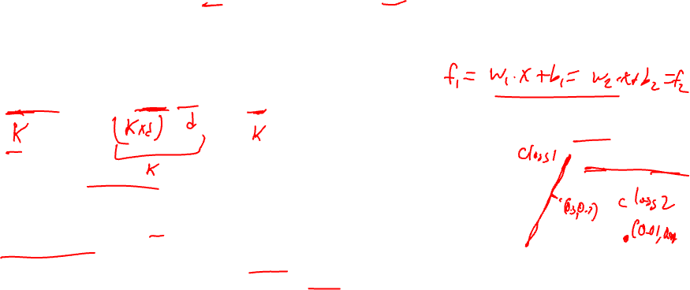
Linear classifier network
Step 1: linear network to give us “logits” for each class (check dimensions)
=
+
k (k, d) d k
Example with K=2, d=2
.
.
x₂
Step 2: softmax gives probabilities
.
.
.
.
.
.
x₁
Step 3: Maximize log likelihood, L(W,b)

Slide 14

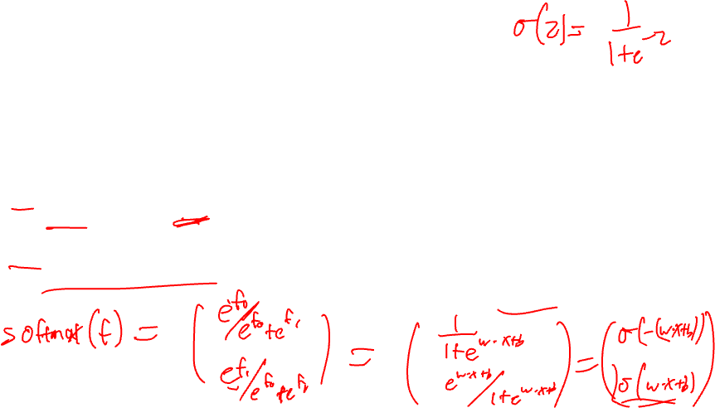
Logistic Regression – special case
Just a special case of the linear classifier with:
Only 2 classes, Y={0, 1}
Set one logit to zero
(We’ll focus on the more general case.)
Notes:
Maybe point out softmax in this case gives us the sigmoid function

Slide 15
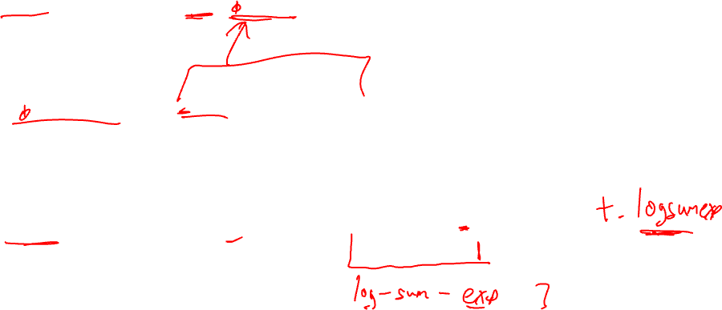
Show Loss in terms of “f”, our “logits”
Take the “y_{i}”th component of probability (assuming y=1,2,..K)

Slide 16
Simplest (nonlinear) neural network classifier: Multi-Layer Perceptron (MLP)

Slide 17



Use an “MLP” for neural network
Generate the logits from ”x”, using a nonlinear model
Output (“logits”)
Get a vector of probabilities
from the vector of logits, using softmax
$$f_{1}\left(x\right)=$$
$$−12.7$$
$$f_{K}\left(x\right)=$$
$$50.1$$
Neural network
Input
x

Slide 18
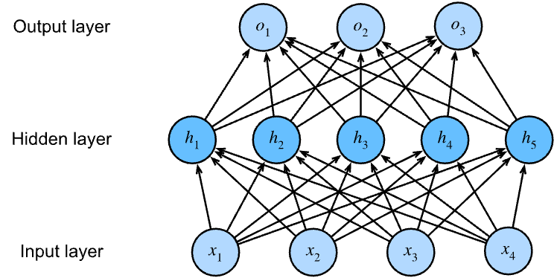
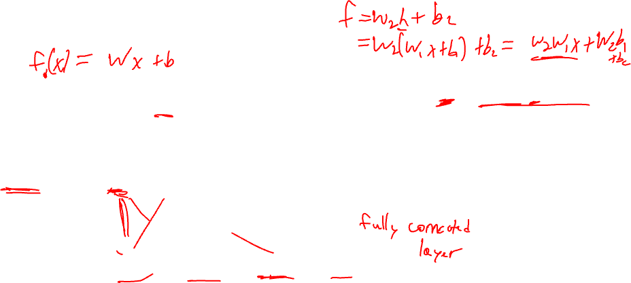
Multi-layer perceptron
f₁
f₂
f₃

Slide 19
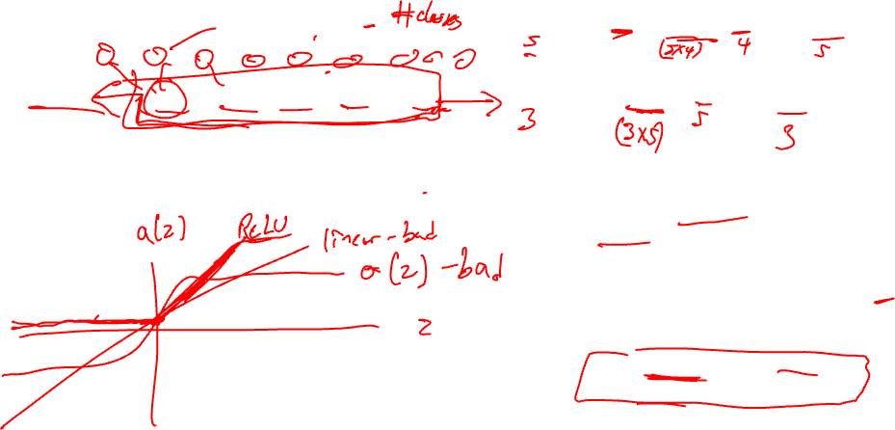
f₁
f₂
f₃
Notes:
Make sure W’s give right shape
“a” is a nonlinearity applied separately to each element
“a” is often “ReLU”
“f” represents the logits for our case
Last layer usually has no nonlinearity
Can stack more hidden layers
Wide enough MLP with ReLU can approximate any function

Slide 20
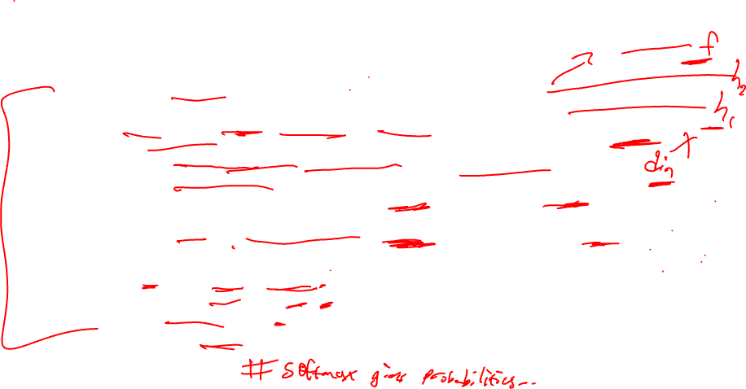
Pytorch Implementation
# Define the MLP - 2 hidden layers
class MyMLP(nn.Module):
def __init__(self, d_in=2, n_hidden=5, n_classes=2):
super(MyMLP, self).__init__()
self.fc1 = nn.Linear(in_features=d_in, out_features=n_hidden)
self.relu = nn.ReLU() # re-use, it has no parameters
self.fc2 = nn.Linear(in_features=n_hidden, out_features=2*n_hidden)
# next an output layer - one logit per class.
self.out = nn.Linear(in_features=2*n_hidden, out_features=n_classes)
def forward(self, x):
h1 = self.relu(self.fc1(x)) # first layer of neurons a(Wx + b)
h2 = self.relu(self.fc2(h1)) # second layer of hidden units/neurons
logits = self.out(h2) # logits, one for each class
return logits

Slide 21
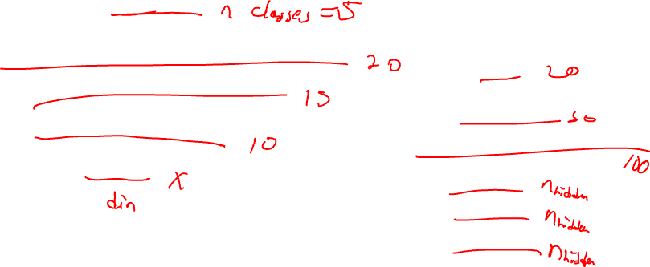

Monday / Next week
Cross entropy loss (is identical to negative log likelihood, for classification!)
Cross validation
Start discussing neural net training

