Slide 1
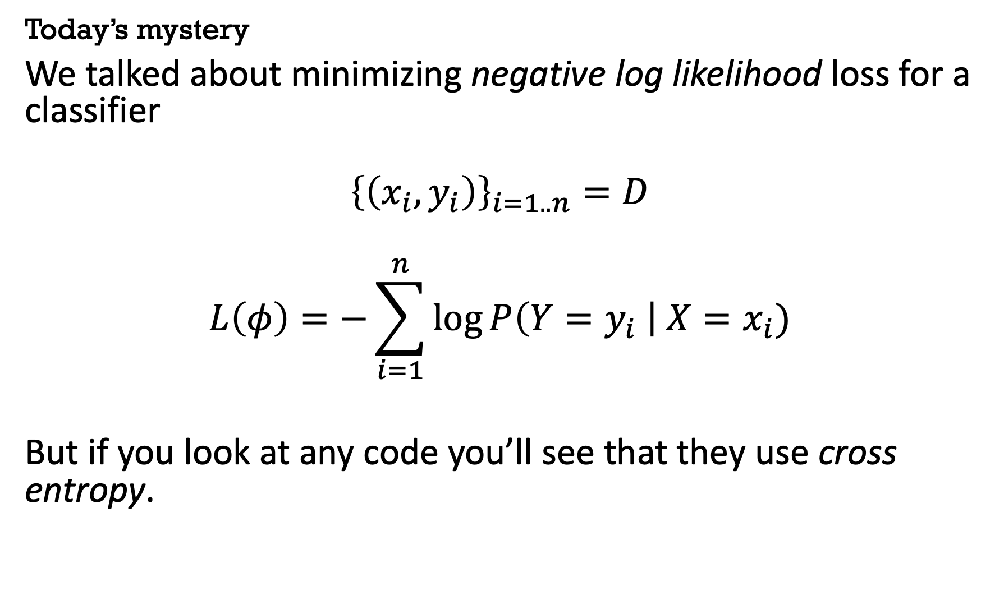
Today’s mystery
We talked about minimizing negative log likelihood loss for a classifier
$${\left\{\left(x_{i}, y_{i}\right)\right\}}_{i=1..n}=D$$
$$L\left(φ\right)=−\sum_{i=1}^{n}{\log{P\left(Y=y_{i} \right| X=x_{i})}}$$
But if you look at any code you’ll see that they use cross entropy.

Slide 2
What is “entropy”?
Entropy
Axiomatic approach
Compression
KL divergence
Cross entropy
Connection to log likelihood objective

Slide 3
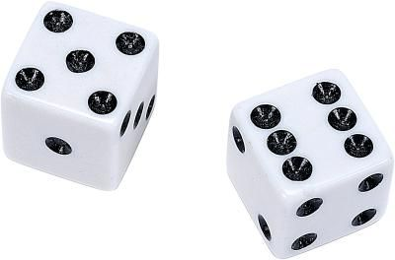
Axiomatic approach: Why “log” probabilities?
A random variable
How would we quantify uncertainty, H(X)?
2 dice: 6*6 = 36 states
log(6*6) = log(6) + log(6) = 2 log(6)
Notes:
Some quick notation, mostly following Cover/Thomas Inf. Theory book

Slide 4
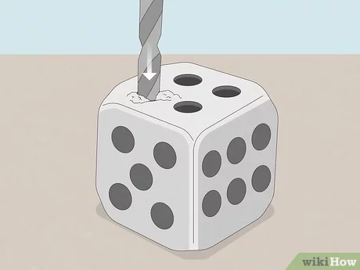
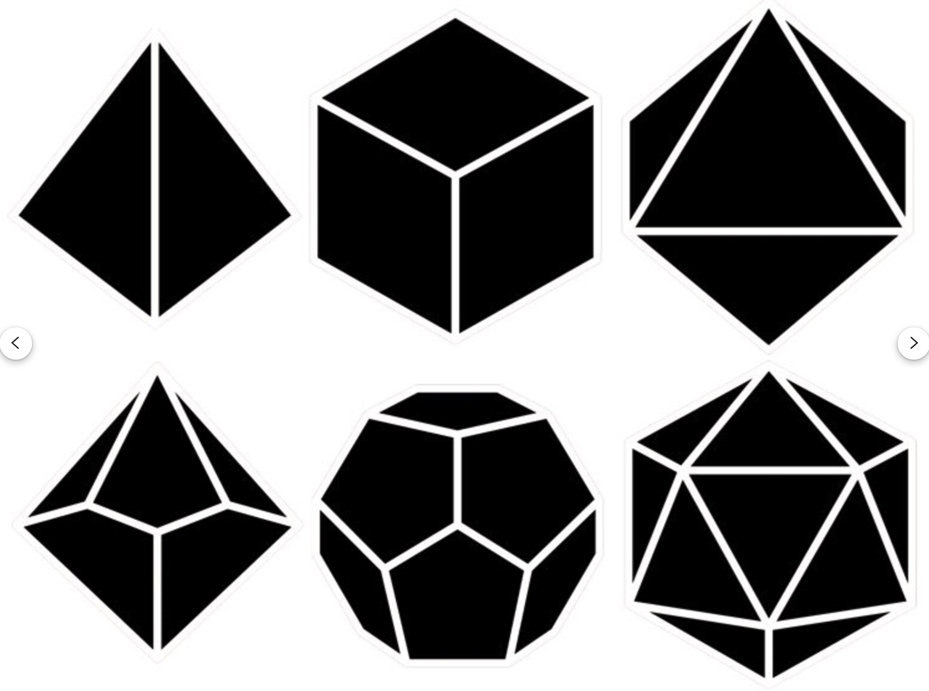
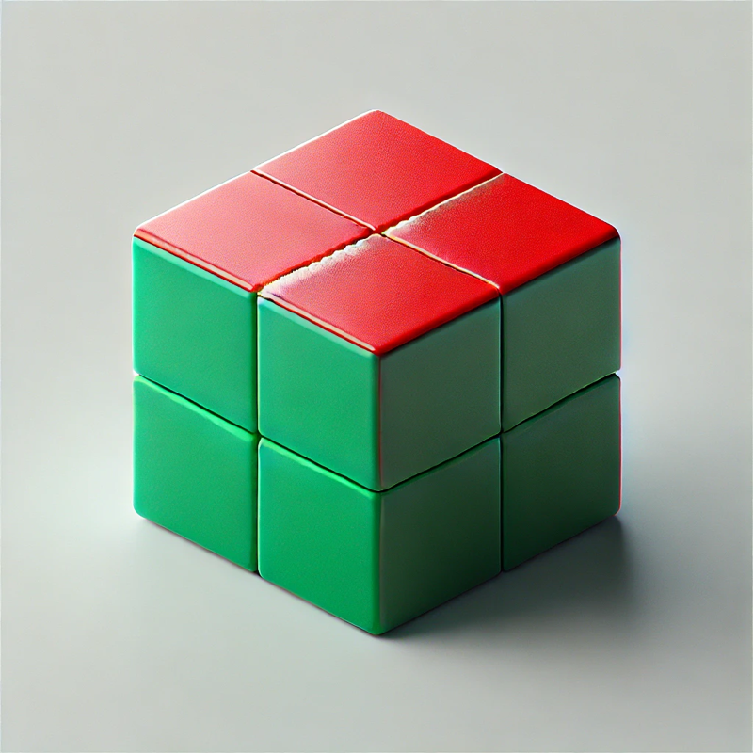

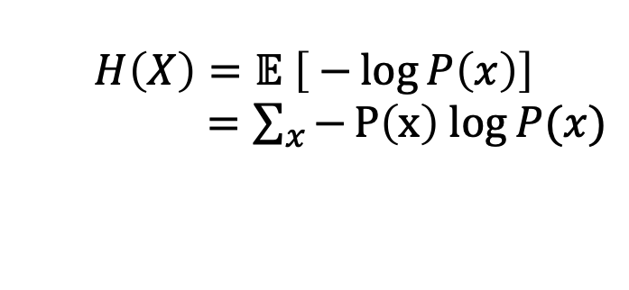
Axiomatic approach to quantify ”Uncertainty” (Shannon)
Given a probability distribution, how much “Uncertainty” / ”Entropy” should it have?
What functions (of P) could quantify uncertainty?
Continuous (a small change in p(x) should lead to a small change in our uncertainty)
Increasing (If there are n equally likely outcomes, uncertainty goes up with n)
Symmetry (order doesn’t matter)
Coarse-graining
$$H\left(X\right)=𝔼 \left[ −\log{P\left(x\right)}\right]$$
$=\sum_{x}{−P\left(x\right) log{P(x)}}$
Notes:
That reasoning echoes the axiomatic approach that Shannon took in one of his original papers…
A unique function satisfies it… (NOT QUITE unique, we have to specify the base, the unit of information. We’ll use bits.)

Slide 5
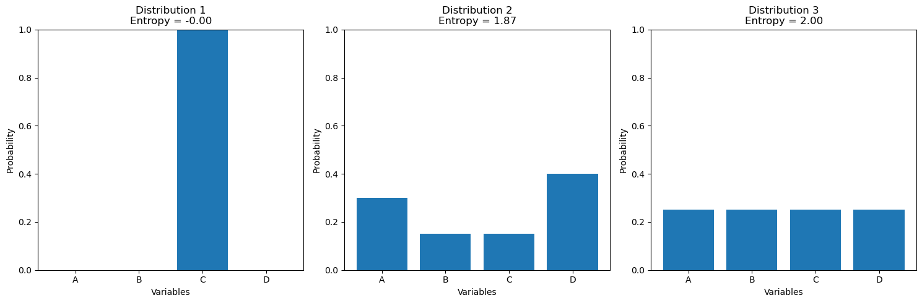
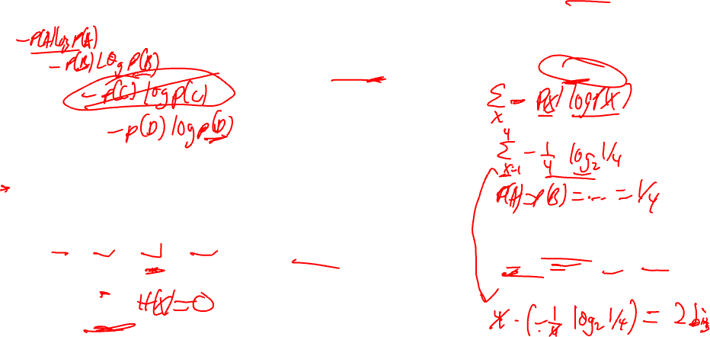
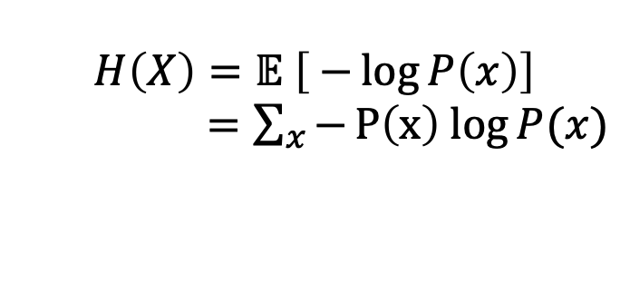
Visualize Shannon entropy
$$H\left(X\right)=𝔼 \left[ −\log{P\left(x\right)}\right]$$
$=\sum_{x}{−P\left(x\right) log{P(x)}}$
State X = {A, B, C, D}
State X = {A, B, C, D}
State X = {A, B, C, D}
(0 log 0?)
Notes:
That reasoning echoes the axiomatic approach that Shannon took in one of his original papers…
A unique function satisfies it… (NOT QUITE unique, we have to specify the base, the unit of information. We’ll use bits.)

Slide 6
A different way to understand entropy: compression
Notes:
16 min

Slide 7
1 | 2 | 3 | 4 | 5 | 6 | 7 | 8
Guess my square game:
I pick a square uniformly at random
You can ask yes/no questions to determine the square
How many questions are required?
To distinguish between N squares, we need log₂ N questions

Slide 8
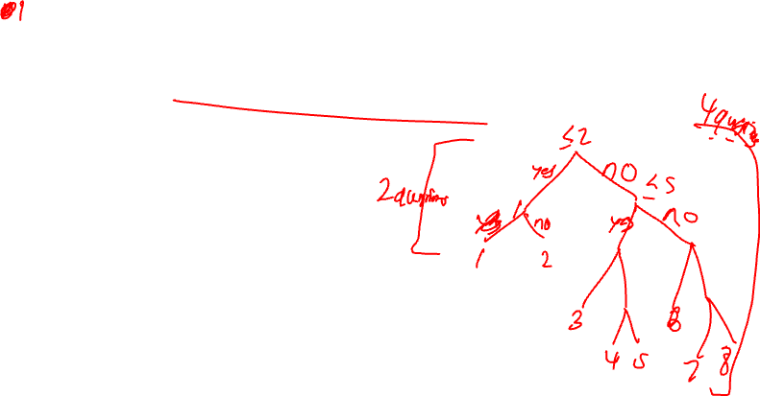
1 | 2 | 3 | 4 | 5 | 6 | 7 | 8
<3?
In Round 2: I prefer 1 & 2, and half the time pick one of those squares
Find the correct square with fewer questions on average
Yes
No
=1?
>5?
No
Yes
No
Yes
=6?
=3?
1
2
No
Yes
Yes
No
6
3
Notes:
Split PROBABILITY mass by half every time. Therefore, if an event has probability p, it should show up as a leaf on the log 1/p level (or a leave at level j has prob ½^j)
18 min

Slide 9
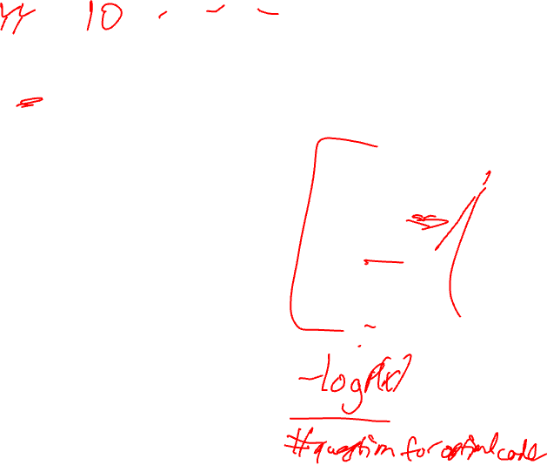
1 | 2 | 3 | 4 | 5 | 6 | 7 | 8
<3?
How many questions do we need on average?
This answer is exactly* the entropy and therefore entropy can be viewed as a measure of compression
Yes
No
=1?
>5?
No
Yes
No
Yes
=6?
=3?
1
2
No
Yes
Yes
No
6
3
Notes:
Split PROBABILITY mass by half every time. Therefore, if an event has probability p, it should show up as a leaf on the log 1/p level (or a leave at level j has prob ½^j)
18 min

Slide 10
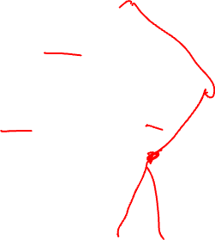
1 | 2 | 3 | 4 | 5 | 6 | 7 | 8
<3?
Yes
No
=1?
>5?
No
Yes
No
Yes
=6?
=3?
1
2
No
Yes
Yes
No
6
3
Notes:
Work out average code length

Slide 11
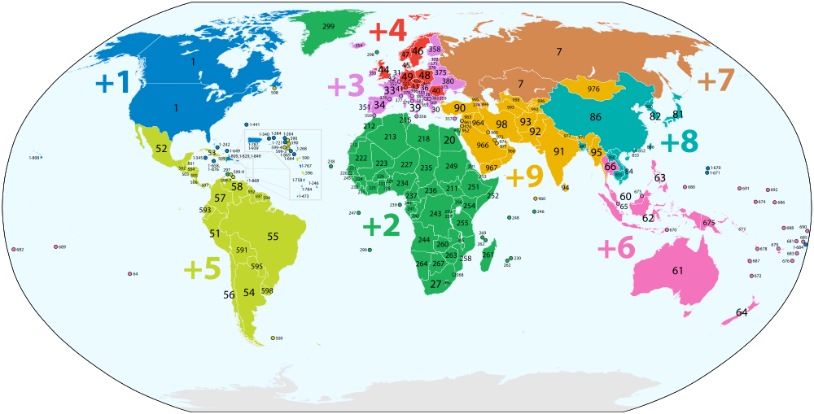

Country Prefix Codes
Spain is +34
Portugal is +351, Finland is +358, therefore no country is +35

Slide 12
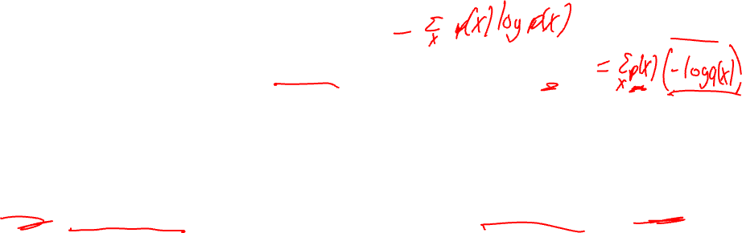
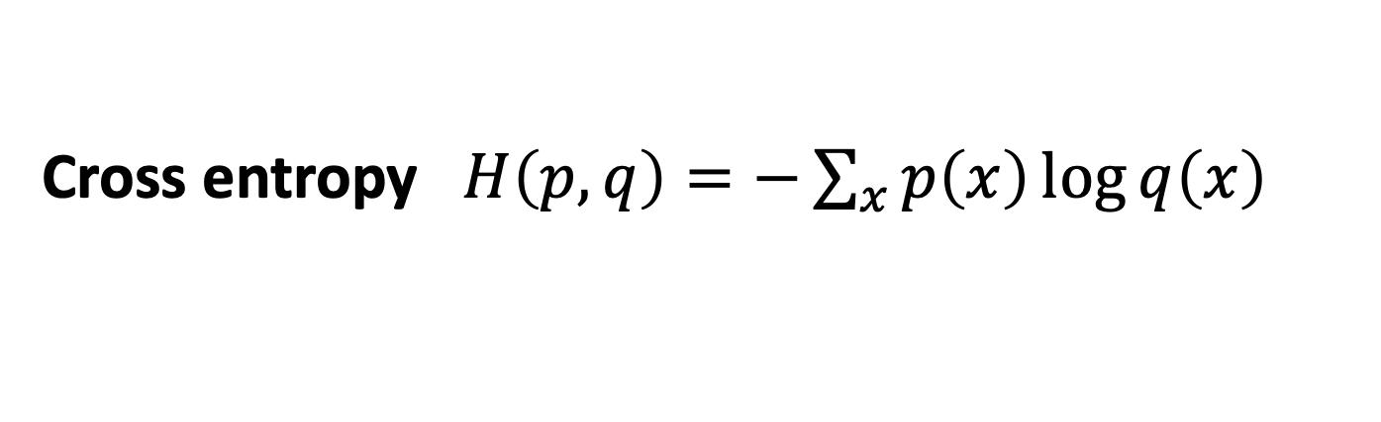
Cross entropy
You thought my distribution was “q” but it was actually “p”?
You will pay a penalty and ask too many questions
How many questions will you ask?
Cross entropy $H\left(p,q\right)=−\sum_{x}{p\left(x\right)\log{q\left(x\right)}}$
You think I prefer these
I actually prefer these
1 | 2 | 3 | 4 | 5 | 6 | 7 | 8

Slide 13
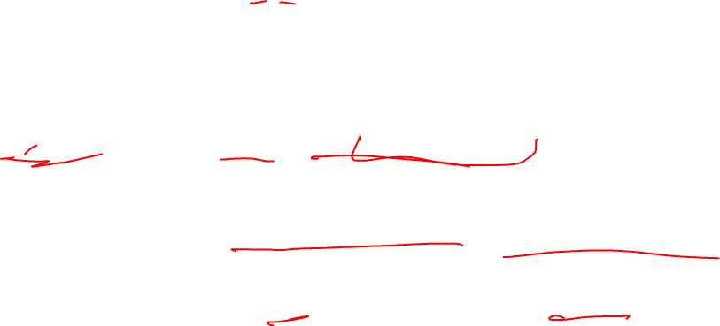
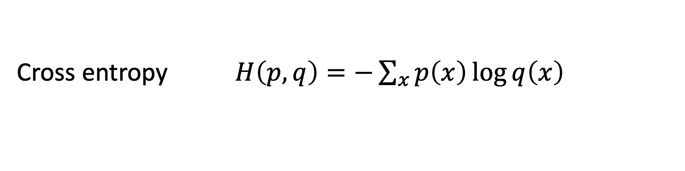
COMPARE two distributions KL Divergence, cross entropy
Cross entropy $H\left(p,q\right)=−\sum_{x}{p\left(x\right)\log{q\left(x\right)}}$
Kullback-Leibler Divergence
- Entropy
Cross entropy!

Slide 14
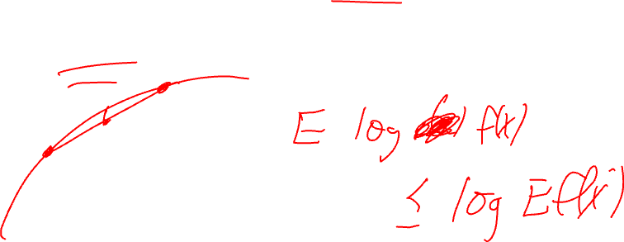
KL Divergence, cross entropy
KL Divergence is non-negative (Jensen’s inequality)
Notes:
Obligatory

Slide 15
(Optional space for Jensen’s inequality)

Slide 16
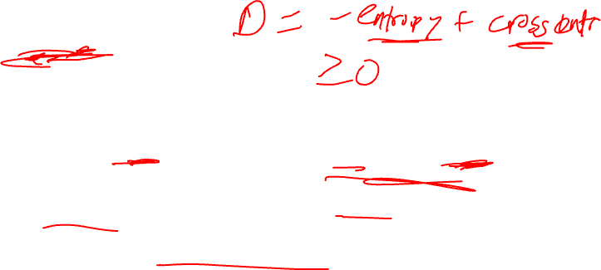
KL Divergence, cross entropy
KL Divergence is non-negative (Jensen’s inequality)
Cross entropy is bigger than entropy.
Alternately, view q as a “variational distribution” (more later!)
Entropy
Cross entropy!
Notes:
Obligatory

Slide 17

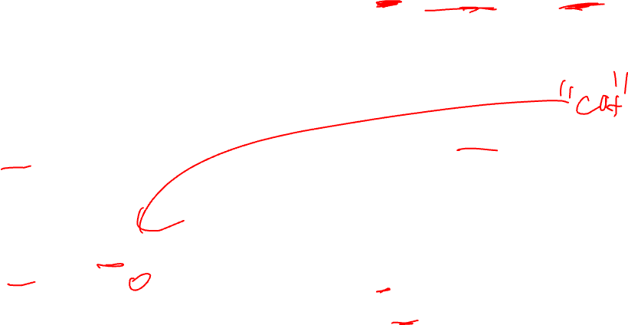
Cross entropy, for our classification problem
X =
P_{data}(y|x)?
P_{ɸ}(y|x)

Slide 18
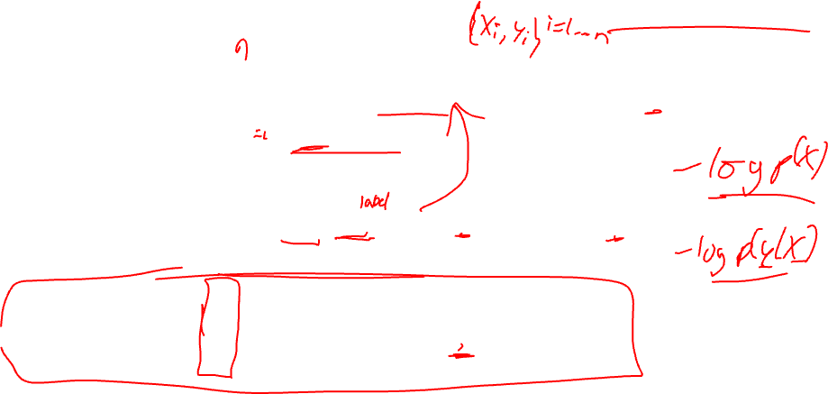
Cross entropy, for our classification problem
Average over x – conventions differ
What is P_{data}(y|x)? P_{data}(Y=y_{i} | x_{i}) = 1, otherwise 0
Equivalent to negative log likelihood:

Slide 19
Bonus slides?

Slide 20
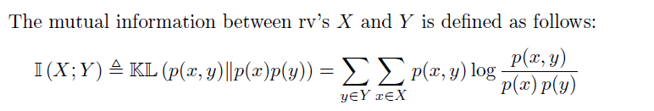
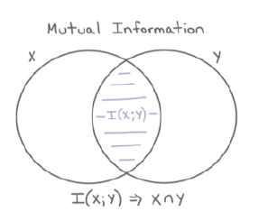
Mutual Information
How similar two distributions were
Notes:
NMI = normalized Mutual information

Slide 21
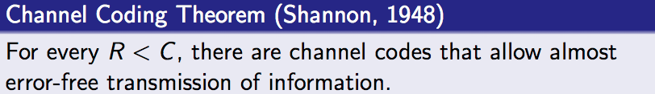
Mutual information
Noisy Channel
Mutual information!

Slide 22
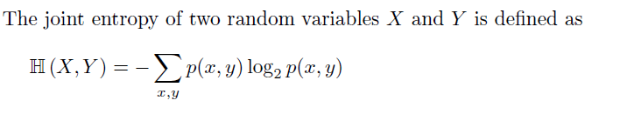
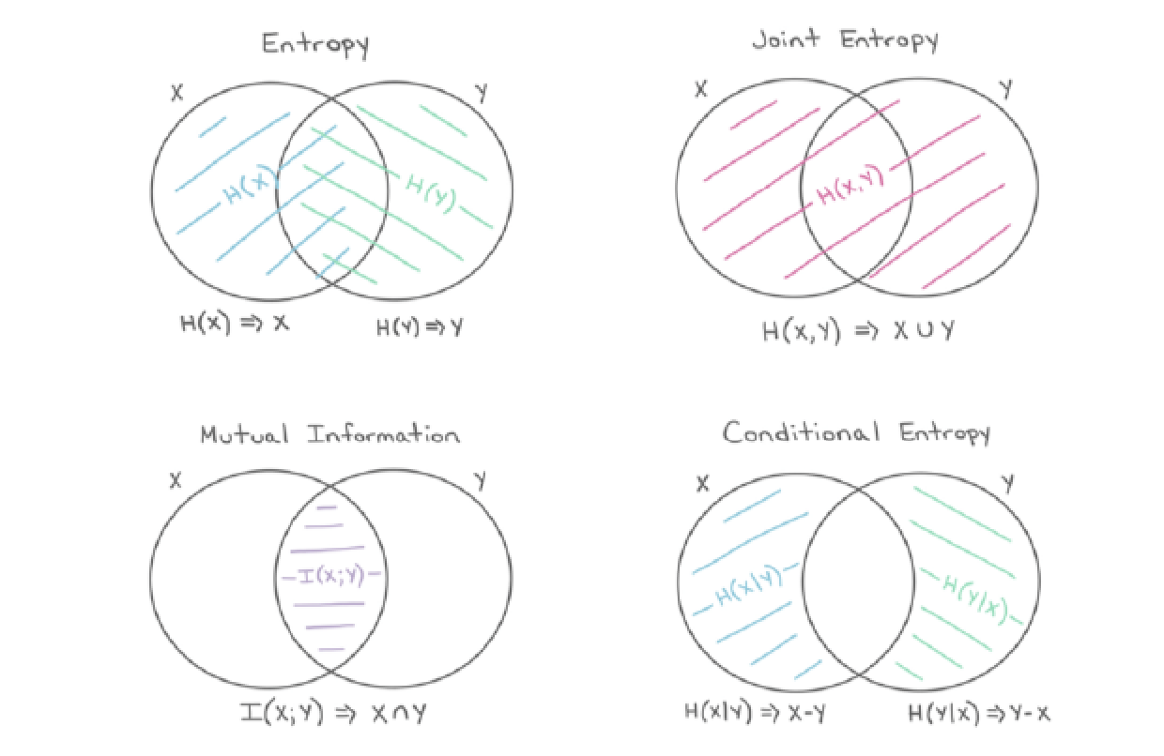
Joint Entropy

Slide 23
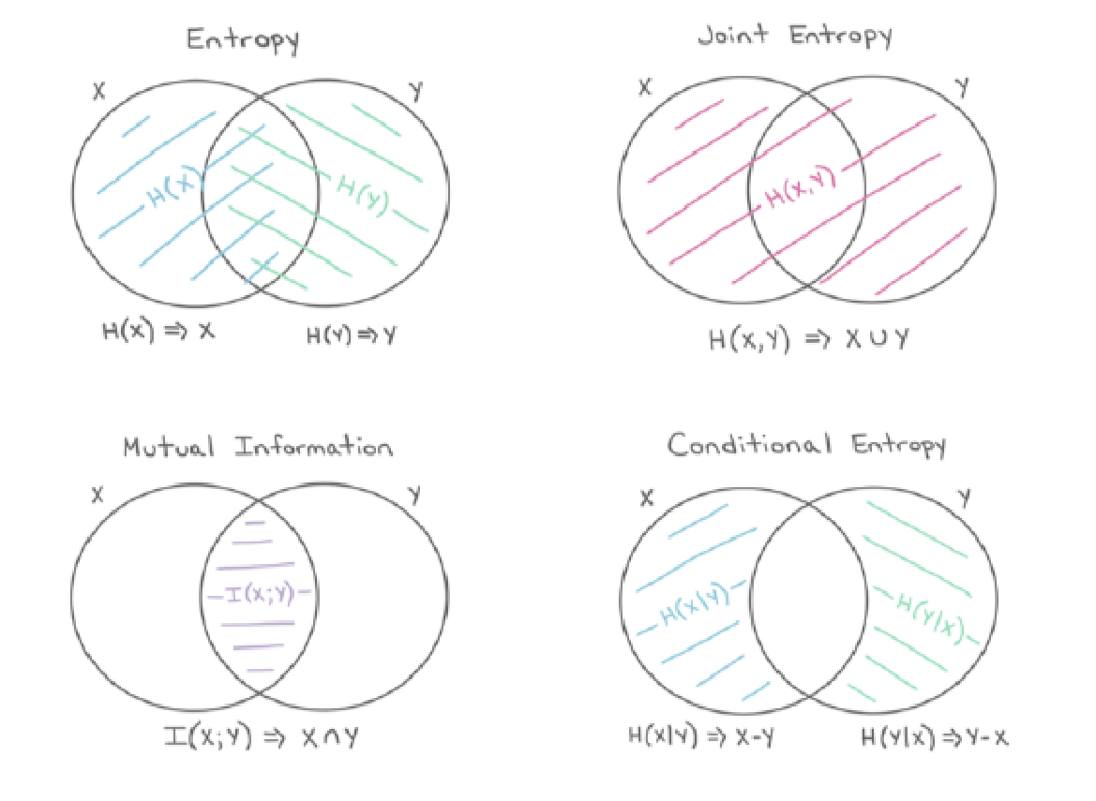
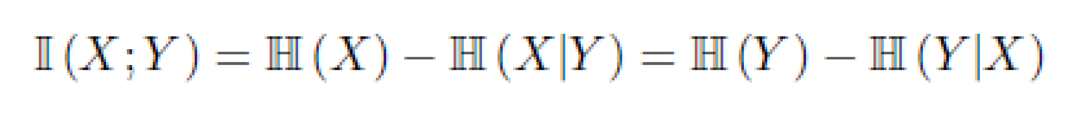
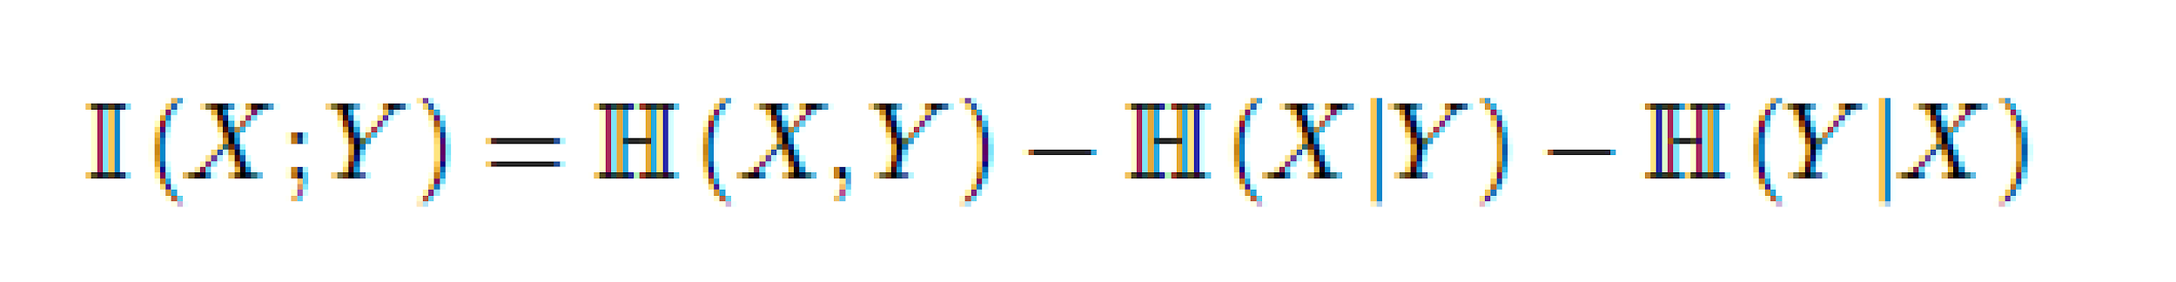
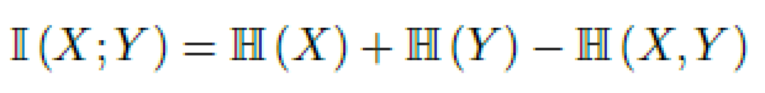
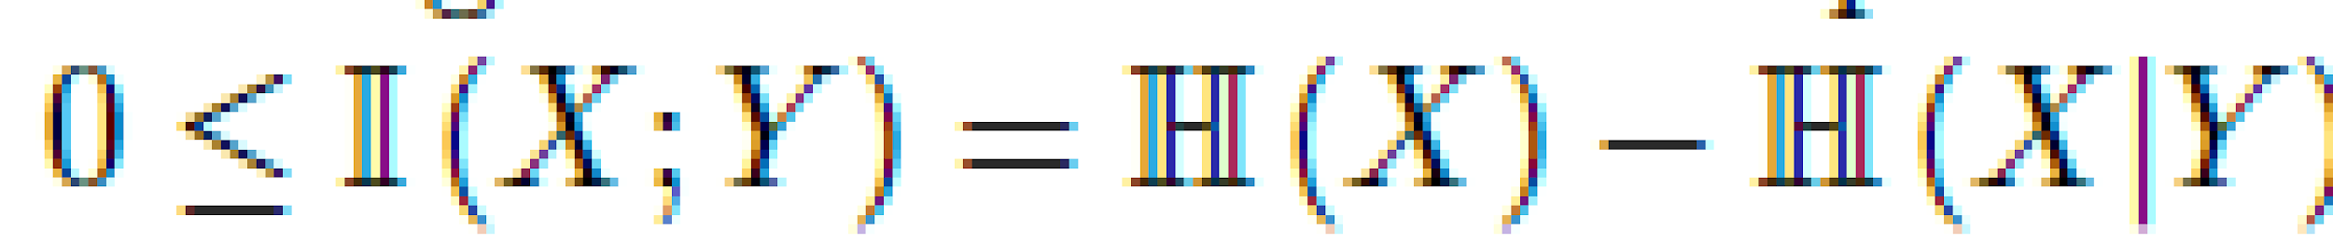
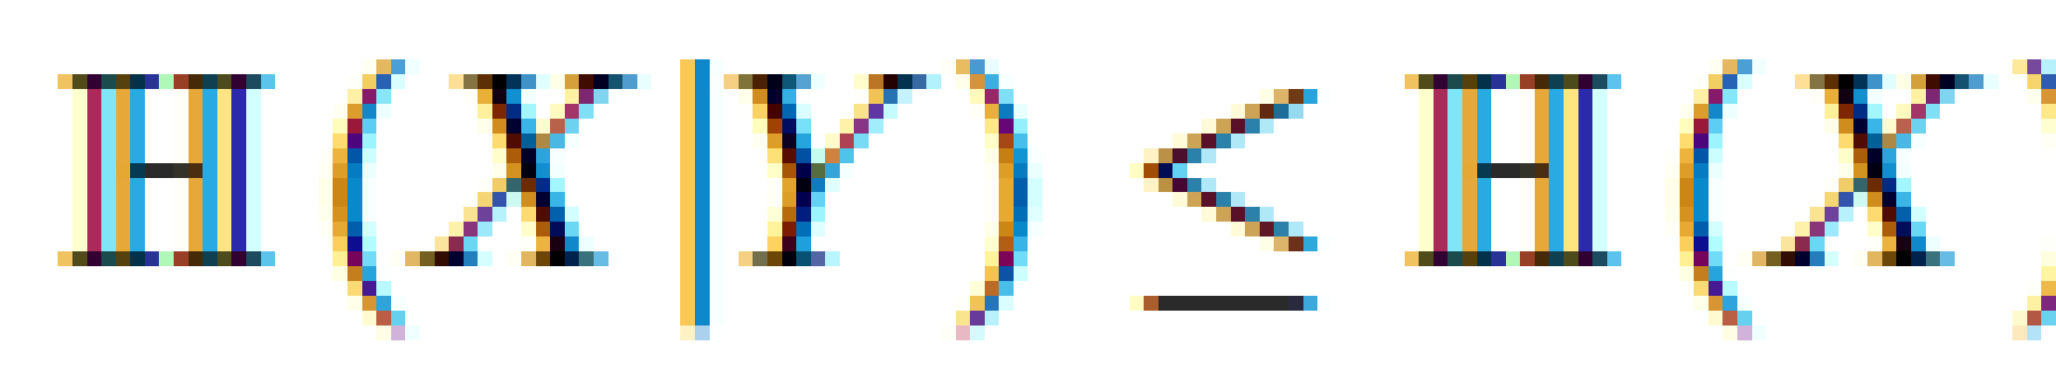
Some Relationships
(conditioning reduces entropy)

Slide 24
Other information measures in ML?
Smoother optimization (than KL divergence) with Wasserstein distance (earth mover distance for distributions)
Martin Arjovsky, Soumith Chintala, Léon Bottou, Wasserstein GAN, https://arxiv.org/abs/1701.07875
Other (in)dependence measures: Hilbert-Schmidt Independence Criterion (HSIC) / Maximum-Mean Discrepancy (MMD) / kernel trick
Introduced: Gretton et al 2007
Example usage: InfoVAE, arXiv:1706.02262
Almost never in ML: Renyi, info decomposition, synergy, intersection, common info
Wyner common information: arXiv:1606.02307
Synergy: arXiv:1710.03839
Hierarchical decomposition of total correlation: arXiv:1410.7404
Tononi, Integrated information (as a measure of consciousness?!)

Slide 25
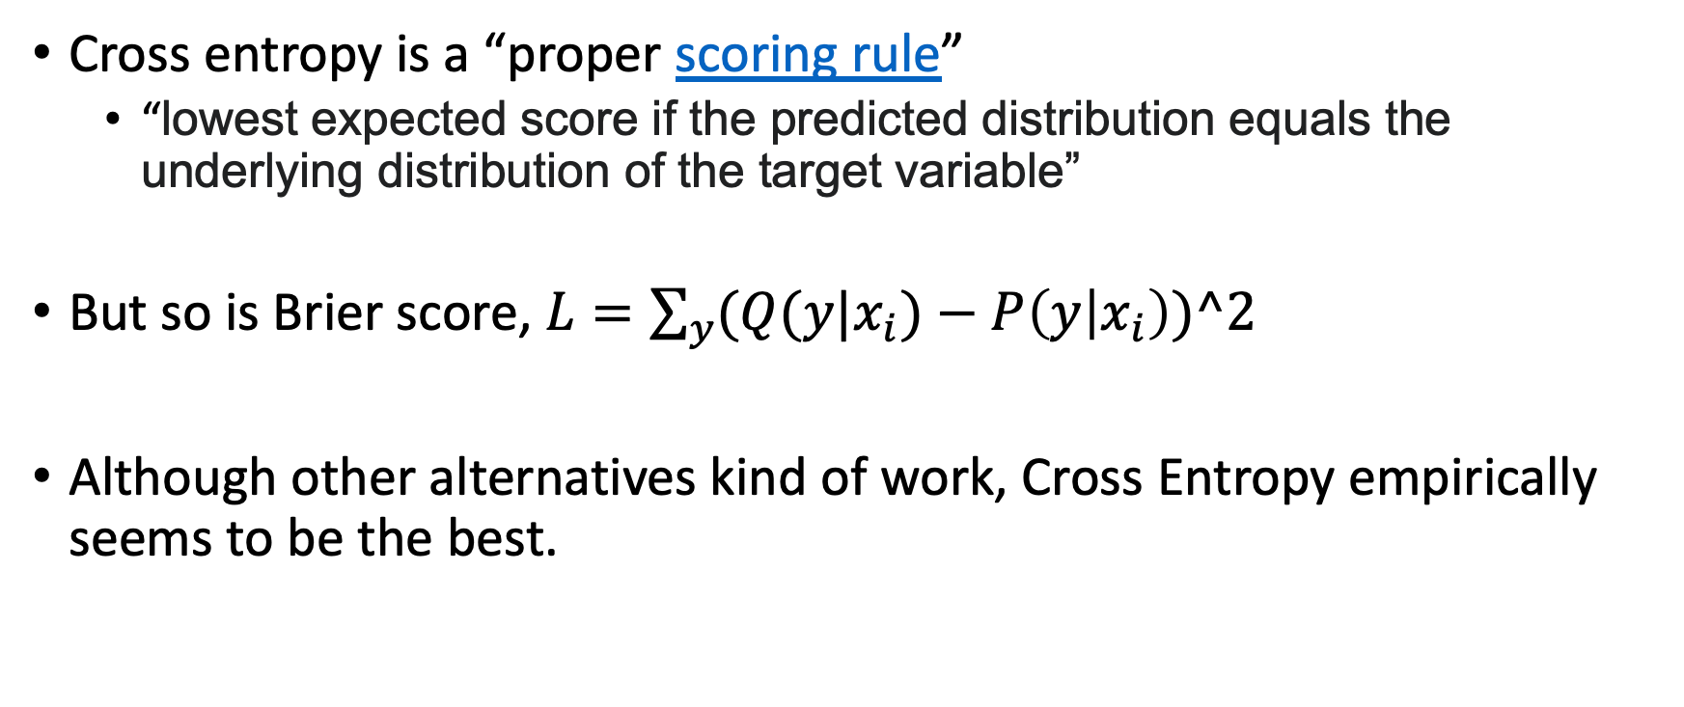
Other objectives for classification?
Cross entropy is a “proper scoring rule”
“lowest expected score if the predicted distribution equals the underlying distribution of the target variable”
But so is Brier score, $L=\sum_{y}{(Q(y|x_{i})−P\left(y | x_{i}\right))^2}$
Although other alternatives kind of work, Cross Entropy empirically seems to be the best.

