Slide 1

MINOR PROJECT
SUBMITTED BY :
Prateek Kumar 22103052
Vedant Singh Chauhan 22103058
Shivam Singh 22103031
Submitted to:
Dr. Kashav Ajmera
Ms. Kirti Jain
Mentor:
Dr. Kavita Pandey

Slide 2
INTRODUCTION
The integration of artificial intelligence (AI) and machine learning (ML) in healthcare has revolutionized the ability to diagnose, predict, and manage a wide range of medical conditions. These advanced technologies offer the potential for highly accurate disease detection, personalized treatment plans, and the automation of diagnostic processes, significantly improving patient care and reducing human error. However, as AI and ML models become more complex, their decision-making processes are often seen as opaque, leading to challenges in trust and acceptance within the medical community.
To address this, explainable AI (XAI) has emerged as a critical innovation, offering transparency by enabling healthcare professionals to understand, interpret, and trust AI-driven predictions. XAI provides insights into how models arrive at their decisions, fostering accountability, enhancing clinical decision-making, and ensuring that AI systems support medical experts rather than replace them. The combination of AI/ML with XAI is transforming healthcare by making advanced technologies more accessible, reliable, and aligned with ethical standards, ultimately improving patient outcomes and safety.
In this context, our research focuses on leveraging Explainable AI for the detection of polycystic ovary syndrome (PCOS). After analyzing 12 research papers on various diseases such as diabetes, cardiovascular conditions, allergies, and asthma, we chose PCOS due to its growing prevalence and diagnostic complexity. By implementing XAI on deep learning models for PCOS detection, the project aims to provide transparency in the decision-making process, ensuring that medical professionals can trust and effectively use these tools. This research highlights the importance of explainability in AI healthcare applications, helping bridge the gap between advanced technology and practical, trustworthy healthcare solutions.

Slide 3
LITERATURE REVIEW
Disease | Year | Objective | Data Sets | ML Models Used | Evaluation Metrics | XAI Models Used | References
HIV | 2021 | Analyze Dry Eye Disease in HIV patients using XAI and ML models | Case-control study on HIV patients | Clustering, Logistic Regression, Decision Trees, Neural Networks | Precision, Recall, Accuracy, Gini Importance, VI | LIME, Shapley, ICE | https://doi.org/10.1016/j.health.2021.100001
Cardiovascular | 2022 | XAI framework for predicting cardiovascular diseases | Dataset with 303 instances, 14 attributes | SVM, AdaBoost, KNN, Bagging, LR, Naive Bayes | AUC, ROC, Sensitivity, Specificity, F1-Score | SHAP, LIME | https://doi.org/10.3390/electronics11244086
Allergy | 2021 | Framework for allergy diagnosis | Intradermal skin test of 878 patients (India) | Decision Tree, SVM, Random Forest | Accuracy, Sensitivity | Post-hoc Explainability | https://doi.org/10.1016/j.bspc.2021.102681
Asthma | 2023 | Identify causes of chronic cough in asthmatic patients | Cohort from NCT04796844 trial | Logic Learning Machine | Accuracy, F1-Score, PPV, NPV, TPR, TNR | Rule-based if-then rules | https://doi.org/10.1371/journal.pone.0292980
Liver | 2023 | Classify liver disease using deep learning and XAI | Indian Patient Liver Dataset | Deep Learning (Keras-Tensorflow) | Accuracy, Precision, Recall, F-Measure | SHAP | https://doi.org/10.31449/inf.v48i1.4611
Monkeypox | 2023 | Detect Monkeypox from skin lesion images using XAI and deep learning | Images from Kaggle (Monkeypox, Measles, etc.) | ResNet-18, ResNet-50, ResNet-101, SqueezeNet | Accuracy, Precision, Recall, F1-Score | LIME | https://doi.org/10.1080/27690911.2023.2225698

Slide 4
Disease | Year | Objective | Data Sets | ML Models Used | Evaluation Metrics | XAI Models Used | References
Breast Cancer | 2023 | Develop a clinical decision support for breast cancer prevention | Public data of Indonesian women | XGBoost, Logistic Regression, Random Forest, SVM | Accuracy, Precision, Recall | SHAP | https://doi.org/10.3390/cancers15092443
Diabetes | 2023 | Apply XAI techniques in diabetes prediction | Diabetes dataset (768 rows, 9 columns) | KNN, Naive Bayes, SVM, Decision Tree, Random Forest, LR | F1 Score, Accuracy, Precision, Recall, ROC AUC, Time Taken | SHAP, LIME | http://www.jomude.com/index.php/jomude/article/view/109
PCOS | 2023 | Predict PCOS using demographic and clinical features | Kaggle PCOS dataset | RF, ADB, GB, XGB, CATB, PODBoost | Accuracy, Error-Rate, ROC-AUC, Recall, Precision, F1-Score | LIME | https://doi.org/10.1007/s00521-024-10171-9
PCOS | 2023 | Early detection of PCOS using optimized feature selection and XAI | PCOS dataset from Kaggle (541 instances) | Logistic Regression, RF, DT, Naive Bayes, SVM, KNN, XGBoost, AdaBoost, Stacking | Accuracy, Precision, Recall, F1-Score, AUC | Local and Global Explainability | https://doi.org/10.3390/diagnostics13081506
Thyroid | 2023 | Predict hypothyroidism and hyperthyroidism using XAI and ML | UCI Machine Learning Repository | Decision Tree, Random Forest, Gradient Boosting, Naive Bayes, KNN, LR, SVM | Accuracy, Precision, Recall, F1-Score | SHAP, LIME | https://doi.org/10.1007/s44230-023-00027-1

Slide 5
ABOUT PCOS
Polycystic Ovary Syndrome (PCOS) is a prevalent hormonal disorder affecting women, commonly diagnosed through ultrasound imaging of the ovaries. Machine learning techniques, particularly Convolutional Neural Networks (CNNs), have demonstrated remarkable accuracy in medical image analysis tasks. However, their “black-box” nature makes them unsuitable for critical medical diagnostics, where the interpretability of decisions is paramount. This project seeks to develop a CNN model for detecting PCOS from ultrasound images while leveraging Explainable AI (XAI) techniques like Grad-CAM to ensure transparency, trust, and clinical validation. By using XAI, clinicians can understand and trust the model’s decisions, making it an integral tool for PCOS diagnosis.

Slide 6
PCOS table
Author | Year | Objective (in short) | Data Sets | ML Models Used | Evaluation Metrics | XAI Models Used | References
Khanna et. al | 2023 | Detect PCOS using AI with ML and DL classifiers, and propose an automated screening system. | 541 patients from Kerala, India, with 43 attributes. | Logistic Regression, Decision Trees, Random Forest, SVM, Naïve Bayes, KNN, etc. | Accuracy, precision, recall, F1-score, AUC-ROC score, and precision-recall curve. | SHAP, LIME, ELI5, Qlattice, and feature importance with Random Forest. | Link
Moral et. al | 2024 | Develop an explainable AI model for early detection of PCOS using machine learning techniques. | PCOS dataset from Kaggle (541 records, 43 attributes) | Logistic Regression, Naive Bayes, Random Forest, Gradient Boosting, etc. | Accuracy, Error-Rate, ROC-AUC Score, Recall, Precision, and F1-Score. | Local Interpretable Model-Agnostic Explanations (LIME). | Link
Elmannai et. al | 2023 | Develop a machine learning model for early detection of PCOS using optimized feature selection and XAI. | PCOS dataset from Kaggle (541 instances, 41 attributes) | Logistic Regression (LR), Random Forest (RF), Naive Bayes (NB), etc. | Accuracy (ACC), Precision (PRE), Recall (REC), F1 Score (F1), and ROC-AUC Curve. | Local and global explainability techniques to ensure model trust. | Link
Çiçek et. al | 2021 | Extract patient-based explanations of important features in PCOS risk using LIME. | “Polycystic ovary syndrome” dataset from Kaggle | Random Forest (RF) | Accuracy, Sensitivity, Specificity, Positive Predictive Value, Balanced Accuracy. | Local Interpretable Model-Agnostic Explanations (LIME). | Link

Slide 7
Author | Year | Objective (in short) | Data Sets | DL Models Used | Evaluation Metrics | XAI Models Used | References
ÖZMEN et. al | 2023 | Determine the best method for follicle detection using ovarian ultrasound images. | Ultrasound images of 54 patients (14 PCOS, 40 control). | Convolutional Neural Network (CNN) and SqueezeNet | Mean Square Error (MSE), Peak Signal-to-Noise Ratio (PSNR), accuracy, etc. | None | Link
Umapathy et. al | 2024 | Develop an automated system for detecting PCOS using deep learning techniques. | Two datasets with ultrasound images (100 normal, 100 PCOS) | Random Forest, k-star, MobileNet, ResNet152V2, etc. | Classification accuracy, sensitivity, specificity, and AUC. | None | Link
Alamoudi et. al | 2023 | Develop a computer-aided diagnosis model for diagnosing PCOS using a deep learning fusion approach. | Ovary ultrasound images and clinical data from 285 patients | VGG-16, VGG-19, InceptionV3, DenseNet121, DenseNet201, etc. | Accuracy, precision, F1-score, recall (sensitivity), specificity. | None | Link
Suha et. al | 2022 | Propose an extended machine learning classification technique for PCOS prediction. | 594 ovary ultrasound (USG) images. | CNN with transfer learning (VGGNet16), XGBoost stacking model | Accuracy, Precision, Sensitivity, F1 Score, Execution Time, AUC-ROC Curve. | None | Link

Slide 8
RESEARCH GAP
While deep learning and explainable AI (XAI) have gained significant traction in healthcare, there remains a substantial gap in applying these technologies specifically to Polycystic Ovary Syndrome (PCOS) prediction from ultrasound images. Most current research has focused on other diseases, such as diabetes, cardiovascular conditions, and cancers, with limited attention given to PCOS despite its growing prevalence. Although advanced AI models have demonstrated excellent performance in medical image analysis, their black-box nature poses a significant barrier to their adoption in sensitive clinical applications, where interpretability is crucial.
In the case of PCOS detection, accurate diagnosis can be particularly challenging, and clinicians often need tools that not only provide reliable predictions but also allow them to understand how those predictions are made. The current literature lacks robust work that combines deep learning with XAI to address these challenges, especially in the context of PCOS.
By focusing on the integration of deep learning models with XAI techniques, this project aims to close the research gap. It will enable more transparent and interpretable models for PCOS detection, making it possible for clinicians to visualize and trust the key factors that influence the AI’s decision-making process. This gap highlights the importance of our work in making AI models more applicable and trustworthy in real-world clinical settings, particularly for diseases like PCOS that demand high levels of diagnostic accuracy and interpretability.

Slide 9
PROBLEM STATEMENT
The diagnosis of PCOS through ultrasound images presents a significant challenge in terms of accuracy and interpretability. While CNNs can achieve high performance in classifying medical images, their black-box nature raises concerns about the trustworthiness of their predictions in sensitive healthcare applications.
The challenge is to build a CNN-based system for detecting PCOS from ultrasound images that is not only accurate but also interpretable. By applying Explainable AI (XAI) techniques, the model's internal workings can be visualized, highlighting the key areas of the image that influenced the model’s decision, making the predictions more understandable and trustworthy to clinicians.

Slide 10
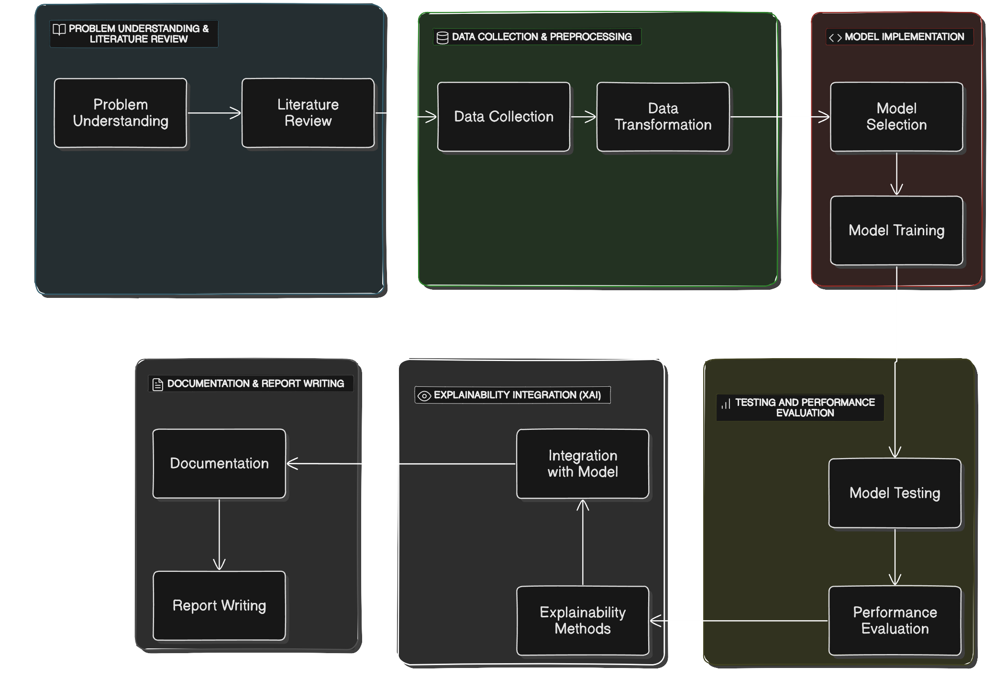

Slide 11
MODEL SELECTION AND SETUP
CNN ARCHITECTURE Selected the CNN MobileNet, known for its high accuracy and efficiency in image classification tasks.
PRE-TRAINED MODEL Using a pre-trained model and fine-tune the weights for the specific task of PCOS detection.
MODEL SETUP Define the input layer and configure the output layer for binary classification (PCOS-positive or PCOS-negative).

Slide 12
MODEL TRAINING
TRAINING We will be training the model on the augmented dataset, while monitoring performance on the validation set.
TESTING Test the trained model on the unseen test dataset to evaluate its generalization capability.
PERFORMANCE METRICS Compute key performance metrics like Accuracy to quantify the model’s ability to detect PCOS.

Slide 13
GRAD-CAM INTEGRATION
IMPLEMENT GRAD-CAM TO GENERATE CLASS ACTIVATION HEATMAPS
Visualizing the regions in the ultrasound images that contributed the most to the model’s diagnosis. These heatmaps will overlay on the original images, highlighting areas such as ovarian cysts or other relevant features that the model used for its decision-making.
VISUAL EXPLANATIONS
The generated heatmaps provide interpretable insights into the CNN model’s decision, revealing whether the model is focusing on clinically relevant areas.

Slide 14
ANALYSIS OF GRAD-CAM HEATMAPS
Evaluate the heatmaps to ensure that the CNN model is focusing on meaningful regions in the images (e.g., cystic formations in the ovaries). If the model is focusing on irrelevant regions, adjustments can be made to the architecture or training data.
TRUST BUILDING
By demonstrating that the CNN model bases its predictions on medically relevant areas, trust in the model is established. This transparency bridges the gap between AI predictions and clinical decision-making, making the model a reliable tool for PCOS diagnosis.

