Slide 1
Lending Club Case Study
Exploratory Data Analysis Case Stydy
by
Vedant Tibrewal
Vishnu Vinod K V

Slide 2
Agenda
Problem Statement
Data Understanding
Data Cleaning
Exploratory Data Analysis
Conlusion

Slide 3
Problem Statement
Problem:
You work for a consumer finance company which specialises in lending various types of loans to urban customers. When the company receives a loan application, the company has to make a decision for loan approval based on the applicant’s profile. Two types of risks are associated with the bank’s decision:
- If the applicant is likely to repay the loan, then not approving the loan results in a loss of business to the company
- If the applicant is not likely to repay the loan, i.e. he/she is likely to default, then approving the loan may lead to a financial loss for the company
Objective:
Use EDA to understand how consumer attributes and loan attributes influence the tendency of default
Target:
The target column have three variables,
Charged Off: This indicate the person has defaulted the loan
Current: This indicates the loan in currently in progress
Fully Paid: This indicates the loan has been fully paid off

Slide 4
Data Understanding
Shape of raw data: 39717 rows and 111 columns
The data is mix of categorical, numerical, and date columns
~50% of the columns having 100% null values
9 columns are constant
3 columns are 100% unique
Target variable columns is “loan_status”
We are focused with the value Charged Off and Fully Paid

Slide 5
Data Cleaning
The columns having >50% of data null was dropped (columns - 57)
The columns having 100% of data unique was removed (columns - 3)
Constant columns were removed (columns - 9)
Dropping unwanted columns (columns - 18)
Dropping the rows with loan status as Current (rows - 1140)
Imputing the rest of the null values
  emp_legth, pub_rec_bankrupties, home_ownership were imputed
  reval_util were dropped
No dulicates were found
Fixing the datatype of the columns were required
  int_rate, revol_util were % symbol was dropped
  issue_d, earliest_cr_line the date as modified as date type
  term were the unwanted space was removed
Final shape of data: 38527 rows and 24 columns

Slide 6
Exploratory Data Analysis

Slide 7
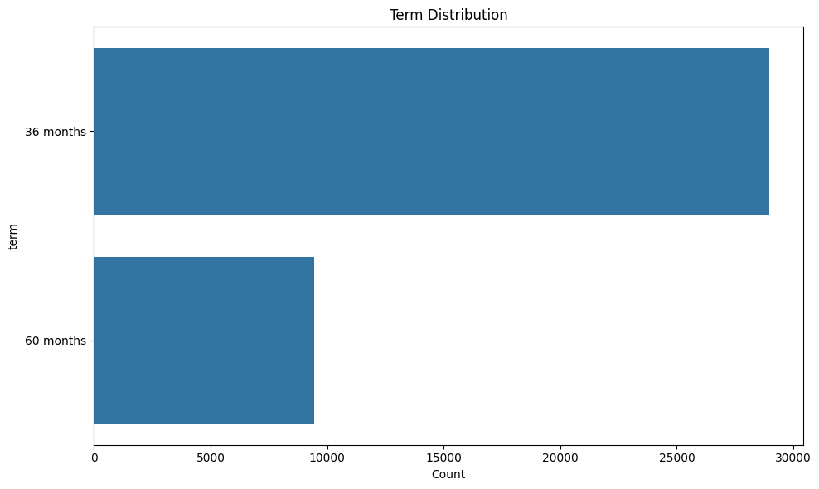
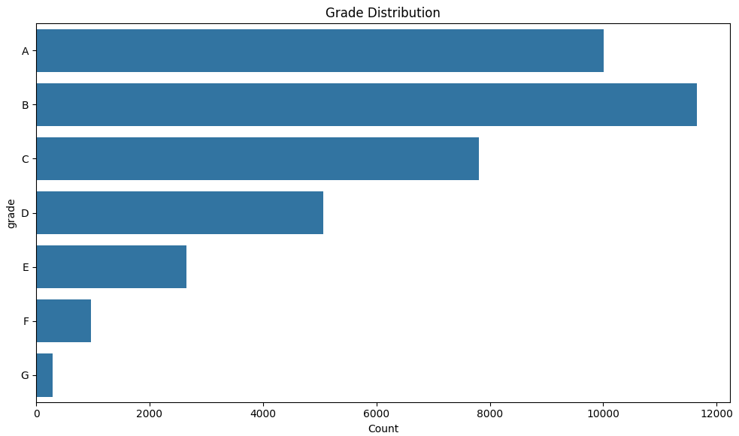
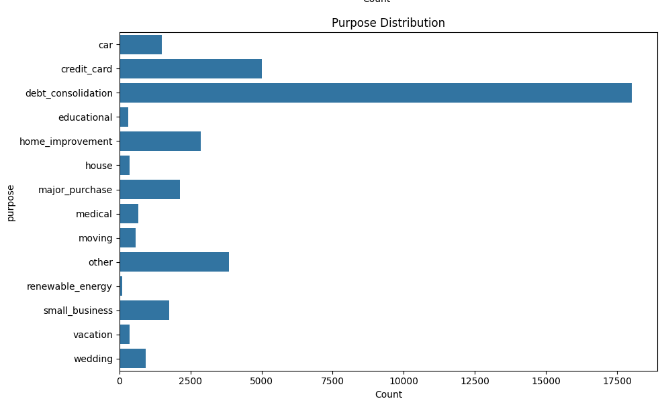
Univariate Analysis
The most common loan term is 36 months
Highest number of loans are provided to people falling in grade B, followed by grade A and than grade C
Mostly the loans are taken for debt consolidation (around 50% of the entire data)

Slide 8
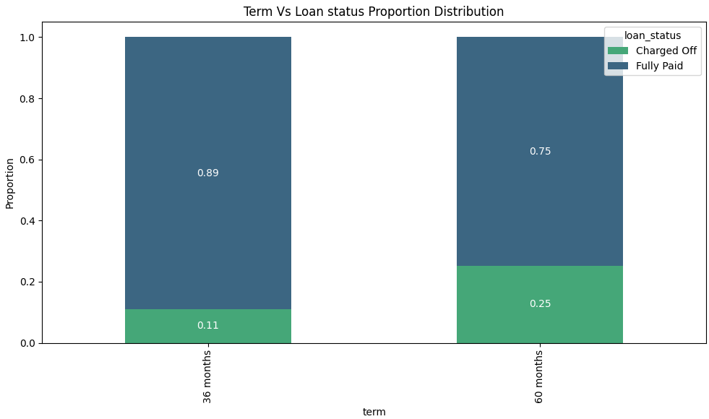
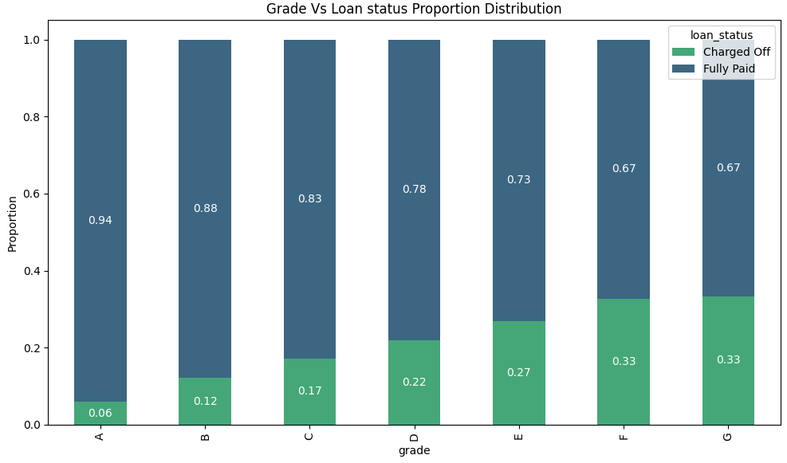
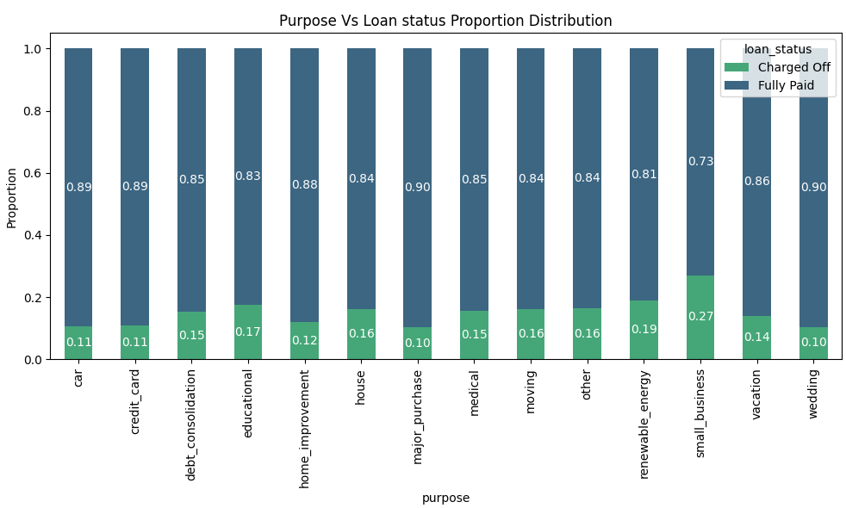
Bi-variate Analysis
The Charged off proportion increases as grade moves from A to G
For loan term the proportion of charged off for term 60 months is double of 36 months
For Purpose, small businesses tends to have more charged off rates

Slide 9
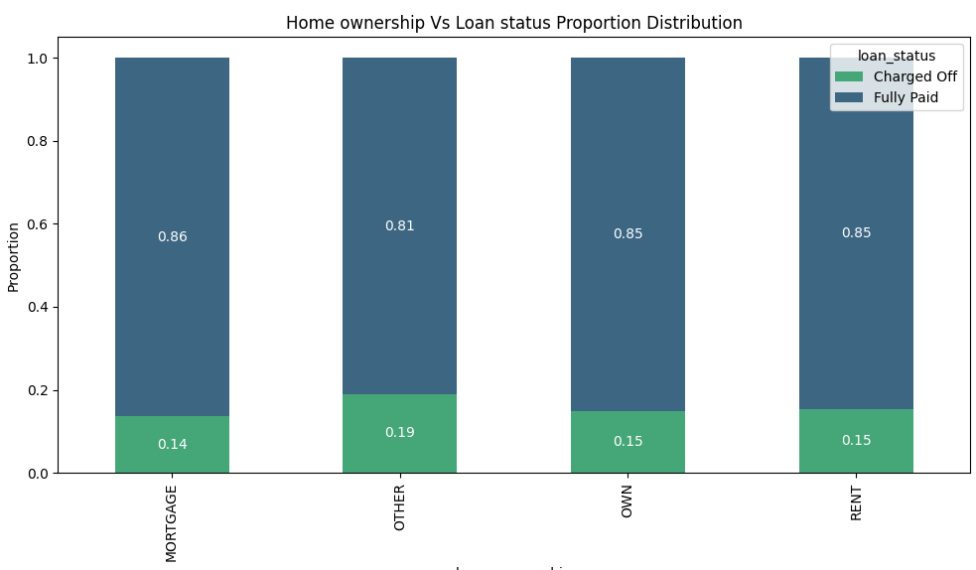
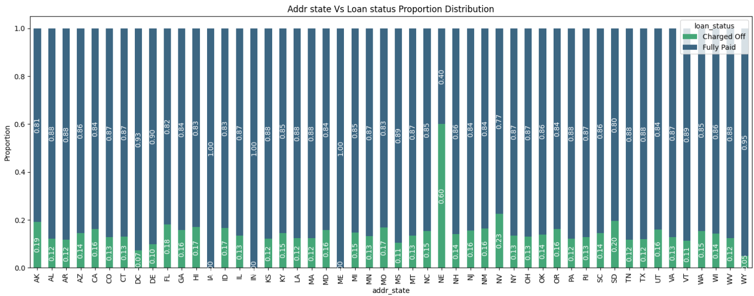
In-case of home ownership the charged off rate in highest for category "OTHER", compared to the rest of the categories
State Addr "NE", has the highest charged off rate

Slide 10
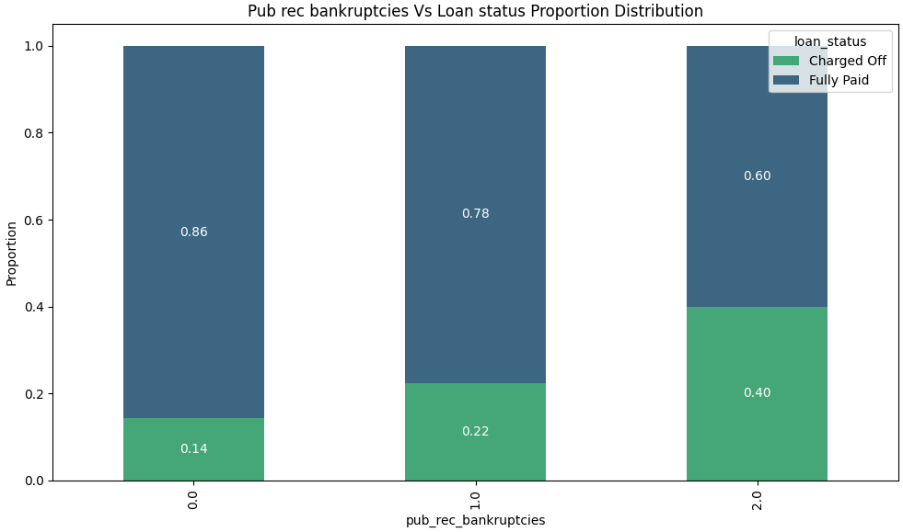
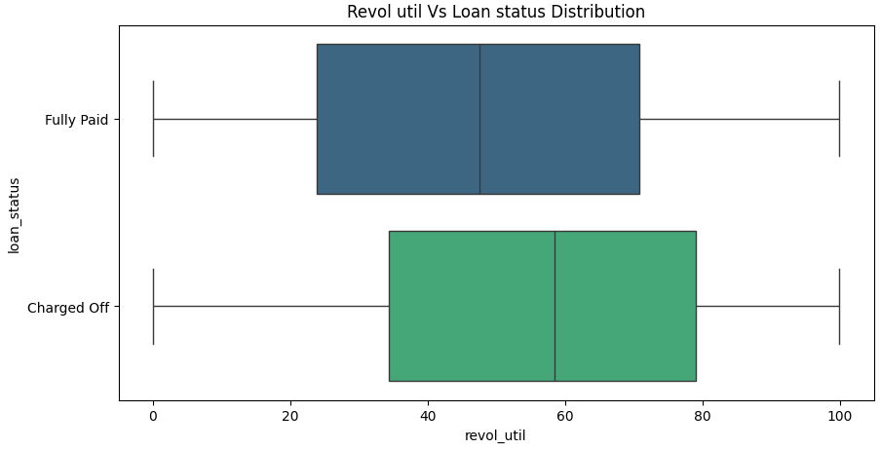
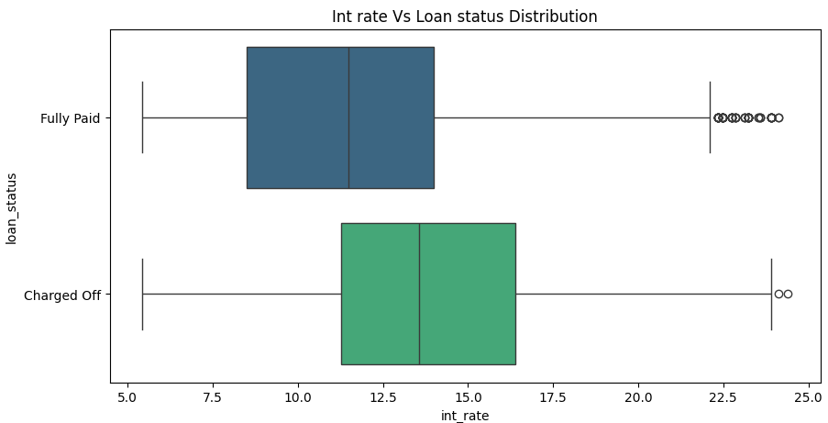
For pub rec bankreupcties, charged of rate increase with count
High revol_util rate have more chances of Charged Off
High interest rate have higher chance of Charge Off

Slide 11
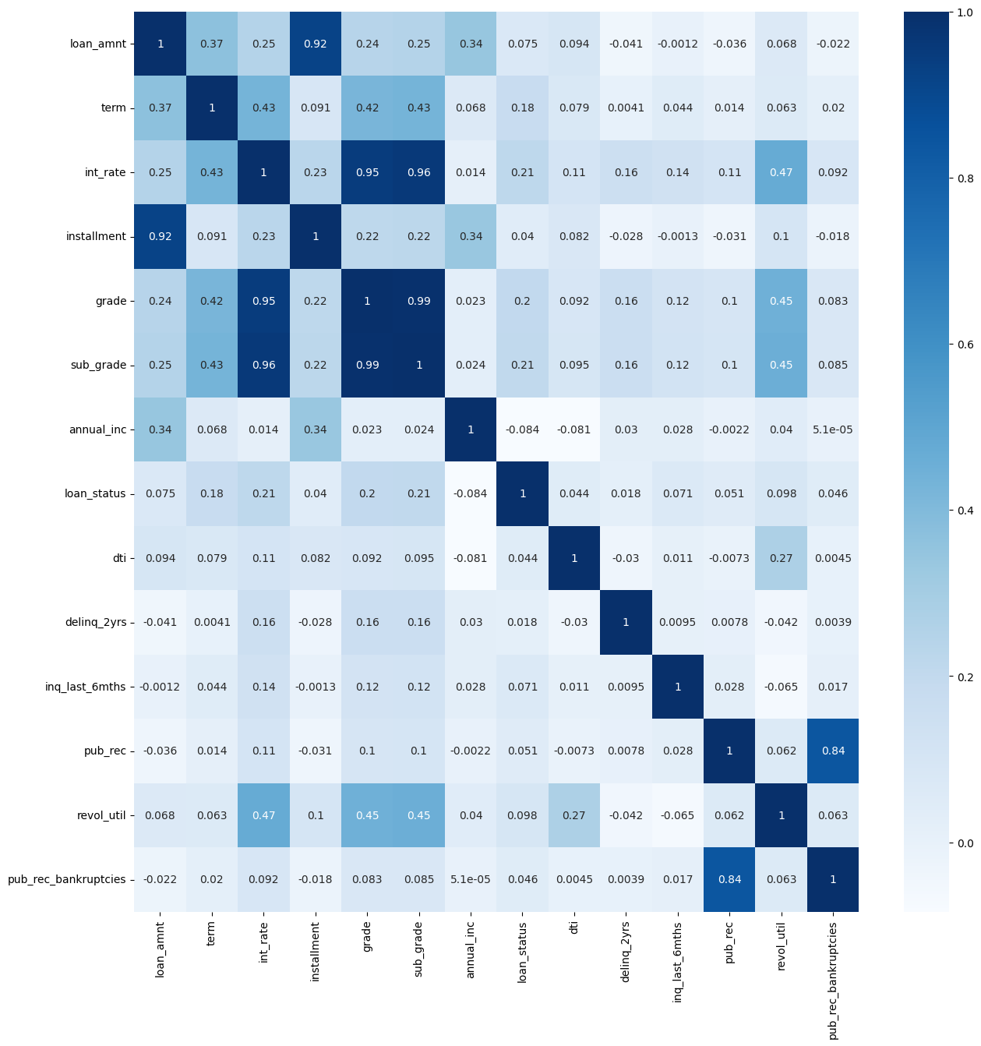

Slide 12
Conclusion
Interest rate more than 13% have higher chance of Charge Off
Those who are not ownig a home have high chances of Charged Off
Loan for small business have high changes of Charged Off
High revol_util rate have more chances of Charged Off
Higher the number of bankrupties, higher the chance of Charged Off
Loan Grades F and G have high chances of Charged Off
Lower the Grade, higher the chance of Charged Off
5 year loans have more chances of Charged Off
State NE have the high chance of Charged Off

