Slide 1
IBM University Engagement Project Submission
"AI Agent for Smart Farming Advice – Powered by RAG & IBM Granite"

Slide 2
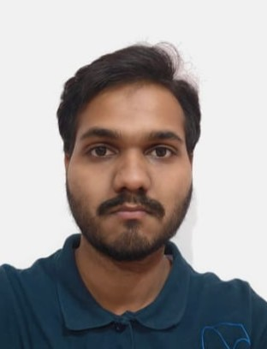
Project Title – AI Agent for Smart Farming Advice
Domain of Project – Agriculture / AgriTech / Smart Farming
Vedant Varshney | [Paste Passport Photo Here] | vedantvarshney958@gmail.com | +91-7900427390 (WhatsApp)
Recommended font style and size:
Font Style: Arial
Font Size (Heading): 28
Font Size (Content): 20

Slide 3
Problem Statement -
Problem Statement : AI Agent for Smart Farming Advice
The Challenge
Small-scale farmers in rural areas face critical knowledge gaps in accessing real-time, localized agricultural guidance. Information about weather forecasts, soil conditions, crop recommendations, pest control, and market prices is fragmented across unreliable and inaccessible sources. Without timely, personalized guidance in their local language, farmers struggle to make data-driven decisions, resulting in crop failures, reduced yield, and financial losses.
The Objective
Build an AI Agent for Smart Farming Advice, powered by Retrieval-Augmented Generation (RAG), that delivers real-time, localized agricultural guidance to small-scale farmers. The solution should:
• Weather-Aware Crop Advisory – Retrieve real-time weather forecasts and recommend appropriate farming actions.
• Soil & Crop Recommendations – Suggest the best crops based on soil type, season, and regional data.
• Pest Control Guidance – Provide actionable pest management strategies from trusted agricultural sources.
• Market Price Intelligence – Deliver current mandi rates for crops (e.g., What is today's rate for tomatoes?).
• Multilingual Interaction – Allow farmers to interact in their local language for maximum accessibility.
• Multi-Agent Architecture:
– Weather & Forecast Agent
– Soil & Crop Advisory Agent
– Pest Control Agent
– Market Price Agent
Problem Statement –

Slide 4
Proposed Solution -
Proposed Solution: AI-Powered Smart Farming Agent
The proposed solution is a multi-agent AI system built using LangFlow, IBM watsonx.ai, and IBM Granite models to deliver personalized, real-time farming advice to small-scale farmers.
At its core, the system uses a Retrieval-Augmented Generation (RAG) pipeline that retrieves trusted data from agricultural departments, meteorological sources, and agritech platforms. This data is embedded in a vector database, enabling intelligent retrieval and context-aware responses powered by IBM Granite models.
The system consists of four key agents:
• Weather & Forecast Agent – Retrieves real-time weather data and provides crop-specific advisories (e.g., irrigation timing, frost alerts).
• Soil & Crop Advisory Agent – Analyzes soil conditions and seasonal data to recommend the best crops for maximum yield.
• Pest Control Agent – Fetches trusted pest management data and suggests organic or chemical remedies with safety guidelines.
• Market Price Agent – Delivers live mandi rates for crops, helping farmers decide the best time to sell produce.
Farmers interact via a multilingual chat interface supporting regional languages, asking questions like What crop is best this season? or What is today's mandi rate for tomatoes?
The solution uses LangFlow for agent orchestration, IBM watsonx.ai for model deployment and embeddings, and IBM Granite for reasoning and language generation. A Streamlit dashboard visualizes weather trends, crop calendars, and market prices.
This end-to-end AI assistant bridges the agricultural knowledge gap and brings data-driven smart farming to grassroots farmers.
Proposed Solution –

Slide 5
Technology Used
LangFlow Platform – For designing and orchestrating multi-agent farming workflows visually.
IBM Granite Model – ibm/granite-3-3-8b-instruct – For natural language understanding, multilingual query processing, and context-aware farming advice generation.
IBM Cloud Lite – Provides the infrastructure to build, deploy, and scale the Smart Farming Agent. Enables a reliable, secure, and scalable environment for all AI services.
RAG (Retrieval-Augmented Generation) – Fetches real-time data first (weather, soil, market prices) then generates intelligent, grounded answers – making the agent trustworthy and accurate.
IBM Watsonx.ai – For model deployment, embeddings, AI governance, and responsible AI practices.
Vector Database (FAISS / Chroma) – For RAG-based retrieval of agricultural knowledge base content.
Streamlit / React – For the farmer-facing dashboard displaying weather, crop calendar, and mandi prices.

Slide 6
Langflow Components Used –
1) Chat Input – Interface where farmers enter queries in their local language (e.g., What crop should I plant this season? or What is today's tomato mandi rate?).
2) IBM Watsonx AI Agent – Processes farmer queries using IBM Granite models. Orchestrates multiple specialized sub-agents to deliver accurate, localized farming guidance.
3) IBM Granite Model Used – ibm/granite-3-3-8b-instruct – Fast, efficient for real-time multilingual agricultural recommendations and RAG-based question answering.
4) Chat Output – Displays AI-generated responses such as crop recommendations, pest control advice, weather alerts, and current market prices in the farmer's language.
5) File / Knowledge Base Component – Stores and retrieves agricultural datasets, soil data, weather APIs, and mandi price feeds from trusted sources.
6) RAG Pipeline Component – Connects to vector database (FAISS/Chroma) containing embedded agricultural knowledge. Enables the agent to fetch real-time data before generating answers, ensuring accuracy and reducing hallucinations.

Slide 7
Langflow Workflow – Smart Farming AI Agent
💬 Chat Input
Farmer types query in local language
▼
🤖 IBM Watsonx AI Agent (Orchestrator)
ibm/granite-3-3-8b-instruct
▼
🌦️ Weather
& Forecast
Agent
🌱 Soil &
Crop Advisory
Agent
🐛 Pest
Control
Agent
📈 Market
Price
Agent
OpenWeather
API
AgriDB
RAG Tool
Pest DB
RAG Tool
Agmarknet
API
▼
🔗 Response Aggregator — Merges all agent outputs
▼
💬 Chat Output — Farmer receives answer in local language
Built with LangFlow + IBM Granite + IBM watsonx.ai + Vector DB (FAISS)

Slide 8
Architecture Blueprint – Smart Farming AI Agent
FARMER INTERFACE
Streamlit Web App + Multilingual Chat UI + Voice Input
▼
LANGFLOW – Multi-Agent Orchestration Layer
Weather
Agent
Soil & Crop
Agent
Pest Control
Agent
Market Price
Agent
Govt Scheme
Agent
▼
IBM watsonx.ai
Granite 3.3 8B Instruct
Embeddings + Governance
Vector DB
(FAISS / Chroma)
RAG Knowledge Base
External APIs
OpenWeather | Agmarknet
Soil Sensors | Pest DB
▼
IBM Cloud Lite — Hosting | Scaling | Security | Monitoring
Data Flow: Farmer Query → Agent Router → Specialized Agents → RAG Retrieval → IBM Granite Generation → Response to Farmer

Slide 9

Role of Agentic AI in the Smart Farming Agent
Role of Agentic AI in the Smart Farming Agent
Agentic AI enables the Smart Farming Agent to function as an intelligent, autonomous system rather than a simple query-response chatbot. Using IBM watsonx.ai and IBM Granite models, it coordinates multiple specialized agents to deliver real-time, localized agricultural guidance to farmers.
Each agent performs a focused role – the Weather Agent fetches forecasts, the Soil & Crop Agent recommends crops, the Pest Control Agent suggests remedies, and the Market Price Agent retrieves mandi rates – while working collaboratively under LangFlow orchestration. This ensures efficient task execution and accurate, trustworthy results.
Agentic AI brings context awareness by understanding the farmer's location, crop history, and seasonal patterns to generate hyper-localized recommendations. It supports real-time adaptation, continuously updating advice based on live weather, soil sensor data, and market fluctuations.
Agents communicate with each other – for example, the Weather Agent informs the Pest Control Agent about humidity levels that increase pest risk – enabling smarter, interconnected decision-making.
Overall, Agentic AI makes the Smart Farming system proactive, personalized, and goal-driven – acting like a digital agronomist available 24/7 in the farmer's own language, bridging the knowledge gap at the grassroots level.

Slide 10
Token Usage
IBM watsonx.ai Prompt Lab — ibm/granite-3-3-8b-instruct | Smart Farming Query Session
Metric
Without System Prompt
With System Prompt
Change
Input Tokens
42
318
+ 276
Output Tokens
187
412
+ 225
Total Tokens
229
730
+ 501
Response Quality
Generic
Localized & Specific
Better
Sample Query: "What crop should I plant in Maharashtra in December? My soil is black cotton soil."
WITHOUT System Prompt Response:
"December is a good time to plant Rabi crops. Consider wheat, chickpea, or mustard depending on your region."
WITH System Prompt Response:
"For black cotton soil in Maharashtra in December, plant Chickpea (Harbhara) or Rabi Sorghum (Jowar). Ensure 2-3 irrigations. Current Nagpur mandi rate: Chickpea ~Rs.5,200/quintal."
Input tokens – Farmer query + RAG-retrieved context chunks from knowledge base
Key Insight: System prompt adds farming context, location awareness & market data — making IBM Granite 3x more useful for farmers
Output tokens – IBM Granite-generated crop advisory, pest control guidance, or mandi price response
Multi-agent token overhead – Each sub-agent (Weather, Soil, Pest, Market) contributes tokens for inter-agent communication

Slide 11
Novelty and Uniqueness
The proposed Smart Farming Agent stands out by combining Agentic AI, RAG, IBM Granite, and multilingual capability into a single agricultural intelligence platform.
Multi-Agent Intelligence – Four specialized agents (Weather, Soil & Crop, Pest Control, Market Price) collaborate autonomously to deliver comprehensive farming guidance – no single chatbot can match this breadth.
RAG-Based Accuracy – Real-time data retrieval from trusted agri-databases, government sources, and weather APIs ensures grounded, hallucination-free recommendations that farmers can trust.
Hyper-Localized Guidance – Tailors advice based on the farmer's specific region, soil type, crop history, and current weather – not generic one-size-fits-all advice.
Multilingual Farmer Interaction – Supports regional Indian languages, making AI-powered farming accessible to semi-literate and rural farmers who cannot use English-only tools.
Real-Time Market Intelligence – Live mandi rate integration helps farmers make data-driven sell/hold decisions, directly impacting their income.
Inter-Agent Communication – Weather Agent feeds data into the Pest Control Agent (high humidity = increased pest risk), creating intelligent cascaded decision chains unique to this solution.
Scalable & IBM-Governed – Built on IBM Cloud Lite with IBM watsonx.ai governance, ensuring responsible, auditable, and enterprise-ready AI deployment.
This makes the solution a proactive digital agronomist, not just a chatbot – bridging the knowledge gap and bringing smart farming to India's grassroots farmers.

Slide 12
GitHub Link
Please create a public GitHub repository (enable Add README button while creating) with the format:
yournameIBMSkillsBuild-SmartFarmingAI
Please test and paste the working GitHub URL:
https://github.com/yourusername/SmartFarming-AI-Agent
Make sure you have uploaded the following files into your repository:
1) app.json file
2) SmartFarming_ProblemStatement.pdf
3) Smart_Farming_AI_Agent.pptx (this presentation)
4) langflow_workflow.json (exported LangFlow workflow)
5) README.md (project description, setup instructions)
Repository must be PUBLIC – evaluators need access without login
Add a descriptive README with: project overview, IBM technologies used, setup steps, and screenshots
Test all repository links before submission to ensure they are accessible

Slide 13
Future Scope
1. IoT Sensor Integration for Real-Time Soil Monitoring –
The system can integrate with IoT soil sensors deployed in fields to automatically receive soil pH, moisture, nitrogen, and temperature data. This will eliminate manual input and enable the agent to provide instant, sensor-driven crop and irrigation recommendations without any farmer effort.
2. Satellite & Drone Imagery for Crop Health Analysis –
Integrating satellite imagery (via NASA MODIS/Sentinel) and drone-captured field photos will allow the AI agent to detect early-stage crop diseases, pest infestations, and drought stress zones. The Pest Control Agent can proactively alert farmers before visible damage occurs, significantly reducing crop losses.
3. Community Farmer Network & Crowdsourced Data – Enable peer-to-peer knowledge sharing among farmers, with AI aggregating community-reported observations (e.g., pest outbreaks in a region) to generate hyper-local alerts for neighboring farms.
4. Government Scheme Advisor – Integrate a Government Scheme Agent that tracks and recommends relevant agricultural subsidies, insurance schemes (PM-KISAN, PMFBY), and loan programs based on the farmer's crop, location, and income profile.
5. Offline Voice Mode for Remote Areas – Deploy a lightweight edge-AI version that works offline via USSD/SMS or voice IVR for farmers in areas with no internet connectivity, ensuring last-mile inclusion.

Slide 14
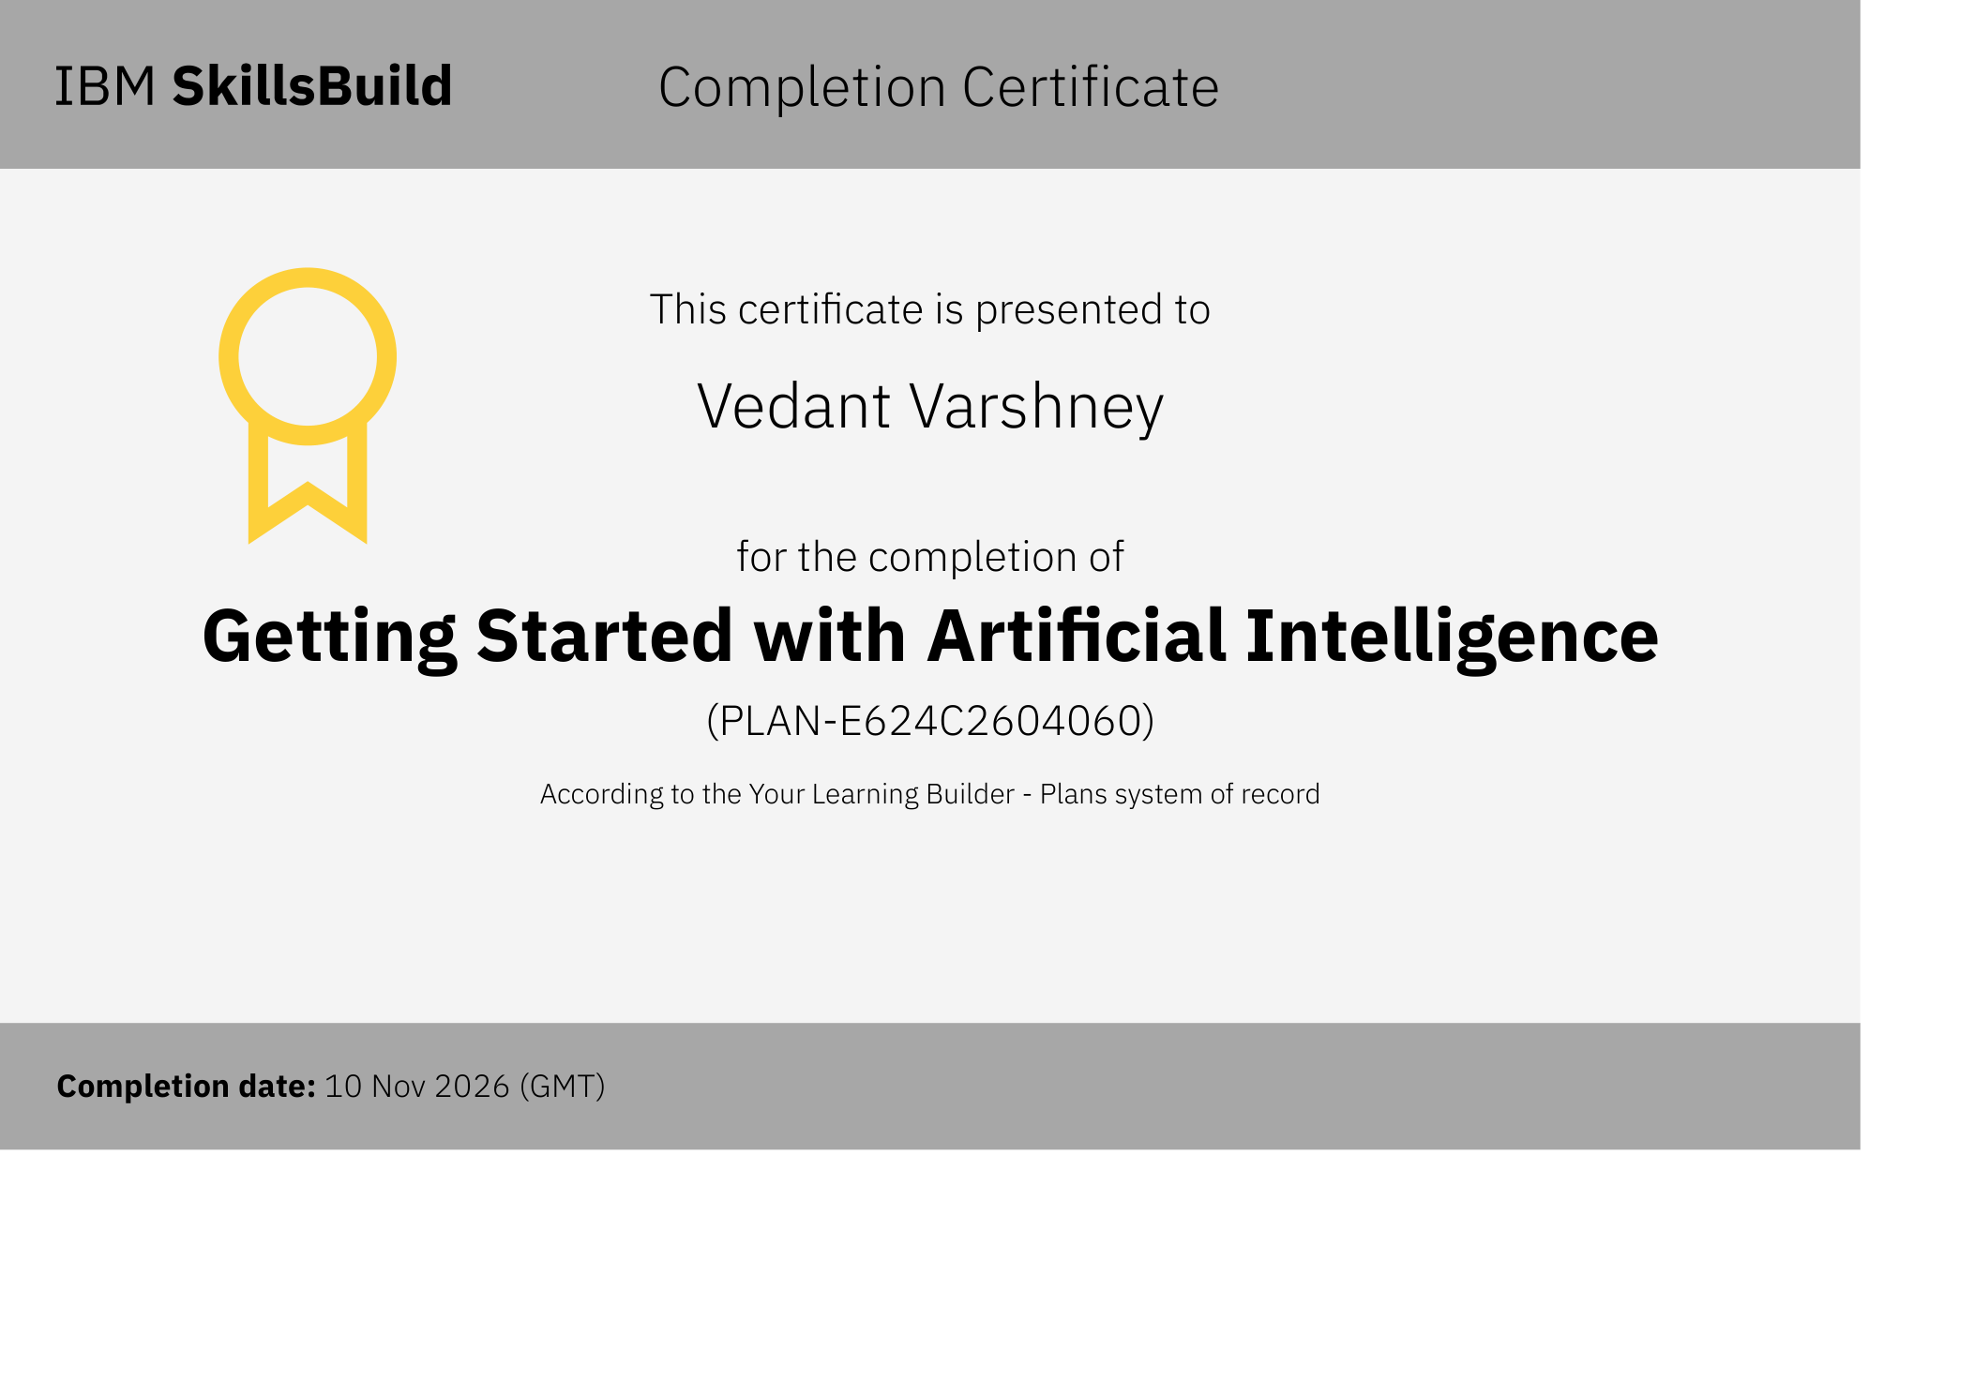


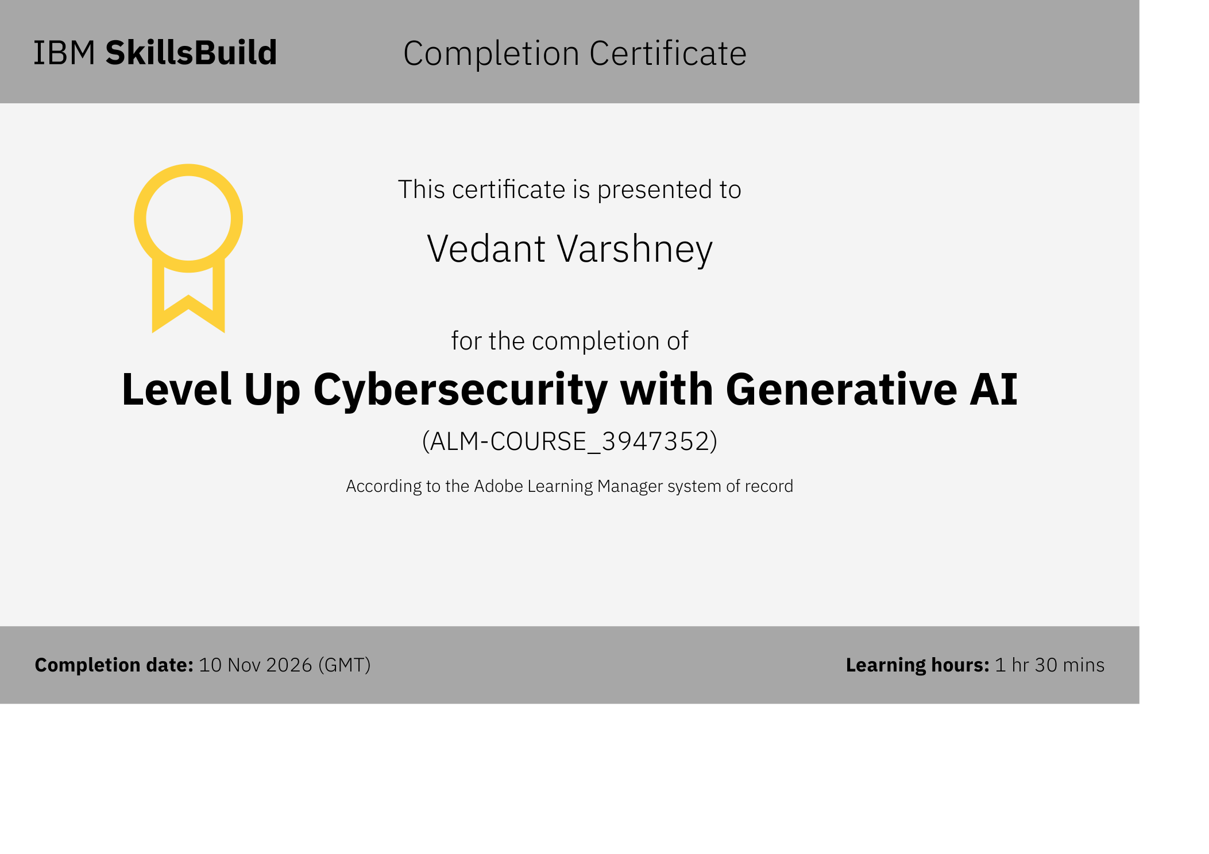
Certificates Earned:
IBM SkillsBuild Certificates – Vedant Varshney | All completed: 10 Nov 2026

Slide 15

Certificates Earned:
IBM Bob Certificate – Vedant Varshney | Lab: Troubleshoot Your Code Using IBM Bob | Completed: 19 Aug 2026

Slide 16


