Slide 1
Skin Cancer Detection using Deep Learning
PROJECT-1 (BCSE497J) REVIEW 2
Team:
21BRS1359 – Chavali Sai Sree Ram Yadav
21BRS1394 – Vedant Adka
Guide:
Dr. Balasundaram A

Slide 2
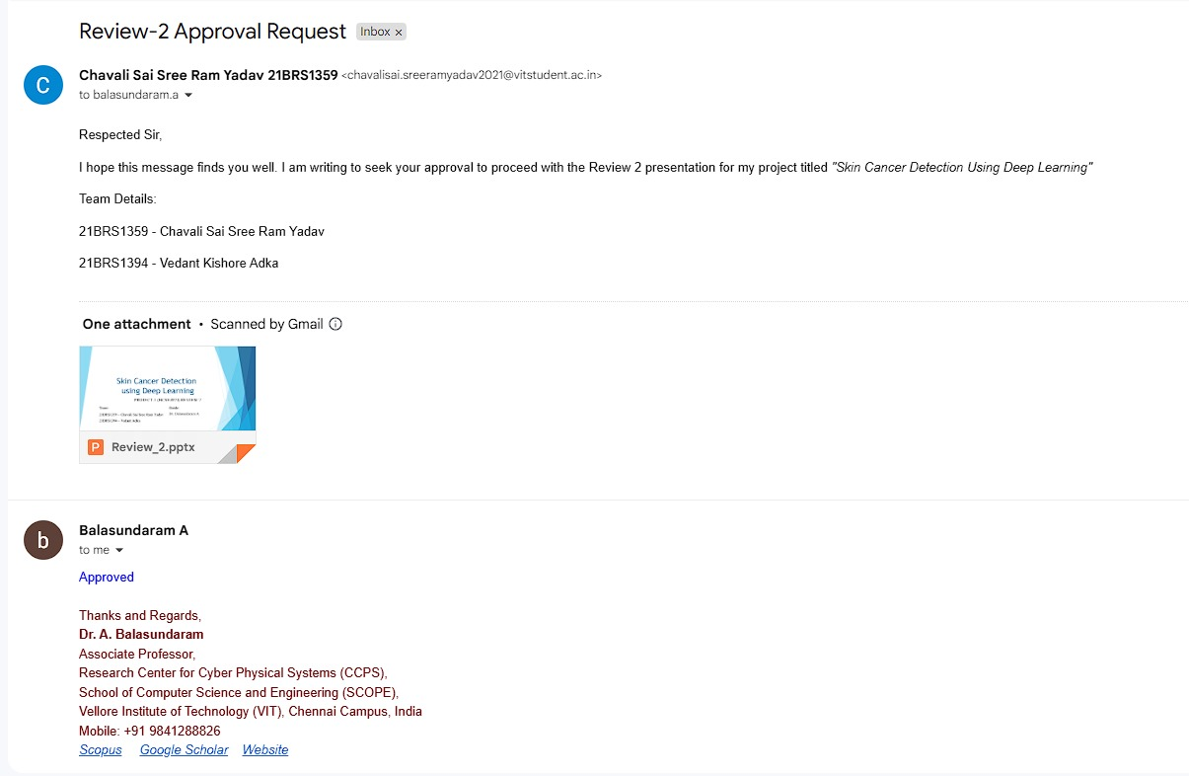
Guide Approval - VTOP

Slide 3
Introduction
Skin cancer, especially melanoma, is one of the fastest-growing cancer types globally.
Early detection is critical for improving survival rates.
Traditional methods (visual exams and biopsies) can be time-consuming, invasive, and less accessible in rural/underserved areas.
Delayed diagnosis can reduce treatment effectiveness and burden healthcare systems.
Deep learning and image processing advancements offer solutions for early, non-invasive detection through automated skin image analysis.
Challenges include ensuring diagnostic accuracy across diverse populations and integrating tools into existing healthcare systems.
Overcoming these issues can make skin cancer detection more accessible and improve early diagnosis and management globally.

Slide 4
Problem Statement
Skin cancer is the most common cancer worldwide, with melanoma being the deadliest due to its fast spread.
Early detection is critical for survival but relies on manual visual exams, which can be slow, costly, and prone to error.
Limited access to specialized healthcare in certain regions leads to variability in diagnosis accuracy.
The rise in skin cancer cases globally stresses healthcare systems, highlighting the need for scalable, efficient diagnostics.
This project aims to develop an automated deep learning model to classify skin lesions as benign or malignant.
The solution seeks to assist dermatologists by providing a reliable, fast, and cost-effective diagnostic tool, improving early detection and patient care.

Slide 5
Research Objective
This study aims to develop an automated deep learning framework for detecting and classifying skin lesions as benign or malignant, supporting early diagnosis and skin cancer prevention. Key objectives include:
Develop an automated deep learning framework to classify skin lesions as benign or malignant.
Enhance accuracy using transfer learning and image augmentation techniques.
Enable real-time detection for clinical and telemedicine applications.
Validate model performance across diverse demographics.
Lay groundwork for future advancements, including edge-device deployment and multi-condition detection.
This framework aims to improve early diagnosis, supporting healthcare providers in delivering timely and effective patient care.

Slide 6
Proposed System - Introduction
Goal: Develop an advanced deep learning-based model for early and accurate classification of skin lesions as benign or malignant.
Approach: Leverages Convolution Neural Network(CNN) architecture and Vision Transformer (ViT) architecture to enhance spatial understanding and precision in skin lesion classification, combined with modern image processing techniques.
Data Sources: Utilizes the HAM10000 dataset, a comprehensive collection of labeled skin lesion images with diverse cases, ensuring robust model performance across various lesion types.
Key Features:
Vision Transformer (ViT) Architecture and Convolution Neural Network(CNN) architecture : Employs ViT to capture complex spatial relationships within image patches, improving detection accuracy over traditional CNNs. Combining with CNN architecture to balance each of their flaws and boost the performance
Extensive Data Augmentation: Applies augmentation techniques (e.g., rotation, zooming, flipping) to enhance model generalization across different patient demographics and lesion variations.
Real-time Diagnostic Integration: Designed for seamless integration with telemedicine platforms, enabling real-time and accessible diagnostics.
User-Friendly Interface: Built to be accessible for both healthcare providers and patients, simplifying the diagnostic process and enhancing usability.
High Model Precision: Focuses on distinguishing intricate patterns in images to reliably classify lesions as benign or malignant, supporting early detection and better patient outcomes.

Slide 7
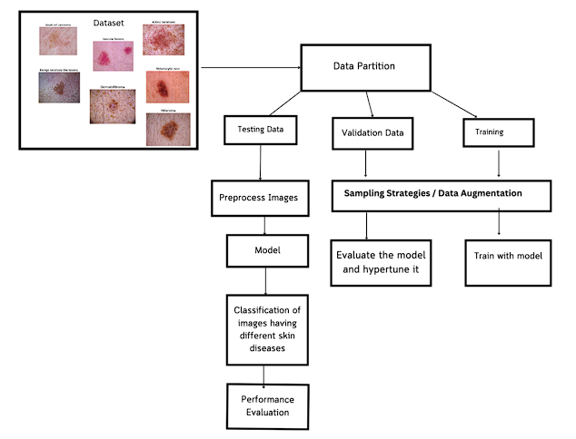
Proposed System - Architecture Diagram

Slide 8
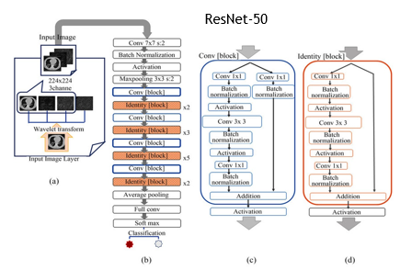
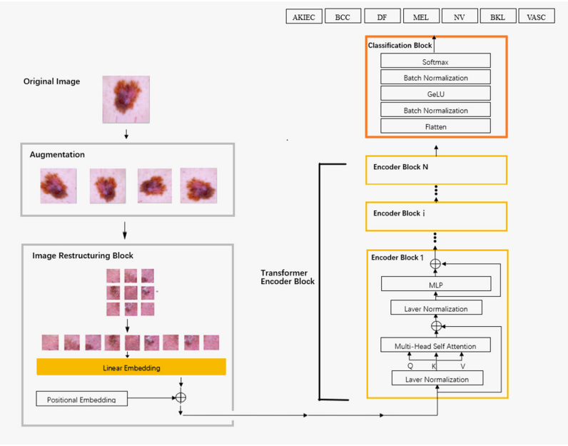
Model
Vit(Vision Transformer)
+

Slide 9
List of Modules in the Proposed System
Data Preprocessing and Augmentation
Model Design and Training (ResNet + ViT(Vision Transformer)
Evaluation Metrics Calculation
Prediction and Interpretation

Slide 10
Module 1: Data Preprocessing and Augmentation
Description: In this module, raw data from the HAM10000 dataset is preprocessed to enhance model performance.
Steps Involved:
Image Resizing and Normalization: Images are resized to match the input requirements of the Vision Transformer (ViT) model, usually 224x224 or can be 128 x 128 pixels. Normalization scales pixel values to a range suitable for model input.
Data Augmentation: Techniques such as rotation, flipping, and zooming are applied to increase dataset variability and reduce overfitting.
Tools/Algorithms: Use of libraries such as OpenCV, PIL, or data augmentation libraries in TensorFlow/PyTorch to perform these transformations.

Slide 11
Module 2: Model Design and Training
Description: : The system core leverages a hybrid ResNet50-ViT architecture, combining the ResNet50's feature extraction capabilities with the Vision Transformer's attention mechanisms for enhanced image data handling.
Key Components:
Patch Embeddings: The ResNet50 backbone processes the image and extracts feature maps, which are then divided into smaller patches (e.g., 16x16 pixels) and converted into embeddings.
Transformer Layers: Following ResNet50's feature extraction, transformer layers apply multi-head self-attention and feed-forward neural networks to the embedded patches, capturing complex relationships and global context across patches.
Classification Head: The final layer serves as a classifier, predicting specific skin lesion types based on the contextualized information provided by the transformer layers.
Algorithm: The ResNet50-ViT model combines the strengths of CNNs and transformers by using ResNet50 for initial feature extraction, followed by ViT’s attention mechanisms applied to the image patches. This approach effectively captures both local features and global dependencies, enhancing classification accuracy for skin lesions

Slide 12
Module 3: Evaluation Metrics Calculation
Description: The training process involves fitting the ViT model to the dataset by minimizing error between predictions and true labels.
Algorithm and Optimization Techniques:
Loss Function: Since this is a multi-class classification problem, cross-entropy loss is utilized to quantify the difference between the predicted probabilities and the true labels.
Optimizer: Optimizers such as AdamW (an improved variant of Adam suited for transformer models) or SGD with momentum can be applied, adjusting weights to minimize the loss effectively.
Learning Rate Scheduling: A learning rate scheduler (e.g., cosine decay or a warm-up strategy) may be used to modulate the learning rate dynamically across epochs, ensuring stable convergence.
Training Setup: Define parameters such as the number of epochs, batch size, and evaluation intervals. Techniques like early stopping and model checkpoints can be used to prevent overfitting and retain the best-performing model during training.

Slide 13
Module 4: Prediction and Interpretation
Description: After training, the model's performance is evaluated using various metrics to understand its accuracy and reliability.
Metrics Used:
Accuracy: Measures the percentage of correct predictions.
Precision, Recall, and F1-Score: Essential for assessing the model's ability to correctly classify different skin lesion types, particularly in imbalanced datasets.
Confusion Matrix: Displays the distribution of true vs. predicted labels, providing insight into any classification biases.
Algorithm for Metric Calculation: Use scikit-learn's metrics library to calculate these evaluation metrics and interpret the model’s strengths and areas for improvement.

Slide 14
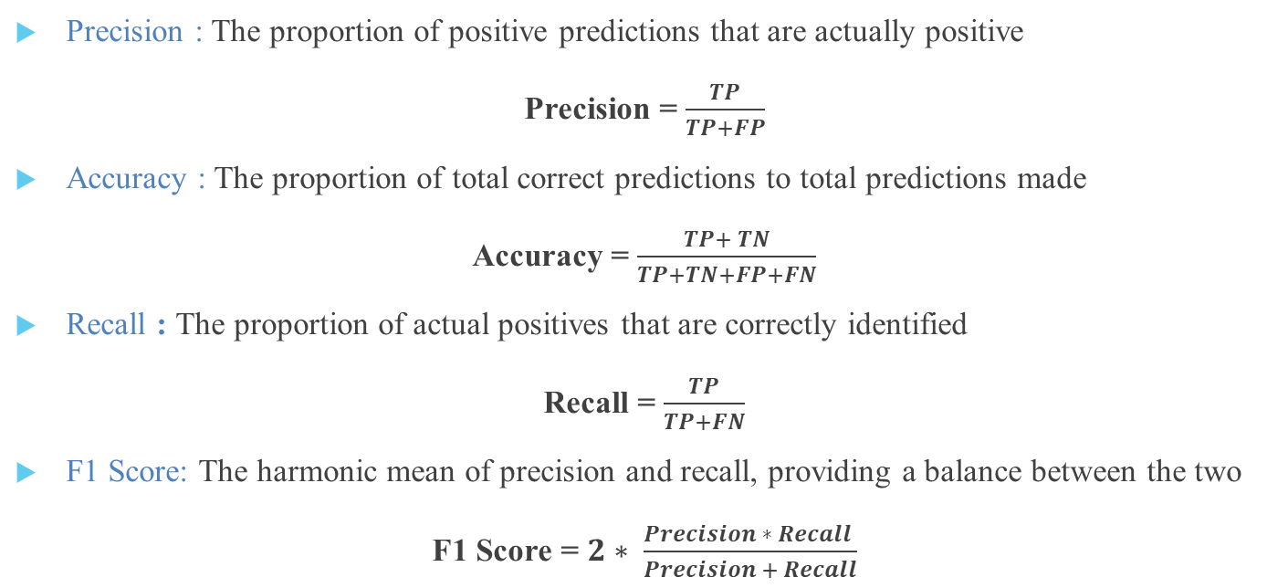
Equations
Precision : The proportion of positive predictions that are actually positive
Precision = $\frac{TP}{TP+FP}$
Accuracy : The proportion of total correct predictions to total predictions made
Accuracy = $\frac{TP+ TN}{TP+TN+FP+FN}$
Recall : The proportion of actual positives that are correctly identified
Recall = $\frac{TP}{TP+FN}$
F1 Score: The harmonic mean of precision and recall, providing a balance between the two
F1 Score = $2∗ \frac{Precision ∗ Recall }{Precision + Recall}$

Slide 15
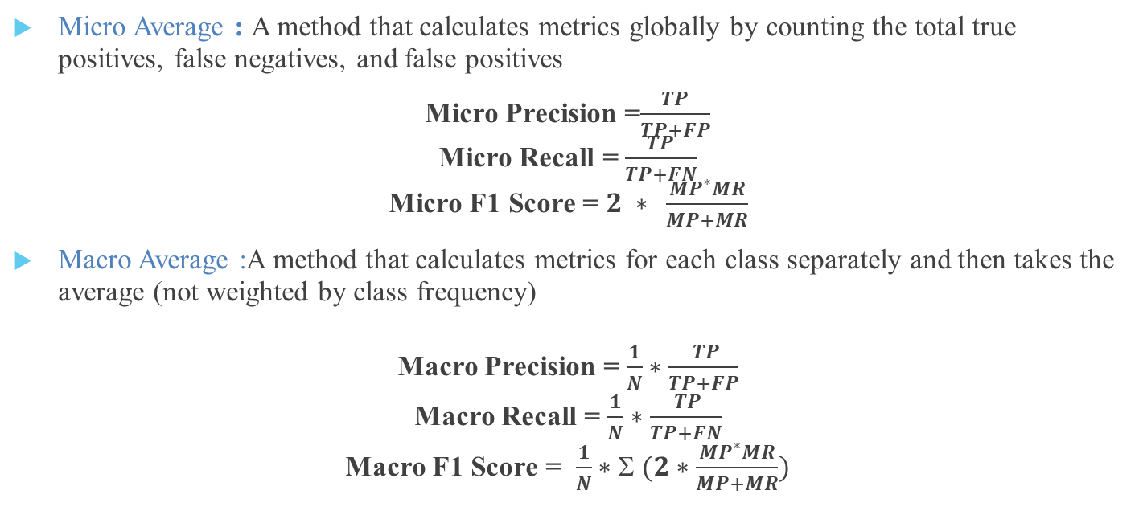
Equations
Micro Average : A method that calculates metrics globally by counting the total true positives, false negatives, and false positives
Micro Precision =$\frac{TP}{TP+FP}$ Micro Recall = $\frac{TP}{TP+FN}$ Micro F1 Score = $2 ∗ \frac{MP^{∗}MR}{MP+MR}$
Macro Average :A method that calculates metrics for each class separately and then takes the average (not weighted by class frequency)
Macro Precision = $\frac{1}{N}∗\frac{ TP}{TP+FP}$ Macro Recall = $\frac{1}{N}∗\frac{ TP}{TP+FN}$ Macro F1 Score = $\frac{1}{N}∗Σ (2∗\frac{MP^{∗}MR}{MP+MR})$

Slide 16
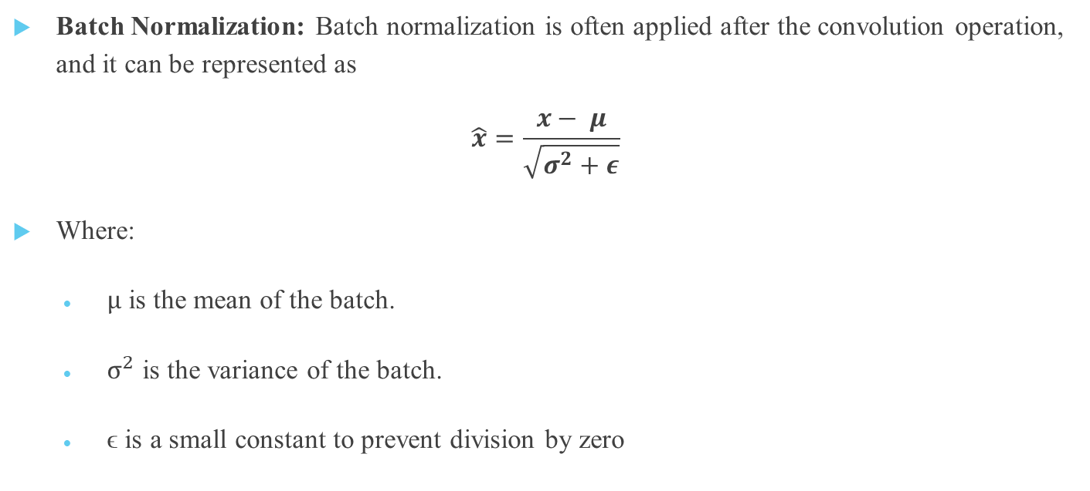
Equations
Batch Normalization: Batch normalization is often applied after the convolution operation, and it can be represented as
$$\hat{x}=\frac{x− μ}{\sqrt{σ^{2}+ε}}$$
Where:
$μ$ is the mean of the batch.
$σ^{2}$ is the variance of the batch.
ϵ is a small constant to prevent division by zero

Slide 17
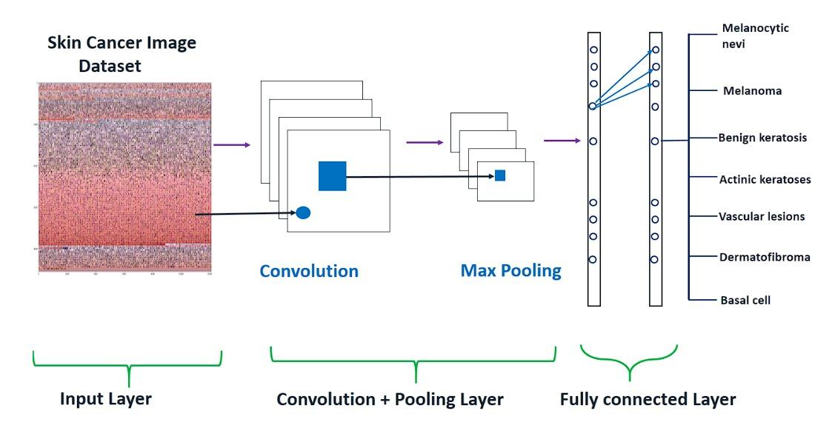
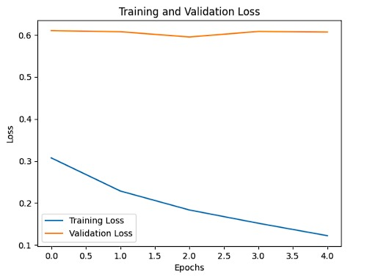
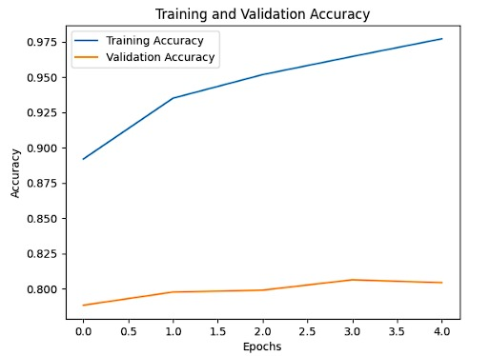
Results & Findings
Pretrained ResNet-50
Training and Validation Results

Slide 18
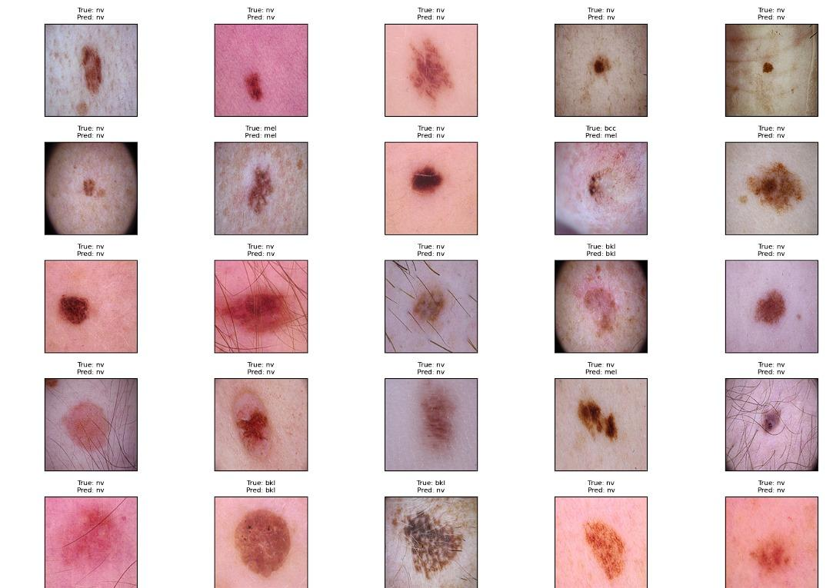
Results & Findings
Results of pretrained ResNet-50

Slide 19
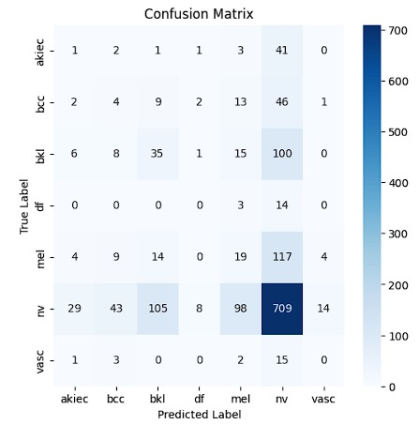
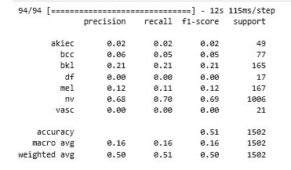
Results & Findings
Confusion matrix of pretrained ResNet-50
Classification Report of pretrained ResNet-50

Slide 20
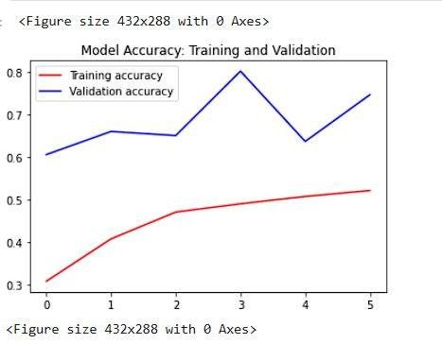
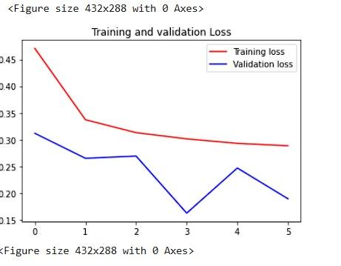
Results & Findings
Training and Validation results of ViT B -32

Slide 21
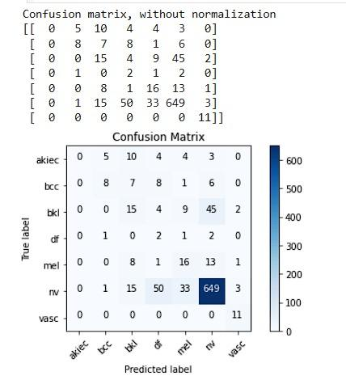
Results & Findings
Confusion matrix of ViT B -32

Slide 22
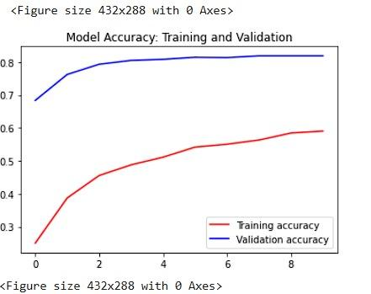
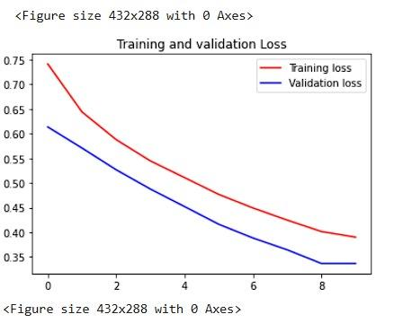
Results & Findings
Training and Validation results of ViT B -16

Slide 23
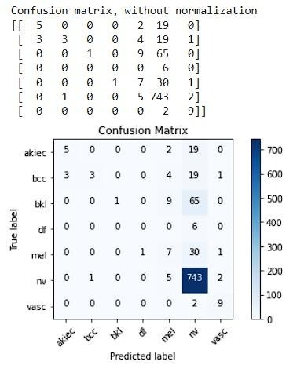
Results & Findings
Confusion Matrix of ViT B -16

Slide 24
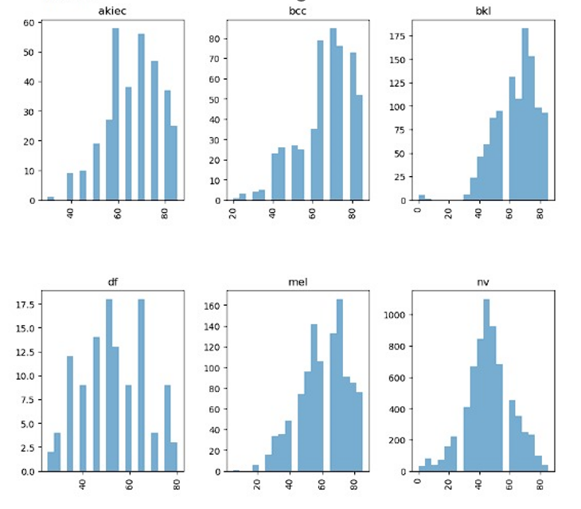
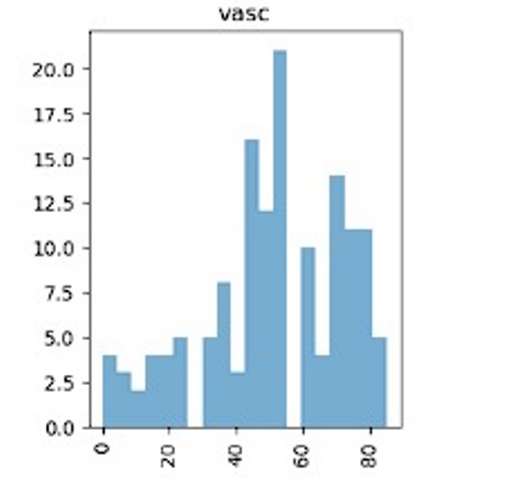
DISTRIBUTION OF CLASSES BY AGE

Slide 25
Interpretation and Discussion
In this project, we propose a novel model architecture that merges ResNet and Vision Transformers to leverage the complementary strengths of convolutional neural networks (CNNs) and transformers. ResNet, known for its effective feature extraction through deep layers and residual connections, allows the model to capture intricate local patterns in skin lesion images. This is essential for distinguishing subtle variations between benign and malignant lesions. Vision Transformers, in contrast, capture global context and relationships across the entire image, offering a broader understanding that enhances classification.
Why Use ResNet?
ResNet was selected over other CNN architectures because of its proven depth and efficiency in extracting complex, hierarchical features, particularly in medical imaging. The residual connections in ResNet help prevent issues like vanishing gradients, enabling stable training even in deep networks. For skin lesion analysis, ResNet is highly effective at identifying the fine-grained, localized details within images, such as texture and boundary nuances, that are critical for distinguishing cancerous lesions. Its architecture is also well-suited for handling high-resolution medical images, where fine details directly influence classification outcomes.

Slide 26
Interpretation and Discussion
Why Use Vision Transformers?
Vision Transformers (ViTs) bring an additional advantage by capturing long-range dependencies and spatial hierarchies through their self-attention mechanism. In skin lesion classification, understanding the global structure and spatial relationships—such as color, texture, and shape across different regions—is crucial for accuracy. ViTs dynamically weigh these areas, identifying subtle yet significant patterns that CNNs alone may overlook. This makes ViTs especially valuable for complex medical imaging, where subtle distinctions are key. By integrating ViTs with ResNet, the model benefits from both precise local feature extraction and a comprehensive global perspective, creating a robust classifier for skin cancer detection.
Accuracy Improvement and Limitations
The combination of ResNet’s proficiency in capturing local texture details with the Vision Transformer’s global modeling capabilities enhances the accuracy of skin cancer classification. This integration results in a richer feature representation than either model alone, improving robustness and performance, especially on diverse datasets. However, the hybrid approach has limitations, including high computational demands and increased training time, as both architectures are resource-intensive. Balancing these requirements while maintaining efficiency is an important consideration for practical deployment..

Slide 27
Interpretation and Discussion
Data Imbalance and Mitigation Techniques
A common limitation in medical imaging datasets, including skin lesion data, is class imbalance, where benign lesions may far outnumber malignant ones. This imbalance can lead the model to be biased toward the majority class, reducing classification accuracy for minority classes. To address this, we will implement several techniques, including:
Class Weighting: Adjusting class weights during training to give more emphasis to underrepresented classes.
Oversampling and Undersampling: Increasing the representation of minority class samples through duplication or reducing majority class samples to create a more balanced dataset.
Synthetic Data Generation: Using techniques like SMOTE (Synthetic Minority Over-sampling Technique) or GANs (Generative Adversarial Networks) to create synthetic samples for the minority class, enhancing the model’s exposure to diverse examples. These approaches aim to create a balanced representation in the training process, leading to a more fair and accurate model.
By combining ResNet’s effective local feature extraction with Vision Transformers’ global perspective, this approach truly represents "the best of both worlds," enabling both localized and broad feature analysis within a unified model.

Slide 28
Interpretation and Discussion
Future Direction
Future work could focus on optimizing this hybrid architecture to reduce computational overhead, making it more suitable for real-time clinical applications. Additionally, exploring advanced attention mechanisms and dynamic augmentation strategies may enhance the model’s interpretability and adaptability further. Extending this model to other areas of medical imaging could broaden its impact, providing benefits across different diagnostic domains beyond skin cancer.

Slide 29
What is to be done next / remaining
To enhance accuracy and tackle class imbalance in skin cancer detection, the following strategies are recommended:
Advanced Data Augmentation: Add Gaussian noise, CutMix, and MixUp to create more diverse training samples. Use class-balanced sampling to ensure equal representation of benign and malignant lesions in each batch.
Enhanced Sampling Techniques: Implement SMOTE for structured data, and use Focal Loss to focus on hard-to-classify examples, improving sensitivity to minority classes.
Model Optimization: Fine-tune ResNet and Vision Transformer layers, add attention mechanisms, and conduct hyperparameter tuning. Testing performance with the new augmentation and sampling strategies will reveal their impact on model robustness.
Future Directions: Test the model in real-time clinical settings, explore multimodal approaches by integrating patient data, and compress the model for efficient deployment on mobile devices.

Slide 30
Research Paper Status
The Introduction, Abstract, Literature survey, Methodology, and References completed.
Results and Conclusion pending.

Slide 31
References
Imran, A., Nasir, A., Bilal, M., Sun, G., & Alzahrani, A. J. (2022). Skin Cancer Detection Using Combined Decision Fusion Strategies with Pretrained Deep Models. IEEE Access.
Ashraf, R., et al. (2020). Region-of-Interest Based Transfer Learning Assisted Framework for Skin Cancer Detection. IEEE Access.
Gururaj, H. L., Manju, N., Nagarjun, A., Muthukuru, V. N., & Kote, S. P. (2023). DeepSkin: A Deep Learning Approach for Skin Cancer Classification Using HAM10000 Dataset. IEEE Systems, Man, and Cybernetics Society.
Hosny, K. M., Elshoura, D., Mohamed, E. R., & Vrtanoski, G. (2023). Deep Learning and Optimization-Based Methods for Skin Cancer Detection..
Mridha, K., Uddin, M. M., Shin, J., & Khadka, S. (2023). An Interpretable Skin Cancer Classification Using Optimized Convolutional Neural Networks
Riaz, L., et al. (2023). A Comprehensive Joint Learning System to Detect and Classify Skin Cancer Using Dermoscopy Images.
Nie, Y., Sommella, P., Carratù, M., Ferro, M., & Inverso, A. (2023). Recent Advances in Diagnosis of Skin Lesions Using Deep Learning.
Magdy, A., Hussein, H., Abdel-Kader, R. F., & Elkilani, K. (2023). Performance Enhancement of Skin Cancer Classification Models Using Transfer Learning and Data Augmentation. Hindawi.
Wei, L., Ding, K., & Hu, H. (2022). Automatic Skin Cancer Detection in Dermoscopy Images Using Lightweight CNN and Ensemble Learning.
Qian, X., et al. (2023). SPCB-Net: A Multi-Scale Skin Cancer Image Identification Model Based on CNN.

Slide 32
References
Faizi, M. I., & Adnan, S. M. (2024). Improved Segmentation Model for Melanoma Lesion Detection in Dermoscopy Images Using Dynamic Segmentation
Gong, A., Yao, X., & Lin, W. (2020). Dermoscopy Image Classification Based on Style-Transfer Pre-Trained Model and Deep Convolutional Neural Network.
Gong, A., Yao, X., & Lin, W. (2020). Classification for Dermoscopy Images Using Convolutional Neural Networks with Decision Fusion Mechanism..
Ichim, L., & Popescu, D. (2020). Melanoma Detection Using an Objective System Based on Neural Networks
Gong, A., Yao, X., & Lin, W. (2020). Classification for Dermoscopy Images Using Convolutional Neural Networks with Decision Fusion Mechanism.
Pereira, P. M. M., et al. (2022). Multiple Instance Learning Using 3D Features for Skin Lesion Classification
Albahar, M. A. (2022). Skin Lesion Classification Using Convolutional Neural Network and Attention Mechanism.
Sathvika, V. S. S. B. T., et al. (2024). Pipelined Structure in the Classification of Skin Lesions for Early Melanoma Detection
Öztürk, Ş., & Çukur, T. (2022). Deep Clustering via Center-Oriented Margin-Free Triplet Loss for Skin Lesion Classification.pdf
Lan, Z., Cai, S., He, X., & Wen, X. (2022). FixCaps: An Improved Capsule Network for Diagnosis of Skin Cancer Using Dermoscopic Images.

Slide 33

Thank You

