Slide 1
E-Commerce Fulfillment & Delivery Performance
Data-Driven Analysis of Delivery Delays, Risk & Operational Performance
Tools: SQL | Python | Power BI

Slide 2
Business Problem & Objectives
Business Problem: Delivery delays reduce customer satisfaction and operational efficiency.
01 | Measure
Delivery performance & delay rate
Objectives
02 | Identify
High-risk states & categories
03 | Analyze
Trends & delivery patterns
04 | Recommend
Data-driven operational actions

Slide 3
Data & Methodology
DATASET → 99,441 Orders
ANALYSIS FLOW :
SQL → Python (EDA) → Power BI
DATA USED :
Orders | Customers | Products | Sellers | Order Items
OUTPUT : Actionable delivery insights

Slide 4
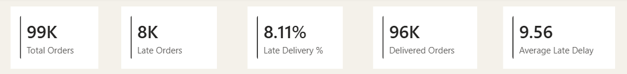
Executive Summary
Note:
8.11% of delivered orders missed the estimated delivery date, with late orders averaging 9.56 days of delay.

Slide 5
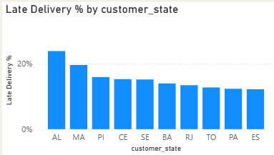
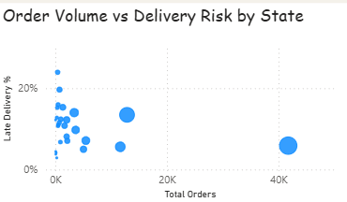
Geographic Delivery Risk
AL
RJ
Sao Paulo
Alagoas (AL): 23.93% late delivery rate
Rio de Janeiro (RJ): 1,663 late orders
São Paulo → Rio de Janeiro: 15.43% late across 8,188 orders

Slide 6
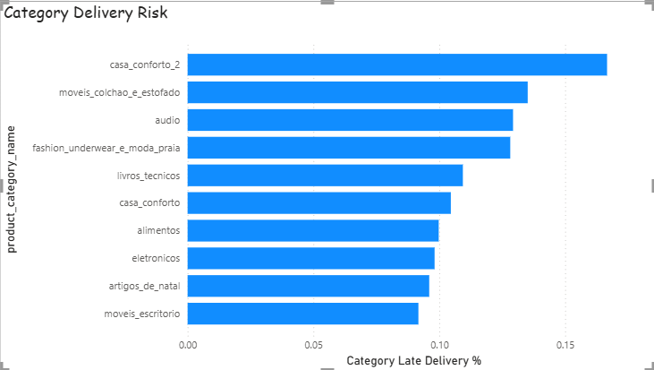
Product & Category Risk
Key observations:
Category-level delay rates vary significantly
Audio and Fashion/Underwear were among the higher-risk categories
Product weight, volume, price and freight cost showed no clear relationship with delivery delays
Category differences exist, but basic product characteristics do not clearly explain delivery delays.

Slide 7
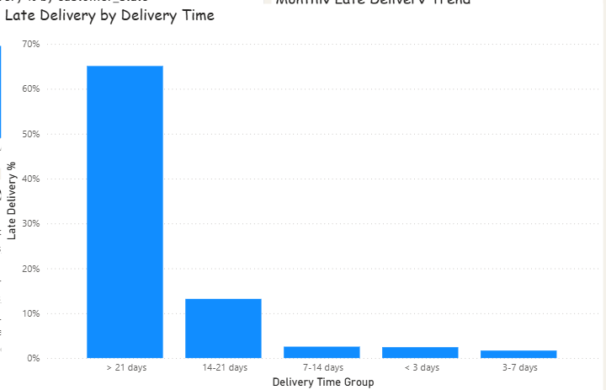
Delivery Duration & Delay Risk
Key Observations :
<3 days: Very low late-delivery rate
7–14 days: Risk begins to increase
14–21 days: Significant increase
>21 days: ~65% late deliveries
Note :
Long delivery cycles are strongly associated with late delivery.

Slide 8
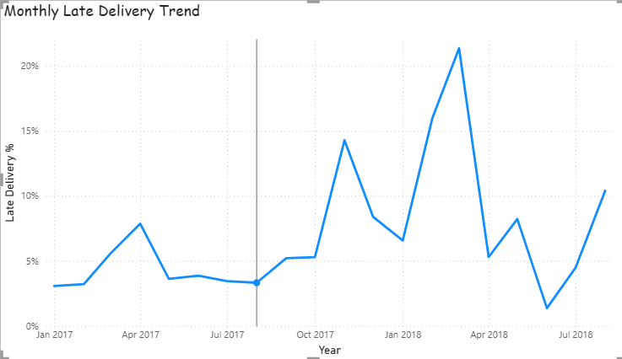
Time-Based Delivery Trends
Key Observations:
Late-delivery rates show strong month-to-month variation
A major spike occurred in early 2018
No consistent seasonal pattern was established
Note :
Delivery performance fluctuates over time, but the data does not indicate a stable seasonal pattern.

Slide 9
Key Findings
01 | Geographic
Delay risk is concentrated in specific states and routes.
02 | Product
Category risk varies, but product characteristics show no clear impact.
03 | Delivery Duration
Longer delivery cycles have sharply higher late-delivery risk.
04 | Time
Delivery performance fluctuates, with no consistent seasonal pattern.
PS: Geography and Delivery Duration emerge as the strongest areas for operational focus.

Slide 10
Business Recommendations
01 | Prioritize High-Risk Routes: Focus logistics reviews on consistently high-delay routes, especially SP → RJ and other high-volume risk corridors.
02 | Monitor Long Delivery Cycles: Flag orders approaching 14+ days for proactive intervention before they become late.
03 | Target High-Risk Regions: Allocate additional logistics attention to states with persistently high late-delivery rates, rather than focusing only on total order volume.
04 | Track Category Performance: Set category-level delivery benchmarks and investigate categories with consistently elevated delay rates.
05 | Build Continuous Monitoring: Use the Power BI dashboard to track late rate, delay duration, state risk and order volume over time.

