Slide 1

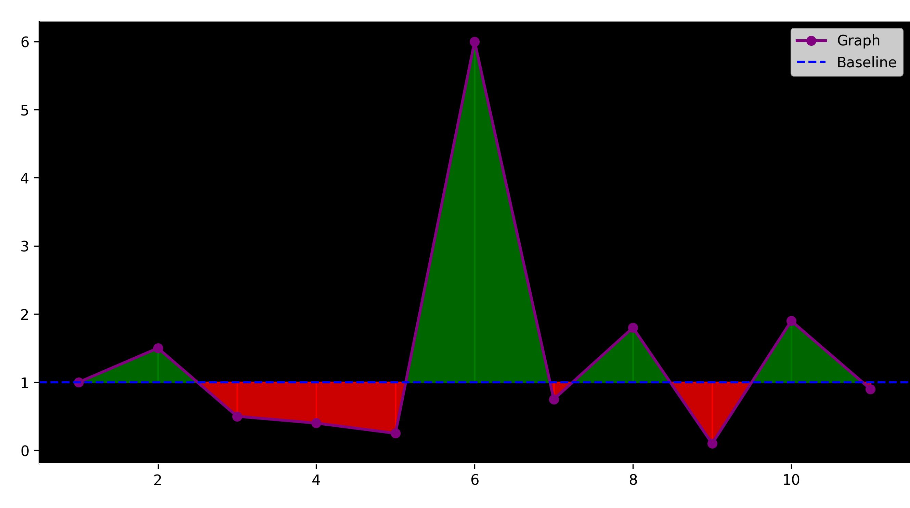












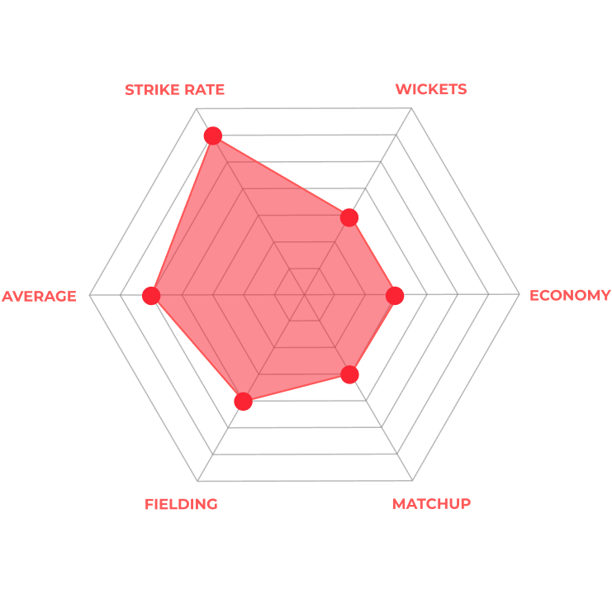
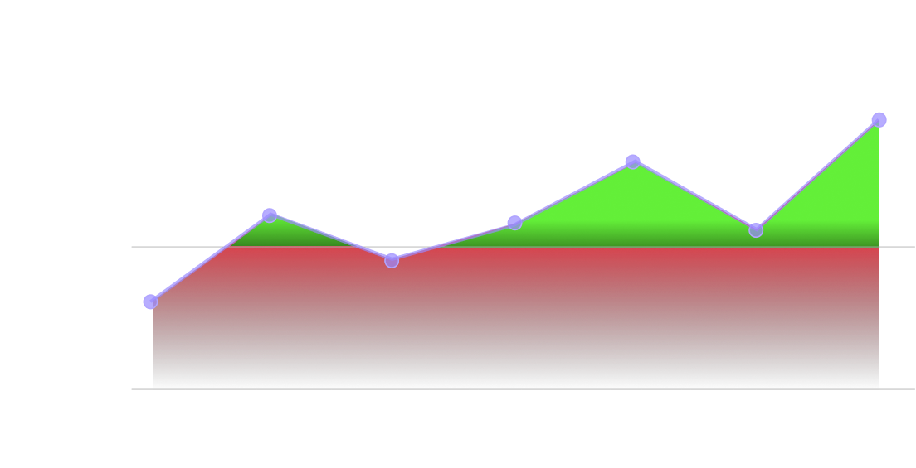
Bob
Cartoon Network
Opposition Performance Index vs Number of Matches
32
EXPT PTS
15
COST
77
EXPT RUNS
8
EXPT 4s & 6s
AGAINST OPPOSITION
PLAYER PROFILE
244
MATCHES
3489
INNINGS
EXPECTED
RUNS
77
ECONOMY
57
324089
RUNS
78
AVERAGE
STRIKE RATE
8
CATCHES
23
23
STRIKE RATE
55
HIGHEST SCORE
BOUNDARIES
8
RUN OUTS
3
WICKETS
1
FORM
92
134/45
4s/6s
133/44
50/100

