Slide 1


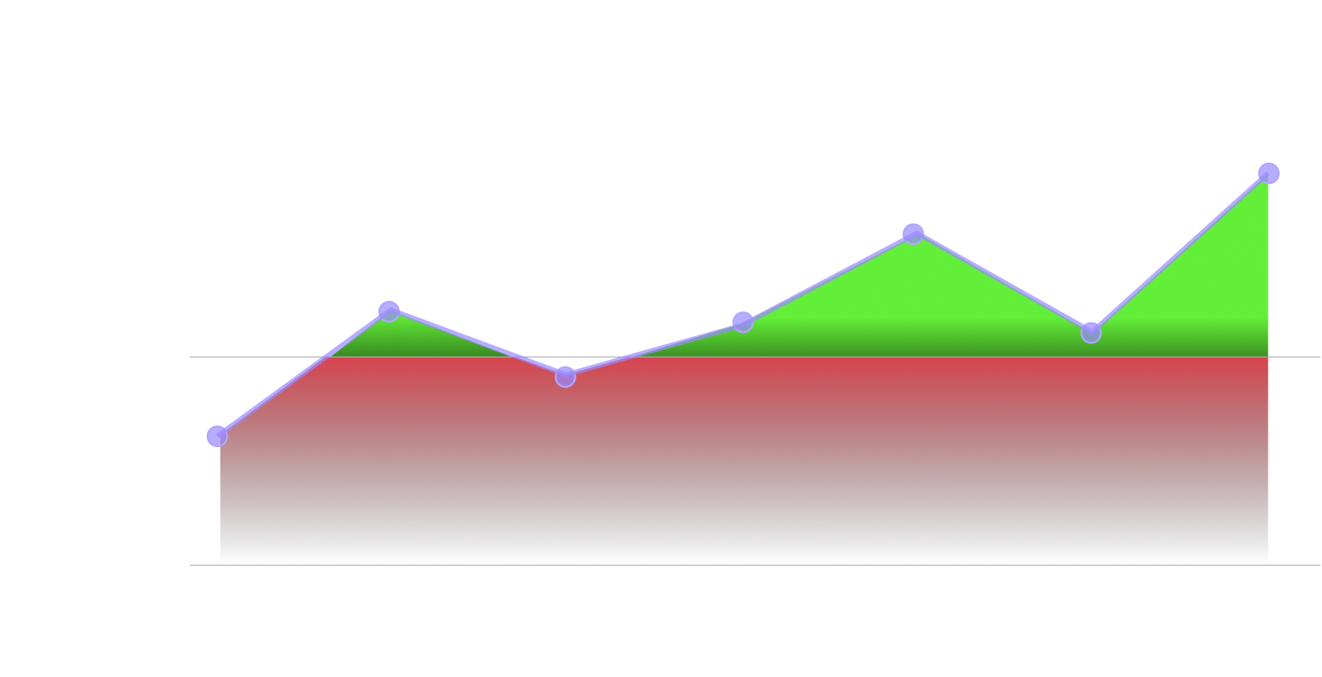

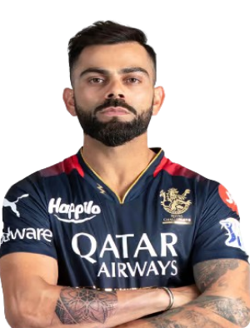





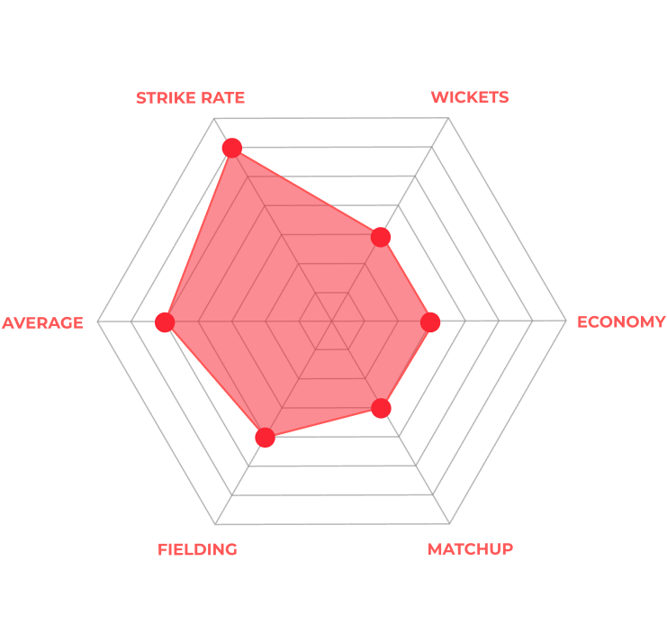



VIRAT KOHLI
ROYAL CHALLENGERS BENGALURU
Venue Performance Index vs Number of Matches
87
EXPT PTS
11
COST
99
EXPT RUNS
7-
EXPT 4s & 6s
IN VENUE
PLAYER PROFILE
244
MATCHES
181
INNINGS
EXPECTED
RUNS
49
ECONOMY
12
42
RUNS
53
AVERAGE
STRIKE RATE
220
CATCHES
13-
154
STRIKE RATE
102
HIGHEST SCORE
BOUNDARIES
15-
RUN OUTS
1-
WICKETS
2-
FORM
92
44/76
4s/6s
21/25
50/100

