Slide 1
Problem and our answer
Every vendor logs differently; parsers break silently when firmware changes
The problem
Firewalls, routers, IDS, VPN and servers emit Syslog, CEF, LEEF, JSON, XML, CSV and proprietary text. Parsers are hand-written, fields get lost, nobody can prove what was kept, and a vendor's format change breaks parsing silently.
812,155
events stored, every one proven lossless
CausalOps ULPF
Ingests any format, keeps every raw byte in a hash-chained vault, normalizes to OCSF 1.3, and proves for each event that the normalized record still contains the whole original.
14 packs · 15 sources
12 vendors; unknown formats onboarded in Parser Studio
And it looks after itself
The CausalOps engine learns each source's normal quality and detects format drift, silence, clock skew and crashed workers, repairs them through a verified, reversible policy, and re-normalizes the affected history.
2,684 events/s
per worker, measured; workers scale out
CausalOps ULPF · SIH 2026 · PS 26156 · numbers measured on the running system

Slide 2
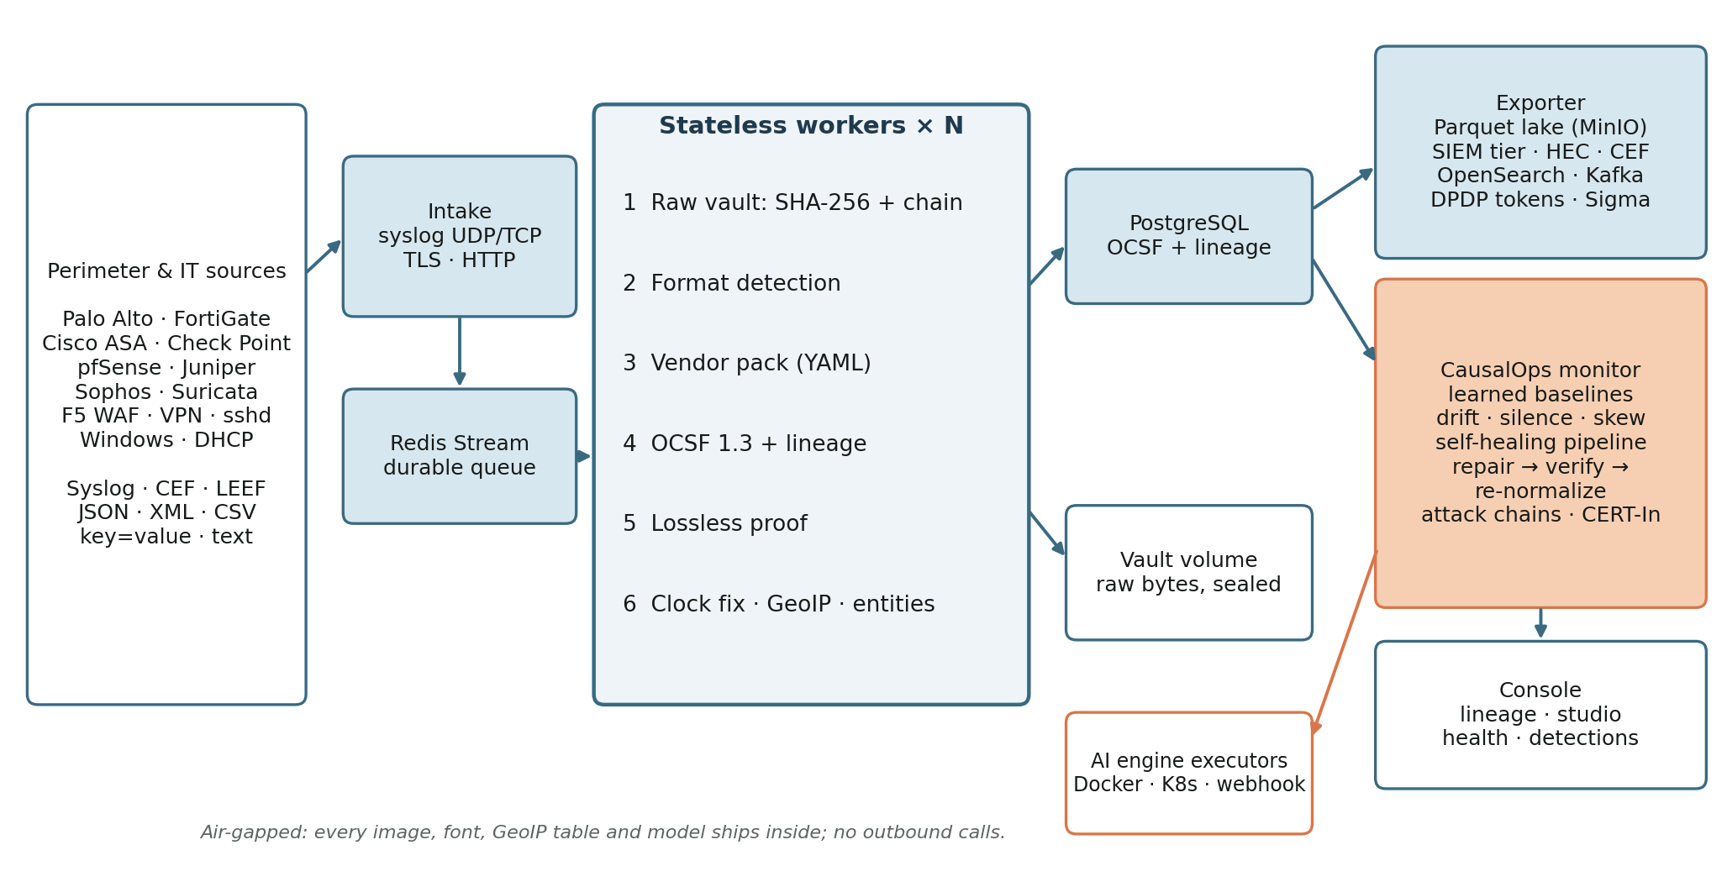
Architecture
Stateless, horizontally scalable, air-gapped; lossless by construction
CausalOps ULPF · SIH 2026 · PS 26156 · numbers measured on the running system

Slide 3
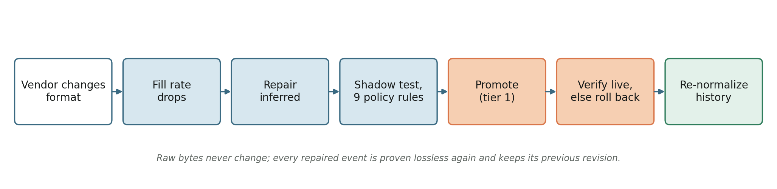
Differentiator: a pipeline that repairs itself
Detect → infer → shadow-test → promote → verify → re-normalize
30 s
median time to detect a vendor format change
122 s
median time to repaired, verified and re-normalized
9 rules
kill switch · dry run · tier · fixes drift · no regression · lossless · evidence · cooldown · reversible
100%
re-normalized events proven lossless again
Same loop for silent sources, clock skew and crashed workers
CausalOps ULPF · SIH 2026 · PS 26156 · numbers measured on the running system

Slide 4
Twelve differentiators
What the SOC gets beyond normalization
1 Parser drift
detected from learned fill rate, repaired automatically
2 Provable losslessness
rebuild from OCSF = vault SHA-256
3 Silent sources
Poisson test on each source's learned rate
4 Self-healing pipeline
crashed workers restarted, zero loss
5 Re-normalization
fix the past from the vault, keep revisions
6 CERT-In 2022
retention, NTP, sources, integrity, evidence
7 Clock skew
per-source offset estimated and corrected
8 SIEM cost tiering
59.1% less volume, lake pointers
9 DPDP privacy
format-preserving tokens, audited reveal
10 Sigma on OCSF
one rule fires across every vendor
11 Entity graph + attack chains
scan → brute force → login, one incident
12 Signed bundles
Ed25519, data diode, tamper-evident
CausalOps ULPF · SIH 2026 · PS 26156 · numbers measured on the running system

Slide 5
Results and deployment
One command, Docker Hub images, offline archive for isolated networks
100.0%
of stored events fully normalized
59.1%
smaller SIEM ingest, nothing dropped
5/6
CERT-In checks passing (measured)
a – k
every PS 26156 requirement met
Run
bash scripts/demo/start.sh
console: http://localhost:3000
Air-gapped
export_offline.sh on a connected machine,
load_offline.sh inside the isolated network
Scale
docker compose up -d --scale ulpf-worker=N
Kafka and OpenSearch: --profile full
Verify
python3 scripts/dev/verify_ulpf.py
every claim, end to end, on the live stack
CausalOps ULPF · SIH 2026 · PS 26156 · numbers measured on the running system

