Slide 1

PBL MIDTERM EVALUATION
AI&DS-A : SEMESTER V · GUIDE: MS. SWATI MUDE
CAUSALOPS
TEAM MEMBERS
14-Vedant Bist
35-Aayush Gupta
54-Mayank Jaiswal
Notes:
CausalOps: a causal AIOps platform that detects incidents in microservice systems, names the root cause, simulates the fix and applies it safely. Team: Vedant Bist (14), Aayush Gupta (35), Mayank Jaiswal (54). Guide: Ms. Swati Mude.

Slide 2
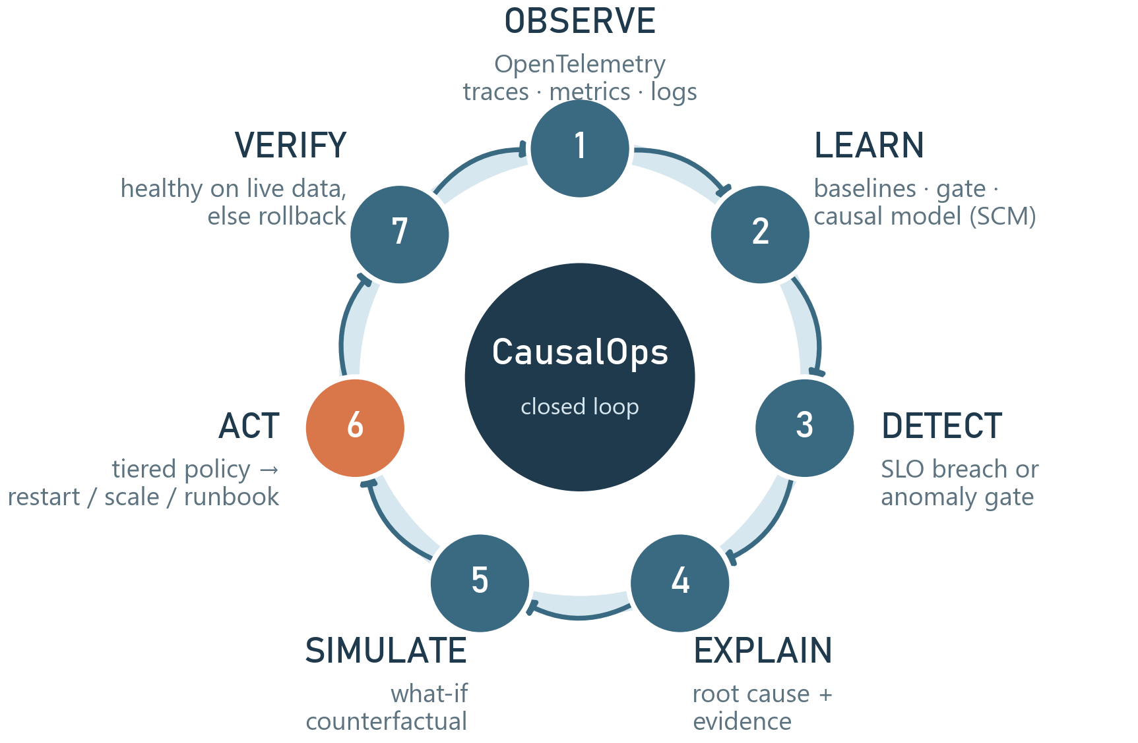
INTRODUCTION
WHAT?
An AI platform that detects microservice incidents, names the root cause and fixes it safely.
WHY?
One failure → alarms on many services
Finding the cause is most of the outage
Unexplained automation isn't trusted
HOW?
Telemetry → causal model → what-if → policy-checked fix → verified
SOCIAL RELEVANCE
Reliable payment, hospital and e-governance systems · fewer night-time pages and less burnout · SRE-grade reliability for start-ups and colleges, open source and self-hosted
Notes:
2W1H. What: detect, explain, fix. Why: alarms spread along call paths; the hunt for the cause is most of the outage; automation is distrusted. How: the closed loop on the right — observe, learn, detect, explain, simulate, act, verify.

Slide 3
OBJECTIVES
WHEN?
Continuously — every 5 s on live telemetry. Semester V (Jul–Dec 2026): Phases 1–5 done, 6–7 next.
WHERE?
Any Docker / Kubernetes system that exports OpenTelemetry. Built and tested at TCET on a 5-service reference shop.
WHO?
SRE, DevOps and on-call engineers · developers · IT-ops of banks, hospitals, e-gov · start-ups without an SRE team.
ENVIRONMENTAL RELEVANCE
Shorter incidents → fewer failed and retried requests → less wasted compute. Fixes one component instead of over-provisioning everything; one small machine, no GPU.
COST RELEVANCE · 3-MONTH PILOT
Item | ₹ (estimate)
Open-source software | 0
Team laptops | 0
Cloud VM 4 vCPU / 8 GB | 7,500–12,000
Domain + TLS | 0–1,000
Contingency 15% | 1,100–2,000
Total | 8,600–15,000
Estimates for an Indian-region VM; confirm before the pilot. Payback: every minute of downtime avoided.
Notes:
3W model with environmental and cost relevance. All software is open source; the only cost is a small cloud VM for a pilot.

Slide 4
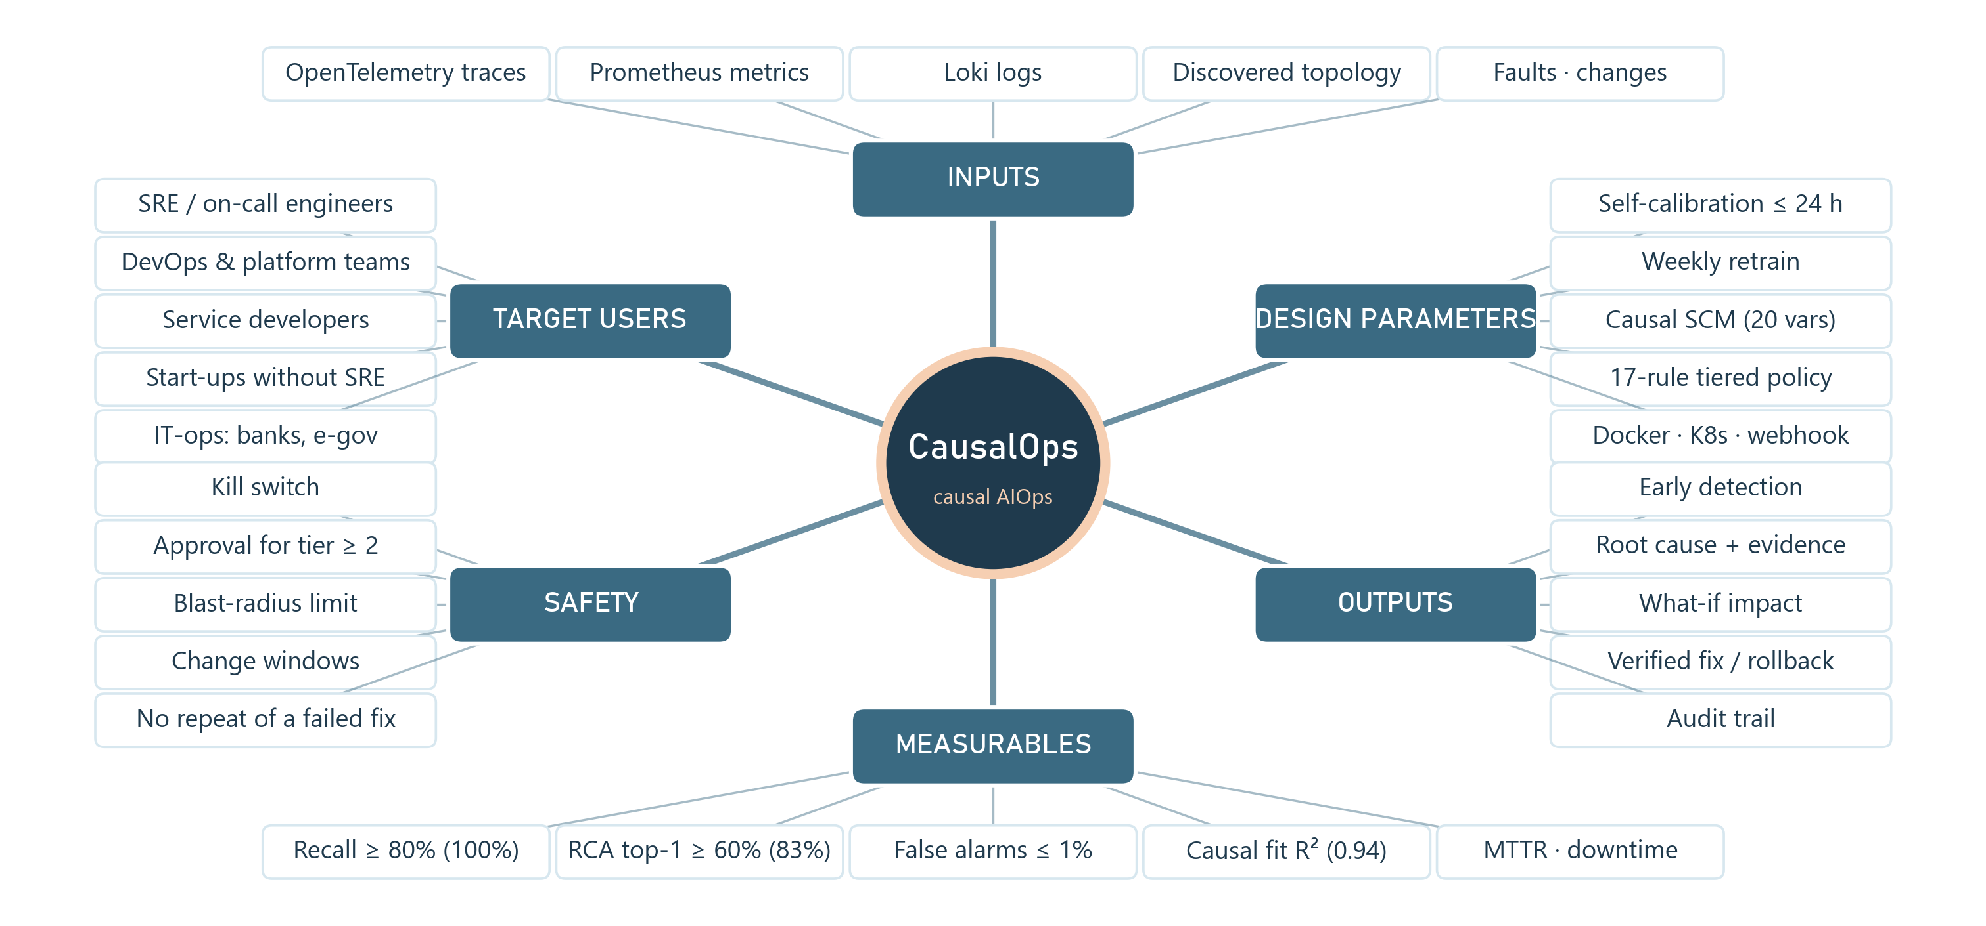
MIND MAP
Notes:
Target users, inputs, design parameters, outputs, measurables and safety, each linked to something we measure (e.g. calibrated gate → early detection → recall ≥ 80%, achieved 100%). The Miro version mirrors this map.

Slide 5
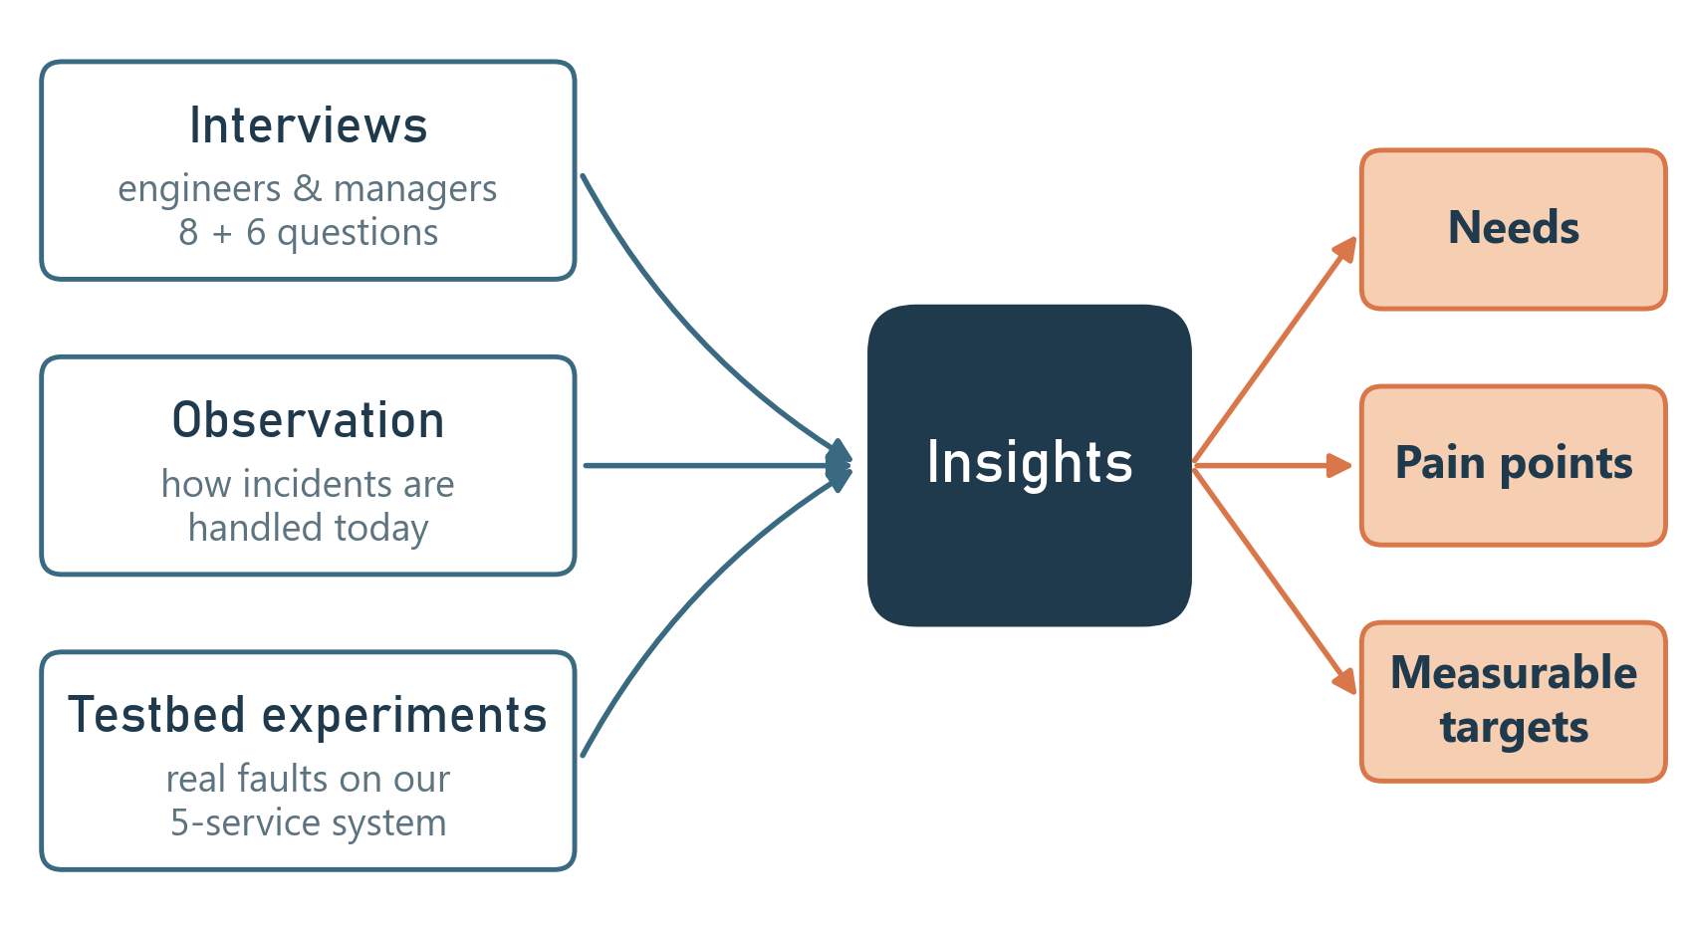
PRIMARY RESEARCH
TARGET USERS
SRE / on-call engineers
DevOps & platform teams
Service developers
IT-operations managers
Start-ups without an SRE team
AGE GROUP
21–55 years (mostly 22–45)
PROFESSION
Engineers and managers who run production software
GENDER
All genders
[Add: number of people interviewed and organisations]
Notes:
End users and how we researched them: interviews, observation of today's incident handling, and experiments with real faults on our testbed. Replace the bracket with your real interview counts.

Slide 6
INTERVIEW QUESTIONS
ENGINEERS
1. How do you learn something is wrong in production?
2. When many services alert, how do you find the cause? How long?
3. Which tools do you open, in what order?
4. What do you do first to recover?
5. Would you let a tool restart a service? When?
6. What must you see before trusting an automatic fix?
7. Do you measure detection time and MTTR?
8. How many night-time pages per month?
MANAGERS
1. What does an hour of downtime cost?
2. Who may change production during an incident?
3. What audit records do you need for changes?
4. Would you adopt a self-hosted open-source tool?
5. What would make you approve auto-remediation?
6. How do you report reliability to leadership?
Notes:
Semi-structured interviews: eight questions for engineers, six for managers (report Tables 5 and 6).

Slide 7
SECONDARY RESEARCH
LITERATURE SURVEY
Source | Key idea | Use in CausalOps
Google SRE book (2016) | SLOs, MTTR; automate toil | SLO detection · MTTR metric
Pearl, Causality (2009) | Interventions & counterfactuals | Causal model + what-if
MicroRCA (NOMS 2020) | Graph ranking of faulty services | PageRank signal in RCA
CIRCA (KDD 2022) · Ikram (NeurIPS 2022) | Causal RCA beats correlation | Residual + causal ranking
Soldani & Brogi (ACM CSUR 2022) | RCA methods rarely act | Gap: close the loop safely
OpenTelemetry (CNCF) | Vendor-neutral telemetry | Works on any system
RESEARCH GAP
Research ranks root causes but never acts; automation acts without knowing the cause or checking the result.
OUR APPROACH Detect → Explain → Simulate → Remediate safely → Verify
Notes:
Literature survey: SRE practice, causal inference, microservice RCA (MicroRCA, CIRCA, Ikram et al.), surveys and OpenTelemetry. The gap: nobody closes the loop from cause to a verified, reversible fix.

Slide 8
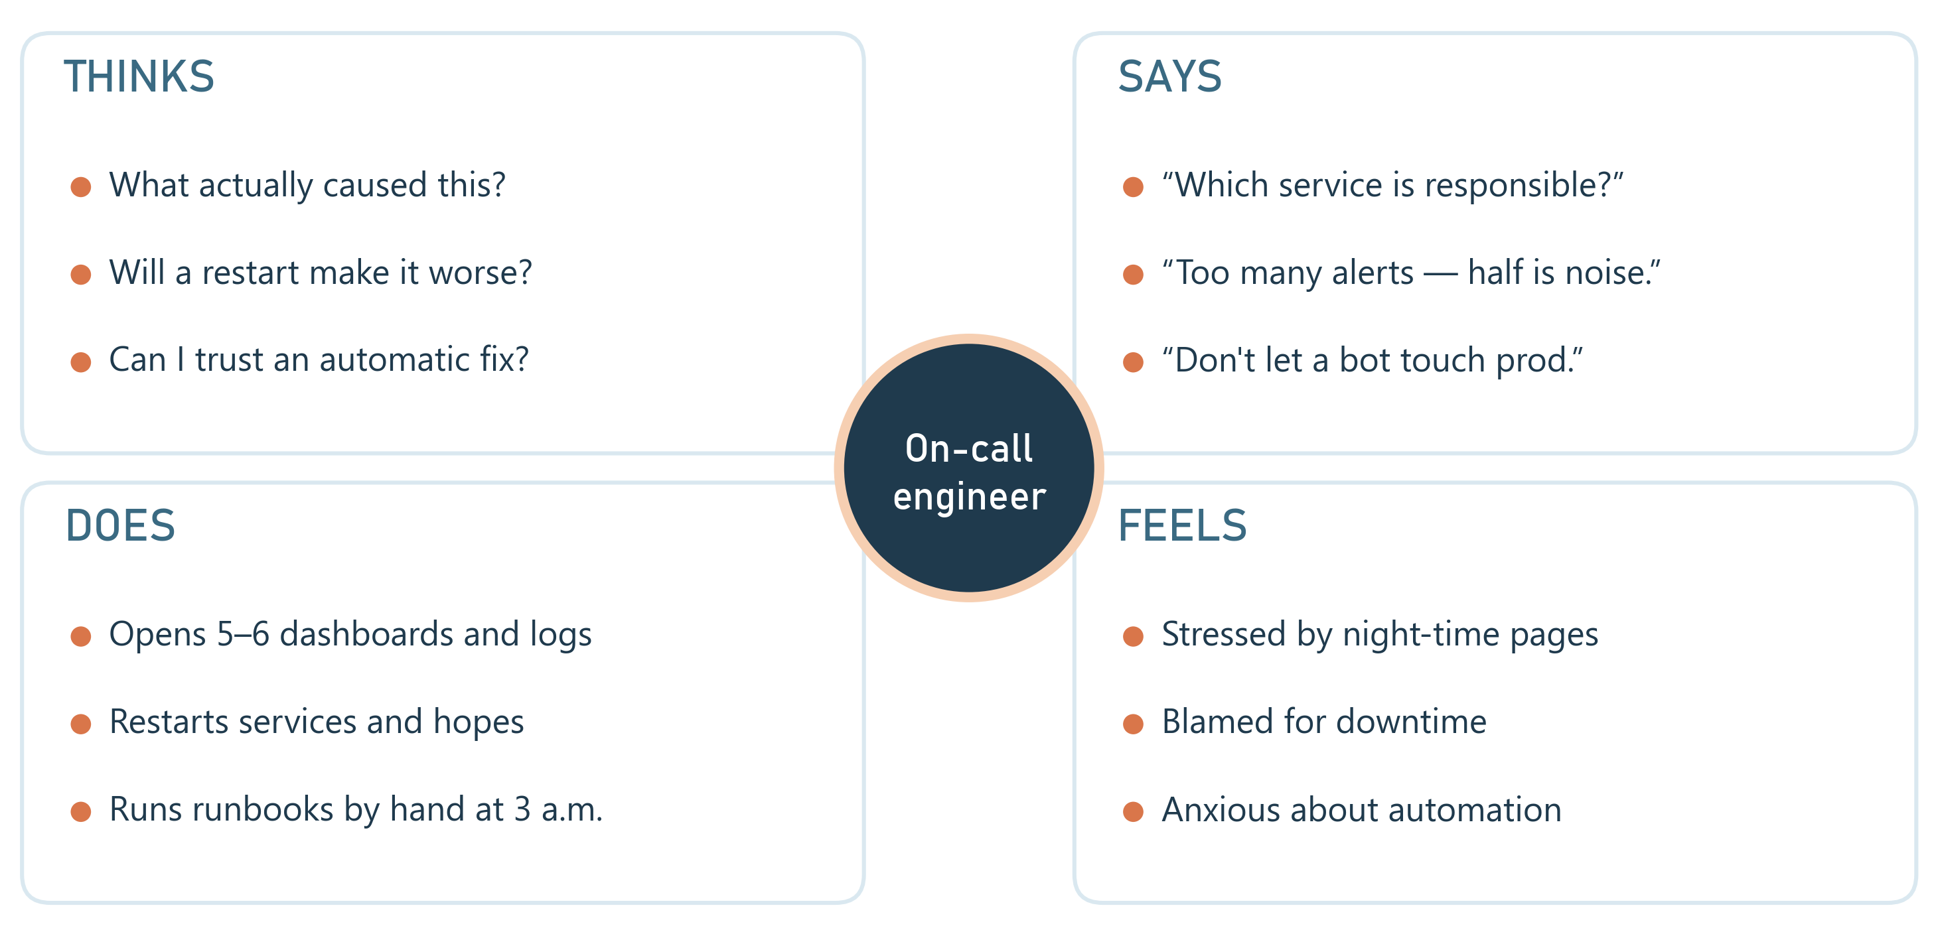
EMPATHY MAP
Insight not short of data — short of answers, and wary of automation that can't explain or undo itself.
Notes:
On-call engineer at 3 a.m.: thinks, says, does, feels. Pains: slow root cause, alert noise, manual fixes, fear of unsafe automation.

Slide 9
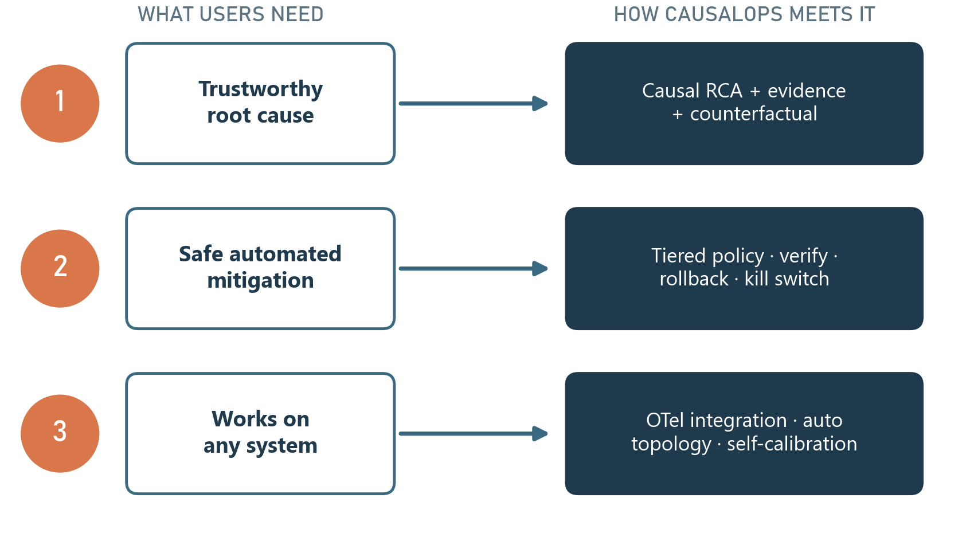
USER NEEDS
Core need faster, trustworthy recovery — with humans in control.
Notes:
Three needs from the empathy map, research and literature, each mapped to the module that meets it.

Slide 10
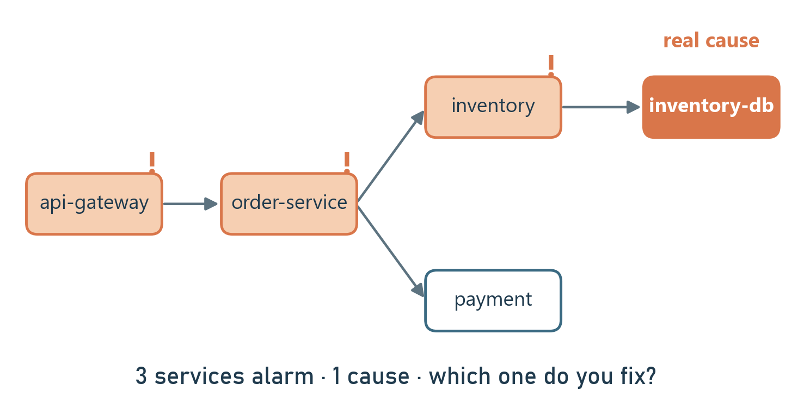
PAIN POINTS
1. Alarm storms
One failure makes several services alert; the real cause is hidden.
2. Root-cause hunt
Switching between dashboards, logs and traces under pressure.
3. Manual night-time fixes
Routine restarts done by hand, often at 3 a.m.
4. Untrusted automation
Fixes that can't explain themselves or be undone.
5. Stale dependency maps
Hand-drawn topologies go out of date.
6. No outcome numbers
Detection time, MTTR and downtime are not measured.
Example inventory-db slows down — three services alarm. Which one do you fix?
Notes:
Six specific pain points; the diagram shows the alarm storm we reproduced on our testbed.

Slide 11
IDEATION
Idea | D | V | F | Total
A · CausalOps: causal RCA + counterfactual + tiered, verified remediation | 9 | 8 | 7 | 24
B · Better threshold alerts and dashboards | 5 | 7 | 9 | 21
C · ML classifier trained once on synthetic data | 6 | 4 | 8 | 18
D · Fully autonomous agent, no policy or approval | 7 | 3 | 5 | 15
SELECTED: IDEA A — CAUSALOPS (24/30)
Self-calibrating causal RCA + counterfactual + tiered, verified auto-remediation
Notes:
Four ideas scored on desirability, viability and feasibility. Idea C is honest history: our first prototype learned a formula, not the real system.

Slide 12

FINAL PROBLEM STATEMENT
PROBLEM STATEMENT
How might we help engineers restore any microservice system faster — by automatically naming the component that caused an incident, showing what fixing it would change, and applying low-risk fixes safely with verification, rollback and human approval for the rest — while the platform learns each system on its own?
Notes:
Reached through 2W1H, 3W, mind map, research, empathy map, literature gap and D/V/F ideation.

Slide 13
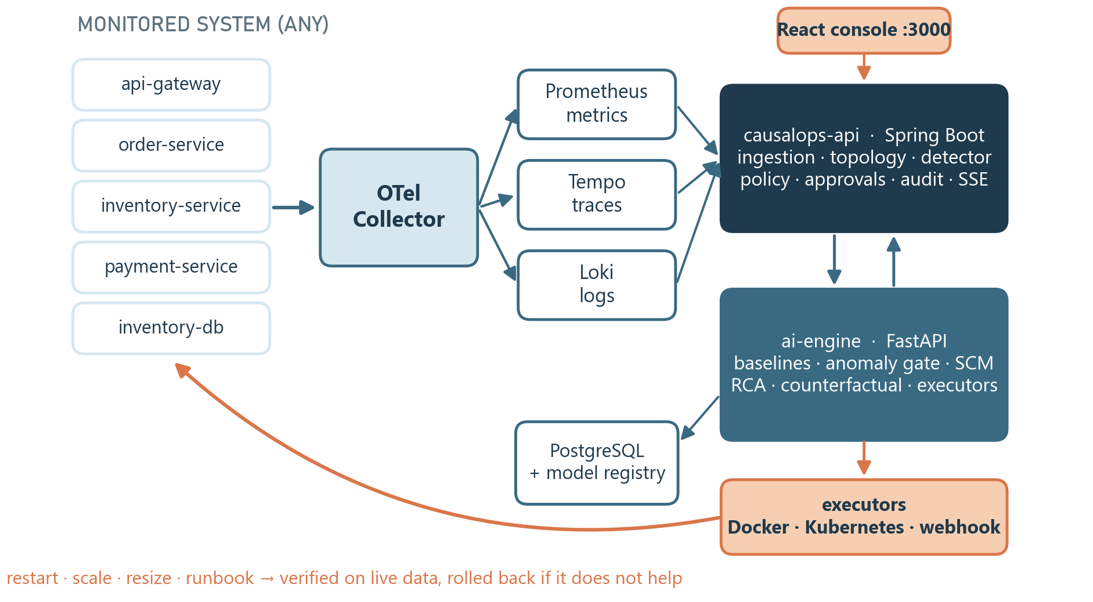
PROPOSED SOLUTION
HOW IT WORKS
1. Observe
OpenTelemetry traces, metrics and logs; topology discovered from traces
2. Learn
baselines, anomaly gate and causal model, per environment (≤ 24 h, weekly retrain)
3. Detect
SLO breach or calibrated anomaly gate
4. Explain
ranked root causes with evidence
5. Simulate
counterfactual: what if this had stayed normal?
6. Act & verify
tiered policy → executor → verified on live data
Notes:
Architecture: any service with OpenTelemetry → collector → Prometheus/Tempo/Loki; Spring Boot platform API and FastAPI AI engine; executors act back on the system.

Slide 14
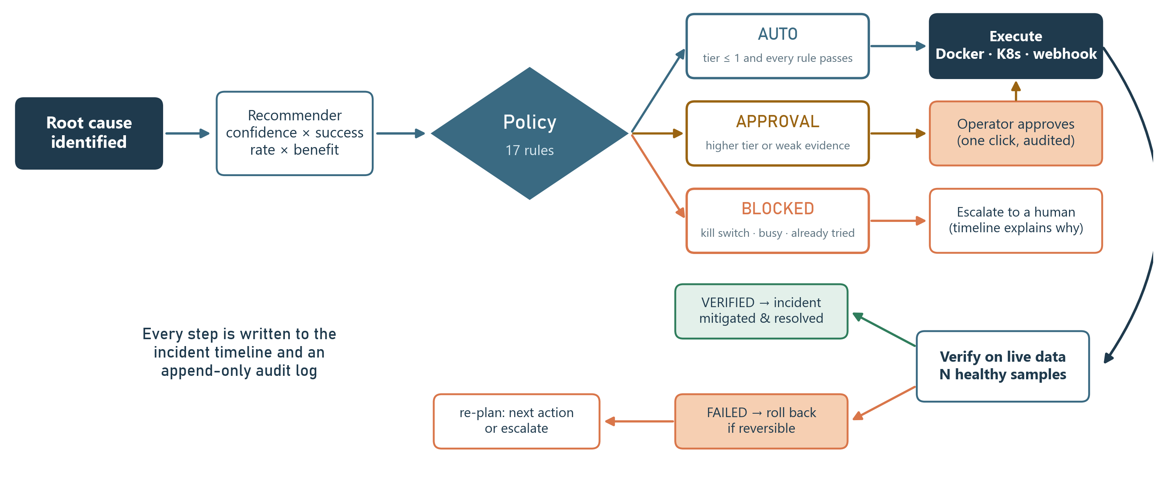
TIERED AUTO-REMEDIATION (USP)
Kill switch
Blast-radius limit
Top root cause only
No change in progress
Never repeat a failed fix
Rollback if it doesn't help
Notes:
The USP. Low-risk, reversible fixes run automatically when all 17 rules pass; higher tiers wait for one-click approval; blocked actions escalate. Every fix is verified on live measurements and rolled back if it does not help.

Slide 15
PROJECT CHARTER
Item | Details
Goal | Detect, explain and safely fix incidents on any OpenTelemetry system, with measured MTTR
Users | SREs, DevOps and on-call engineers
In scope | Telemetry, topology, self-calibration, causal RCA, counterfactual, tiered remediation, console
Deliverables | Platform, PPT, poster, reports, setup & demo guide
Success | Recall ≥ 80% · RCA top-1 ≥ 60% · false alarms ≤ 1% · auto MTTR < manual
Budget | ≈ ₹8,600–15,000 (3-month pilot)
Team | Vedant Bist · Aayush Gupta · Mayank Jaiswal
TECHNOLOGIES
Java 21
Spring Boot
Python
FastAPI
scikit-learn
React 19
PostgreSQL
OpenTelemetry
Prometheus
Tempo · Loki
Grafana
Docker
Kubernetes
Toxiproxy
OUTPUT
Detection + root cause + what-if + verified, reversible fix + audit trail
Notes:
Charter: goal, scope, deliverables, success criteria, budget, team and technology stack.

Slide 16
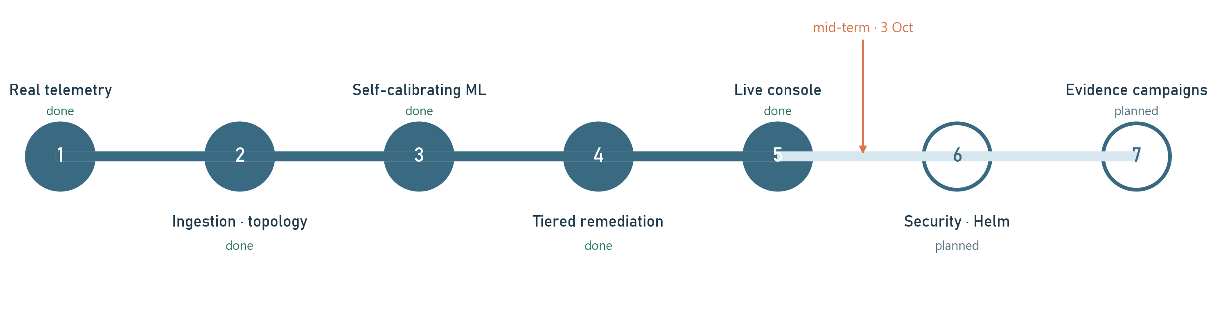
IMPLEMENTATION PROGRESS
5 / 7
phases complete
27/27
backend tests (Testcontainers)
25/25
AI-engine tests
live
end-to-end verification on real faults
Notes:
Phases 1–5 done and verified: real telemetry, ingestion and topology, self-calibrating ML, tiered remediation, live console. Next: security and Helm (6), long evidence campaigns (7).

Slide 17
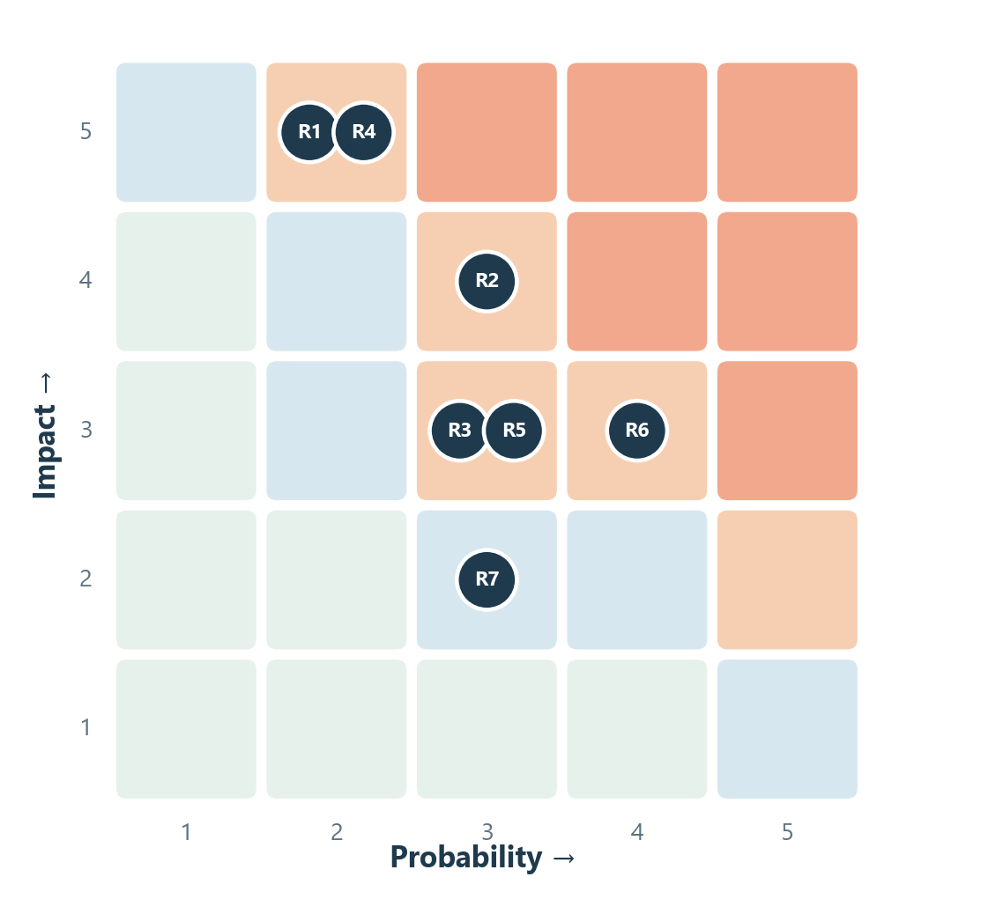
RISK MANAGEMENT
ID | Risk | P×I | Mitigation
R1 | Automatic fix makes it worse | 10 | Tiers, 17 rules, verify, rollback, kill switch
R2 | Wrong root cause | 12 | Auto only on top cause; approval otherwise
R3 | False alarms | 9 | Calibrated on quiet data; change windows excluded
R4 | Executor misuse | 10 | Internal token, scoped executors, audit log
R5 | Too few labelled incidents | 9 | Chaos campaigns; ACTIVE only after gates pass
R6 | Behaviour shifts after deploys | 12 | Change events, weekly retrain, champion/challenger
R7 | Time clash with exams | 6 | Phase-wise milestones
Probability × impact, 1–5 each. No risk above 12 after mitigation.
Notes:
Risk register with probability × impact and the mitigation built into the platform for each.

Slide 18
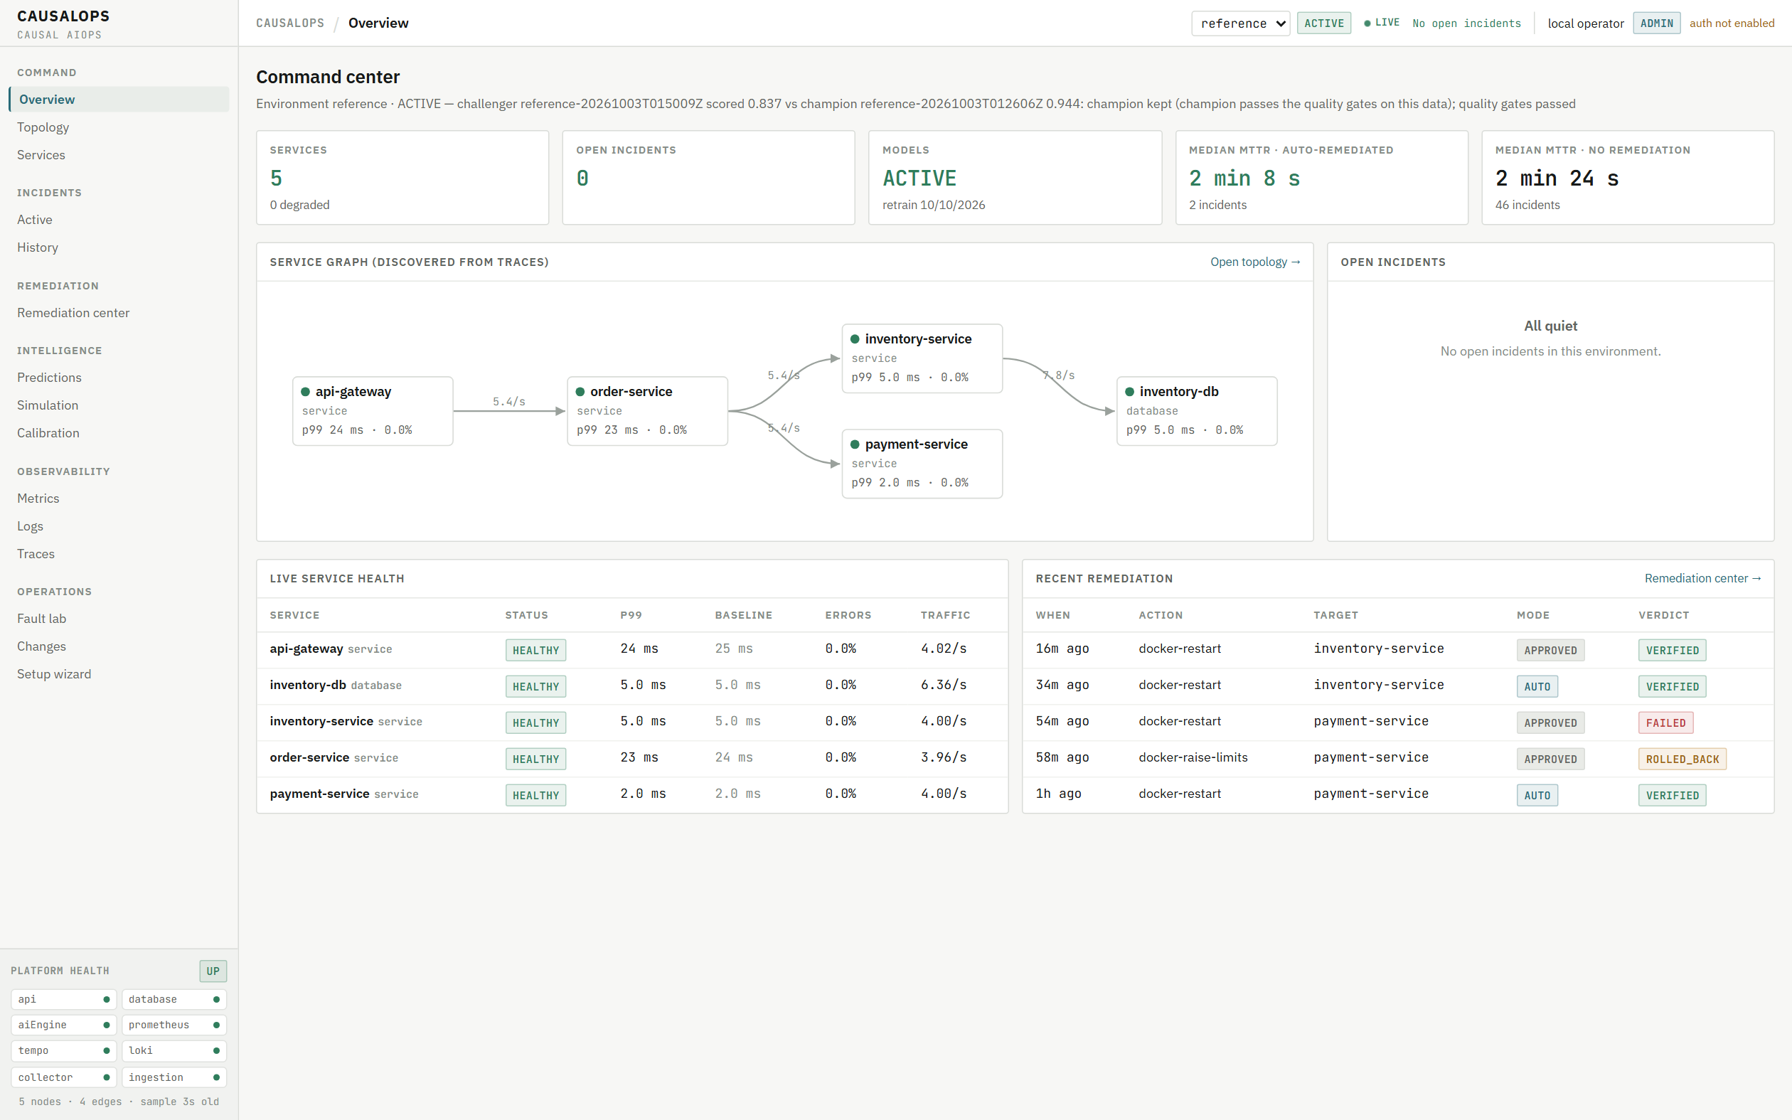
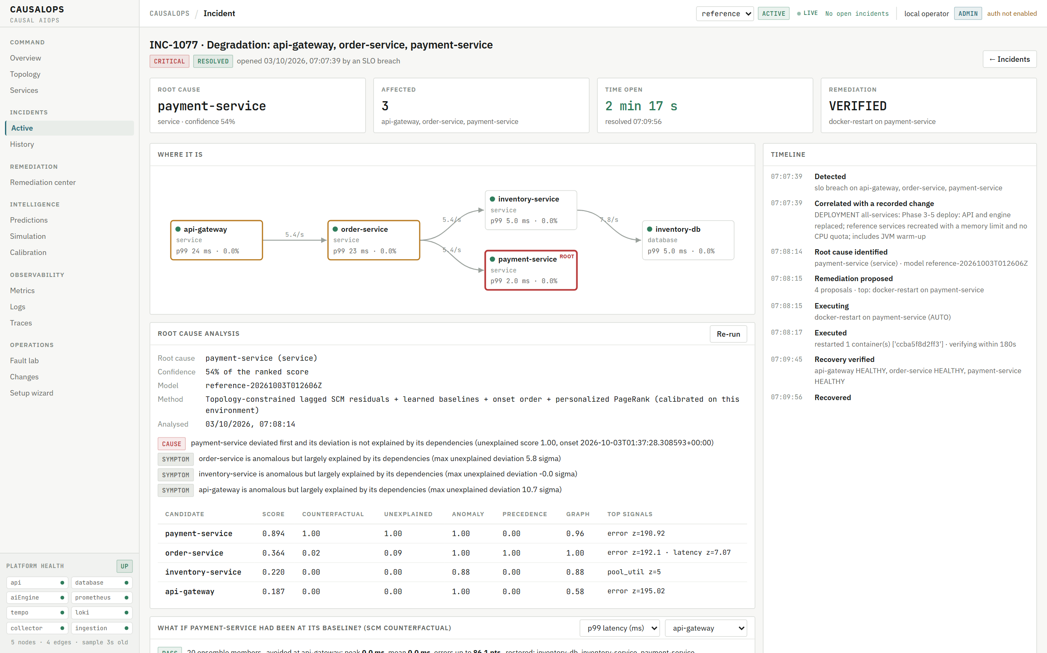
PROTOTYPE
DETECT & EXPLAIN
Live service graph · incidents with timeline · ranked root cause with evidence · counterfactual chart
REMEDIATE SAFELY
Tiered autonomy · one-click approval · verification · rollback · kill switch · audit trail
LEARN & OBSERVE
Calibration & model registry · fault lab · changes · metrics, logs (Loki), traces (Tempo) · setup wizard
Command center: discovered graph, live health, recent remediation
Incident: root cause, verified automatic restart, resolved in 2 min 17 s
Notes:
Live demo follows. Every number on these screens comes from the API; there is no mock data.

Slide 19
RESULTS & FUTURE SCOPE
MEASURED RESULTS
100%
incidents detected (18 labelled), median 22 s
83% / 100%
root cause ranked first / in top two
0.94
causal-model fit (cross-validated R²)
2m 17s
live payment failure: auto-restart, verified, resolved
FUTURE SCOPE
Sign-in, roles and a Helm chart
Onboard a second real system via the wizard
Long chaos campaigns for evidence
Better network-link root causes
Learned failure forecasting with more data
More executors: databases, feature flags
Runbook marketplace via signed webhooks
Notes:
All numbers are the platform's own (Calibration page and live verification). Weakest case today: network-link faults (link usually ranked second).

Slide 20
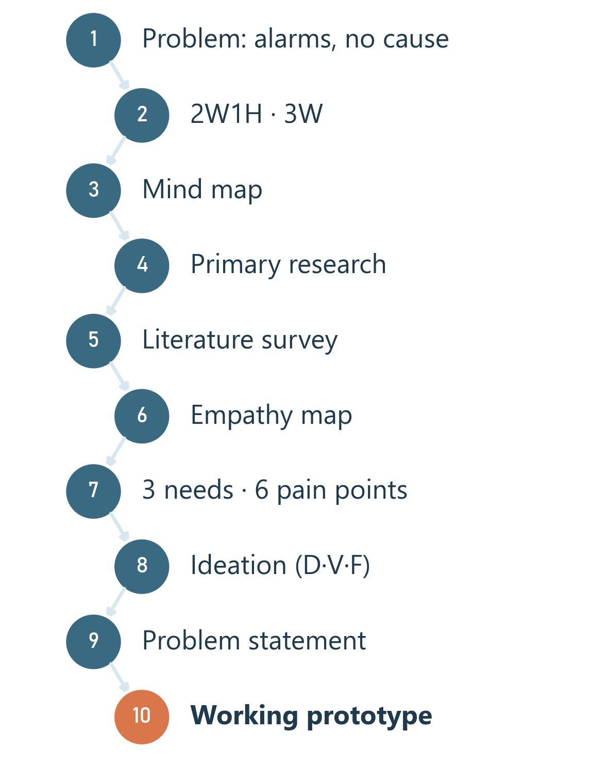
REPORT & PROJECT JOURNEY
PROJECT REPORT
Introduction (2W1H)
Objective (3W), cost
Mind map
Primary research
Literature survey
Empathy map
Needs · pain points
Ideation (D/V/F)
Problem statement
Charter · risks
Prototype · results
Conclusion
Notes:
The 26-page report follows the same structure; the journey shows how each step led to the next.

Slide 21
Thank You
CAUSALOPS
Detect the Failure
Explain the Cause
Simulate the Fix
Remediate Safely
QUESTIONS?
Notes:
Close: detect the problem, name the cause, show what the fix will change, fix it safely or ask you — and prove it worked. Then the live demo.

