Slide 1




SMART INDIA HACKATHON 2026
CODE BANDITS
  Problem Statement ID – SIH26156
  Problem Statement Title- Universal Log Pre-processing Framework
  Theme- Blockchain & Cybersecurity
  PS Category- Software
  Team ID- 124470
  Team Name - Code Bandits
1

Slide 2










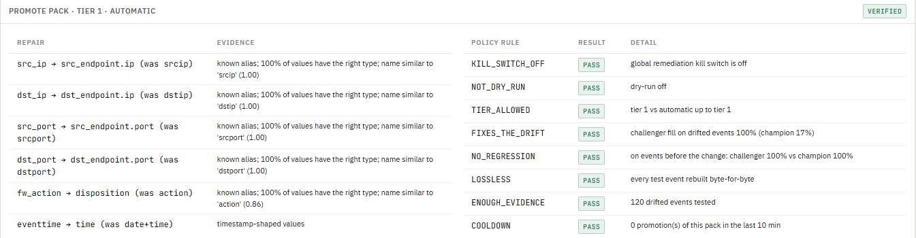


CODE BANDITS
SCHEMAOPS
PROBLEM OVERVIEW
OUR SOLUTION: DIFFERENT LOGS → ONE SCHEMA → USEFUL OUTPUTS
Security teams receive logs from firewalls, IDS, VPNs and servers, each in its own format:
Syslog · CEF · LEEF · JSON · XML · CSV · key=value · text
Different logs
One schema
Preserved evidence
Easier onboarding
Parser repair
Useful outputs
Syslog UDP / TCP / TLS, HTTP
Auto-discovered sources
Received = stored + in flight
Format auto-detect
YAML vendor packs
OCSF: src, dst, action, class
Raw bytes in write-once vault
SHA-256 + hash chain
Rebuilt event = vault hash
Load samples, Analyze
Proposed YAML (Drain3)
Test, Activate: no restart
Fill-rate drift detected
Shadow test + policy rules
Verify, re-process history
Parquet lake on MinIO
Slim SIEM tier
Entities, Sigma, privacy
Device logs
Hand-written parsers
SIEM
many vendors, formats
break on firmware updates
fields lost, no proof
Limitation: parsers fail silently. Fields vanish after a firmware update and nobody can prove the stored copy matches the original log.
Log sources
Event explorer
Verify lossless
Parser studio
Pipeline health
Outputs & cost
UNIQUENESS OF SOLUTION
PARSER REPAIR IN THE PROTOTYPE: PIPELINE HEALTH → LOG-1059
Capability | Typical pipeline | SchemaOps
Many formats → one schema (OCSF 1.3)
Raw bytes kept in a write-once vault
Per-event lossless verification
No-code onboarding, tested before activation
Detects parser drift after a firmware change
Safe parser repair + history re-processed
SIEM tier with pointers to the full lake
Pseudonymised export, audited reveal
01:44:05 DETECTED
+30 s, 5 attributes lost
01:44:08 CHALLENGER TESTED
fill 17% → 100%
01:44:13 PACK PROMOTED
tier 1, rules pass
01:45:26 VERIFIED
live buckets at 100%
01:45:32 RE-NORMALIZED
222 events, 1,110 fields
01:45:37 RESOLVED
2 min 2 s end to end
2

Slide 3













CODE BANDITS
Technical Architecture
1
Log sources
2
Collector
3
Queue
4
Workers ×2 (stateless)
5
Raw vault
6
Exporter
Firewall, IDS, VPN, WAF, AD, DHCP
Demo: log-replayer, 12 vendors
Fault lab: firmware change, silence, clock drift
Syslog UDP/TCP 5514 (RFC 6587)
Syslog TLS 6514
HTTP POST /ingest (X-Source)
Bytes queued unchanged
Redis Stream ulpf:raw
Consumer group, AOF
Dead worker's events reclaimed
a Append raw bytes to vault
e Map to OCSF 1.3 + unmapped{}
a
Write-once segments
SHA-256 + hash chain
Reads events in commit order
Full stream → lake
SIEM tier: slim records + summaries
DPDP tokens on export
b Detect format
f Lossless proof (rebuild = SHA)
c Apply YAML vendor pack
g GeoIP + entity graph
PostgreSQL
d Fix device clock skew
h Store, then ACK
h
OCSF events, sources, packs
Quality, incidents, audit
Console: Log sources
Console: Parser studio → Connect
Console: Log sources (in flight)
Console: Event explorer (lineage, Verify lossless) · Entities
Console: Outputs & cost
promoted pack, hot reload ≤10 s
11
SchemaOps console (React + Vite, nginx :3000)
7
Monitor (ulpf-monitor)
quality series
8
Sinks
Log sources sources, conservation, vault check
Learns each source's fill, volume, clock (20 s buckets)
Drift → repair → shadow test → 9 rules → promote → verify
Rolls back on failure · re-normalizes history from the vault
Restarts crashed workers (Docker), zero events lost
data-lake: Parquet on MinIO (S3), every event
siem-tier: JSONL, slim + summaries
Ready, off by default: Splunk HEC, CEF syslog, OpenSearch, Kafka
1·3·5
Event explorer raw ↔ OCSF lineage, Verify lossless
4·5
9
ULPF API
Parser studio connect a device, samples → pack
2·4
Parser packs versions and YAML
4·7
Console: Pipeline health · Fault lab · Parser packs
FastAPI :8090
Stats, events, verify, packs, studio, incidents, scenarios
Pipeline health baselines, incidents, Fault lab
7
Entities ip / host / mac / user graph
4
Detections Sigma rules on OCSF
4·5
Outputs & cost sinks, SIEM bytes, ₹ saved
6·8
10
API gateway
Privacy tokens, audited reveal
6
Compliance CERT-In checks, signed bundles
5·7
Spring Boot proxy /api/ulpf/** → ULPF API
One origin for the console
Benchmarks measured events/s per worker
4
orange numbers = components the page reads
Console: Outputs & cost
KEY TECHNOLOGIES
Python 3.12
FastAPI
Redis Streams
PostgreSQL
MinIO + Parquet
YAML + Drain3
Spring Boot
React + Vite
Docker
parsers, workers, monitor
collector + ULPF API
durable queue
OCSF events, incidents
data lake (S3, pyarrow)
vendor packs, onboarding
API gateway
SchemaOps console
Compose, Docker Hub
3

Slide 4







CODE BANDITS
Impact and Benefits
Key Details & Capabilities
Live sources
Events stored
Conservation
Vendor packs
Common schema
Throughput
15
1.32 M
balanced
13
OCSF 1.3
~2,500/s
auto-discovered, 12 vendor formats
100% verified lossless
0 events unaccounted
YAML, versioned, hot-reloaded
unmapped{} keeps vendor fields
events per worker (Benchmarks)
Outputs & SIEM Cost (live)
Pipeline Health (measured)
SIEM INGEST REDUCED BY
WITHOUT TIERING
SENT TO THE SIEM
Fault (Fault lab) | Detect | Resolve | Outcome
Firmware change, FortiGate | 30 s | 2 m 2 s | pack repaired, 222 events re-processed
Clock drift, Juniper SRX | 60 s | 2 m 59 s | time corrected, residual 0 ms
Device silenced, Cisco ASA | 79 s | 2 m 21 s | escalated to analyst
Worker crashed | 22 s | 35 s | restarted, zero events lost
60.6%
1.54 GB
622.0 MB
measured bytes, same events
1.97 GB/day
0.78 GB/day
SAVED PER MONTH
EVENTS IN / RECORDS OUT
DATA LAKE (FULL FIDELITY)
₹1,07,646
1,036,106 / 906,625
1,045,183
estimate at ₹3,000 per GB (setting)
summaries carry their event count
events written as Parquet
Sinks: data-lake ON, siem-tier ON · Splunk HEC, CEF syslog, OpenSearch, Kafka configured and ready (off). Every summary points back to the lake: nothing is dropped.
Same columns (MTTD, MTTR) as the Pipeline health incidents table
Benefits
Evidence preserved
Parsers repair themselves
Lower SIEM bill
Faster onboarding
every event verifiable, byte for byte
format changes fixed in minutes, audited
60.6% less ingest, full data in the lake
new formats via Parser studio, no code
4

Slide 5




CODE BANDITS
Feasibility and Viability
FEASIBILITY
VIABILITY
Runs today: one docker compose starts collector, 2 workers, monitor, exporter, Redis, PostgreSQL, MinIO and the console.
Fits SOC workflows
OCSF + Sigma out of the box; outputs for Parquet lakes, Splunk HEC, CEF syslog, OpenSearch, Kafka.
Tested: 52 unit and golden tests per format and vendor, plus an end-to-end checker (verify_ulpf.py).
Low cost, no lock-in
open-source stack; SIEM ingest measured 60.6% lower with nothing dropped.
Scales out: stateless workers on a Redis consumer group, about 2,500 events/s each (Benchmarks page).
Trust by design
parser changes pass shadow tests and policy rules; every action is audited.
Self-hosted: images on Docker Hub plus an offline image-packaging script; GeoIP and fonts bundled.
Impact: unified logs and preserved evidence for SOCs and critical-infrastructure teams
CHALLENGES & MITIGATION
FROM DEMO TO REAL DEPLOYMENT
Identified Risk | Engineering Mitigation
Vendor changes its log format without notice | Fill-rate drift detection; repaired pack shadow-tested, promoted, rolled back if it fails
Unknown or in-house log formats | Parser studio: Drain3 proposal, tested on samples before activation
Tampering or loss after ingestion | Write-once vault, SHA-256 hash chain, conservation counter, lossless check
Prototype runs on generated demo logs | Pilot with live device feeds; packs already follow vendor log formats
High event volumes | Stateless workers scale out; routine flows summarised for the SIEM
Now
~3 months
6–12 months
Working prototype: multi-vendor intake, OCSF, lossless vault, Parser studio, self-repairing parsers, outputs.
Pilot at a partner SOC on live feeds; more vendor packs; Kubernetes/Helm, SSO and roles.
Multi-site clusters, object-lock vault, SOAR integration, shared signed-pack library.
Unified logs • preserved evidence • self-repairing parsers • OCSF
5

Slide 6


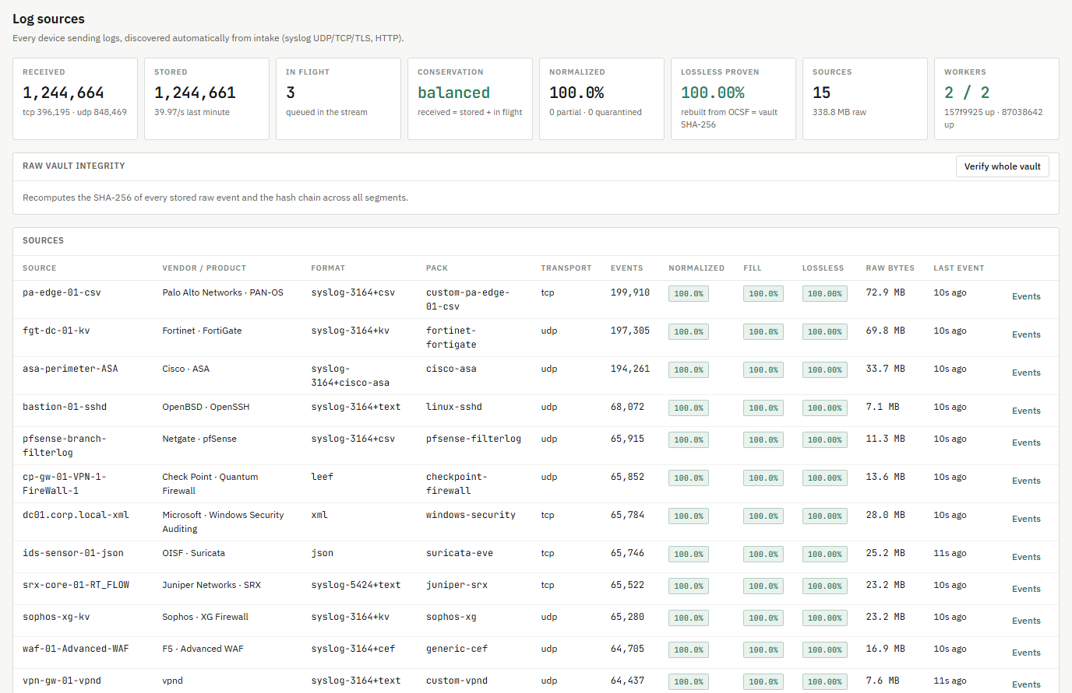
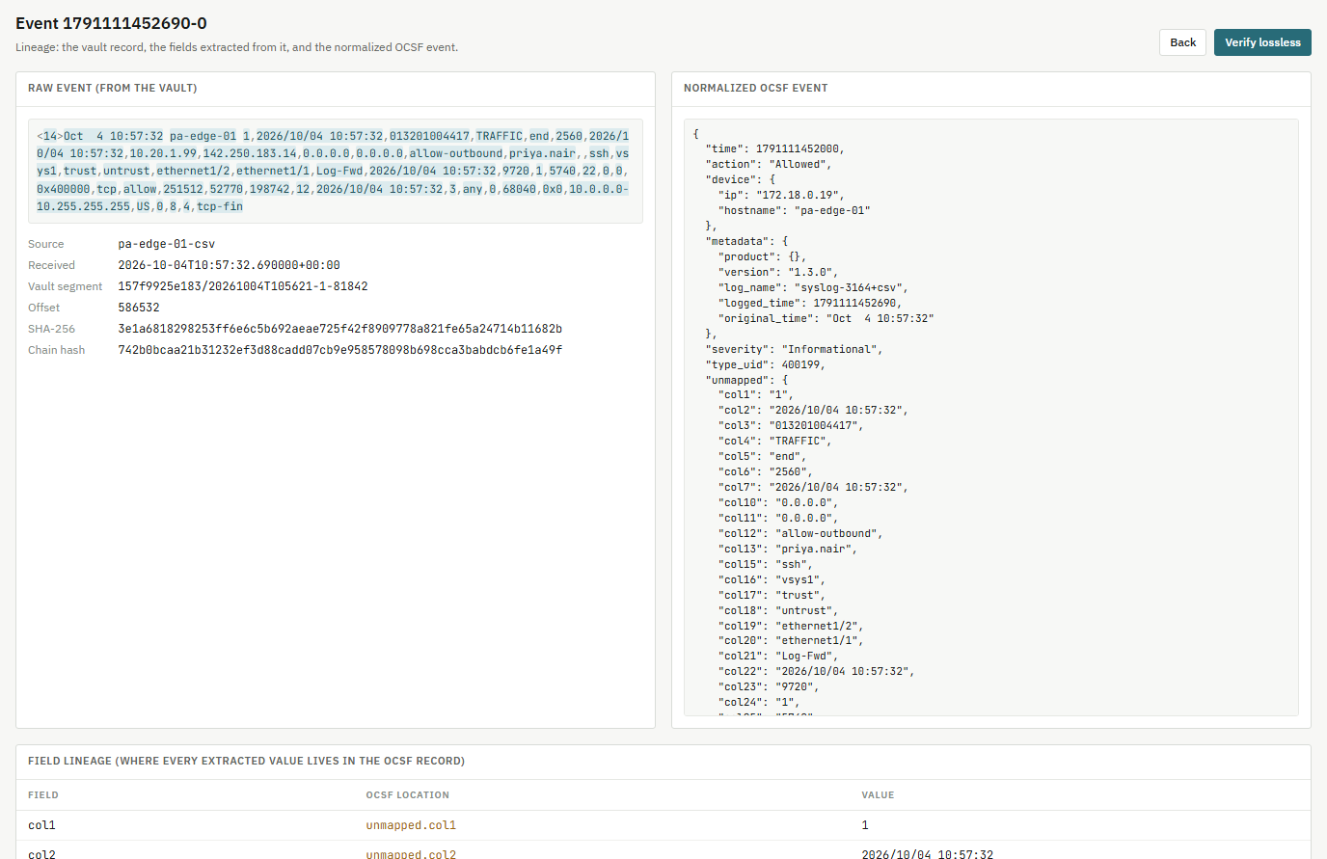
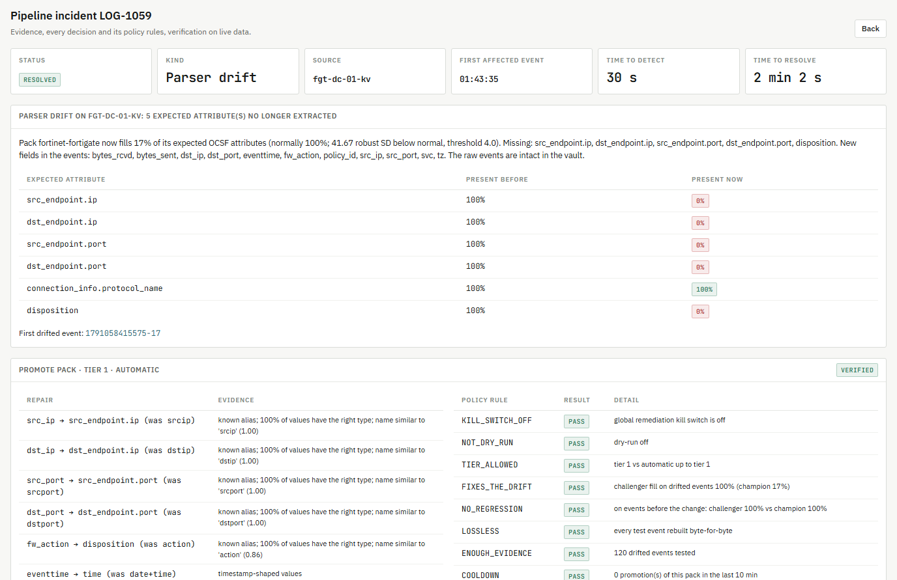
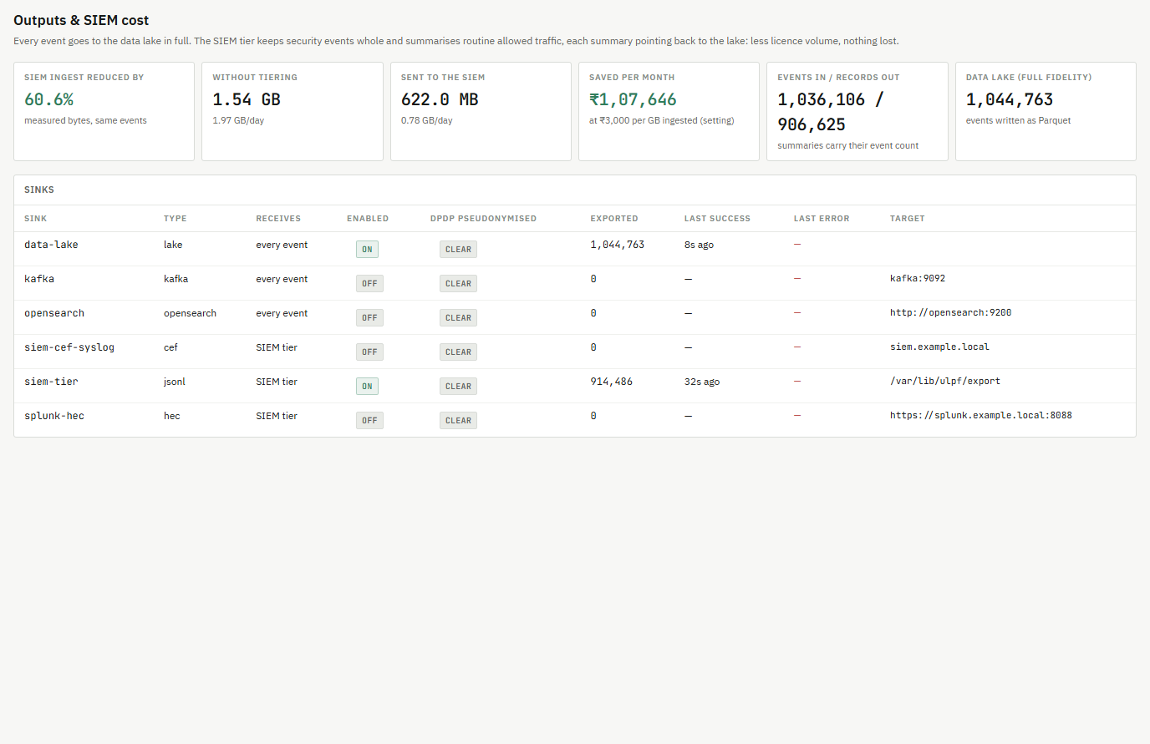
CODE BANDITS
Research and References
DEMO VIDEO
GITHUB REPO
RESEARCH
SchemaOps is a universal log pre-processing framework for heterogeneous security logs. It keeps every raw log byte for byte in a hash-chained vault, normalizes it to OCSF, proves each event lossless, and watches parsing quality so that a vendor format change is detected and repaired instead of silently losing fields.
github.com/VedantBist/causalops
SYSTEM PREVIEW
Built on open standards and published methods:
Contribution: losslessness is verified by rebuilding the raw bytes from the normalized record and comparing hashes with the vault; parser drift is detected from learned fill-rate baselines and repaired through shadow tests, policy rules, live verification and re-processing of the affected history.
OCSF 1.3 event schema
Syslog RFC 5424 / 3164 / 6587
ArcSight CEF and IBM LEEF
Drain log parsing (He et al., 2017)
Sigma rules, MITRE ATT&CK
Log sources: live intake, conservation
Event explorer: raw ↔ OCSF, verify lossless
REFERENCES
1. OCSF Schema 1.3
https://schema.ocsf.io
2. RFC 5424: The Syslog Protocol
https://www.rfc-editor.org/rfc/rfc5424
3. RFC 6587: Syslog over TCP
https://www.rfc-editor.org/rfc/rfc6587
4. He, P. et al. (2017) Drain: online log parsing, IEEE ICWS
https://doi.org/10.1109/ICWS.2017.13
5. Sigma detection rule format
https://github.com/SigmaHQ/sigma
6. CERT-In Directions, 28 April 2022
https://www.cert-in.org.in/Directions70B.jsp
7. Digital Personal Data Protection Act, 2023
https://www.meity.gov.in
8. MITRE ATT&CK
https://attack.mitre.org/
Pipeline health: parser-drift incident
Outputs & cost: lake, SIEM tier, ₹ saved
6

