Slide 1
"Predicting Stroke Risk Using Machine Learning Models”
A Comprehensive Approach to Healthcare Analytics

Slide 2
Team Members:-
Name | Roll No. | PRN
Vedant Borle | 324007 | 22211379
Purva Kale | 324078 | 22320019
Ajay Guhade | 324021 | 22210623
Burhanuddin Naeem | 324009 | 22210013

Slide 3
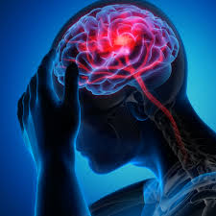
Introduction
Stroke is a leading cause of death and disability worldwide, making early prediction crucial for effective intervention.
This project explores the use of machine learning models to predict stroke risk based on medical and demographic data. Five different models—Logistic Regression, Decision Trees, Random Forest, Support Vector Machines (SVM), and Gradient Boosting—were evaluated for their predictive performance. By comparing these models, the study aims to identify the most effective method for stroke prediction, offering valuable insights to healthcare professionals for better risk assessment and patient care.

Slide 4
Importance of Early Prediction and the Role of Machine Learning in Healthcare
Timely Intervention: Early stroke prediction allows for faster medical responses, reducing mortality and long-term disability.
Preventive Measures: Identifying high-risk patients early helps in applying preventive strategies to lower stroke occurrence.
Improved Accuracy: Machine learning can analyze large datasets to uncover patterns, improving the accuracy of stroke predictions compared to traditional methods.
Personalized Treatment: ML models enable personalized healthcare by tailoring treatments based on individual risk factors.
Enhanced Decision-Making: Machine learning supports healthcare professionals in making data-driven, proactive decisions.

Slide 5
Research Problem
Challenge: Predicting stroke risk is complex due to the variety of medical and demographic factors involved.
Existing Gaps:
Current models often struggle with data imbalance, leading to biased predictions.
Many methods lack accuracy in predicting stroke, especially for high-risk patients.
Interpretability of models is limited, making it difficult for healthcare professionals to understand the factors driving predictions.
Need:There is a demand for more accurate, interpretable models that can offer reliable insights into stroke risk, improving both prevention and treatment.

Slide 6
Objectives
Compare the Performance
Enhance Model Interpretability
Improve Prediction Accuracy
Compare the Performance of different machine learning models, including Logistic Regression, Decision Trees, Random Forest, SVM, and Gradient Boosting, for stroke prediction.
Enhance Model Interpretability to help healthcare professionals better understand the key risk factors influencing stroke predictions.
Improve Prediction Accuracy by addressing data imbalance and evaluating models on key metrics like accuracy, precision, recall, and AUC-ROC.

Slide 7
Dataset Description
Source: The dataset contains medical and demographic data from a healthcare dataset.
Sample Size: 10,000 records
Key Features:
Age, Gender
Hypertension, Heart Disease
Blood Pressure, Cholesterol Levels
Smoking Status, BMI
Stroke (target): Binary variable indicating stroke occurrence (yes/no).
Preprocessing:
Handling Missing Data: Missing values were handled via imputation.
Normalization: Applied to continuous features (e.g., age, BMI) to standardize the dataset.
Class Imbalance: Addressed using oversampling techniques like SMOTE to balance stroke/non-stroke cases.

Slide 8

Machine Learning Models
Logistic Regression:
Decision Trees:
Random Forest:
A fundamental classification model that predicts stroke risk based on the linear relationship between features and outcomes.
A tree-structured model that splits data based on key features like age, hypertension, and heart disease to classify stroke risk.
An ensemble method that aggregates multiple decision trees to improve prediction accuracy and minimize overfitting, proving to be the best-performing model in the project.
Gradient Boosting:
Support Vector Machine (SVM):
A boosting technique that builds models sequentially, improving accuracy by focusing on the errors of previous models.
A powerful classifier that finds the optimal boundary between stroke and non-stroke cases, achieving strong AUC-ROC results.

Slide 9
Model Evaluation
Evaluation Process:
10-Fold Cross-Validation: The dataset of 10,000 records was divided into 10 subsets. Each model was trained on 9 subsets and validated on the remaining subset, rotating through all folds to ensure robust performance assessment.
Performance Metrics:
Accuracy: Overall accuracy of each model in predicting stroke occurrences.
Precision: Proportion of true positive stroke predictions relative to all positive predictions.
Recall: Ability of the model to correctly identify actual stroke cases
F1-Score: Harmonic mean of precision and recall, providing a balance between the two metrics.
AUC-ROC: Area under the receiver operating characteristic curve, indicating the model's ability to discriminate between stroke and non-stroke cases across various thresholds.
The evaluation of each model based on these metrics revealed insights into their predictive capabilities and robustness in stroke risk assessment.

Slide 10
Data Analysis
Metric | Logistic Regression | Decision Tree | Random Forest | Support Vector Machine (SVM) | Gradient Boosting
Accuracy | 94% | 97.1% | 97.9% | 94% | 95%
Precision | 91% | 94% | 94.5% | 90% | 92%
Recall | 92% | 96% | 95% | 90% | 90%
F1-Score | 91% | 94% | 95% | 91% | 92%
AUC-ROC | 0.89 | 0.92 | 0.93 | 0.90 | 0.90

Slide 11
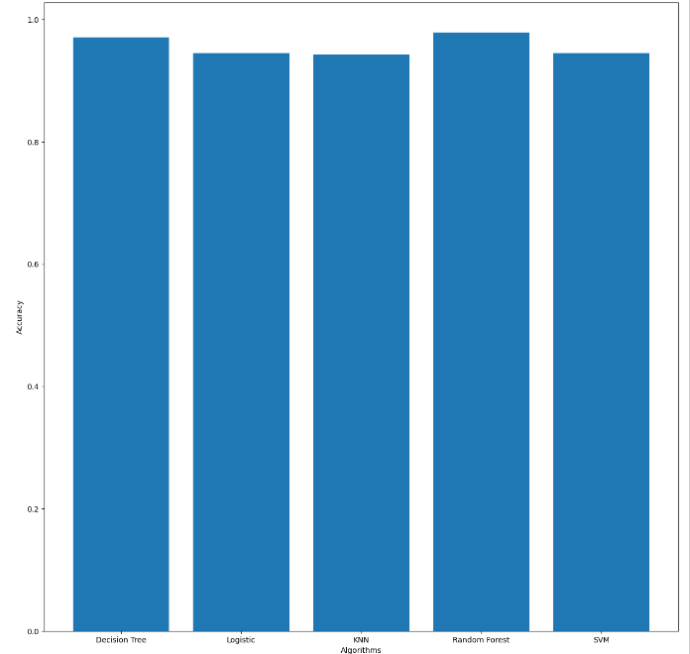
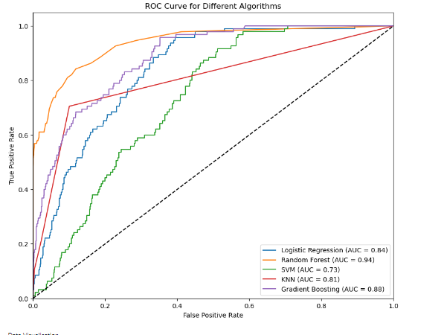

Slide 12
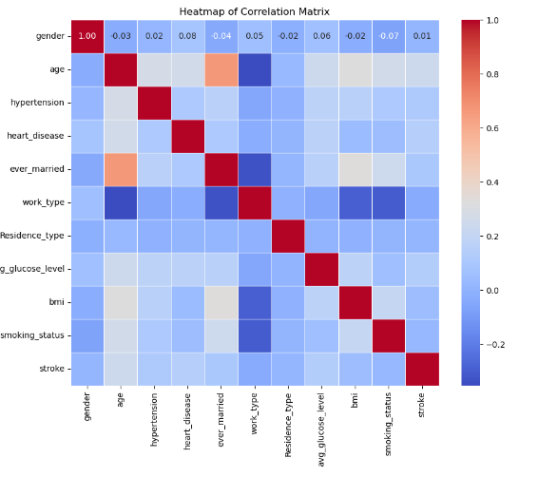

Slide 13
Conclusion:-
This study demonstrates that the Random Forest algorithm achieves an impressive accuracy of 97% in predicting stroke risk, significantly outperforming traditional methods like Logistic Regression. The analysis emphasizes the effectiveness of ensemble approaches in capturing complex interactions in medical datasets, with age and hypertension identified as critical risk factors.
However, limitations include reliance on a single dataset, which may not reflect the full range of clinical diversity, and challenges in model interpretability for complex algorithms.
Future research should focus on integrating more diverse datasets and exploring advanced techniques like explainable AI and deep learning to enhance accuracy and interpretability, ultimately improving stroke prediction and patient outcomes.

Slide 14
Future Scope:-
Dataset Diversity
Advanced Techniques
Real-time Prediction
User-Friendly Tools
Longitudinal Studies

Slide 15
Thanks!

