Slide 1

Insurance Customer Response Prediction
Vedant Burande

Slide 2

AGENDA
Problem Statement
Data Overview
Exploratory Data Analysis (EDA)
Data Preprocessing
Model Selection
Model Performance Evaluation
Business Impact & Interpretation
Conclusion
CONFIDENTIAL: The information in this document belongs to Boston Institute of Analytics LLC. Any unauthorized sharing of this
material is prohibited and subject to legal action under breach of IP and confidentiality clauses.

Slide 3
Problem Statement :
Insurance companies struggle to identify potential customers who are likely to respond positively to policy offers. This leads to insufficient marketing efforts and increased costs.
Objective :
Develop a machine learning model to predict customer responses.
Improve targeted marketing strategies for better conversion rates.
Enhance customer acquisition efficiency and reduce costs.
Benefits :
Helps insurance companies focus on high-potential leads.
Reduces marketing expenditure & increase revenue.

Slide 4
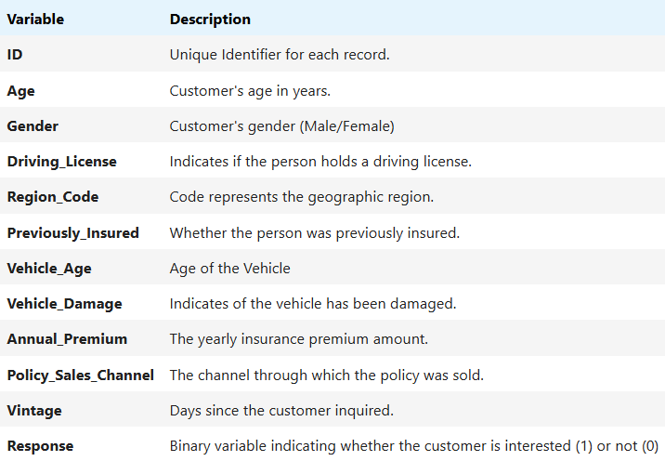
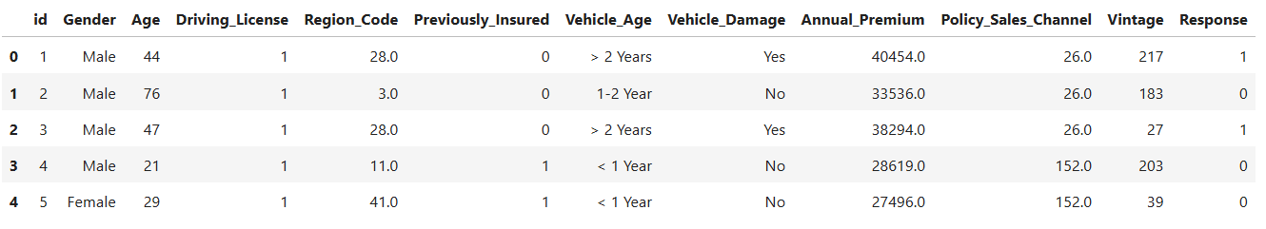
Data Overview
Data Source: The dataset contains customer response to a policy offer.
Number of records: 381,109 records
Number of features: Includes Demographics like: Age, Gender, Region.
Target Variable: Customer Response: Contains Binary values (0,1) indicates if a customer is interested or not.
CONFIDENTIAL: The information in this document belongs to Boston Institute of Analytics LLC. Any unauthorized sharing of this
material is prohibited and subject to legal action under breach of IP and confidentiality clauses.

Slide 5
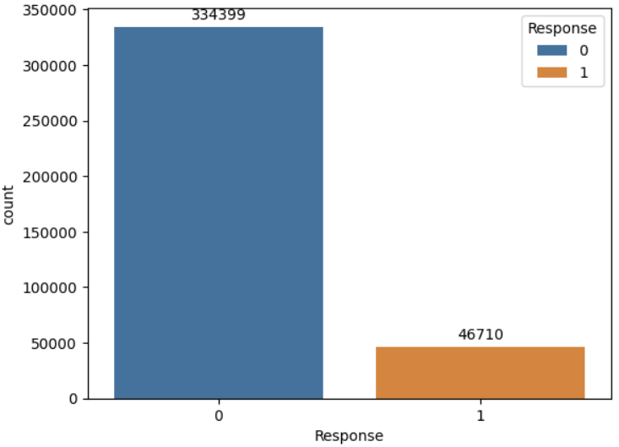
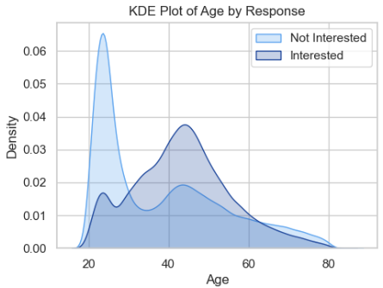
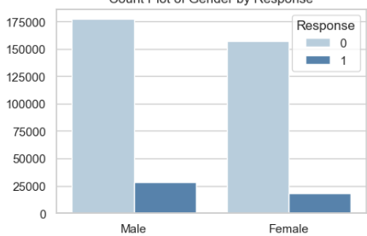
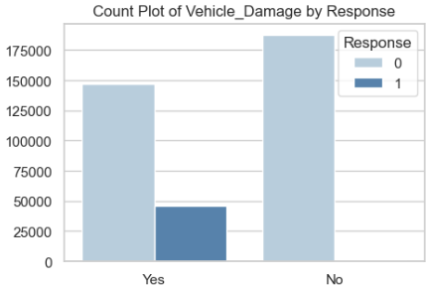
Exploratory Data Analysis (EDA)
Feature vs Target:
Age vs Response
Gender vs Response
Vehicle Damage vs Response
Response Rate Distribution
Age vs Response
Gender vs Response
Vehicle Damage vs Response
CONFIDENTIAL: The information in this document belongs to Boston Institute of Analytics LLC. Any unauthorized sharing of this
material is prohibited and subject to legal action under breach of IP and confidentiality clauses.

Slide 6
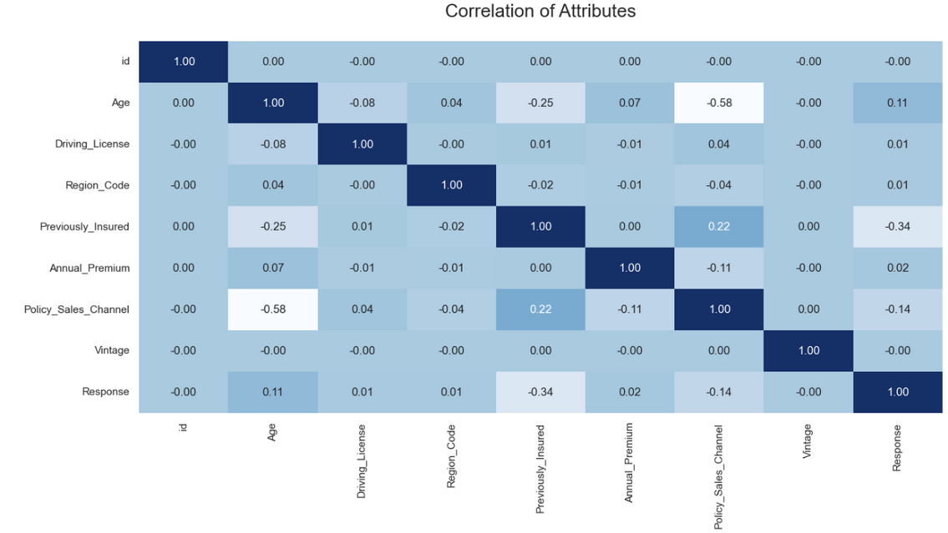

Correlation Heatmap
Key Drivers of Response:
Previously_Insured (-0.34) negatively impacts Response, meaning previously insured customers are less likely to respond.
Policy_Sales_Channel (-0.14) and Age (0.11) show weak correlations with Response.
Feature Relationships:
Age and Policy_Sales_Channel (-0.58) strongly negatively correlate, indicating older customers interact less with certain sales channels.
Previously_Insured and Policy_Sales_Channel (0.22) show a mild positive correlation.
Weak Correlations:
Annual_Premium, Driving_License, Region_Code, and Vintage (~0.00 to 0.02) have little impact on Response.
CONFIDENTIAL: The information in this document belongs to Boston Institute of Analytics LLC. Any unauthorized sharing of this
material is prohibited and subject to legal action under breach of IP and confidentiality clauses.

Slide 7
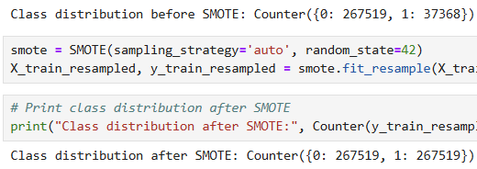
Data Preprocessing
Encoding Categorical Variables:
Used One-Hot Encoding for nominal categorical features.
Applied Label Encoding for ordinal features.
Feature Scaling:
• Used Normalization (Min-Max scaling) for numerical features.
Handling Class Imbalance:
• Used SMOTE (Synthetic Minority Over-Sampling Technique) to balance response classes.
CONFIDENTIAL: The information in this document belongs to Boston Institute of Analytics LLC. Any unauthorized sharing of this
material is prohibited and subject to legal action under breach of IP and confidentiality clauses.

Slide 8
Model Selection
Machine Learning Models Used:
1. Logistic Regression – Baseline model for interpretability.
2. Random Forest – Ensemble method that reduces overfitting.
3. Extra Trees Classifier – More randomized than Random Forest for better generalization.
4. Linear SVC (Support Vector Classifier) – Works well with high-dimensional data.
5. AdaBoost (Adaptive Boosting) – Boosting technique that combines weak learners.
6. XGBoost (Extreme Gradient Boosting) – High-performance boosting algorithm.
CONFIDENTIAL: The information in this document belongs to Boston Institute of Analytics LLC. Any unauthorized sharing of this
material is prohibited and subject to legal action under breach of IP and confidentiality clauses.

Slide 9
Model Selection
Why These Models?
Diversity: Combination of linear, tree-based, and boosting models.
Performance: XGBoost and AdaBoost often provide higher accuracy.
Efficiency: Random Forest and Extra Trees handle large datasets well.
Training Approach:
Train-Test Split: 80% training, 20% testing.
Used SMOTE: To imbalance the data and generate better accuracy for the model.
CONFIDENTIAL: The information in this document belongs to Boston Institute of Analytics LLC. Any unauthorized sharing of this
material is prohibited and subject to legal action under breach of IP and confidentiality clauses.

Slide 10
Model Performance Evaluation
Evaluation Metrics Used:
Accuracy – Overall correctness of the model.
Precision – How many predicted positives were actually correct? (Important if false positives are costly)
Recall (Sensitivity) – How many actual positives were correctly identified? (Important if missing potential customers is costly)
F1-Score – Balance between Precision & Recall.
CONFIDENTIAL: The information in this document belongs to Boston Institute of Analytics LLC. Any unauthorized sharing of this
material is prohibited and subject to legal action under breach of IP and confidentiality clauses.

Slide 11
Model Performance Evaluation
Before Using SMOTE
Model | Accuracy | Precision | Recall | F1-Score
Logistic Regression | 87.74 % | 77 % | 88 % | 82 %
Random Forest | 86.69 % | 82 % | 87 % | 84 %
Extra Tree Classifier | 86.10 % | 82 % | 86 % | 84 %
Linear SVC | 87.74 % | 77 % | 88 % | 82 %
ADA Boost | 87.74 % | 77 % | 88 % | 82 %
XG Boost | 87.62 % | 82 % | 88 % | 83 %
CONFIDENTIAL: The information in this document belongs to Boston Institute of Analytics LLC. Any unauthorized sharing of this
material is prohibited and subject to legal action under breach of IP and confidentiality clauses.

Slide 12
Model Performance Evaluation
After Using SMOTE
Model | Accuracy | Precision | Recall | F1-Score
Logistic Regression | 78.24 % | 83 % | 78 % | 77 %
Random Forest | 91.81 % | 92 % | 92 % | 92 %
Extra Tree Classifier | 92.47 % | 93 % | 92 % | 92 %
Linear SVC | 78.24 % | 83 % | 78 % | 77 %
ADA Boost | 79.51 % | 83 % | 80 % | 79 %
XG Boost | 86.23 % | 86 % | 86 % | 86 %
CONFIDENTIAL: The information in this document belongs to Boston Institute of Analytics LLC. Any unauthorized sharing of this
material is prohibited and subject to legal action under breach of IP and confidentiality clauses.

Slide 13
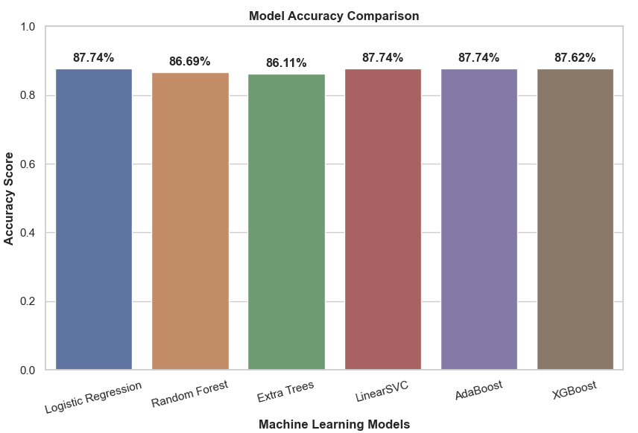
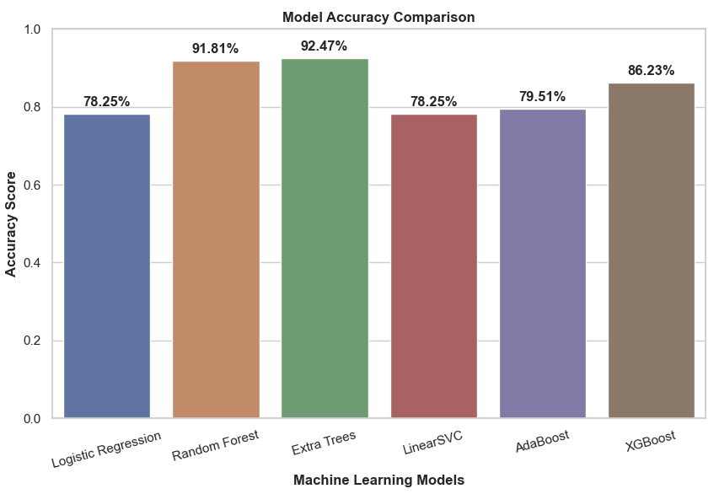
Model Performance Evaluation
Before Using SMOTE
After Using SMOTE
Best-performing model: Extra Tree Classifier based on 92.47 %.
CONFIDENTIAL: The information in this document belongs to Boston Institute of Analytics LLC. Any unauthorized sharing of this
material is prohibited and subject to legal action under breach of IP and confidentiality clauses.

Slide 14
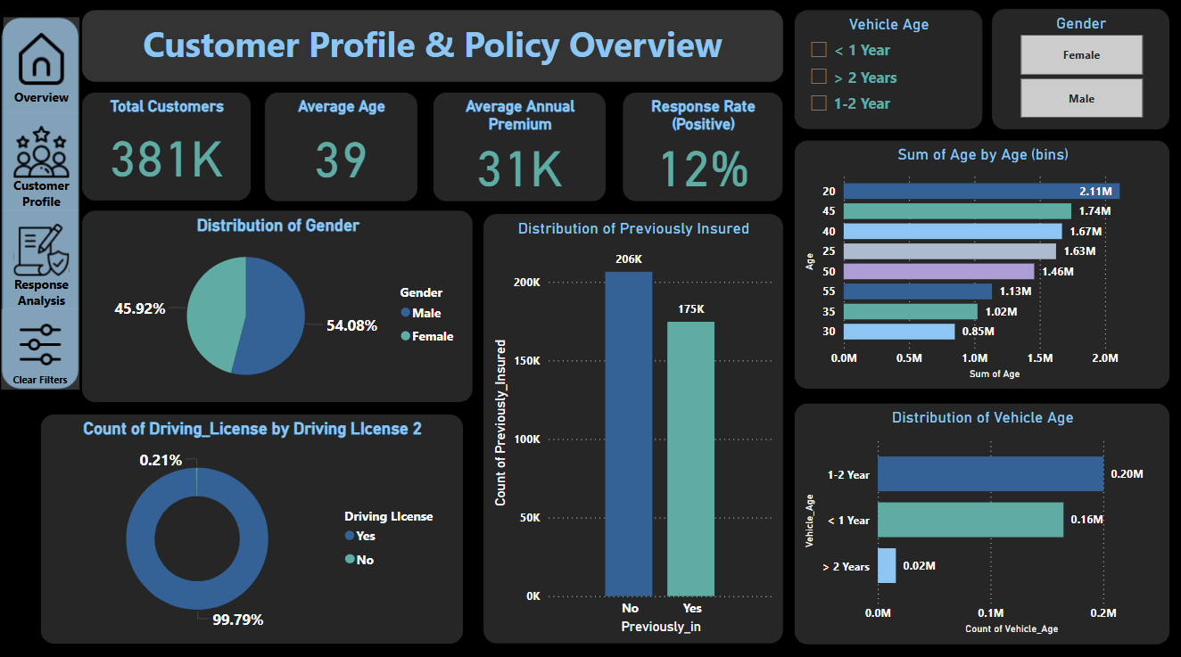
Power BI Dashboard
CONFIDENTIAL: The information in this document belongs to Boston Institute of Analytics LLC. Any unauthorized sharing of this
material is prohibited and subject to legal action under breach of IP and confidentiality clauses.

Slide 15
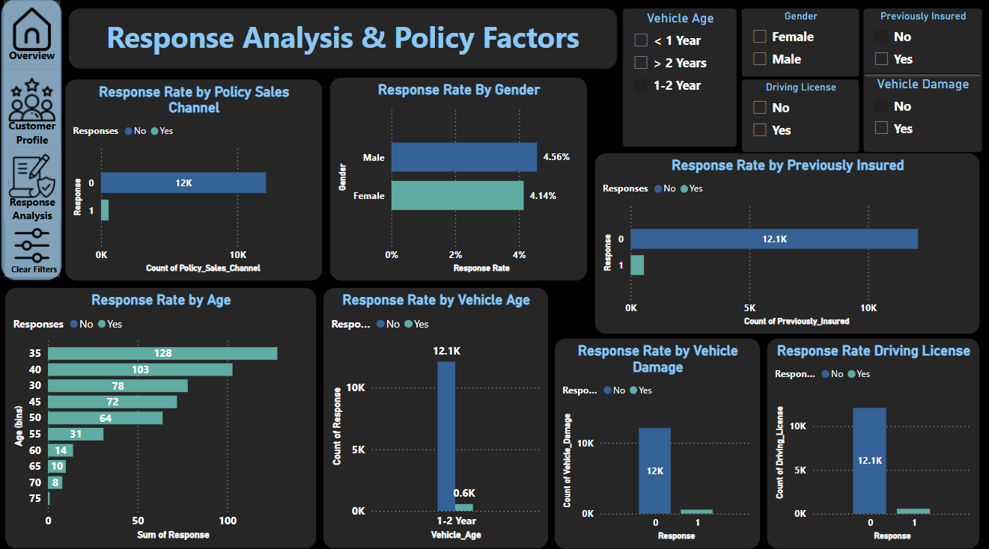
Power BI Dashboard
CONFIDENTIAL: The information in this document belongs to Boston Institute of Analytics LLC. Any unauthorized sharing of this
material is prohibited and subject to legal action under breach of IP and confidentiality clauses.

Slide 16
Business Impact & Interpretation
How the Model Helps the Insurance Industry:
✅ Improved Customer Targeting – Focus marketing efforts on customers likely to respond.
✅ Cost Savings – Reduce unnecessary outreach, saving on marketing expenses.
✅ Higher Conversion Rates – Personalized offers lead to increased policy sales.
✅ Optimized Sales Strategy – Use model predictions to guide sales teams on whom to contact.
Real-World Application:
Scenario 1: The insurance company can prioritize high-probability leads for sales calls.
Scenario 2: Adjust marketing strategies based on top customer segments identified.
CONFIDENTIAL: The information in this document belongs to Boston Institute of Analytics LLC. Any unauthorized sharing of this
material is prohibited and subject to legal action under breach of IP and confidentiality clauses.

Slide 17
Conclusion
✅ Problem Addressed:
The project successfully tackled the challenge of predicting customer responses to insurance offers, allowing for more efficient and data-driven marketing strategies.
✅ Key Findings:
Among the models tested, Extra Tree Classifier achieved the highest accuracy: 92.47 %, making it the most effective for customer response prediction.
Feature Importance Analysis revealed that Previously_Insured (-0.34), Age (0.11), and Policy_Sales_Channel (-0.14) played the most crucial roles in determining customer responses.
Implementing this model can reduce unnecessary marketing costs, increase customer engagement, and improve policy sales efficiency.
CONFIDENTIAL: The information in this document belongs to Boston Institute of Analytics LLC. Any unauthorized sharing of this
material is prohibited and subject to legal action under breach of IP and confidentiality clauses.

Slide 18
Questions?
CONFIDENTIAL: The information in this document belongs to Boston Institute of Analytics LLC. Any unauthorized sharing of this
material is prohibited and subject to legal action under breach of IP and confidentiality clauses.

Slide 19


